Slide 1
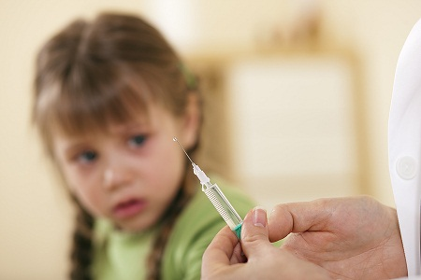
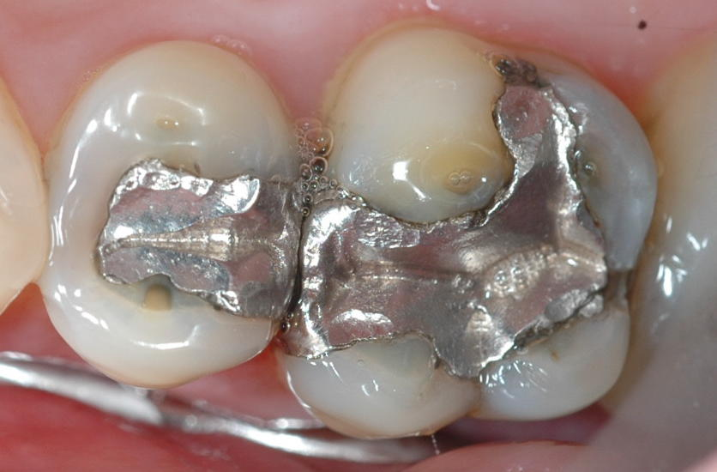
Environmental Toxicants and Autism: How to Safeguard Your Children.
Stephanie Seneff
AutismOne
May, 2015

Slide 2
“It's difficult to get a man to understand something if his salary depends on his not understanding it."
Upton Sinclair

Slide 3
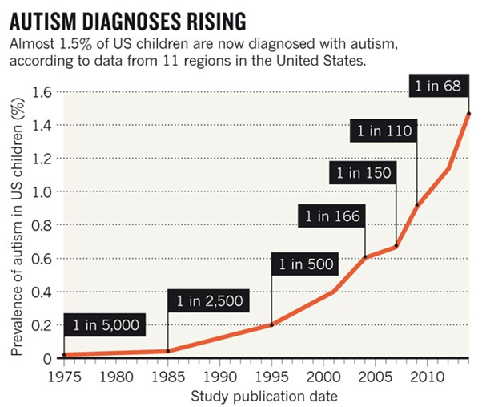
A Frightening Trend*
?
?
Exponential Growth!
12 years
*K. Weintraub, Nature 479, Nov. 3 2011, 22-24.
Notes:
./NatureAutismRising.pdf
CDC provides these numbers for kids who are 12 years old at the time the numbers are reported.
You have to project twelve years into the future to get the rate for kids being born at that time.

Slide 4
Percentage of children with Autism in the US
50%
2032
Notes:
Plotting the CDC’s data on a log scale reveals that the growth is exponential.
Extending the line predicts 1 in 4 kids born in 2025 will be diagnosed with autism, and 1 in 2 kids seven years later (by 2032).

Slide 5
Percentage of children with Autism in the US
50%
A linear extension of the trend line says that 1 in 2 children born in 2032 will end up on the autism spectrum.
2032
Notes:
Plotting the CDC’s data on a log scale reveals that the growth is exponential.
Extending the line predicts 1 in 4 kids born in 2025 will be diagnosed with autism, and 1 in 2 kids seven years later (by 2032).

Slide 6
Last Year’s Talk
Video (no slides):
http://www.autismone.org/content/autism-explained-synergistic-poisoning-aluminum-and-glyphosate-stephanie-seneff
Slides:
http://people.csail.mit.edu/seneff/glyphosate/Seneff_AutismOne_2014.pptx

Slide 7
Outline
Glyphosate
Toxic Food
Glyphosate and Folic Acid
Glyphosate, Oxalate and Anemia
How to Protect Yourself and Your Family
Summary

Slide 8
Glyphosate

Slide 9
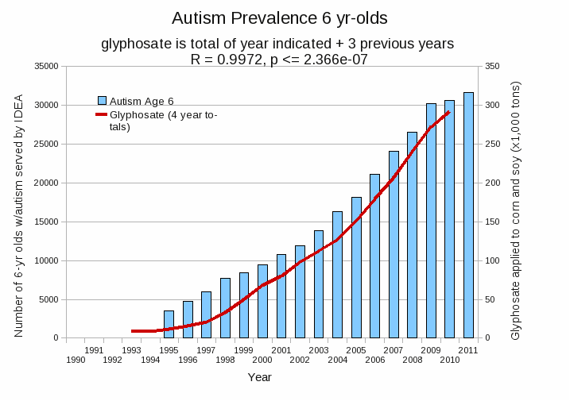
Autism Prevalence: 6 year olds
R = 0.9972
*Plot provided by Nancy Swanson, with permission
Data sources: autism: US Department of Education; Glyphosate: US Department of Agriculture
Notes:
Nancy/latest_plots/6-yr-old autism.gif
autism: USDE
oil consumption: USDA
glyphosate: USDA
GE crops: USDA
Mortality data: CDC

Slide 10
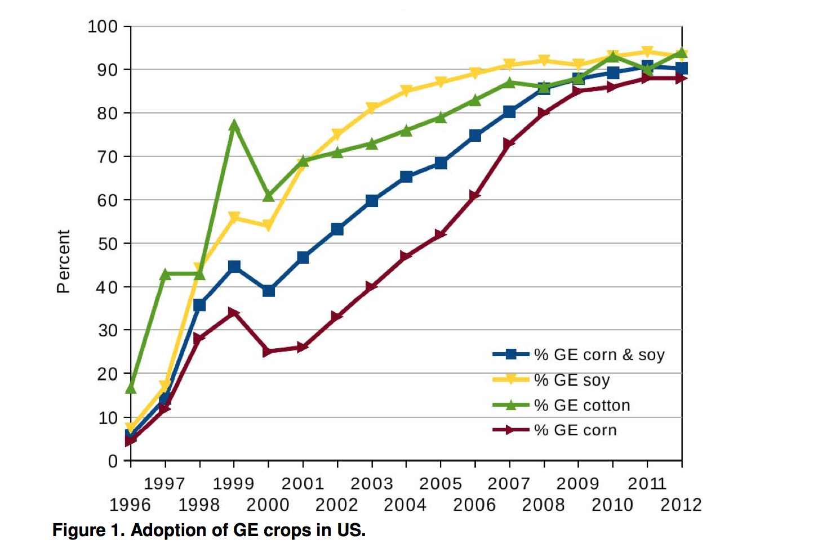
Adoption of “Roundup Ready” Crops*
* N. Swanson et al., Journal of Organic Systems 20145;9(2): 6-37.

Slide 11
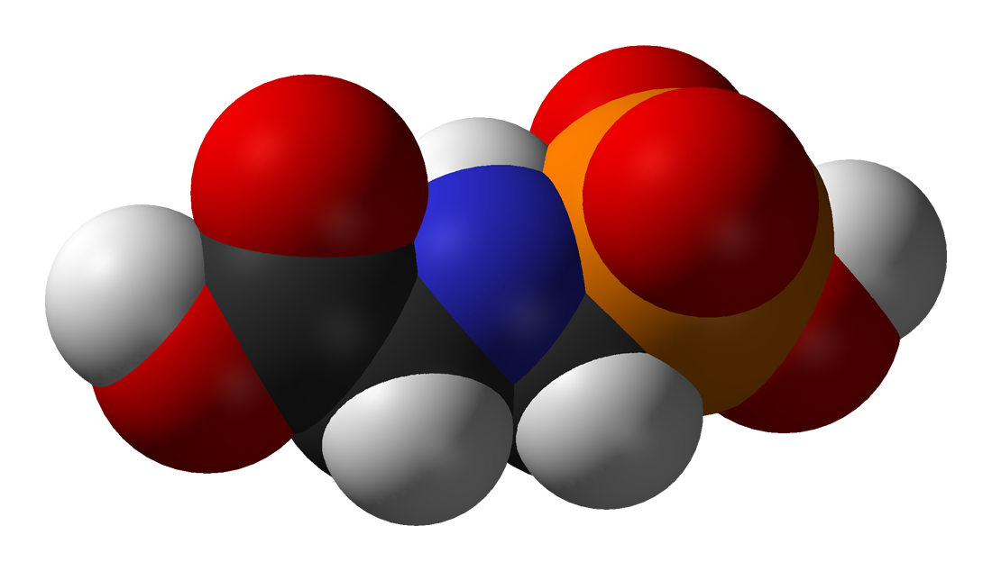
Is Glyphosate Toxic?
Monsanto has argued that glyphosate is harmless to humans because our cells don’t have the shikimate pathway, which it inhibits
However, our gut bacteria DO have this pathway
We depend upon them to supply us with essential amino acids (among many other things)
Other ingredients in Roundup greatly increase glyphosate’s toxic effects
Insidious effects of glyphosate accumulate over time
Most studies are too short to detect damage

Slide 12
Main Toxic Effects of Glyphosate*
Kills beneficial gut bacteria and allows pathogens to overgrow
Interferes with function of cytochrome P450 (CYP) enzymes
Chelates important minerals (iron, cobalt, manganese, etc.)
Interferes with synthesis of aromatic amino acids and methionine
Leads to shortages in critical neurotransmitters
Disrupts sulfate synthesis and sulfate transport
*Samsel and Seneff, Entropy 2013, 15, 1416-1463

Slide 13
The Enhancing Effect of Adjuvants*
“Adjuvants in pesticides are generally declared as inerts, and for this reason they are not tested in long-term regulatory experiments. It is thus very surprising that they amplify up to 1000 times the toxicity of their APs [Active Principles] in 100% of the cases where they are indicated to be present by the manufacturer.”
*R. Mesnage et al.BioMed Research International 2014; Article ID:179691.
Notes:
Glypohsate/seralini_2014_pesticide_toxicity_adjuvants.pdf

Slide 14
Some Biomarkers for Autism
Disrupted gut bacteria; inflammatory bowel
Low serum sulfate
Methionine deficiency
Serotonin and melatonin deficiency
Defective aromatase
Excess serum oxalate
Urinary p-cresol
Mitochondrial disorder
Glutamate toxicity in the brain
Notes:
Samantha/zinc_deficiency_autism.text

Slide 15
Some Biomarkers for Autism
Disrupted gut bacteria; inflammatory bowel
Low serum sulfate
Methionine deficiency
Serotonin and melatonin deficiency
Defective aromatase
Zinc and iron deficiency
Urinary p-cresol
Mitochondrial disorder
Glutamate toxicity in the brain
These can all be explained as potential effects of glyphosate on biological systems
Notes:
Samantha/zinc_deficiency_autism.text

Slide 16
Paper on Glyphosate and Manganese Published March 24, 2015

Slide 17
Manganese and Autism*
Glyphosate chelates manganese
Manganese disruption leads to:
Disrupted gut bacteria → anxiety
Impaired dopamine synthesis → thyroid disease
Glutamate and ammonium toxicity in the brain
Mitochondrial damage
Impaired bone development and osteoporosis
Impaired development of perineuronal nets
Many of these pathologies are associated with autism
*A Samsel and S Seneff, Surg. Neurol. Int. 2015;6:45.
Notes:
./manganese_damages_dopamine_brainstem.pdf

Slide 18
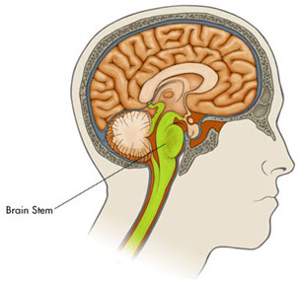
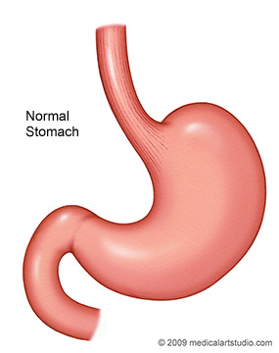
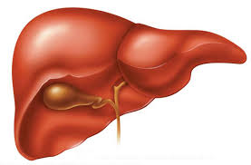
It’s not just deficiency!
Too much manganese in the brain stem
Too little manganese in the cortex
Vagus Nerve
Bile acids

Slide 19
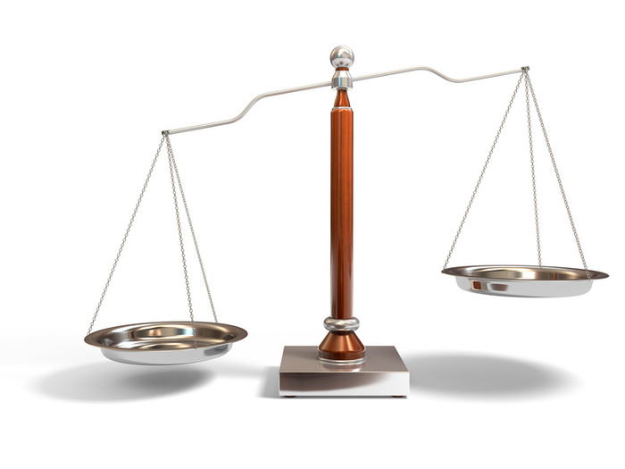
Balancing the Scales
manganese
iron
iron
manganese
Autism
ADHD
Alzheimer’s
Parkinson’s
Glyphosate disrupts the body’s ability to distribute the minerals safely: Everybody walks a tight rope between deficiency and toxicity

Slide 20
Glyphosate and Vaccines*,**
Vaccines containing glutamate (MMR) and aluminum (Hep-B, DTaP) have been linked to autism
Glyphosate enhances transfer of aluminum across the blood brain barrier and enhances uptake of aluminum into cells
Glyphosate prevents detoxification of glutamate due to manganese deficiency
*A Samsel and S Seneff, Surgical Neurology International 2015, 6:45.
**S Seneff et al., Agricultural Sciences Jan. 12, 2015, 6, 42-70.

Slide 21
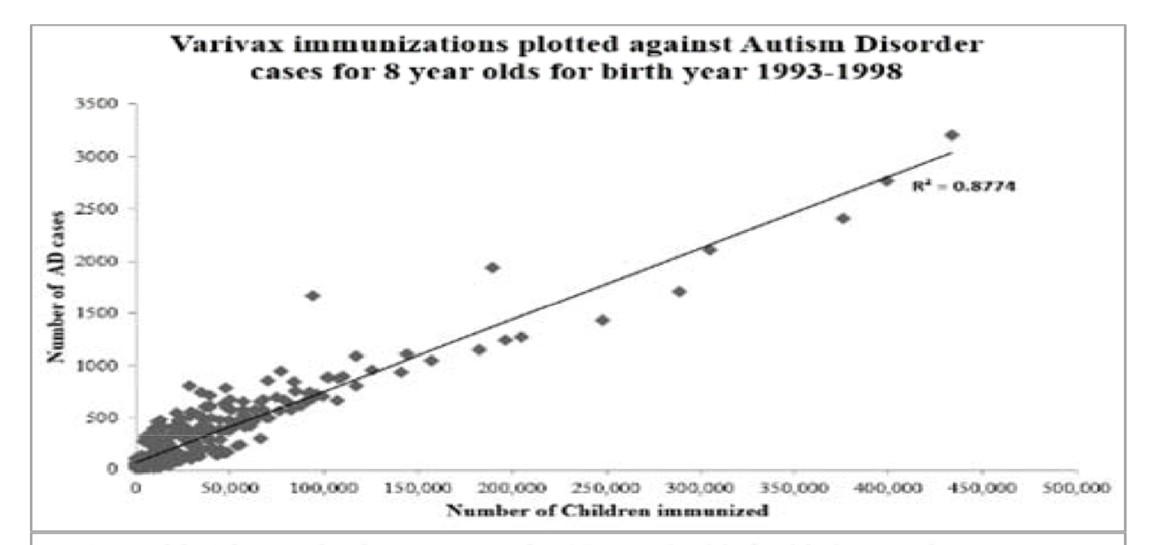
Varivax and Hepatitis A Vaccines: Linked to Autism*
Contains Glutamate
Contains Aluminum
*TA Deisher et al., Journal of Public Health and Epidemiology 6(9), 271-284, 2014.
Notes:
Samantha/Autism_Varicella_Deisher_2014.pdf

Slide 22
Recapitulation
Monsanto claims glyphosate is nontoxic to humans, but this is not true
Gut microbes are damaged by shikimate pathway disruption
Adjuvants increase toxicity to plants but glyphosate is usually studied in isolation
Many features of autism can be explained by glyphosate's known effects
Impaired mineral management is key
Disrupted manganese and iron homeostasis
Aluminum and glutamate toxicity
These effects can explain increased frequency of severe adverse reactions to vaccines

Slide 23
Toxic Food

Slide 24
Health Care Costs: US
Why??

Slide 25
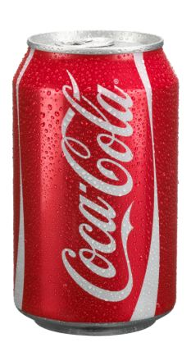
Toxic Food!!

Slide 26
Poison Spring
Author E.G. Vallianatos worked for the US EPA for 25 years.
Corruption and misuse of science and public trust has turned EPA into a "polluters' protection agency."
Repeatedly endorsed deadly chemicals, often against the advice of their own scientists.
Botched field investigations.
Turned a blind eye to toxic disasters.

Slide 27
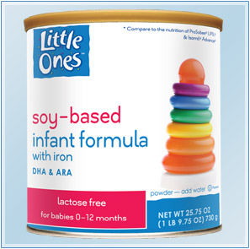
Soy Protein Products*
Heavily used in processed foods for emulsification, water and fat absorption, aeration and increasing protein content
Derived from "white flakes" made by defatting soybeans by extraction
Milled into defatted flours that are turned into soy protein isolates by further chemical processing
These are added to infant soy formula!
* EW Lusas and MN Riaz, J Nutr 1995, 125(3 Suppl): 573S-580S.
Notes:
http://europepmc.org/abstract/MED/7884536
Chenny/soy_protein_products.text

Slide 28
Soy Formula Linked to Seizures in Autism*
"There was a 2.6-fold higher rate of febrile seizures, a 2.1-fold higher rate of epilepsy comorbidity and a 4-fold higher rate of simple partial seizures in the autistic children fed soy-based formula"
*CJ Westmark, PLOSOne March 12, 2014, DOI: 10.1371/journal.pone.0080488.
Notes:
./SoyFormulaSeizuresAutism.pdf

Slide 29
Protein Bars!
“Most soy protein ingredients in meat analogs and nutrition bars, which are listed on labels as soy protein isolate, soy protein concentrate or textured vegetable protein, have undergone hexane processing.”*
*http://www.berkeleywellness.com/healthy-eating/food-safety/article/hexane-soy-food
Notes:
It’s hard to get a measure of soy protein consumption but a proxy is the measure of vegetable oil consumption – the residue from extraction of oil from soy is used as a protein additive

Slide 30
Toxic Effects of Inhaled Hexane*
Low: Dizziness, headache, nausea, vomiting
High: Death from asphyxiation
Chronic: Peripheral neuropathy, pain, weakness, loss of sensation, impaired gait, muscle atrophy, visual disturbances
Allowable amounts in food:
10 parts per million in Europe
500 parts per million in China
No restrictions in US
*N-HEXANE. Toxicology data network Hazardous Substances Data Bank. US National Library of Medicine
Notes:
Chenny/hexane_microbes_1991.pdf
ADD THIS

Slide 31
“Another claim of Monsanto's has been that residue levels of up to 5.6 mg/kg in GM-soy represent "...extreme levels, and far higher than those typically found" (Monsanto 1999).
Glyphosate in GM Roundup Ready Soy*
5.6
*Figure 1, T. Bohn et al. Food Chemistry 153, 15 June 2014, 207-215.
www.greenmedinfo.com/blog/how-extreme-levels-roundup-food-became-industry-normal
Notes:
http://www.greenmedinfo.com/blog/how-extreme-levels-roundup-food-became-industry-normal

Slide 32
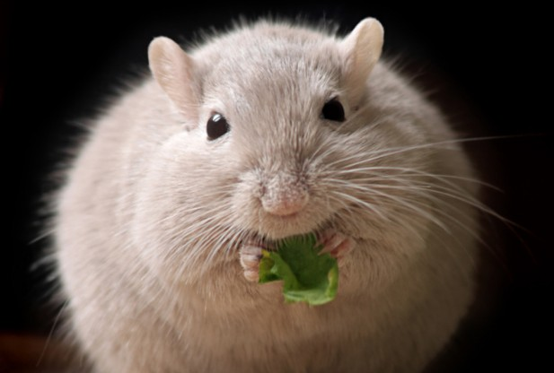
Polysorbate 80*
Food additives (emulsifiers) like polysorbate 80 induce inflammatory gut in mice
This is due to disruption of the gut microbes’ cell wall
It leads to increased risk to obesity and diabetes
Exposed gut microbes can be transferred to germ-free mice and they too get fat and diabetic
*http://www.nih.gov/researchmatters/march2015/03162015additives.htm
Notes:
AutismOne/FoodAdditives_Tween80_cause_gut_inflammation_mice.pdf ~/Desktop/Present

Slide 33
Organochlorine Pesticides & Obesity in Women*
Polychlorinated biphenyls (PCBs) and organochlorine insecticides (e.g., DDT) are xenoestrogenic
Linger a long time in the environment
Accumulate in fat tissue and lead to obesity (especially in premenopausal women)
They depend on CYP enzymes for breakdown
*D Teixeira et al., Journal of Clinical and Endocrinology & Metabolism
[Epub ahead of print, Apr. 8, 2015]
Notes:
Glyphosate/PCBs_require_CYPs_for_metabolism_1991.pdf
Glyphsoate/PCBs_estrogenic_premenopausal_women_2015.pdf

Slide 34
Mercury Levels can be High in Rice, Fish, and High Fructose Corn Syrup
Mercury is probably the most toxic metal on earth

Slide 35
Mercury and Desulfovibrio
Desulfovibrio is a gut microbe that reduces sulfate to hydrogen sulfide gas
It is over-represented in association with autism*
Desulfovibrio also reduces nitrate to ammonia
Desulfovibrio converts mercury to methyl mercury, a much more toxic form**
*SM Finegold et al., Anaerobe 2012;18(2):260–262.
**SC Choi et al., Appl Environ Microbiol. 1993 Jan;59(1):290-5.
Notes:
Samantha/desulfovibrio_autism.text
AutismOne/Desulfovibrio_methylates_mercury_1993.pdf

Slide 36
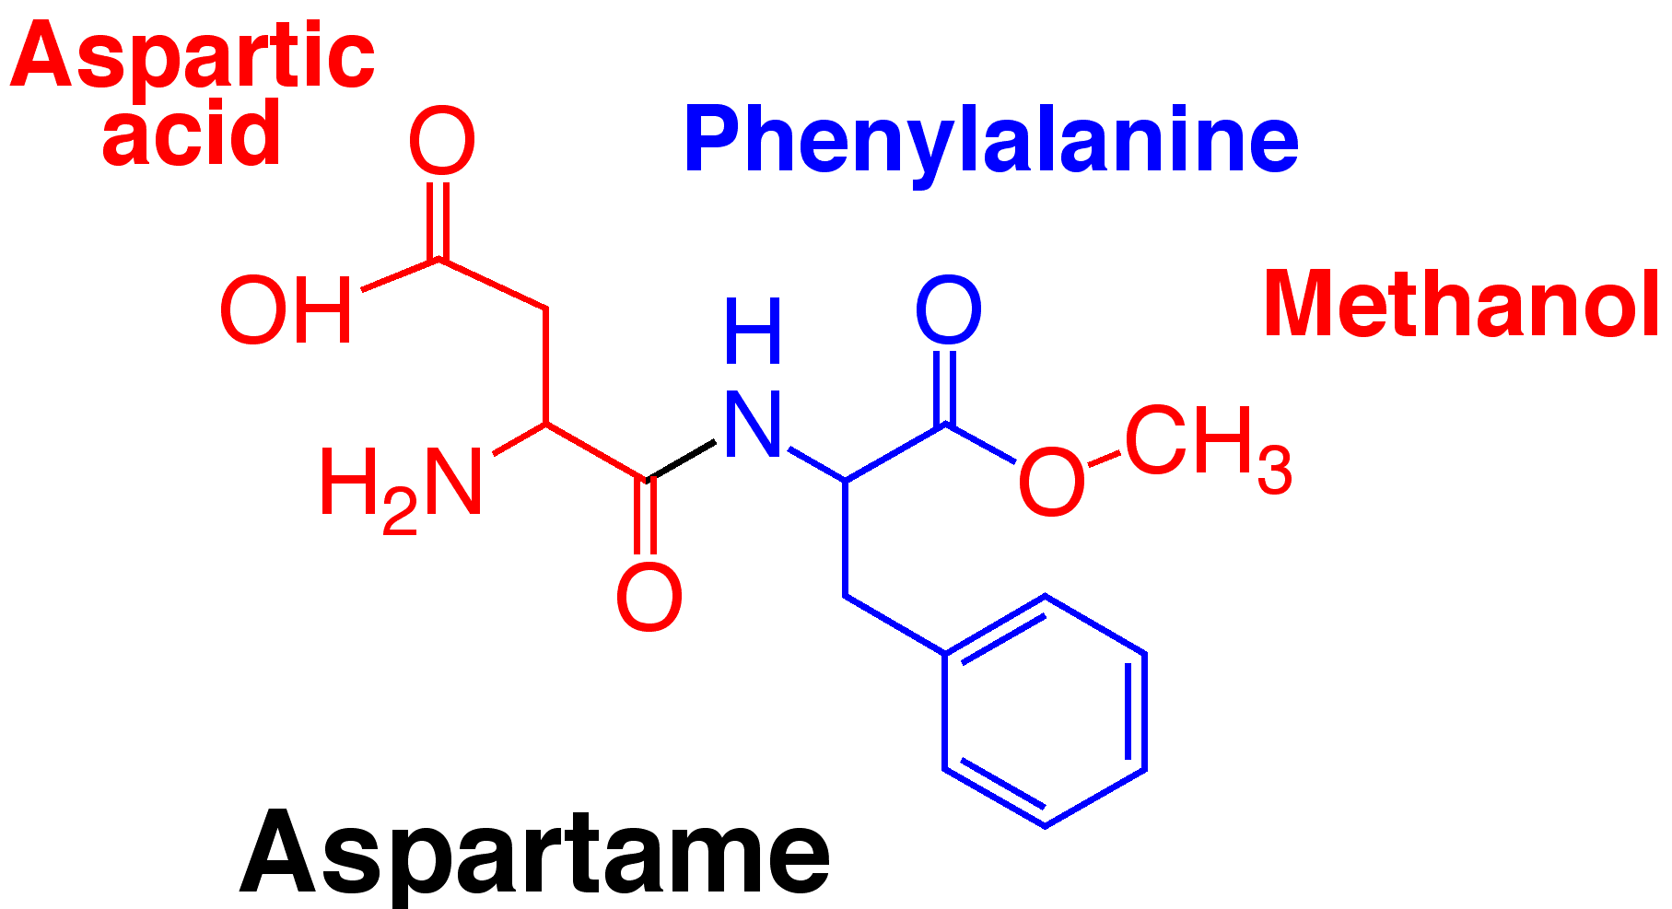
Asparatame*
Aspartame is the sweetener in NutraSweet, Equal, Spoonful, and Equal-Measure
Accounts for over 75% of the adverse reactions to food additives reported to the FDA
Asparatame breaks down to methanol (wood alcohol) and then to formaldehyde (neurotoxic)
*http://articles.mercola.com/sites/articles/archive/2012/11/11/aspartame-dangers.aspx

Slide 37
Recapitulation
The EPA is not safeguarding our health
Soy protein products are unsafe to eat due to both hexane and glyphosate
Polysorbate 80 can cause disruption of gut microbes' cell walls leading to obesity and diabetes
PCBs and insecticides are estrogen disruptors and their breakdown is inhibited by glyphosate
Mercury levels can be high in fish and rice
Aspartame is a dangerous sugar substitute, breaking down to formaldehyde

Slide 38
Glyphosate and Folic Acid

Slide 39
A Bit of History
The US first considered adding folic acid supplements to grains in 1996, and introduced the mandate in 1998
GMO “Roundup Ready” crops were just beginning to be introduced in 1996 and had obtained widespread adoption by 1998
Spina bifida is a very rare genetic disorder that is linked to folate deficiency

Slide 40
Adoption of “Roundup Ready” Crops*
* N. Swanson et al., Journal of Organic Systems 20145;9(2): 6-37.

Slide 41
Inverse Correlation Between Neural Tube Defects and Autism Trends*
Proposed mechanism involves increased GABA receptor activity (neuronal inhibition)
GABA increase has been linked to autism
Asthma is implicated as well
*Figure 4, K. Vasquez et al., Adv Exp Med Biol. 2013;775:101-9.
Notes:
Fig. 8.4 Depicts the trend of neural tube defect decreasing, at the same time the prevalence of autism was increasing
./fa\ on\ gaba\ receptor\ upregulates\ genes-\ autism.pdf
From Sylvia

Slide 42
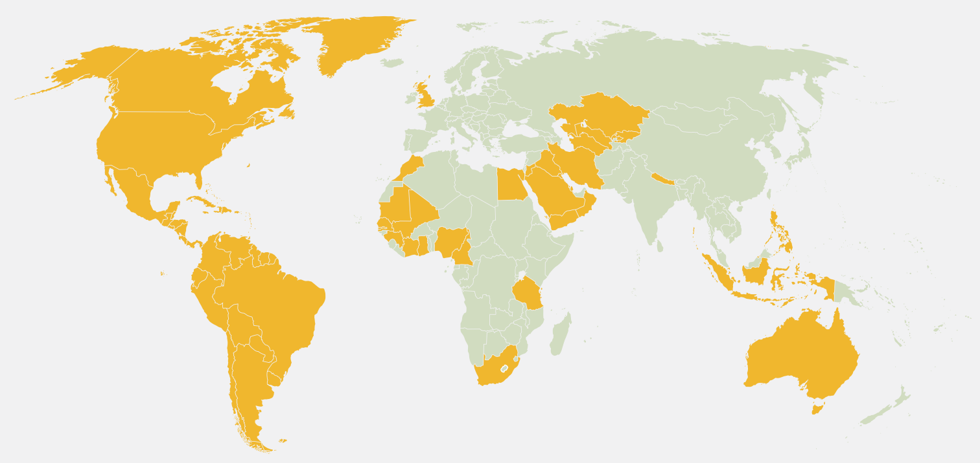
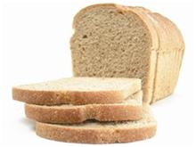
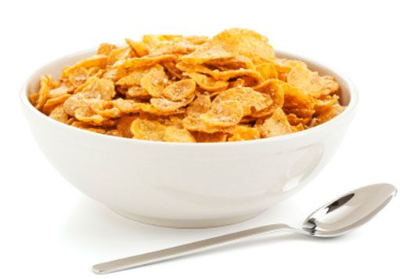
Folic Acid and/or Iron Fortification!!*
*B Handforth and S. Zimmerman,
Sight and Life 27 (1); 70-75, 2013
Notes:
Gerry/*/*Improving_Nutrition_in_Europe_–_Renowned_Experts_Highlight_Flour_Fortification_marked.pdf
./European_pressure_to_introduce_folate.pdf
Note: All countries in orange fortify flour with at least iron and folic acid except Australia which does not include iron, and Venezuela, the United Kingdom, and the Philippines which do not include folic acid.
Source:The Flour Fortification Initiative, 2012

Slide 43
Folic Acid and/or Iron Fortification!!*
Europe has steadfastly refused to adopt
policy of folic acid supplementation!
*B Handforth and S. Zimmerman,
Sight and Life 27 (1); 70-75, 2013
Notes:
Gerry/*/*Improving_Nutrition_in_Europe_–_Renowned_Experts_Highlight_Flour_Fortification_marked.pdf
./European_pressure_to_introduce_folate.pdf
Note: All countries in orange fortify flour with at least iron and folic acid except Australia which does not include iron, and Venezuela, the United Kingdom, and the Philippines which do not include folic acid.
Source:The Flour Fortification Initiative, 2012

Slide 44
Folic Acid is Complex
Folic acid is a synthetic, oxidized form of folate
It induces oxidative stress in the liver
This can lead to folic acid build-up (unnatural) in the blood
This interferes with nitric oxide release which is important for promoting blood flow
Folic acid in the blood may also cause the antibodies to folate receptors in the brain associated with cerebral folate deficiency

Slide 45
Generating Methionine from Homocysteine
Folate trap: One or more of these requirements are missing; Methyl group stays stuck on folate (inactive)
There is a belief that elevated serum homocysteine is bad, but the homocysteine is desperately needed to produce sulfate
Methionine
Homocysteine
Methionine
Homocysteine
Requirements:
Working MTHFR enzyme
Cobalamin
Zinc
Vitamin B6
Methyl tetrahydrofolate

Slide 46
Nitrous Oxide Inhibits Methionine Synthesis
Nitrogen
Methionine synthase is inhibited by nitrous oxide
Excess serum ammonia is a source of nitrous oxide
Glyphosate likely induces ammonia synthesis by gut microbes (disrupts uptake of nitrogen into proteins)*
Ammonia
Protein
Nitrous Oxide
Inhibition
*SO Duke et al., Plant Physiol 1980; 65: 17-21.
Notes:
Glyphosate/glyphosate_inhibits_PAL_induces_ammonia_1980.pdf

Slide 47
Transsulfuration Pathway*
*Figure 1, DA Geier et al., Neurochem Res (2009) 34:386–393.
Notes:
WAPF/transsulfuration_biomarkers_autism_2009.pdf

Slide 48
Transsulfuration Pathway*
Three very important molecules!!!
*Figure 1, DA Geier et al., Neurochem Res (2009) 34:386–393.
Notes:
WAPF/transsulfuration_biomarkers_autism_2009.pdf

Slide 49
What’s the difference between folic acid and folate???
Folic acid is a synthetic molecule, and it’s stable
Folate is typically methylated
Folic acid is missing four hydrogen ions – THIS IS VERY IMPORTANT!!!
Folic acid is oxidized, and
to convert it to folate is costly for the body

Slide 50
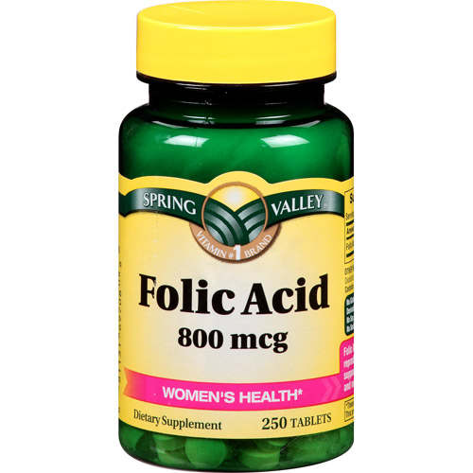
A Problem with Folic Acid
Excess folic acid drives biopterin towards the
reduced form, which is not good!
REDUCED
HHHH
HHHH
BH4
Tetrahydrobiopterin
Tetrahydrofolate
Tetrahydrobiopterin
+HH
-HH
Dihydrofolate
Dihydrobiopterin
Dihydrofolate
HH
HH
OXIDIZED

Slide 51
A Problem with Folic Acid
Low BH4 in the cerebrospinal fluid is linked to autism*
REDUCED
HHHH
HHHH
BH4
Tetrahydrobiopterin
Tetrahydrofolate
Tetrahydrobiopterin
+HH
-HH
Dihydrofolate
Dihydrobiopterin
Dihydrofolate
HH
HH
OXIDIZED
*RE Frye et al., Neurotherapeutics. 2010 July ; 7(3): 241–249.
Notes:
Samantha/BH4_treatment_for_autism_2010.pdf

Slide 52
A Problem with Folic Acid
BH4 is essential for nitric oxide release, which promotes blood flow
REDUCED
HHHH
HHHH
BH4
Tetrahydrobiopterin
Tetrahydrofolate
Tetrahydrobiopterin
+HH
-HH
Dihydrofolate
Dihydrobiopterin
Dihydrofolate
HH
HH
OXIDIZED
*RE Frye et al., Neurotherapeutics. 2010 July ; 7(3): 241–249.
Notes:
Samantha/BH4_treatment_for_autism_2010.pdf

Slide 53
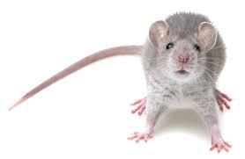
“High folic acid consumption leads to pseudo-MTHFR deficiency, altered lipid metabolism, and liver injury in mice”*
Fed mice excessive amounts of folic acid
Reduced methylation capacity in liver
CYP7A1 level was dramatically reduced. (rate limiting enzyme in bile acid synthesis)
Caused liver damage and fatty liver disease
Works synergistically with glyphosate to disrupt bile flow
*KE Christensen e tal., Am J Clin Nutr 2015;101:646–58.
Notes:
Csail/2015/SallyFallon/high_folic_acid_causes_pseudo_MTHFR_deficiency.pdf

Slide 54
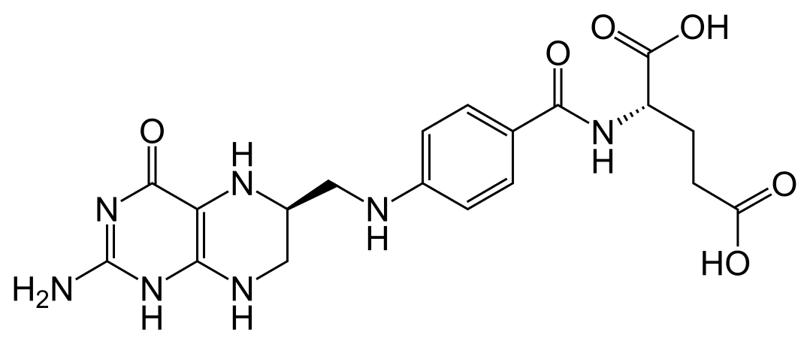
“Cerebral folate deficiency with developmental delay, autism, and response to folinic acid”*
Folinic acid is a form of TETRAHYDRO-folate
* P Moretti et al., Neurology March 22, 2005 vol. 64 no. 6 1088-1090

Slide 55
“Cerebral folate deficiency with developmental delay, autism, and response to folinic acid”*
Folinic acid is a form of TETRAHYDRO-folate
Folate receptor antibodies due to
excess folic acid in the blood???
* P Moretti et al., Neurology March 22, 2005 vol. 64 no. 6 1088-1090

Slide 56
Recapitulation
The timing of mandatory folic acid enrichment is uncanny: hide pending epidemic in spina bifida?
Folic acid is synthetic, and it leads to excessive oxidation in the liver and/or depleted BH₄
Glyphosate depletes methionine
Folate converts homocysteine to methionine, depleting sulfate supplies
This causes severe systemic sulfate deficiency
Folate receptor antibodies in the brain may be an attempt to protect the brain from sulfate deficiency

Slide 57
Glyphosate, Oxalate
and Anemia

Slide 58
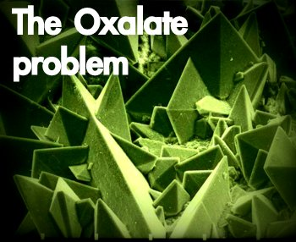
Autism Linked to Oxalate Crystals*
Crystals of oxalate form kidney stones and cause great discomfort
Study has shown at least 3-fold higher serum and urinary levels of oxalate in autistic kids**
*William Shaw, The Role of Oxalates in Autism and Chronic Disorders WAPF, March 26, 2010
**J Konstantynowicz et al., European Journal of Paediatric Neurology 16(5), 2012, 485-491.
Notes:
samantha/oxalates_in_autism.text~
samantha/william_shaw_on_oxalates_autism.text
http://www.westonaprice.org/health-topics/the-role-of-oxalates-in-autism-and-chronic-disorders/

Slide 59
“Oxalate crystals in the bone may crowd out the bone marrow cells, leading to anemia and immunosuppression”*
*http://www.greatplainslaboratory.com/home/span/oxalates.asp

Slide 60
“Cerebral edema, and perhaps injury to other organs, could result from oxalate crystal deposition in small blood vessels in the brain and other organs.”*
*K Froberg et al., Clin Toxicol (Phila). 2006;44(3):315-8.
Notes:
2015’Anthony/oxalate_crystals_brain.text

Slide 61
Oxalate Metabolism*
*http://www.greatplainslaboratory.com/home/eng/oxalates.asp
Notes:
./oxalates.text

Slide 62
Glyphosate Metabolism*
*Figure 3 in L. Polligioni et al., FEBS Journal 278 (2011) 2753–2766
Notes:
Glyphosate/glyphosate_metabolism_to_glyoxylate.pdf

Slide 63
Monsanto Patents: 2002-2010: Pesticide Compositions Containing Oxalic Acid
“[origin: WO02069718A2] Pesticidal concentrate and spray compositions are described which exhibit enhanced efficacy … More particularly, the present invention relates to a method of enhancing the herbicidal effectiveness of glyphosate concentrate and tank mix formulations containing one or more surfactants through the addition of oxalic acid.”
Monsanto Technology,
St. Louis, MO
Notes:
https://data.epo.org/gpi/EP1389912A2-PESTICIDE-COMPOSITIONS-CONTAINING-OXALIC-ACID (quote)
“[origin: WO02069718A2] Pesticidal concentrate and spray compositions are described which exhibit enhanced efficacy due to the addition thereto of a compound which increases cell membrane permeability, suppresses oxidative burst, or increases expression of hydroxyproline-rich glycoproteins. More particularly, the present invention relates to a method of enhancing the herbicidal effectiveness of glyphosate concentrate and tank mix formulations containing one or more surfactants through the addition of oxalic acid.”

Slide 64
Monsanto Patents: 2002-2010: Pesticide Compositions Containing Oxalic Acid
“[origin: WO02069718A2] Pesticidal concentrate and spray compositions are described which exhibit enhanced efficacy … More particularly, the present invention relates to a method of enhancing the herbicidal effectiveness of glyphosate concentrate and tank mix formulations containing one or more surfactants through the addition of oxalic acid.”
Oxalic acid and oxalate are essentially
the same thing!
Monsanto Technology,
St. Louis, MO
Notes:
https://data.epo.org/gpi/EP1389912A2-PESTICIDE-COMPOSITIONS-CONTAINING-OXALIC-ACID (quote)
“[origin: WO02069718A2] Pesticidal concentrate and spray compositions are described which exhibit enhanced efficacy due to the addition thereto of a compound which increases cell membrane permeability, suppresses oxidative burst, or increases expression of hydroxyproline-rich glycoproteins. More particularly, the present invention relates to a method of enhancing the herbicidal effectiveness of glyphosate concentrate and tank mix formulations containing one or more surfactants through the addition of oxalic acid.”

Slide 65
Oxalate Enhances Glyphosate’s Toxicity to Plants at Small Concentrations*
*Figure 1, Monsanto Patent #US 7,771,736 B2, Aug. 10, 2010

Slide 66
Hypothesis: flooding with oxalate prevents metabolism of glyoxylate to oxalate. Glyoxylate is a very potent glycating agent, leading to widespread damage.
This also inhibits glyphosate breakdown to glyoxylate.

Slide 67
sec.gov/Archives/edgar/data/1110783/000103570403000400/c77652exv99w2.htm

Slide 68
WEATHERMAX!!
sec.gov/Archives/edgar/data/1110783/000103570403000400/c77652exv99w2.htm

Slide 69
New Roundup Transorb'R' Herbicide Formulation to Hit Retail Shelves in Eastern Canada*
“In 2004, this powerful new formulation was chosen by more western Canadian growers than any other non-selective herbicide on the market. Grower satisfaction with the performance in the field has reached new heights - 99% of growers who used Roundup WeatherMAX were satisfied with their experience.”
*www.highbeam.com/doc/1P2-13686824.html
JANUARY 3, 2005
Notes:
The product received its registration certificate in October 2003 after six years of research and development work and field testing across various regions in Canada. It was introduced in Western Canada last
season.

Slide 70
Plot produced in collaboration with Dr. Nancy Swanson from US Government data

Slide 71
This Detoxification Scheme is Essential in Red Blood Cells
Inhibited by glyphosate
Product of shikimate pathway
Depleted by glyphosate
Induced by excess folic acid
Depends on selenium

Slide 72
Anemia is also Caused by Damage to Red Blood Cells
Inhibited by glyphosate
Product of shikimate pathway
G6PD Deficiency Leads to Hemolysis and Anemia
Depleted by glyphosate
Depends on selenium

Slide 73
Anemia leads to low oxygen which induces chronic low grade encephalopathy linked to autism

Slide 75
Oxalate, Iron and Autism
Agricultural workers exposed to glyphosate suffer from high rate of kidney failure due to tubular interstitial diseases*
Tubules depend on transferrin to supply iron
Oxalate interferes with transferrin iron delivery**
Autistic children also have intractable iron deficiency
Child with defective gene for transferrin receptor had developmental delay and intractable seizures***
*C Jayasumana et al., Int. J. Environ. Res. Public Health 2014
**AN Luck et al., Biochemistry. 2013 November 19; 52(46)
***Stockler et al. Orphanet Journal of Rare Diseases 2014, 9:141.
Notes:
Glyphosate/glyphosate_sri_lanka_kidney_failure_epidemiology.pdf
./defective_endocytosis_autism_transferrin_impairment.pdf
Where is this?
J Konstantynowicz et al., European Journal of Paediatric Neurology 2012;16(5):485–491.

Slide 76
Autistic Children are Sensitive to Iron Overload*
Children with autism have low levels of transferrin, which protects from oxidative damage due to free iron in the cells
*A Chauhan et al., Life Sciences 2004; 75: 2539–2549
Notes:
WAPF/low_transferrin_autism_oxidative_stress_2004.pdf

Slide 77
Recapitulation
Serum oxalate is elevated in association with autism
Oxalate can cause crystals to form in tissues which is very damaging (especially in brain)
Monsanto has patents on oxalate as an additive to enhance toxicity to plants
Oxalate can work synergistically with glyphosate to cause essential iron deficiency
Anemia can lead to low oxygen supply and encephalopathy (linked to autism)
Oxalate interferes with delivery of iron to the tissues, and Impaired transferrin receptors are linked to autism

Slide 78
How to Protect Yourself
and Your Family

Slide 79
Go Organic!

Slide 80
Avoid Foods that are Enriched in Folic Acid

Slide 81
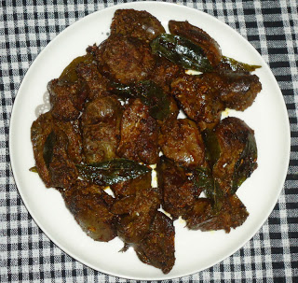
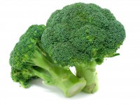
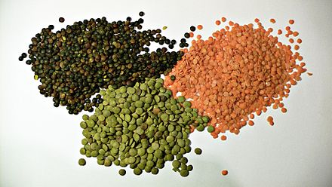
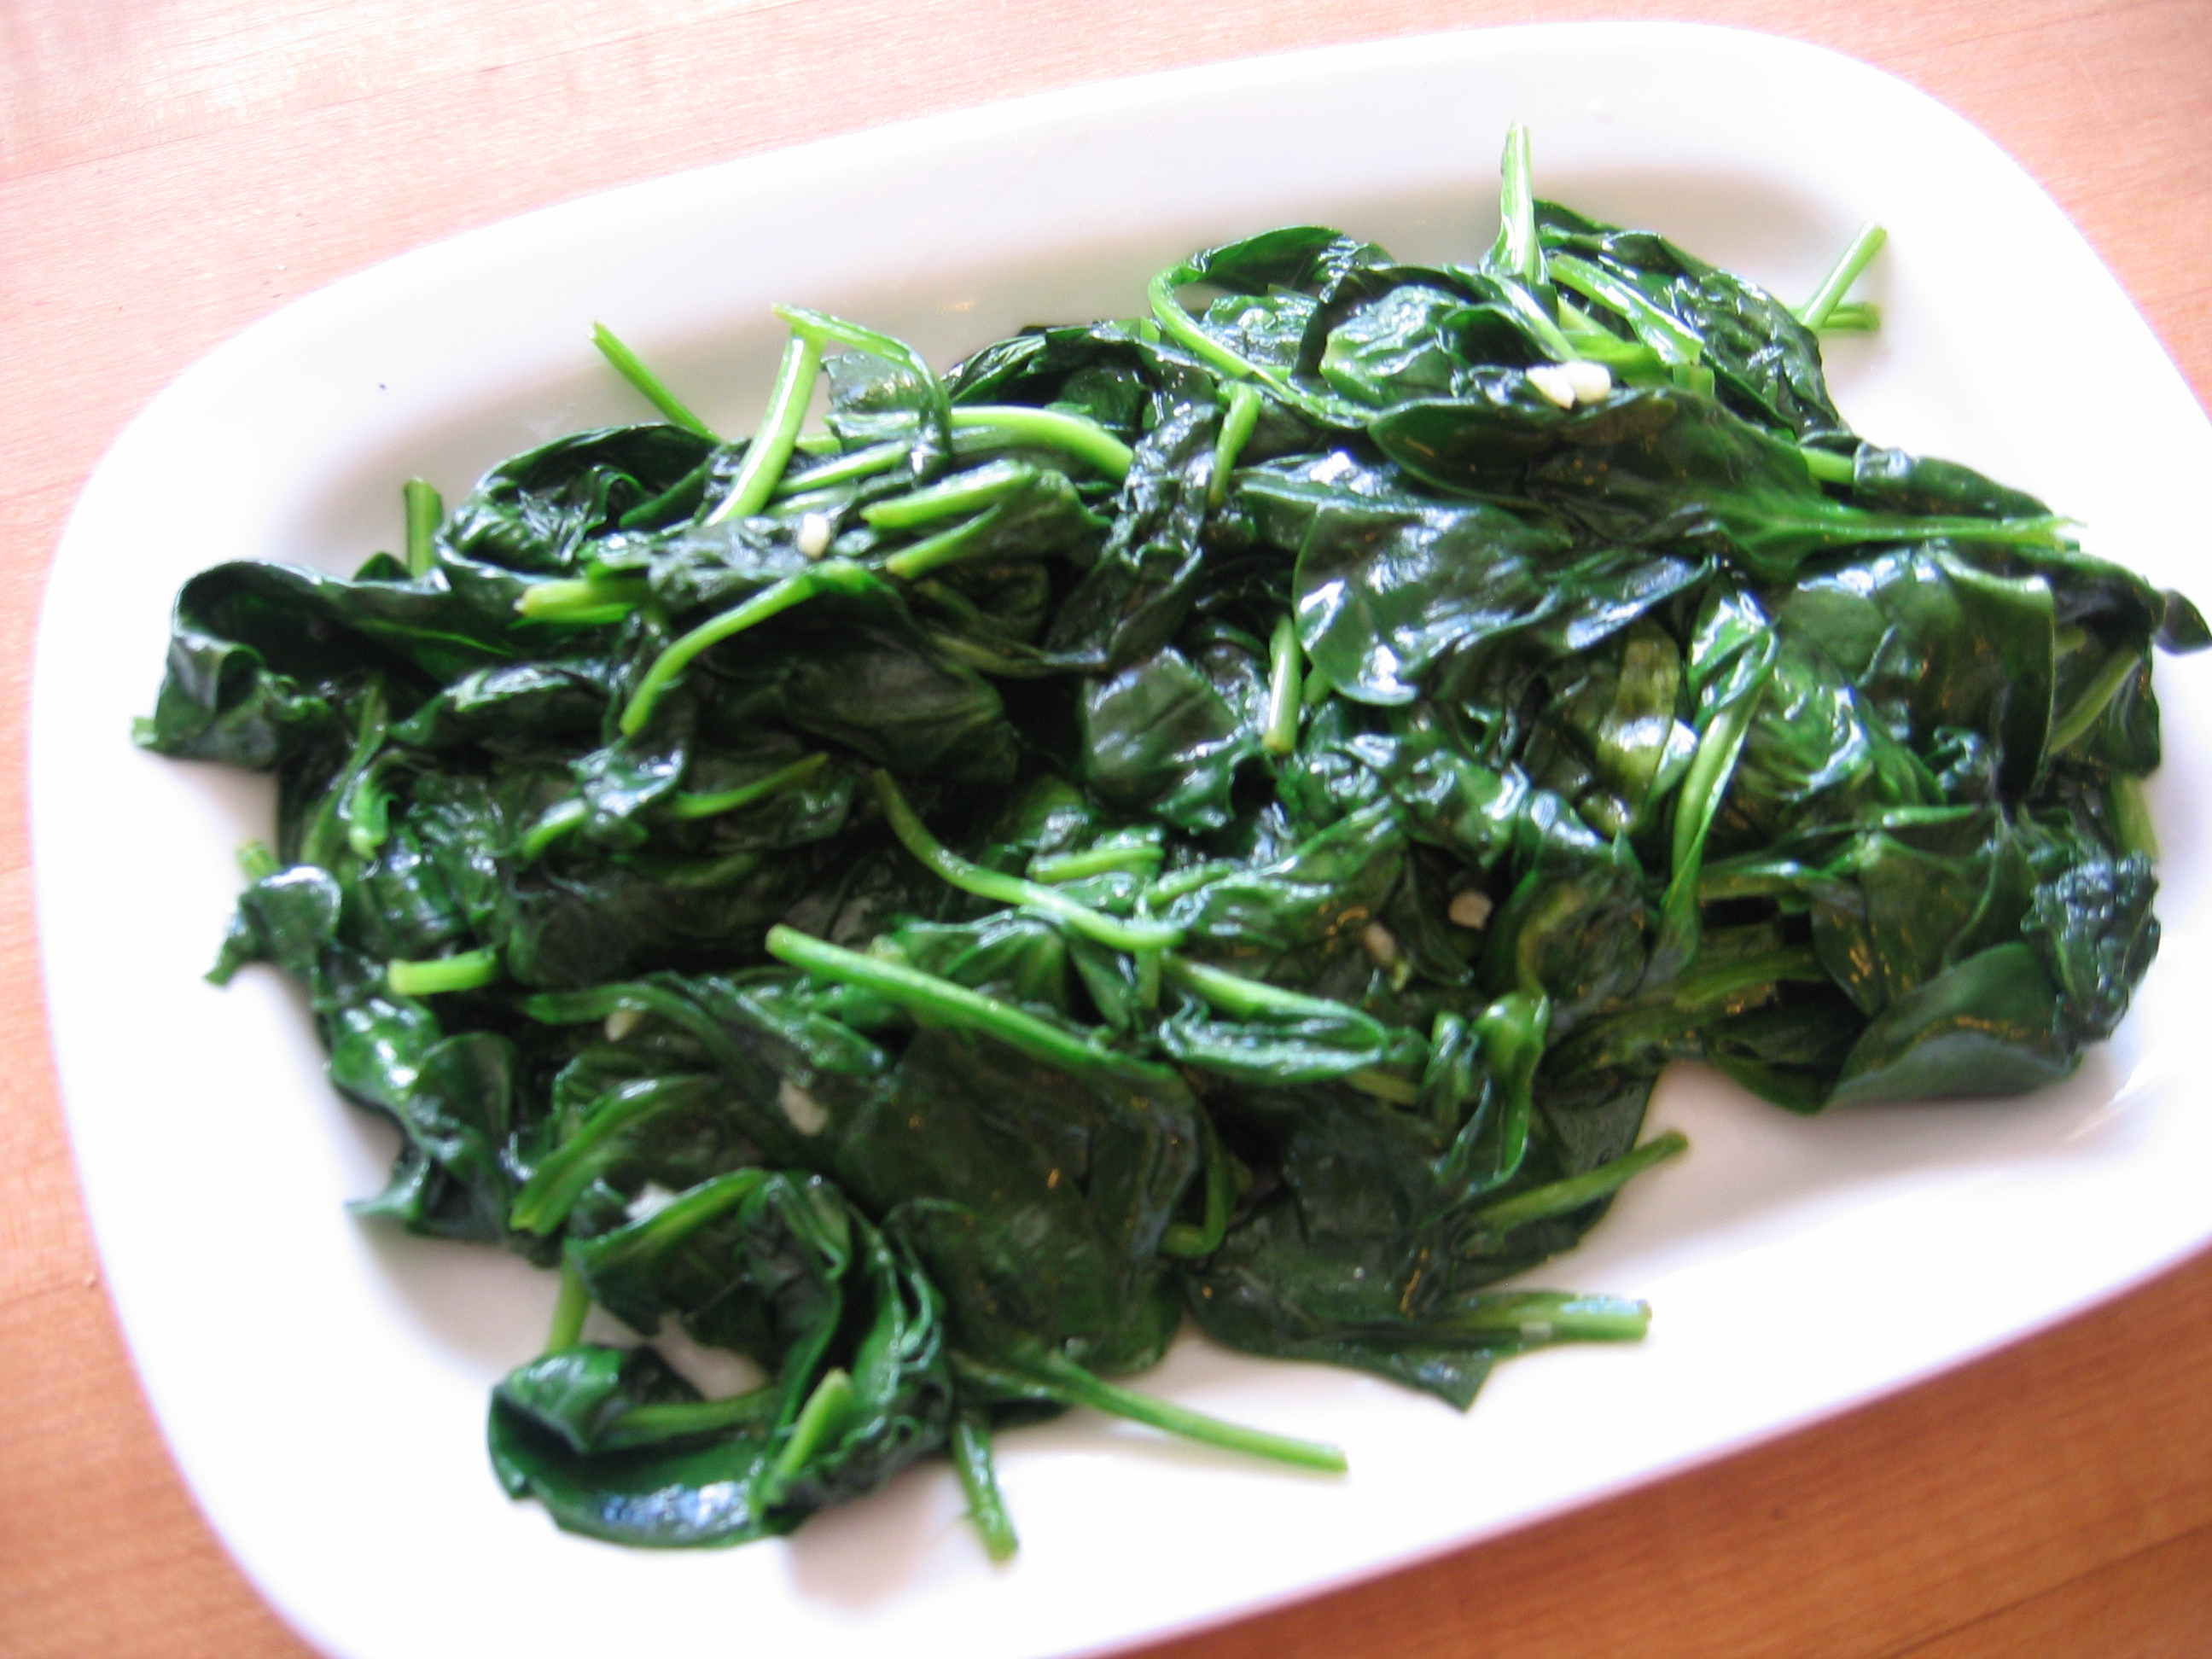
Eat Foods that Contain Folate
Notes:
Rich sources of folate include spinach, dark leafy greens, asparagus, turnip, beets, and mustard greens, Brussels sprouts, lima beans, soybeans, beef liver, brewer's yeast, root vegetables, whole grains, wheat germ, bulgur wheat, kidney beans, white beans, lima beans, mung beans, salmon, orange juice, avocado, and milk. In addition, all grain and cereal products in the U.S. are fortified with folic acid. Source: Vitamin B9 (Folic acid) | University of Maryland Medical Center http://umm.edu/health/medical/altmed/supplement/vitamin-b9-folic-acid#ixzz3WRIDDE2h University of Maryland Medical Center Follow us: @UMMC on Twitter | MedCenter on Facebook

Slide 82
Eat Foods that Contain Folate
These foods are also rich in
manganese and sulfur

Slide 83
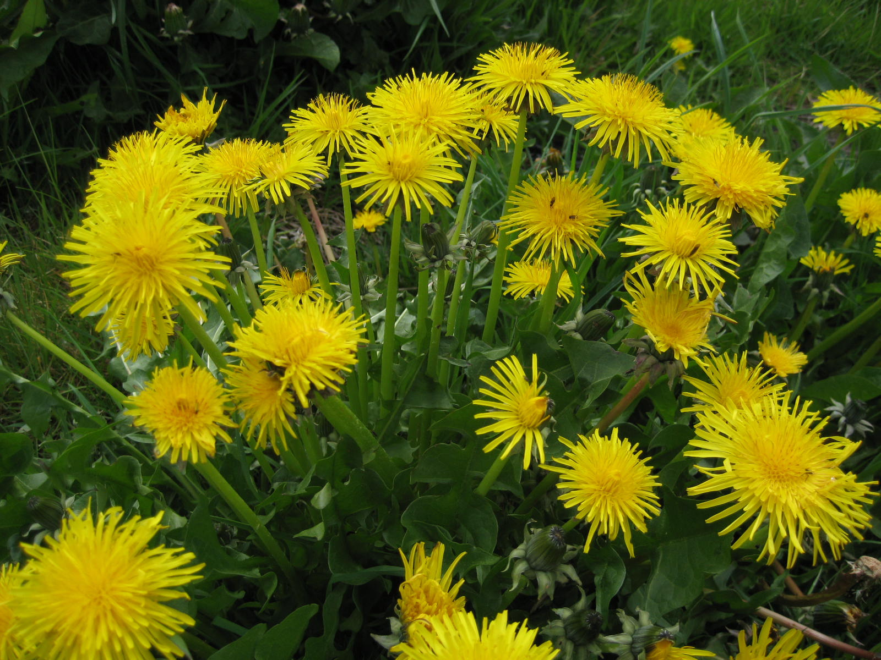
Extracts from Common Plants Can Treat Glyphosate Poisoning*
Roundup is toxic to hepatic and embryonic cells at doses far below those used in agriculture and at residue levels present in some GM food.
Extracts from common plants such as dandelions, barberry, and burdock can protect from damage, especially if administered prior to exposure.
*C Gasnier et al. Journal of Occupational Medicine and Toxicology 2011, 6:3

Slide 84
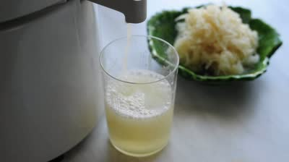
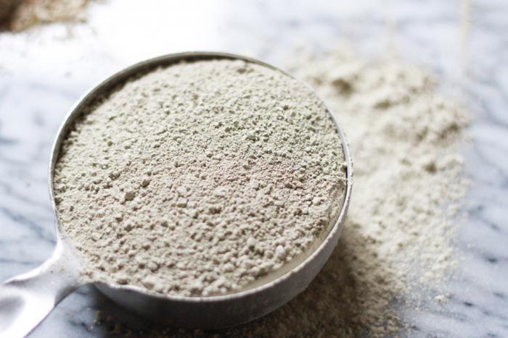
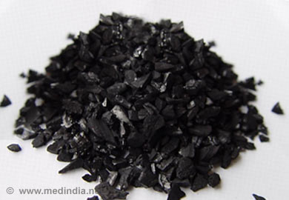
Treating Glyphosate Poisoning in Animals (e.g., cows) *
Activated charcoal, bentonite clay, humic and fulvic acids, and sauerkraut juice have been shown to be effective in reducing urinary levels of glyphosate and improving animal health
Sauerkraut
Juice
Fulvic Acid
Activated Charcoal
Bentonite Clay
*H Gerlach et al., J Environ Anal Toxicol 2014, 5:2
Notes:
Glyphosate/Monika_cows_humic_acid_fulvic_acid_treat_glyphosate.pdf

Slide 85
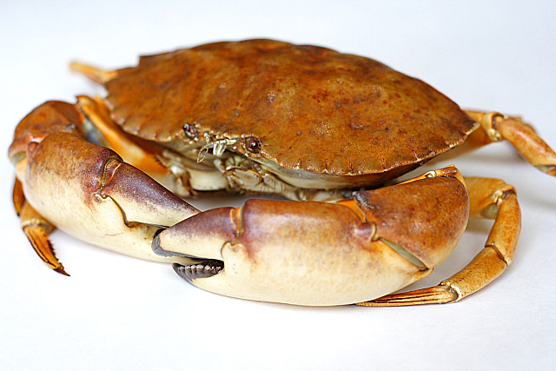
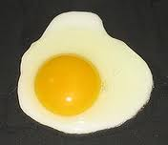
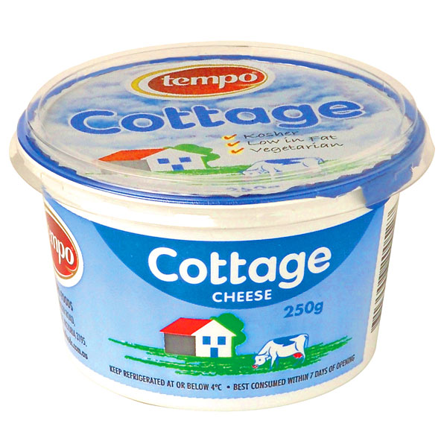
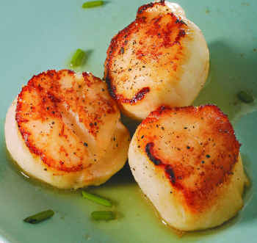
Eat Foods High in Sulfur
Notes:
http://healthyeatingclub.com/info/books-phds/books/foodfacts/html/data/data5g.html

Slide 86
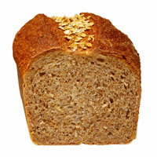
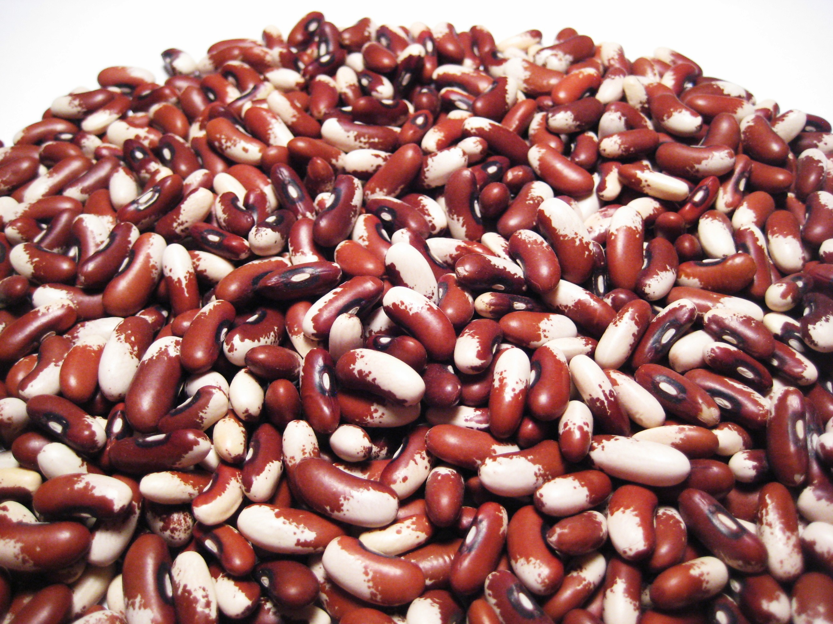
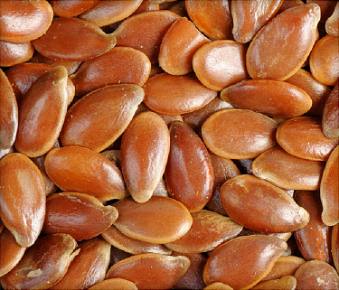
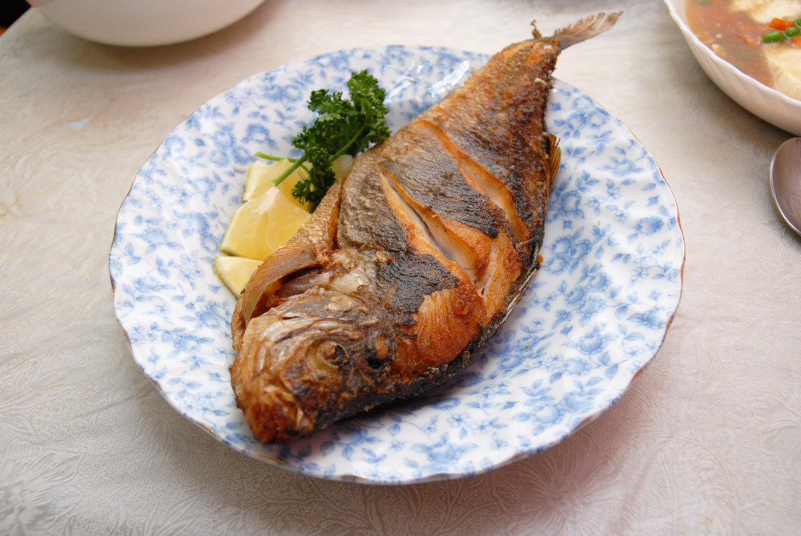
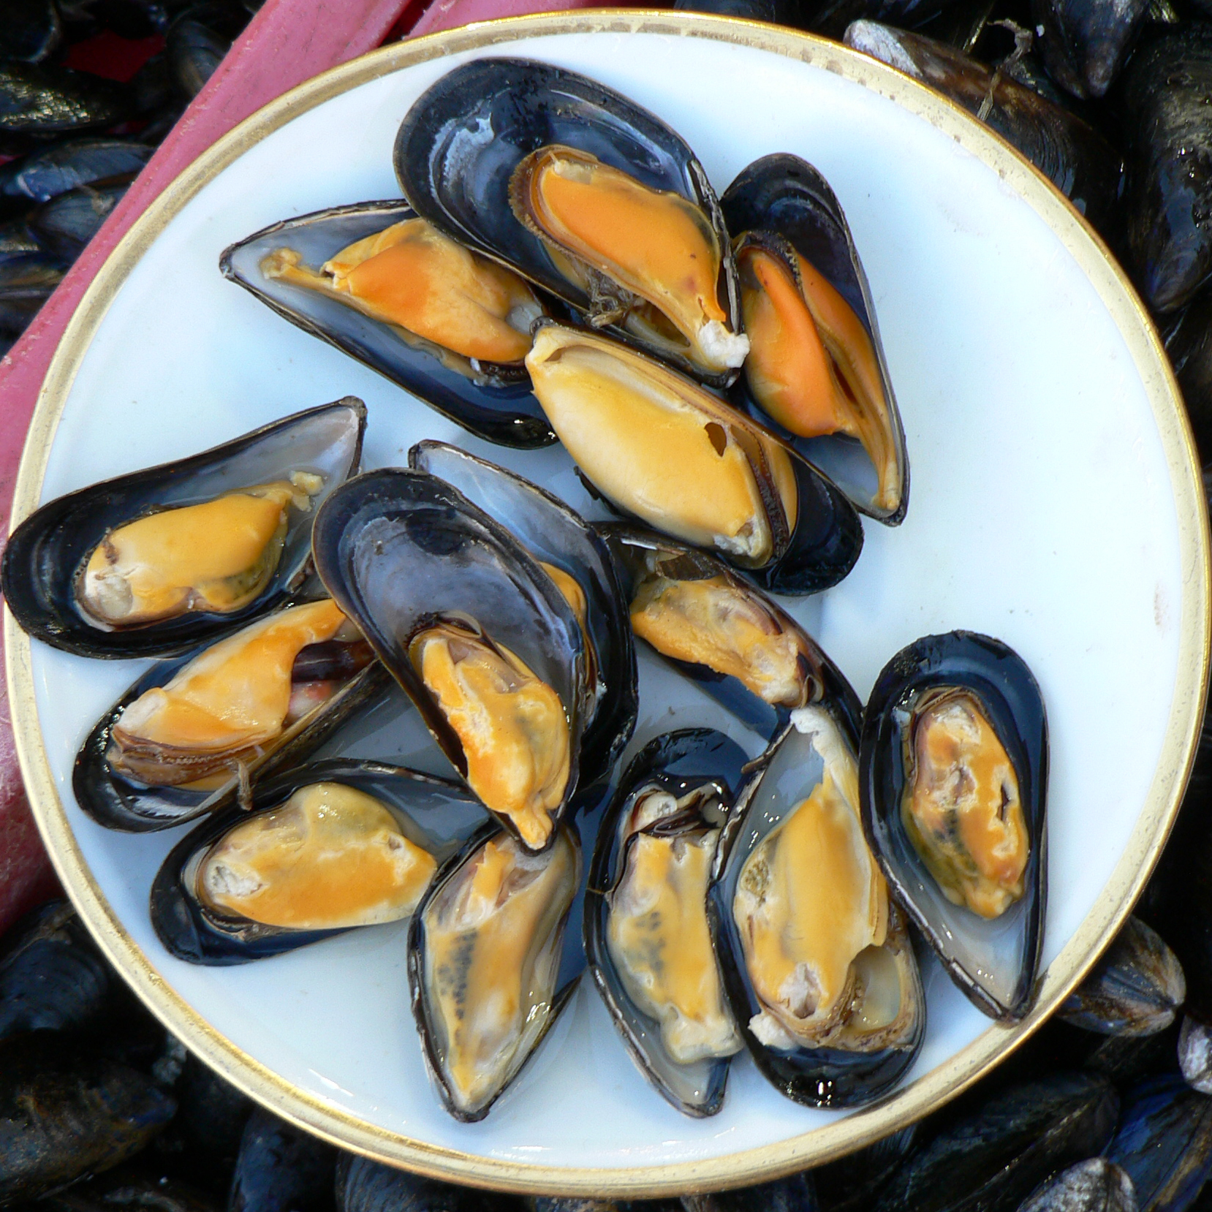
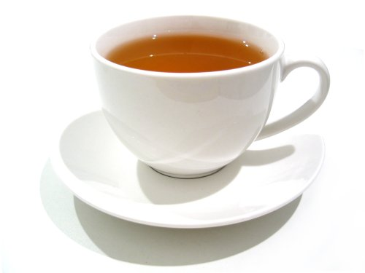
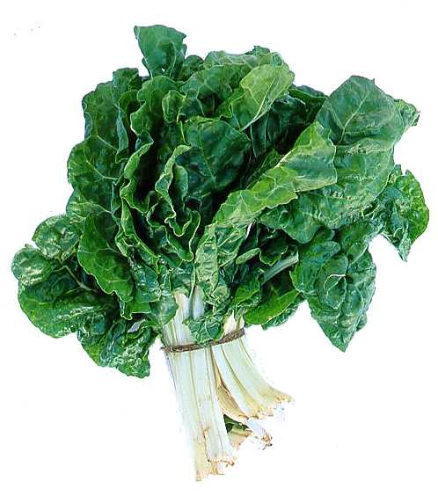
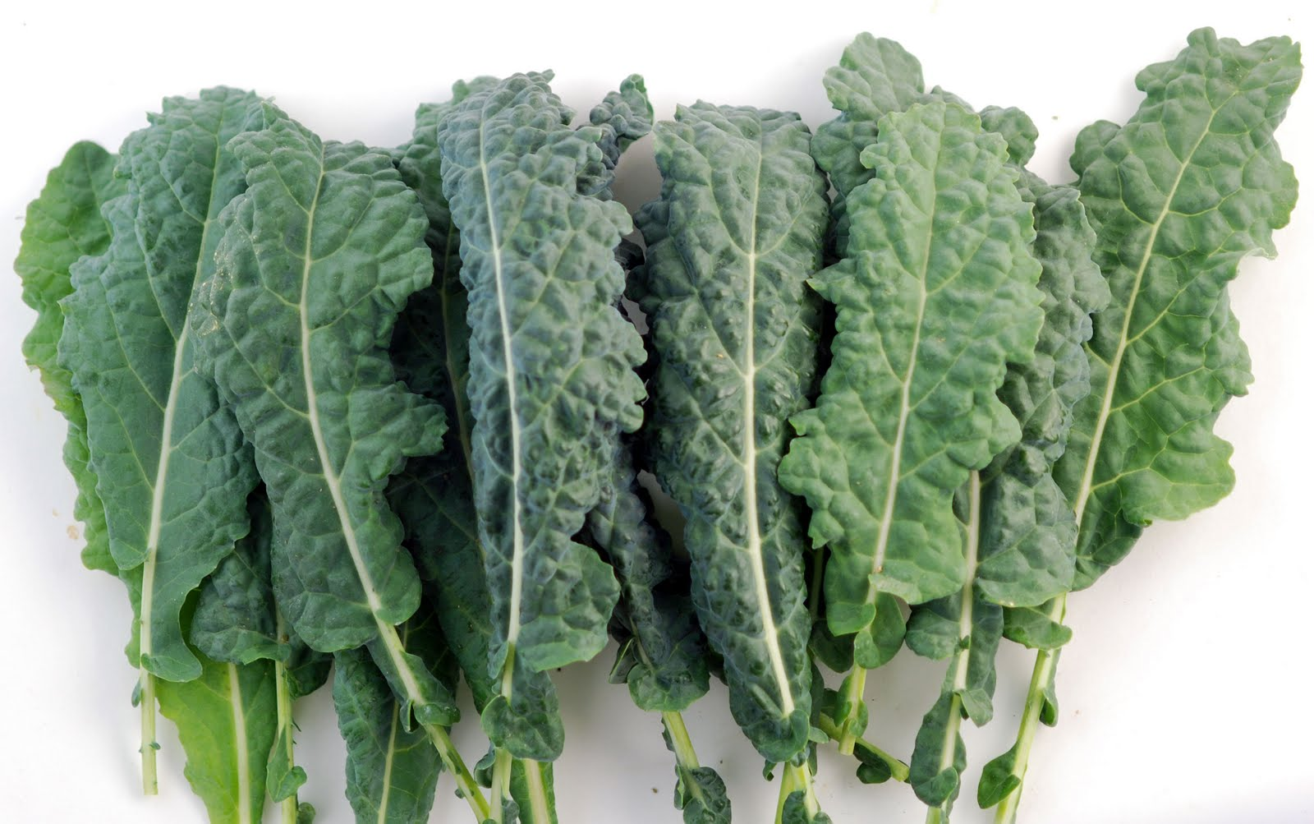
Eat Foods Containing Manganese

Slide 87
Summary
Autism rates are growing exponentially, and this trend will destroy the nation if we stay the course
Our cheap food supply is making us sick
Mercury, aspartame, polysorbate 80, PCBs, organochlorine pesticides, hexane, folic acid, oxalate and glyphosate!! are all contributing
Autism and ADHD are intimately related and may differ just by the balance of manganese and iron in a toxic environment
We need to return to sustainable organic agricultural methods and we need to spend more time in the kitchen cooking whole foods!

