Slide 1
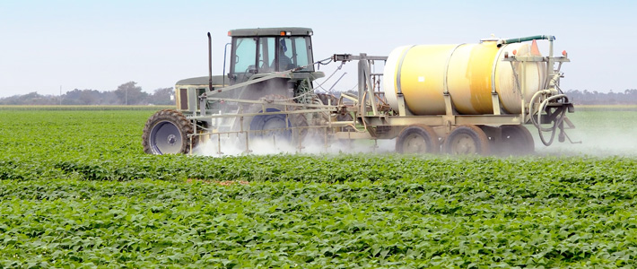
The Pervasive Herbicide, Roundup: Evidence that It Is Toxic to Humans
Stephanie Seneff
MIT CSAIL

Slide 2
Outline
Introduction: Focus on Autism (自閉症)
Is Glyphosate (草甘膦) Toxic?
Manganese (錳) Dysbiosis
Anemia (貧血) and Vitamin D Deficiency (維生素D缺乏症)
Many Animal Species under Stress
Summary
Notes:
自閉症
Zì bì zhèng
錳
Měng
anemia
貧血
Pínxiě
維生素D缺乏症
Wéishēngsù D quēfá zhèng

Slide 3
Introduction

Slide 4
US Health Status
US makes up 5% of the world’s population but consumes more than 50% of the world’s pharmaceutical drugs
We spend more on health care than Japan, France, China, UK, Italy, Canada, Brazil, Spain, and Australia, combined
US ranks last or near last among developed nations on infant mortality and life expectancy
We also suffer from more chronic illnesses
We consume 25% of the world supply of glyphosate

Slide 5
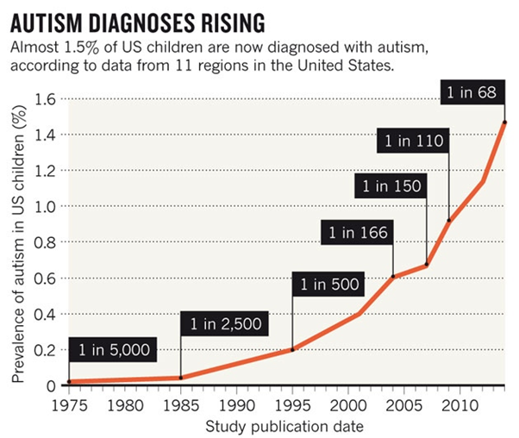
A Frightening Trend*
?
?
12 years
*K. Weintraub, Nature 479, Nov. 3 2011, 22-24.
Notes:
./NatureAutismRising.pdf

Slide 6
Percentage of children with Autism in the US
50%
2032

Slide 7
Percentage of children with Autism in the US
50%
Half the children born in 2032 will be diagnosed with autism
2032

Slide 8
“If it is an environmental cause contributing to an increase, we certainly want to find it.”*
*K. Weintraub, Nature 479, Nov. 3 2011, 22-24.

Slide 9
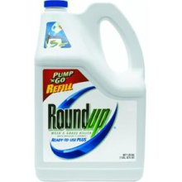
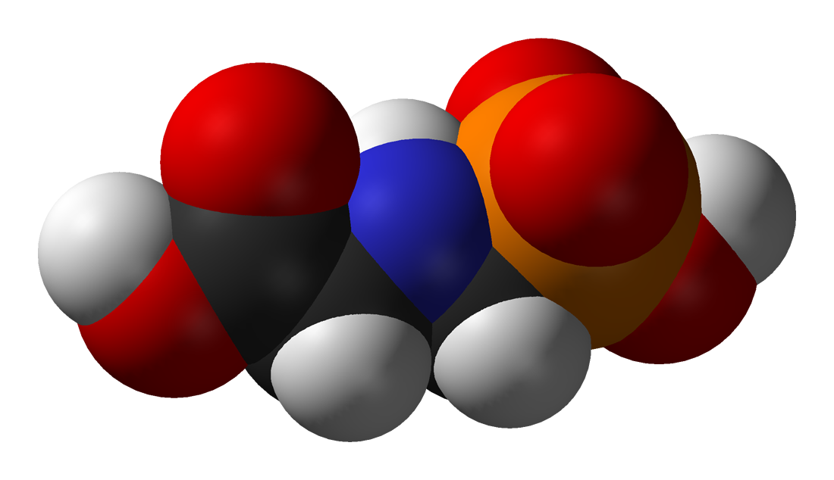
草甘膦
GLYPHOSATE
Notes:
草甘膦
Cǎo gān lìn

Slide 10
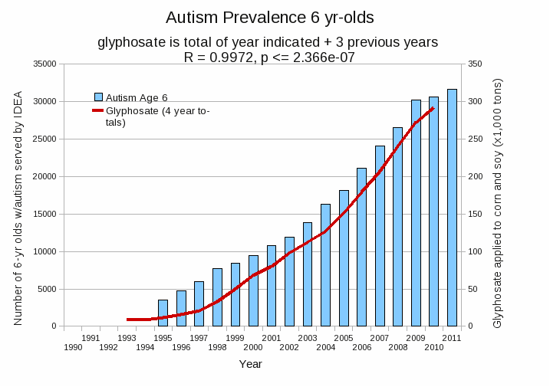
Autism Prevalence: 6 year olds
R = 0.9972
*Plot provided by Nancy Swanson, with permission
Data sources: autism: US Department of Education; Glyphosate: US Department of Agriculture
Notes:
Nancy/latest_plots/6-yr-old autism.gif
autism: USDE
oil consumption: USDA
glyphosate: USDA
GE crops: USDA
Mortality data: CDC

Slide 11
Is Glyphosate Toxic?

Slide 12
Is Glyphosate Toxic?
Monsanto has argued that glyphosate is harmless to humans because our cells don’t have the shikimate pathway, which it inhibits
However, our gut bacteria DO have this pathway
  We depend upon them to supply us with essential amino acids (氨基酸) (among many other things)
Other ingredients in Roundup greatly increase glyphosate’s toxic effects
Insidious effects of glyphosate accumulate over time
  Most studies are too short to detect damage
Notes:
Amino acids
氨基酸
Ānjīsuān

Slide 13
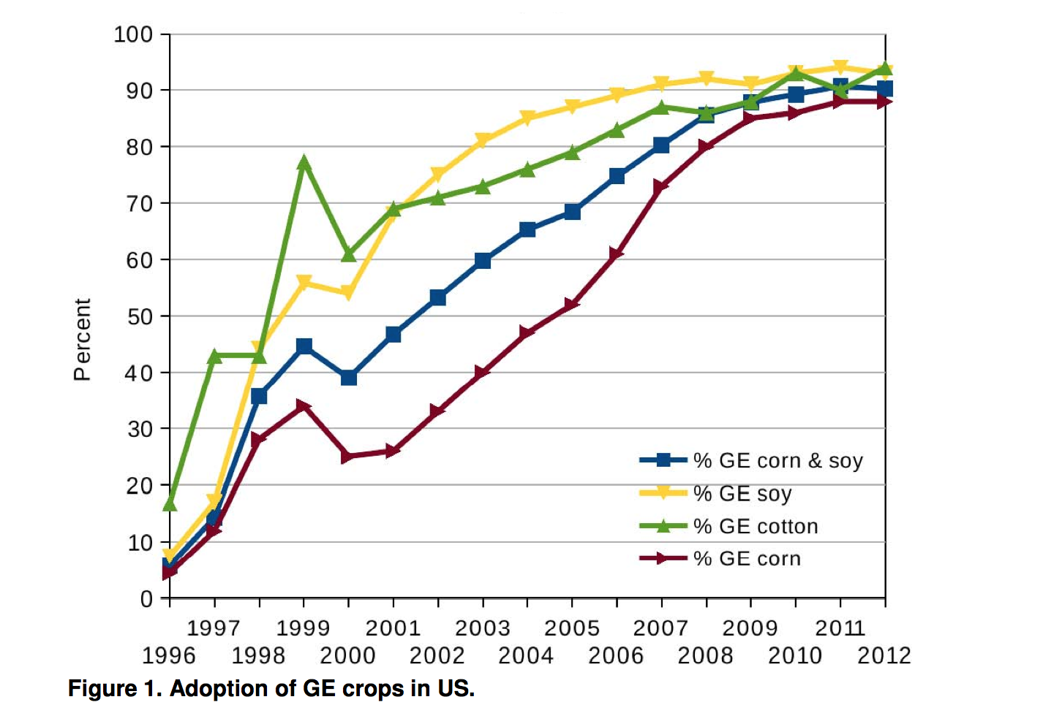
Adoption of “Roundup Ready” Crops in US*
* N. Swanson et al., Journal of Organic Systems 20145;9(2): 6-37.

Slide 14
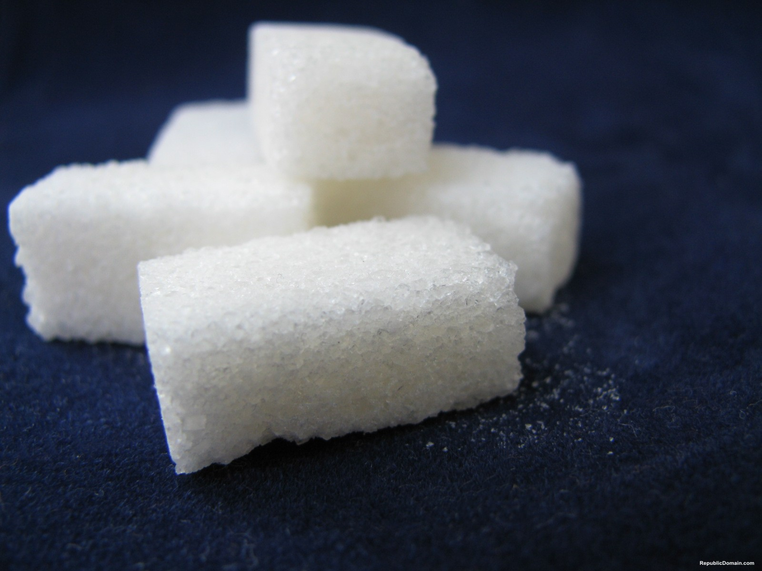
Why Sugar is Bad For You!
Beet sugar is derived from GMO Roundup-Ready beets
High fructose corn syrup is derived from GMO Roundup Ready corn
Cane sugar is derived from sugar cane that’s sprayed with Roundup right before the harvest for ripening

Slide 15
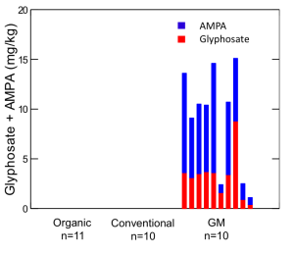
“Another claim of Monsanto's has been that residue levels of up to 5.6 mg/kg in GM-soy represent "...extreme levels, and far higher than those typically found" (Monsanto 1999).
Study of glyphosate and AMPA (breakdown product) residues in soy crops*
5.6
*Figure 1, T. Bohn et al. Food Chemistry 153, 15 June 2014, 207-215.
www.greenmedinfo.com/blog/how-extreme-levels-roundup-food-became-industry-normal
Notes:
http://www.greenmedinfo.com/blog/how-extreme-levels-roundup-food-became-industry-normal

Slide 16
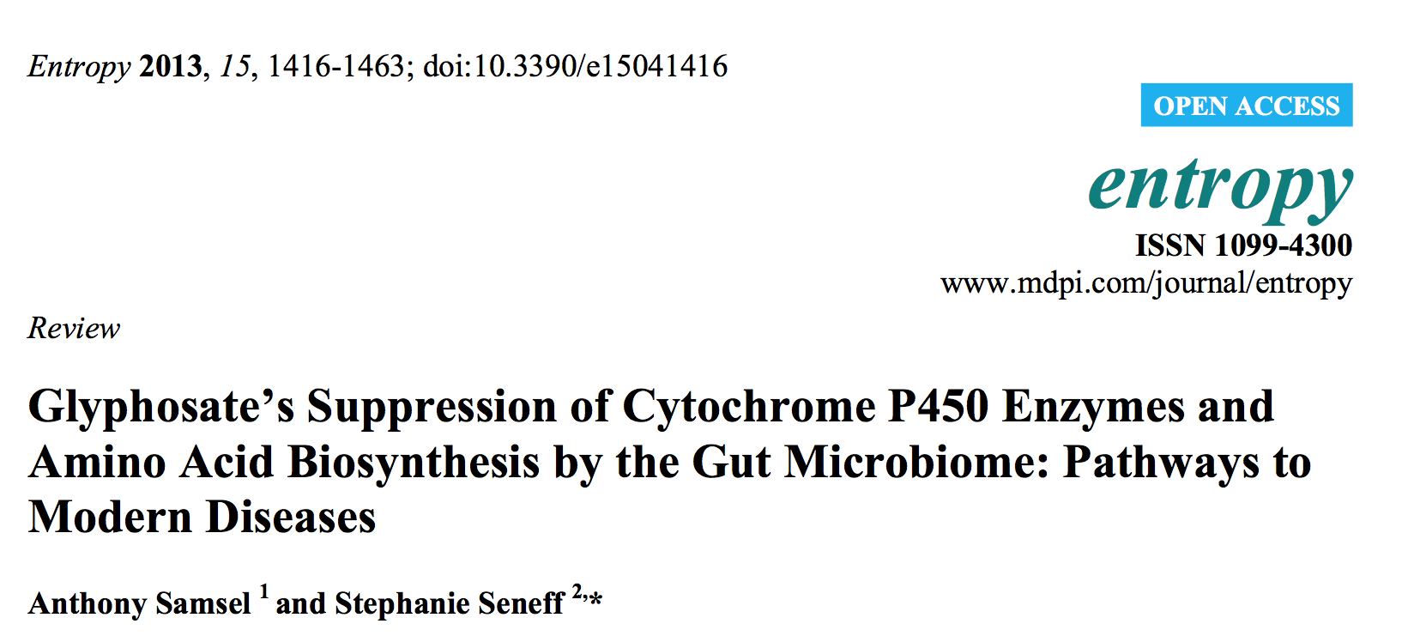
Paper Published in 2012

Slide 17
Main Toxic Effects of Glyphosate*
Kills beneficial gut bacteria and allows pathogens (病原體) to overgrow
Interferes with function of cytochrome P450 (CYP) enzymes
Chelates important minerals (螯合礦物質) (iron, cobalt, manganese, etc.)
Interferes with synthesis of aromatic amino acids and methionine (蛋氨酸)
  Leads to shortages in critical neurotransmitters (神經遞質) and folate (葉酸)
Disrupts sulfate synthesis (合成硫酸) and sulfate transport (硫酸運輸)
*Samsel and Seneff, Entropy 2013, 15, 1416-1463
Notes:
pathogens
病原體
Bìngyuántǐ
Chelates minerals
methionine
蛋氨酸
Dàn'ānsuān
neurotransmitters
神經遞質
Shénjīng dì zhì
folate
葉酸
Yèsuān
sulfate
硫酸
Liúsuān

Slide 18
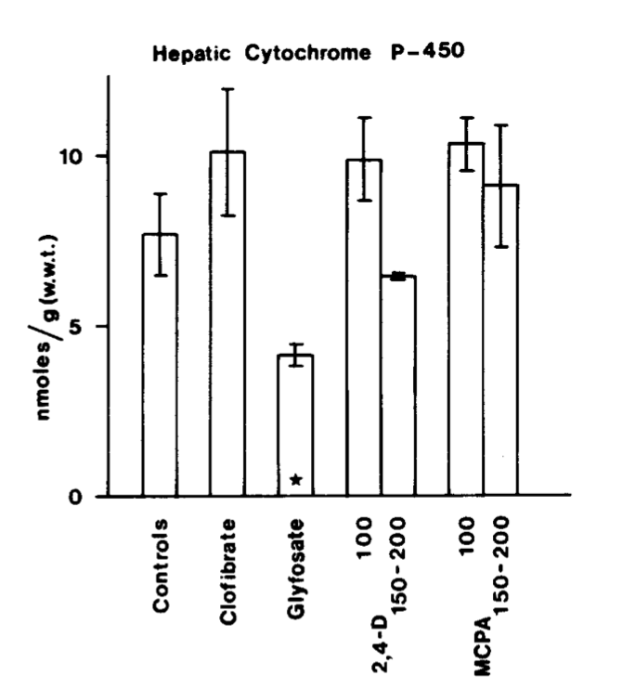
Inhibition of Cytochrome P450 Enzymes (CYPs) by Various Pesticides*
Study in rats on 2,4-D, clofibrate, MCPA, and glyphosate
*E Hetanen et al., Acta Pharmacol. Et Toxicol. 1983, 53, 103-1 12.
Notes:
./glyphosate_inhibits_CYPS_and_other_issues.pdf
Fig. 1. The concentration of hepatic cytochrome P-450 in rats exposed to clofibrate, glyphosate, 2,4dichlorophen- oxyacetic acid (2,4-D) or 4-chloro-2-methylphenoxyace- tic acid (MCPA) for 2 weeks. The doses of 2,4-D and MCPA are also shown. The meansfS.E.M. are shown. The statistical significances were analyzed with Student's t-test using controls as a reference group. The following symbol is used: *: P<0.05.

Slide 19
The Enhancing Effect of Adjuvants*
“Adjuvants in pesticides are generally declared as inerts, and for this reason they are not tested in long-term regulatory experiments. It is thus very surprising that they amplify up to 1000 times the toxicity of their APs [Active Principles] in 100% of the cases where they are indicated to be present by the manufacturer.”
佐劑
惰性的
*R. Mesnage et al.BioMed Research International 2014; Article ID:179691.
Notes:
Glyphosate/seralini_2014_pesticide_toxicity_adjuvants.pdf
佐劑
Zuǒ jì

Slide 20
Roundup Safety Claims Disputed*
“It is commonly believed that Roundup is among the safest pesticides. … Despite its reputation, Roundup was by far the most toxic among the herbicides and insecticides tested. This inconsistency between scientific fact and industrial claim may be attributed to huge economic interests, which have been found to falsify health risk assessments and delay health policy decisions.”
*R. Mesnage et al., Biomed Research International, Volume 2014 (2014),
Article ID 179691
Notes:
Glyphosate/ Mesnage_Seralini_2014_glyphosate_toxicity_proven.pdf
This is the first time that all these formulated pesticides have been tested on human cells well below agricultural dilutions.
adjuvants were also more cytotoxic through the disruption of membrane and mitochondrial respiration,
1000-fold enhancement w/ adjuvants

Slide 21
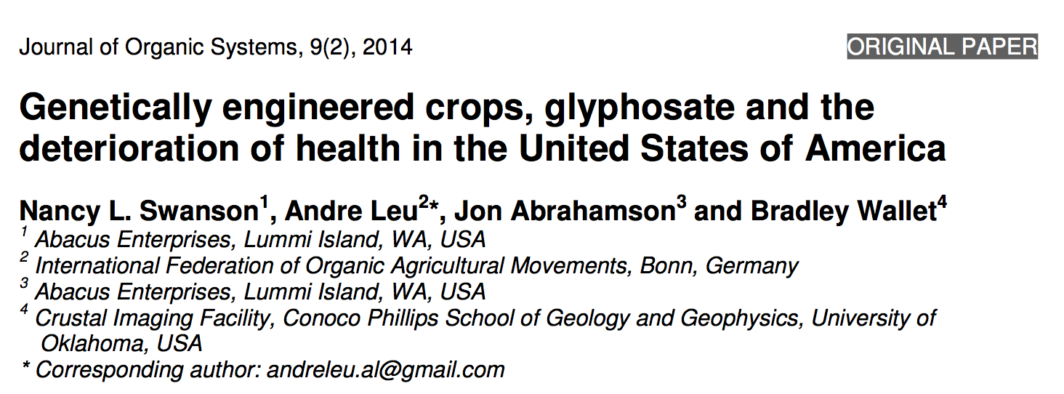
Paper by NL Swanson et al.

Slide 22
Quote from the Conclusion*
“Although correlation does not necessarily mean causation, when correlation coefficients of over 0.95 (with p-value significance levels less than 0.00001) are calculated for a list of diseases that can be directly linked to glyphosate, via its known biological effects, it would be imprudent not to consider causation as a plausible explanation.”
*NL Swanson et al. Journal of Organic Systems 9(2), 2014, p. 32,

Slide 23
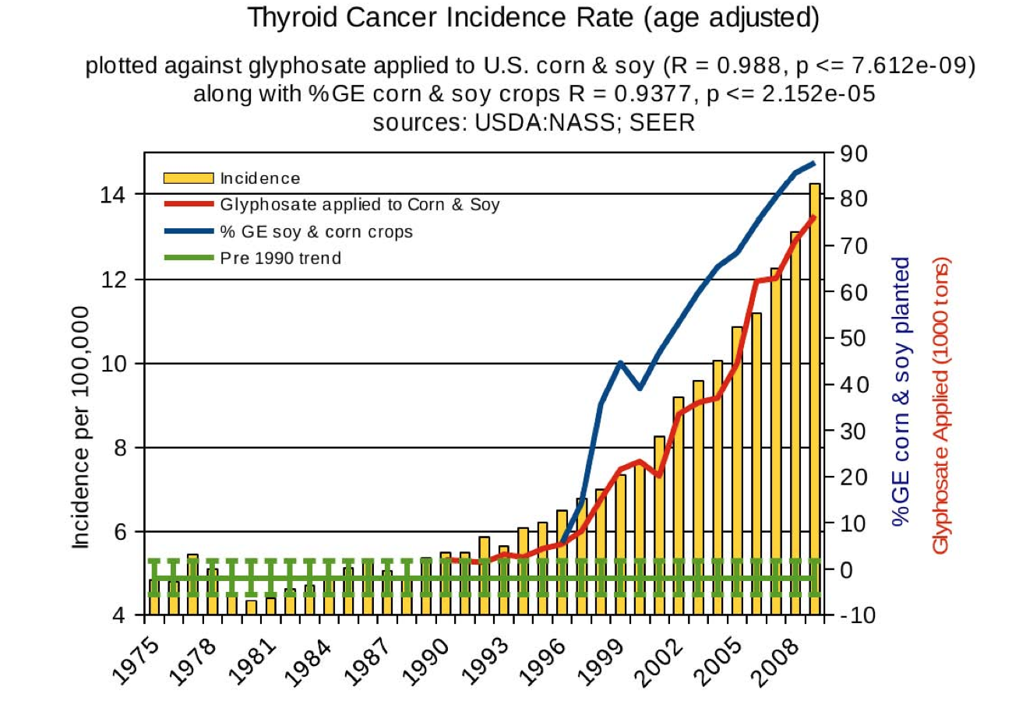
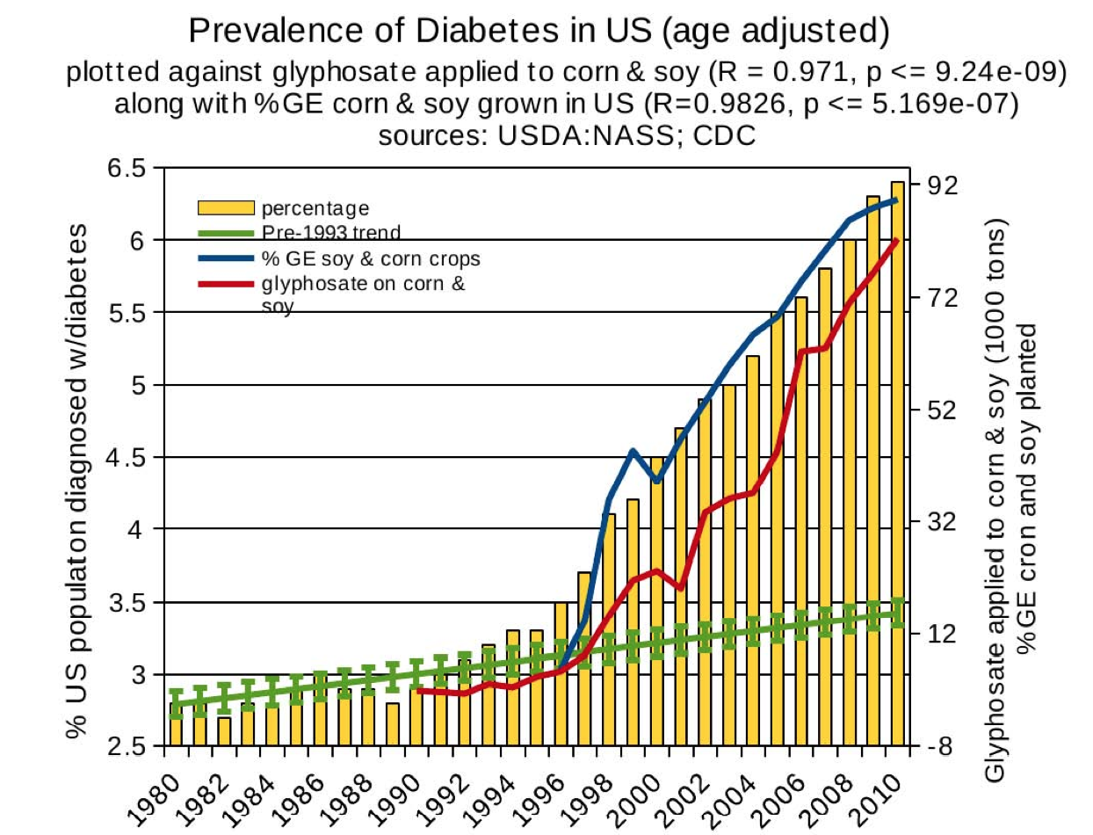
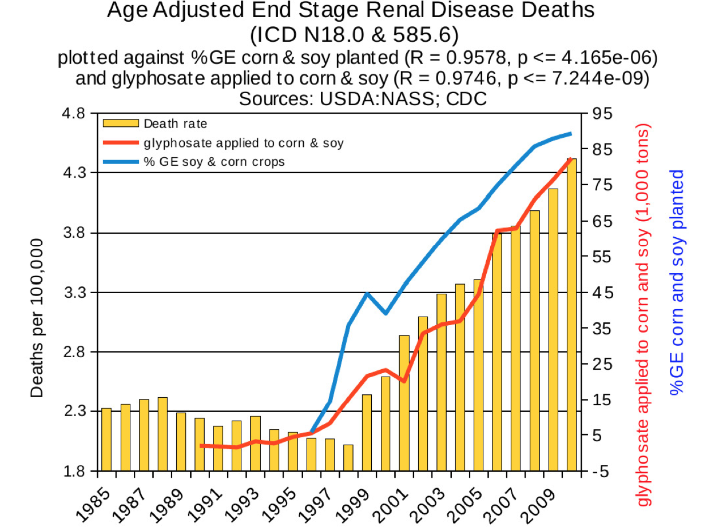
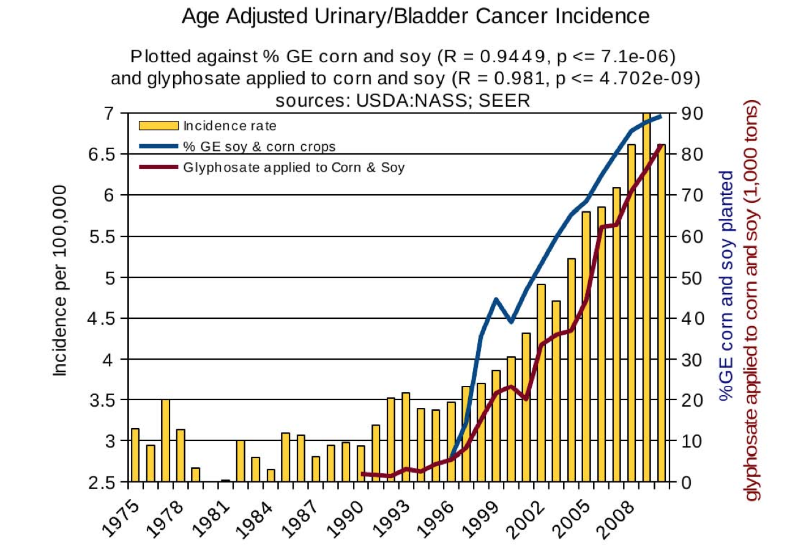
Thyroid cancer
Diabetes
End stage
renal disease
Urinary/bladder
cancer

Slide 24
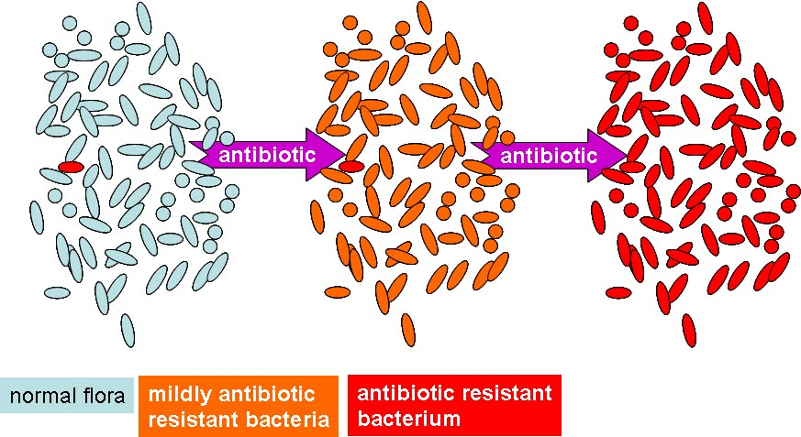
Glyphosate and Antibiotic Resistance*
Huge and growing problem with antibiotic resistant microbes (抗生素耐藥微生物) in hospitals worldwide
Glyphosate is a patented antimicrobial agent
Chronic low-level exposure to one antibiotic empowers pathogens to become resistant to other antibiotics
*B Kurenbach et al., mBio March/April 2015; 6(2):e00009-15.
Notes:
Glyphosate/treasures/mBio_glyphosate_induces_antibiotic_resistance_pathogens_2015.pdf
抗生素耐藥微生物
Kàngshēngsù nài yào wéishēngwù

Slide 25
Manganese Dysbiosis

Slide 26
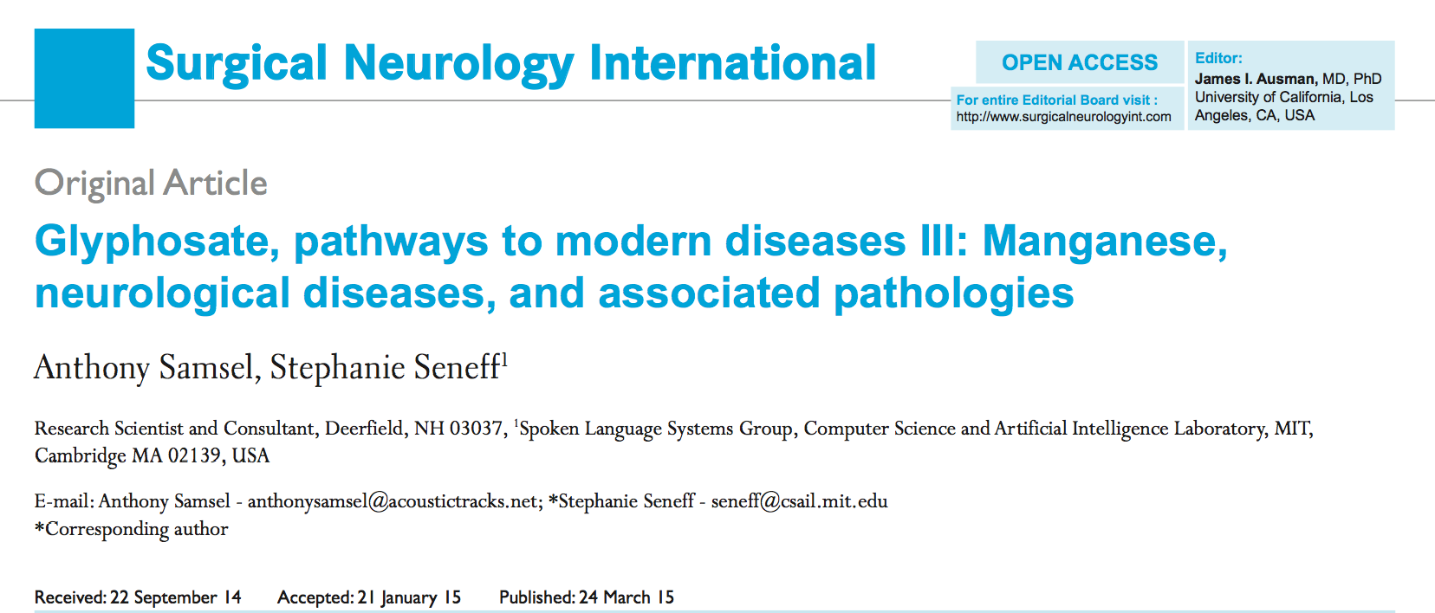
Paper on Glyphosate and Manganese
Published March 24, 2015

Slide 27
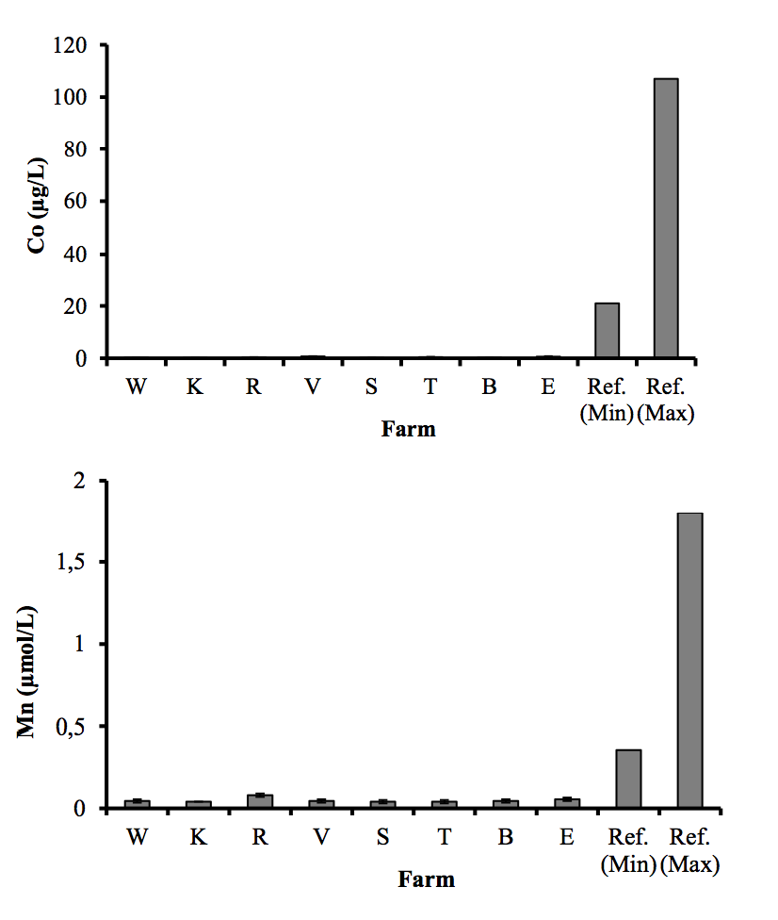
Severe Deficiency in Serum Manganese and Cobalt in Cows*
Eight different farms: all cows tested had glyphosate in the urine
*M. Krüger et al., J Environ Anal Toxicol 2013, 3:5
Notes:
glyphosate//cows_cobalt_deficiency_glyphosate.pdf

Slide 28
Manganese and Autism*
Glyphosate chelates manganese
Manganese disruption leads to:
  Disrupted gut bacteria → anxiety
  Impaired dopamine (多巴胺) synthesis → thyroid disease (甲狀腺疾病)
  Glutamate (谷氨酸) and ammonium (氨) toxicity in the brain
  Mitochondrial damage (線粒體損傷)
  Impaired bone development and osteoporosis (骨質疏鬆)
  Impaired development of perineuronal nets
Many of these pathologies are associated with autism
*A Samsel and S Seneff, Surg. Neurol. Int. 2015;6:45.
Notes:
./manganese_damages_dopamine_brainstem.pdf
dopamine
多巴胺
Duōbā'àn
甲狀腺疾病
Jiǎzhuàngxiàn jíbìng
osteoporosis
骨質疏鬆
Gǔzhí shūsōng

Slide 29

Low Manganese in Teeth Linked to Autism*
Studied lead (領導), mercury (汞) and manganese (錳) levels in tooth enamel of shed primary teeth in 84 children
Manganese accumulated after birth was down by 60% in autistic children
No other result was statistically significant
*MM Abdullah et al., J Autism Dev Disord. 2012 Jun;42(6):929-36.
Notes:
Samantha/heavy_metal_in_childrens_tooth_enamel_as_diagnostic_autism.pdf
lead
領導
Lǐngdǎo
汞
Gǒng

Slide 30
Low Manganese in Teeth Linked to Autism*
Studied lead (領導), mercury (汞) and manganese (錳) levels in tooth enamel of shed primary teeth in 84 children
Manganese accumulated after birth was down by 60% in autistic children
No other result was statistically significant
Other studies have shown low serum manganese and low manganese in urine samples in association with autism
*MM Abdullah et al., J Autism Dev Disord. 2012 Jun;42(6):929-36.
Notes:
Samantha/heavy_metal_in_childrens_tooth_enamel_as_diagnostic_autism.pdf
lead
領導
Lǐngdǎo
汞
Gǒng

Slide 31
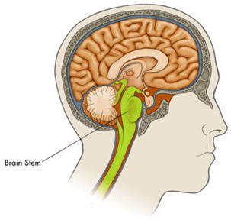
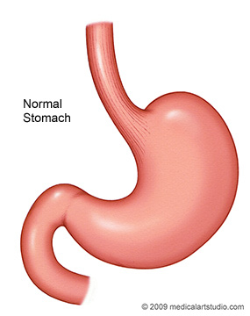
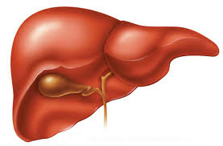

It’s not just deficiency!
Too much manganese in the brain stem
Too little manganese in the cortex
Vagus Nerve
Bile acids

Slide 32

Balancing the Scales
manganese
iron
iron
manganese
Autism
ADHD
Alzheimer’s
Parkinson’s
Glyphosate disrupts the body’s ability to distribute the minerals safely: Everybody walks a tight rope between deficiency and toxicity

Slide 33
Endocrine Disruption
And Cancer

Slide 34
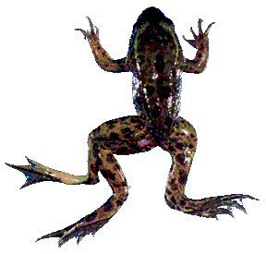
Glyphosate is an endocrine disruptor that promotes breast cancer*
Low and environmentally relevant concentrations of glyphosate possess estrogenic activity (雌激素)
Glyphosate caused human hormone-dependent breast cancer cells to proliferate at concentrations of parts per trillion
Additive effect from genistein, a phytoestrogen in soybeans
* S. Thongprakaisang et al., Food Chem Toxicol. 2013 Jun 8. S0278-6915(13)00363-3.
Notes:
./glyphosate_and_breast_cancer.text
Swine/glyphosate_breast_cancer.pdf
Please make a note that this study shows Glyphosate effects down to parts per trillion (10 to the minus12th).
In this study, we found that glyphosate at a log interval concentration ranging from 10-12 to 10-6 M increased the cell proliferation of a hormorne dependent breast cancer T47D ce
estrogenic
雌激素
Cí jīsù

Slide 35
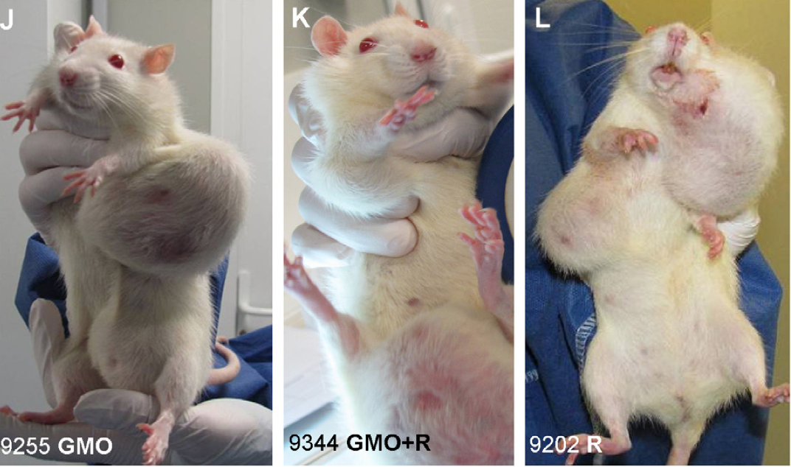
Mammary Tumors in Rats*
Rats through their entire lifespan exposed to Roundup at levels well below established safety limits
*G-E Séralini et al. Environmental Sciences Europe 2014, 26:14
Notes:
Images/seralini_rats.png
./seralini_paper.pdf
1-Seralini&al.ESEU-RepublishedInVivo_June2014.pdf
2-Seralini et al-RetTR- 1-s2.0-S0278691512005637-main.pdf
3 Seralini&al.ESEU-Conflicts_June2014.pdf

Slide 36
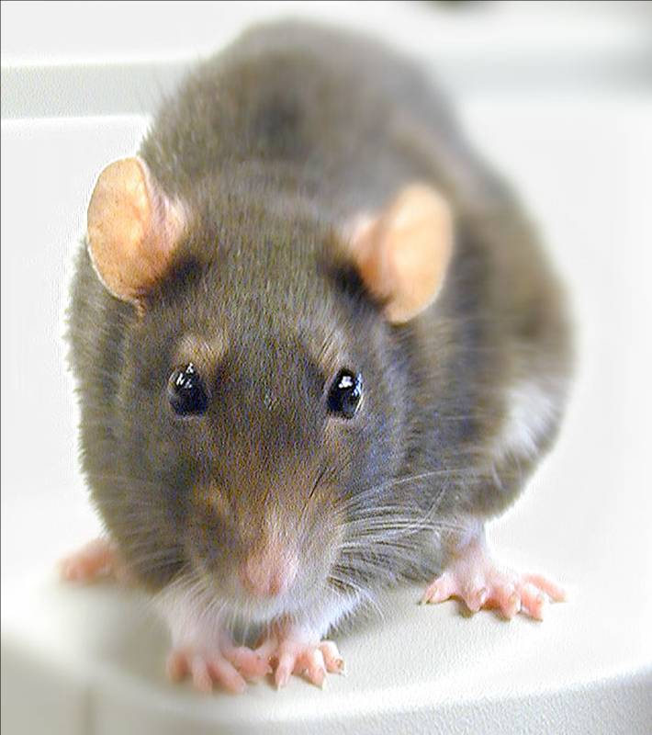
Conclusions from Rat Study *
Female rats had greatly increased risk of mammary tumors
Males had significantly increased risk of tumors of the liver and kidney
Sex hormone disruption for both males and females
Enhanced oxidative stress
Very significant kidney dysfunction
Effects didn’t become apparent until after 4 months
*G-E Séralini et al. Environmental Sciences Europe 2014, 26:14
Notes:
Spacedoc/mercola/GMOS_mouse_study_2012.pdf

Slide 37
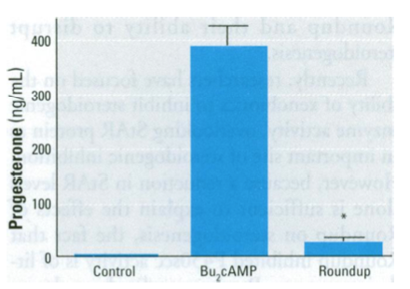
Roundup Disrupts Steroid Synthesis*
StAR protein mediates rate- limiting step in steroid synthesis
Roundup suppresses StAR protein by 90% and reduces steroidogenesis by 94%
This affects both the production of sex hormones in the gonads and the production of cortisol (皮質醇) and aldosterone (醛固酮) in the adrenal glands
*L.P. Walsh et al., Environmental Health Perspectives 108(8), 2000 769-776.
Notes:
aldosterone
醛固酮
Quángùtóng
Pízhí chún
reduction in StAR expression in the adrenal gland may affect carbohydrate metabolism, immune system function, and water balance.

Slide 38



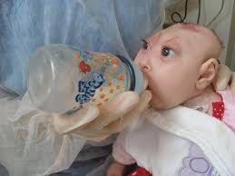

“Glyphosate, Brain Damaged Babies
in Yakima Valley”*
8
6
4
2
0
Noxious aquatic weed
control program with
Glyphosate ‘Rodeo’
1980 1990 2000 2010 2020
“Glyphosate, Three Rivers, and Anencephaly”
Yakima Harold Republic
Slide thanks to Prof. Don Huber, with permission
*Farm Wars 3/6/14
Notes:
From Don Huber:
Attached/LondonGlyphosate/
2014-0618_Huber_short.ppt

Slide 39
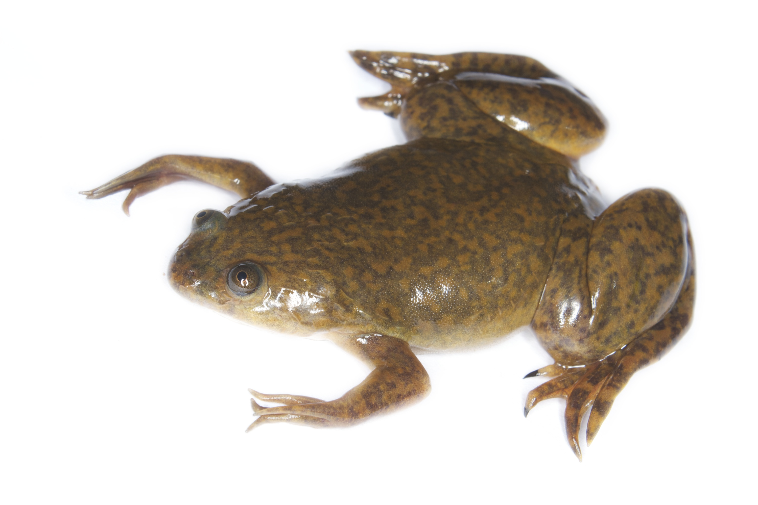
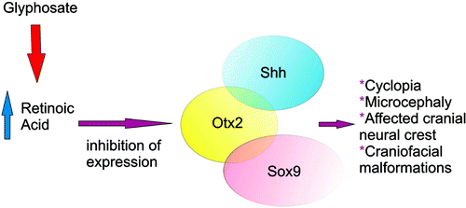
Glyphosate Upregulates Retinoic Acid*
CYP Enzyme Repression
Small Brain
*A. Carrasco, Teratogenesis by glyphosate based herbicides and other pesticides. Relationship with the retinoic acid pathway. In Breckling, B. & Verhoeven, R. (2013) GM-Crop Cultivation – Ecological Effects on a Landscape Scale. Theorie in der Ökologie 17. Frankfurt, Peter Lang.

Slide 40
Anemia and
Vitamin D Deficiency

Slide 41
Glyphosate: the Central Mechanisms
Glyphosate acts as an antibiotic (抗生素) to disrupt gut bacteria, leading to overgrowth of pathogens
Disruption of liver CYP enzymes leads to impaired bile flow (膽汁流量) and low vitamin D
  This disrupts sulfate synthesis and transport
  Also impairs detoxification of other toxic chemicals
Damage to red blood cells leads to anemia and toxicity due to free iron
  Hypoxia ensues → low grade encephalopathy (腦病)
Manganese, aluminum and glutamate become toxic to the brain
Notes:
antibiotic
抗生素
Kàngshēngsù
Bile flow
膽汁流量
Dǎnzhī liúliàng
encephalopathy
腦病
Nǎobìng

Slide 42
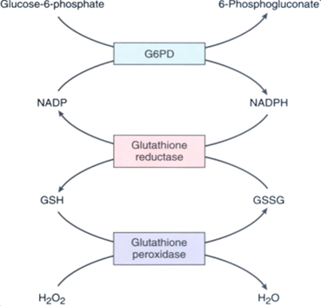
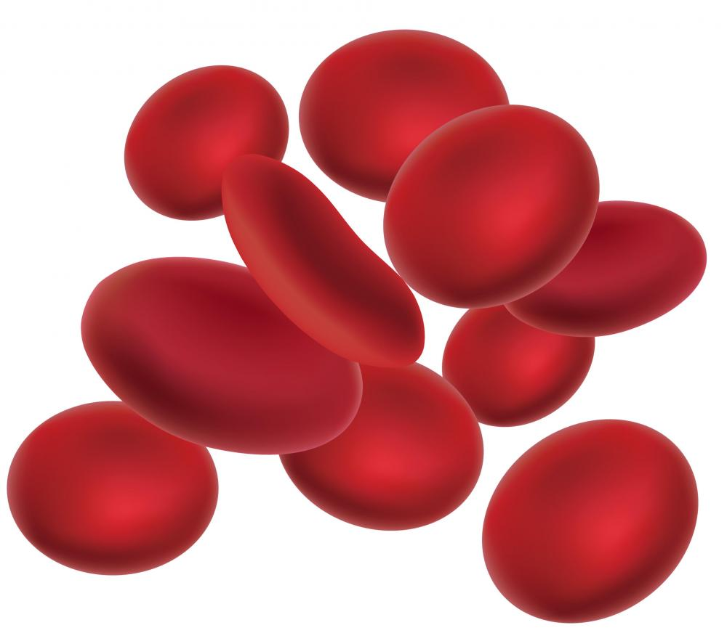
This Detoxification Scheme is Essential in Red Blood Cells
Inhibited by glyphosate
Product of shikimate pathway
Depleted by glyphosate
Depends on selenium

Slide 43
This Detoxification Scheme is Essential in Red Blood Cells
Inhibited by glyphosate
Product of shikimate pathway
G6PD Deficiency Leads to
Hemolysis (溶血) and Anemia (貧血)
Depleted by glyphosate
Depends on selenium
Notes:
溶血
Róngxiě
貧血
Pínxiě

Slide 44
Plot produced in collaboration with Dr. Nancy Swanson from US Government data

Slide 45
Anemia leads to low oxygen which induces chronic low grade encephalopathy linked to autism

Slide 46
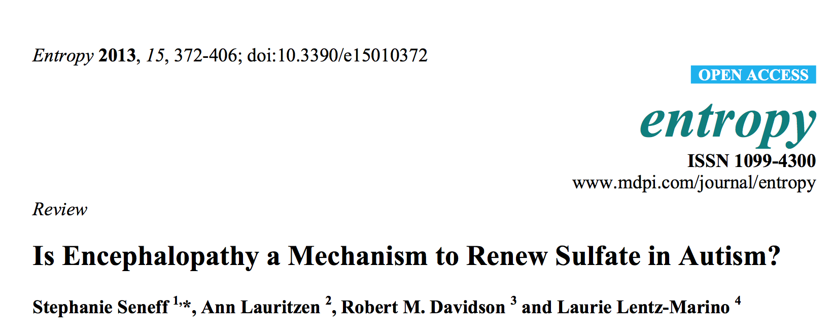

Slide 47
Vitamin D Deficiency Epidemic in the United States
Year
Hospital Discharge Data from the US CDC

Slide 48
Vitamin D Deficiency Epidemic in the United States
Vitamin D is activated by Cytochrome P450 enzymes in the liver
Year
Hospital Discharge Data from the US CDC

Slide 49
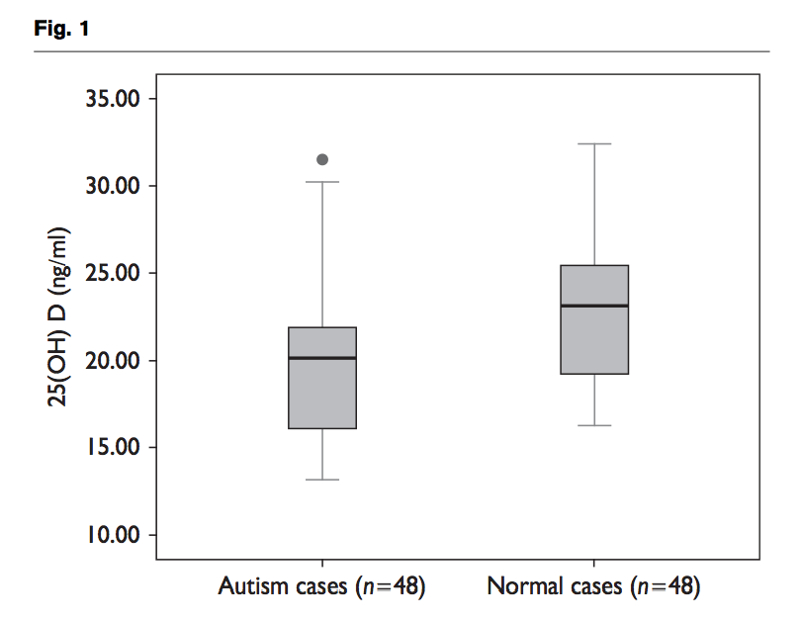
Recent Study from China*
Vitamin D (ng/ml)
*Z-L Gong et al., NeuroReport 2014, 25:23–27
Notes:
Samantha/autism_vitamin_D_deficiency_Chinese_study.pdf
Boxplot of serum 25(OH) D levels between ASD patients and normal cases. The mean serum 25(OH) D levels were significantly (P = 0.002) lower in children with ASD as compared with normal cases. 25(OH) D, 25-hydroxyvitamin
d

Slide 50
Many Animal Species
under Stress

Slide 51
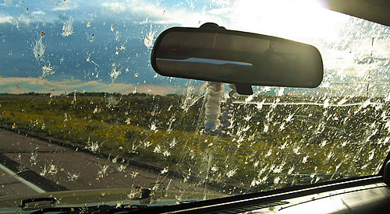
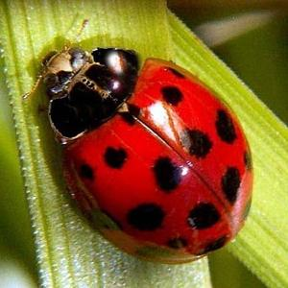
Where Have all the Insects Gone?
“The nine-spotted beetle commonly made her home on farmlands for the rich source of insects these regions provided.”
“Until the mid-1970s, the nine-spotted beetle was one of the most common ladybug beetles”
*http://animals.pawnation.com/causes-decline-ninespotted-beetle-6492.html

Slide 52
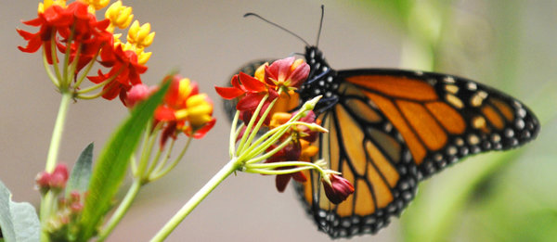
Monarch Butterfly Collapse*
“.. farmers have switched in droves to new varieties of crops that are genetically engineered to tolerate the most widely used weed killer in the United States. The resulting use of weed killers has wiped out much of the milkweed that once grew between crop rows and on buffer strips separating fields and roads.”
Glyphosate
*M. Wines, New York Times, Dec. 20, 2013.
nytimes.com/2013/12/21/us/setting-the-table-for-a-fluttering-comeback-with-milkweed.html

Slide 53
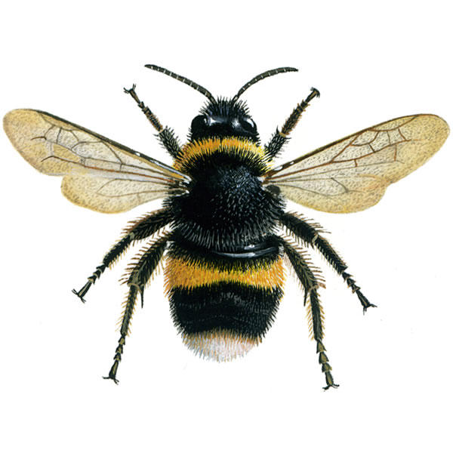
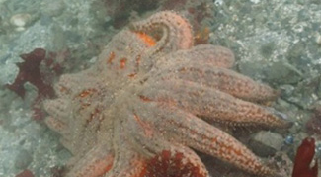
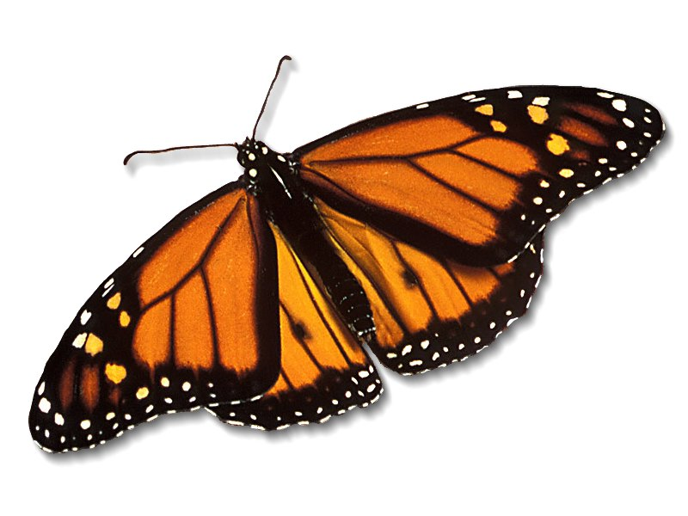
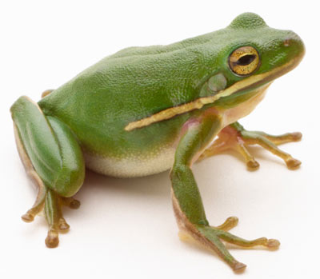
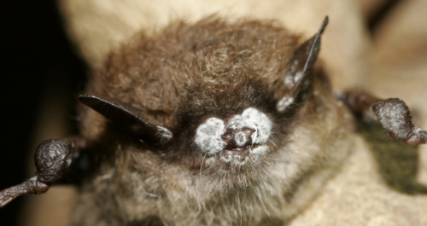
We Should be Alarmed!*
Bee Colony Collapse Disorder
Fungus Infection
Dissolving starfish
Disappearing monarch butterflies
Fungus Infection
After bees, butterflies are the second largest pollinators.
Bats eat an enormous number of insects
Fungus Infection
White-nose bat syndrome
Fungus Infection
*R. Mason et al., Journal of Environmental Immunology and Toxicology 1:1, 3-12; 2013
Notes:
Frogs -- drop 3.7% every year, meaning they could disappear in half of the habitats they now occupy nationwide in 26 years
Monarch butterflies – milkweed being killed by glyphosate
http://salsa3.salsalabs.com/o/1881/p/dia/action3/common/public/?action_KEY=12506

Slide 54
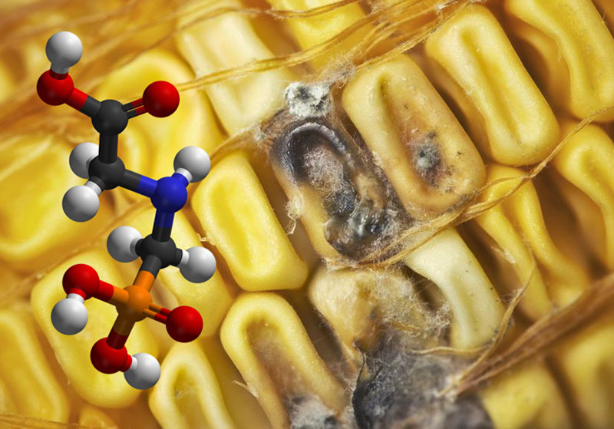
Roundup herbicide enhances the growth of aflatoxin-producing fungi*
Fungus (菌) is a growing threat in GMO Roundup-Ready corn
Research consistent with studies on other fungal strains such as Fusarium, Rust fungi and Blight fungi
*Barberis et al., Journal of Environmental Science and Health, Part B: Pesticides, Food Contaminants, and Agricultural Wastes. 2013, 48(12), 1070-1079.
Notes:
http://www.greenmedinfo.com/blog/breaking-study-links-roundup-weedkiller-overgrowth-deadly-fungal-toxins-1
Barberis CL, Carranza CS, Chiacchiera SM, Magnoli CE. Influence of herbicide glyphosate on growth and aflatoxin B1 production by Aspergillus section Flavi strains isolated from soil on in vitro assay. Journal of Environmental Science and Health, Part B: Pesticides, Food Contaminants, and Agricultural Wastes. 2013, 48(12), 1070-1079.
fungus
菌
Jūn

Slide 55
“Emerging fungal threats to animal, plant and ecosystem health”*
“The past two decades have seen an increasing number of virulent infectious diseases in natural populations and managed landscapes. In both animals and plants, an unprecedented number of fungal and fungal-like diseases have recently caused some of the most severe die-offs and extinctions (滅絕) ever witnessed in wild species, and are jeopardizing food security.”
*M.C. Fisher et al., Nature Reviews 484(7393), 186-194.
Notes:
./nature_fungus.text
./nature_fungus.pdf
滅絕
Mièjué

Slide 56
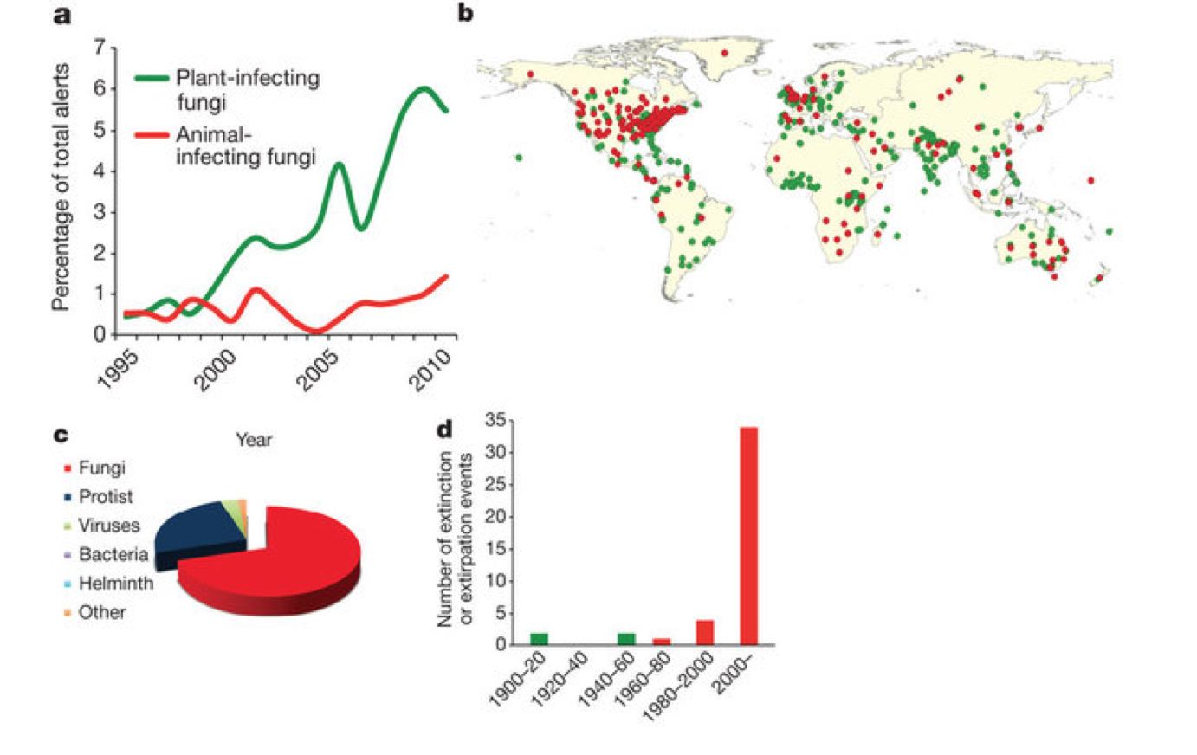
Figure 1, Nature Reviews Paper*
Causes of Extinction
*M.C. Fisher et al., Nature Reviews 484(7393), 186-194.
Notes:
2014/nature_fungus.pdf
c, d, Relative proportions of species extinction and/or extirpation events for major classes of infectious disease agents (c) and their temporal trends for fungal pathogens (d). Primary data sources are given in the Supplementary Information.

Slide 57
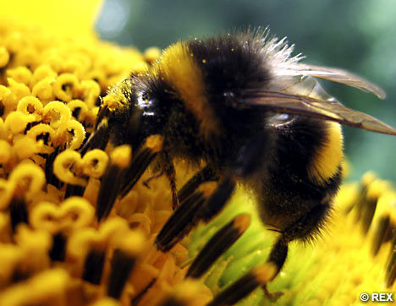
Bee Colony Collapse Syndrome
Bees are exposed to many insecticides from pollen – e.g., Chlorpyrifos (neonicotinoid)
Their resistance to neonicotinoids depends on CYP enzymes
Honey bees have fewer CYP enzymes than other insects*
These enzymes are disrupted by glyphosate
Disruption of CYP enzymes in the liver would impair humans’ ability to detoxify many environmental toxicants: synergistic effect
*Claudianos et al., Insect Molecular Biology (2006) 15(5), 615–636.

Slide 58
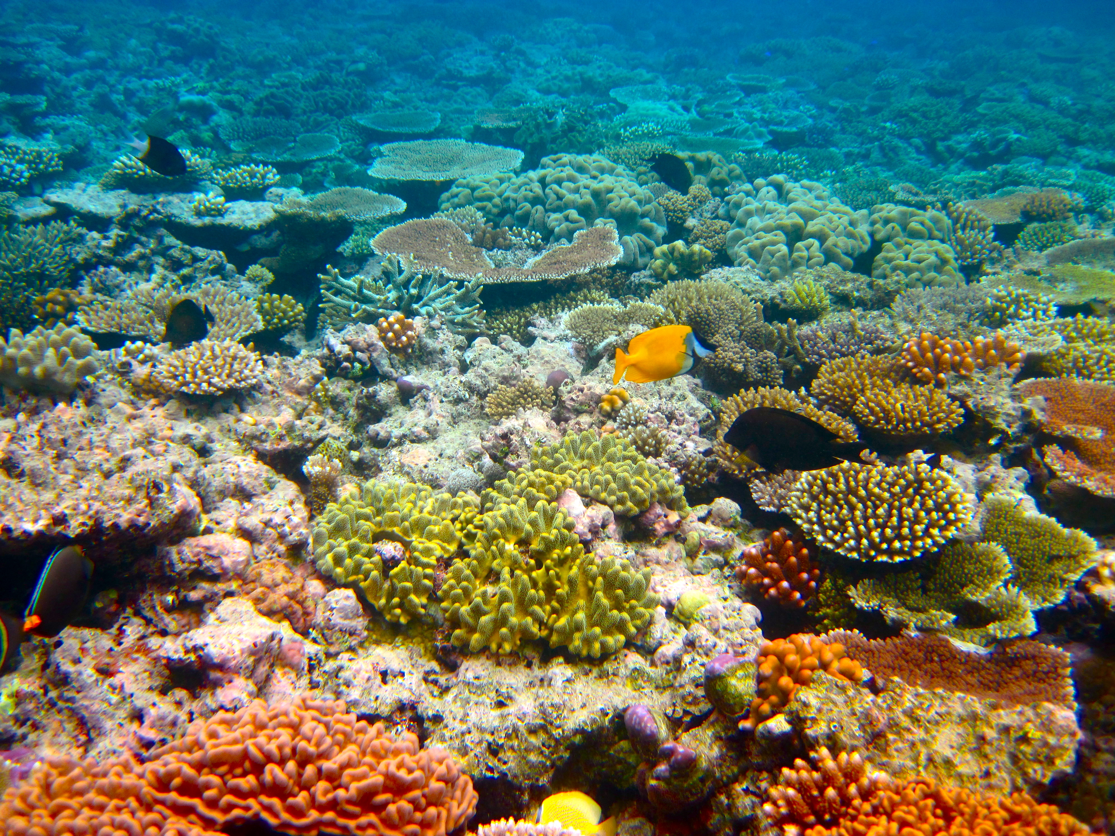
“Glyphosate persistence in seawater”*
“Glyphosate degraded most rapidly under low light conditions at 25 °C with none detected by day 180, and most slowly in the dark at 31 °C where 52% remained by day 330“
*P. Mercurio et al., Marine Pollution Bulletin 2014;85(2):385-390.
Notes:
Glyphosate/glyphosate_persistance_sea_coral_2014.pdf
http://www.greenmedinfo.com/blog/roundup-weed-killer-threatens-coral-reefs-persists-seawater

Slide 59
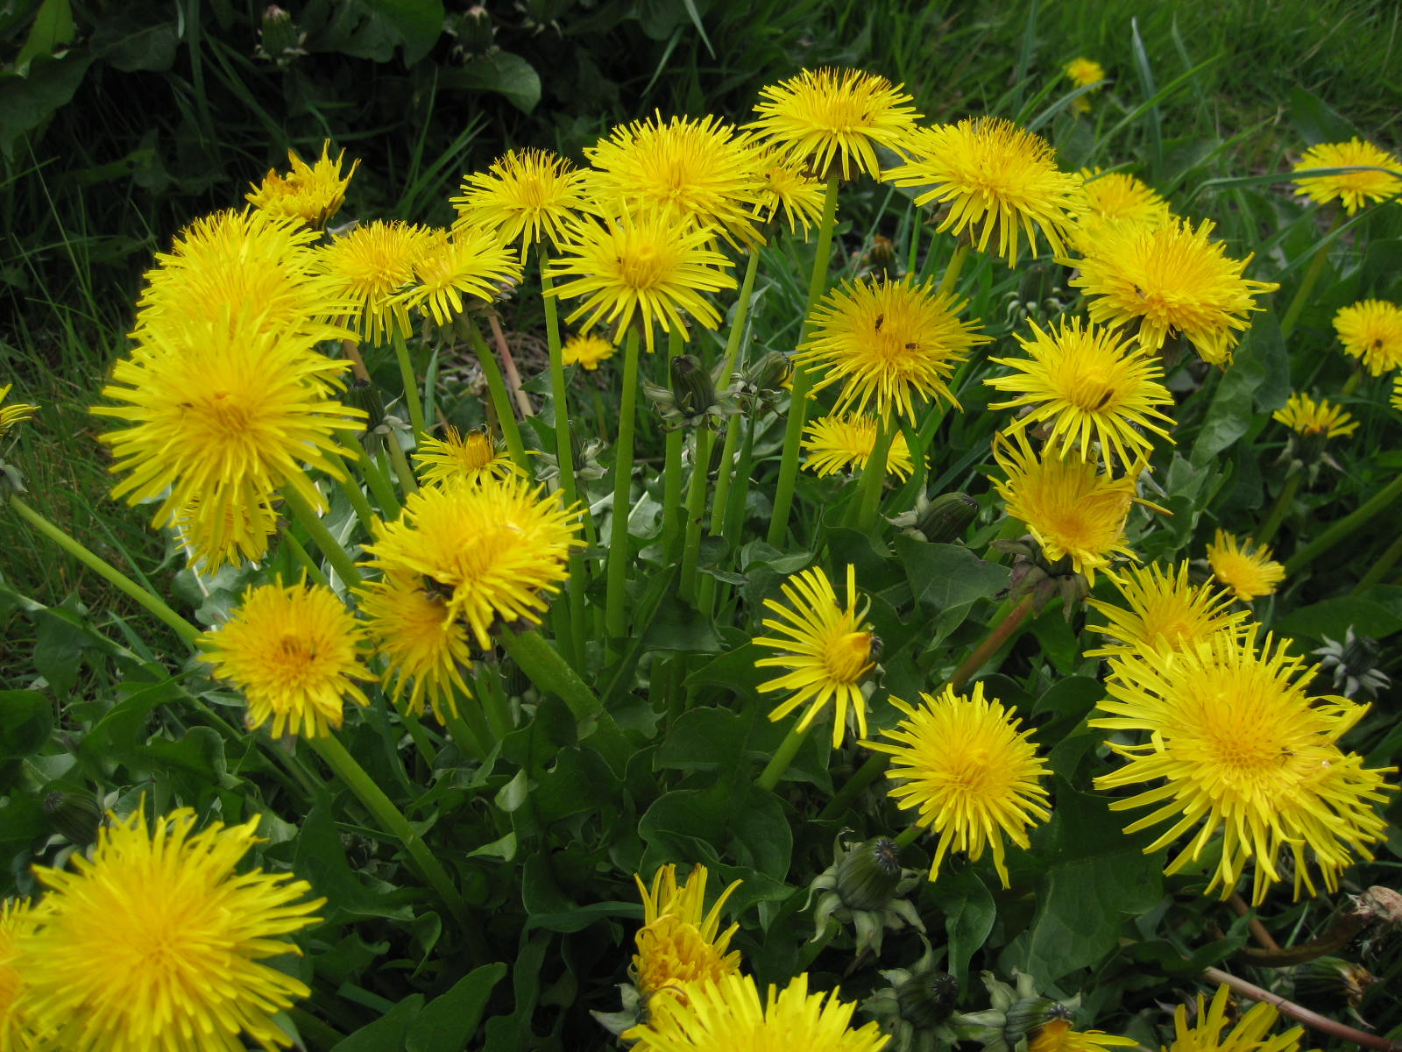
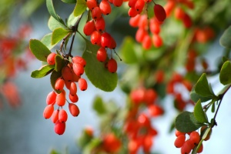
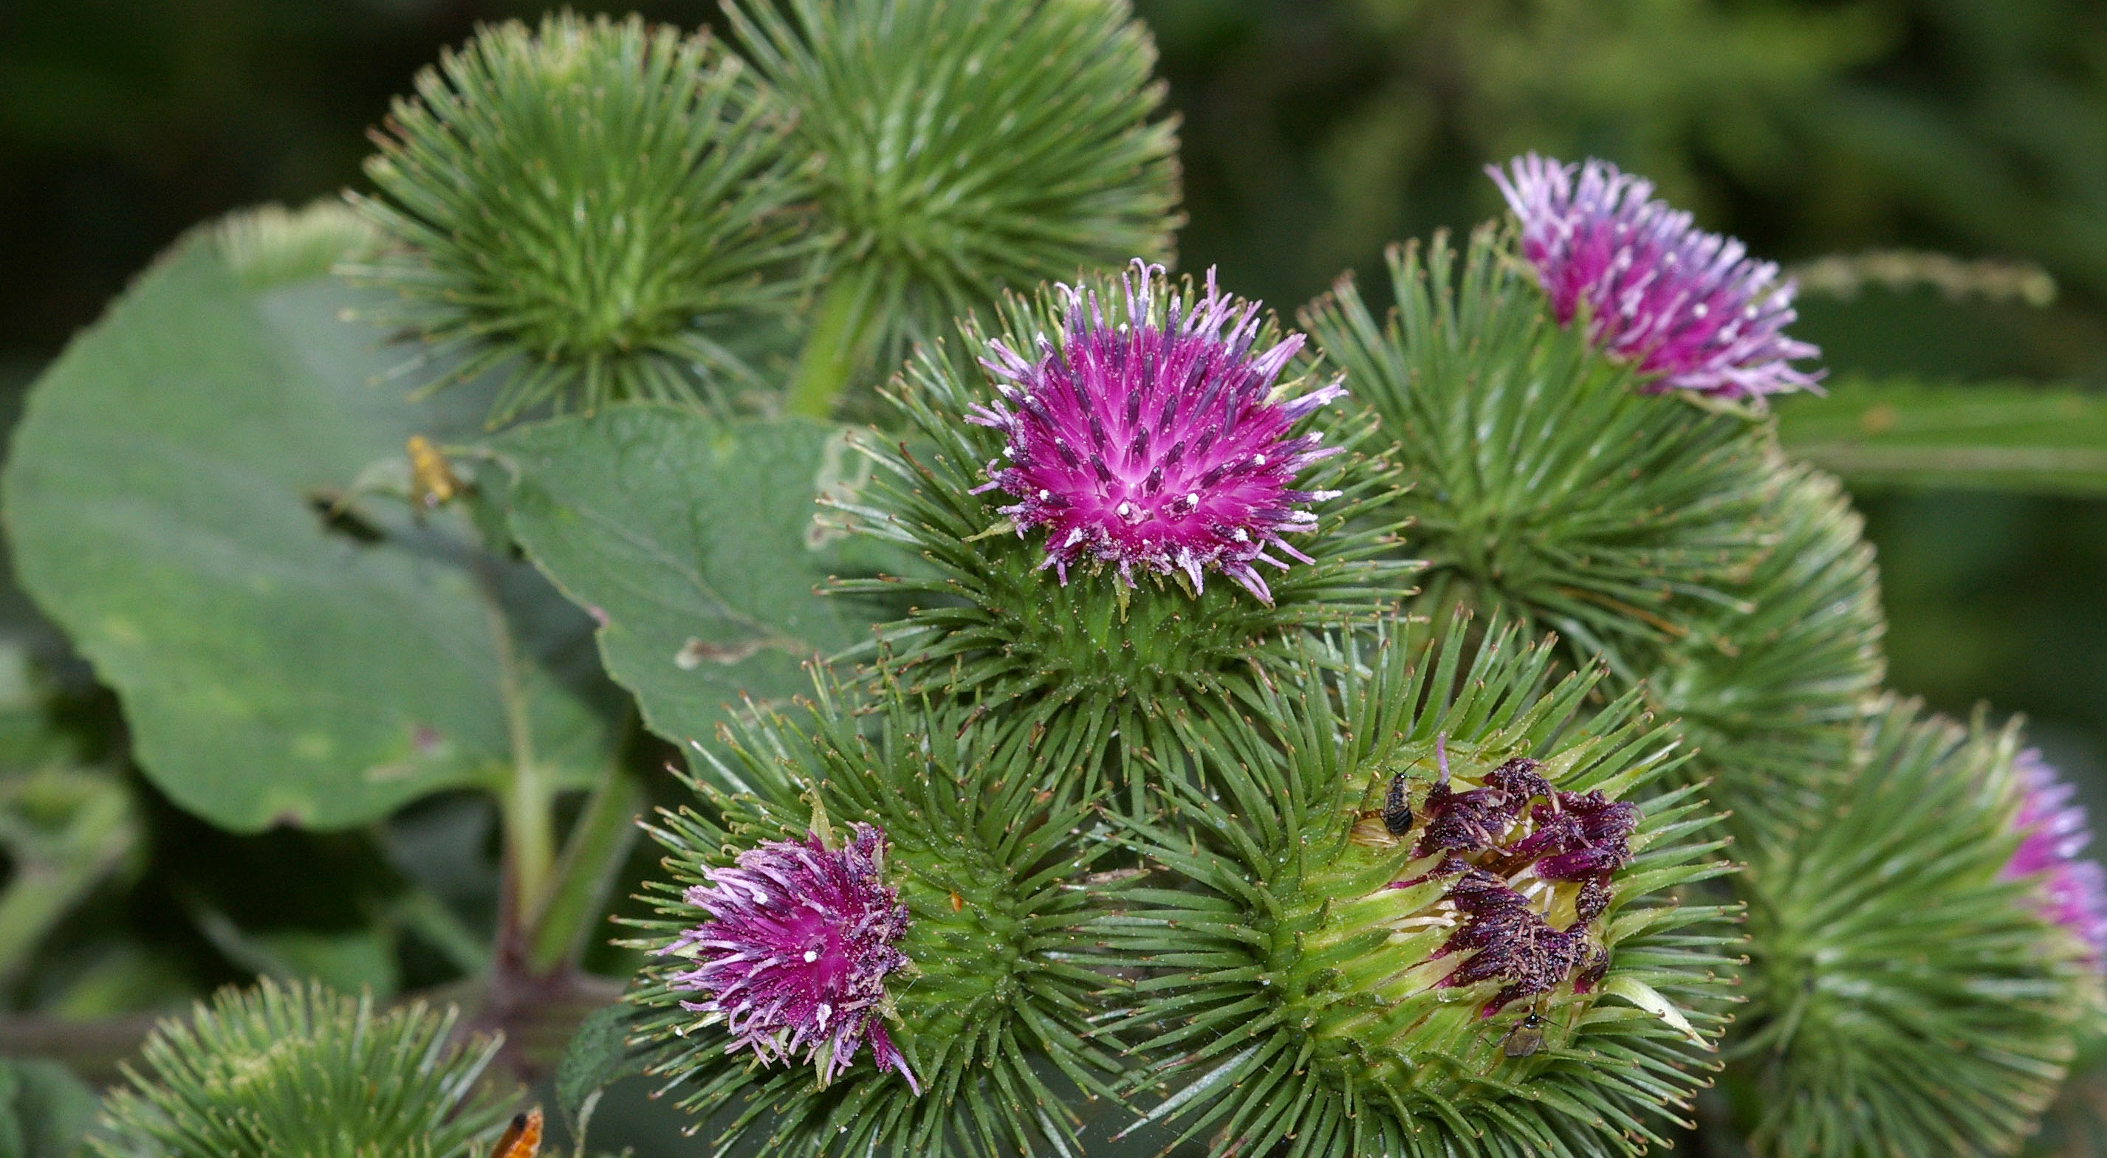
Extracts from Common Plants Can Treat Glyphosate Poisoning*
Roundup is toxic to hepatic (肝) and embryonic cells (胚胎幹細胞) at doses far below those used in agriculture and at residue levels present in some GM food.
Extracts from common plants such as dandelions, barberry, and burdock can protect from damage, especially if administered prior to exposure.
*C Gasnier et al. Journal of Occupational Medicine and Toxicology 2011, 6:3

Slide 60
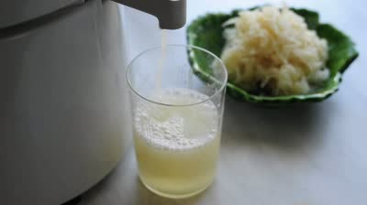
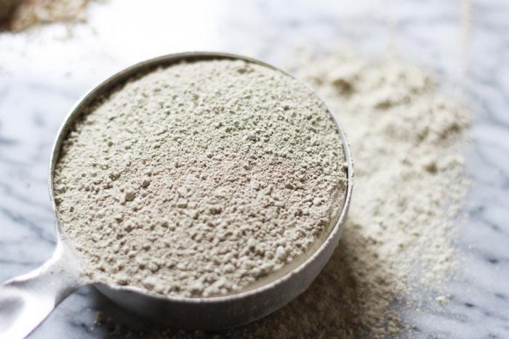
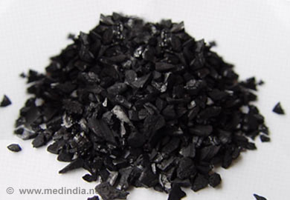

Treating Glyphosate Poisoning in Animals (e.g., cows) *
Activated charcoal (活性炭), bentonite clay (粘土), humic and fulvic acids, and sauerkraut juice (酸菜) have been shown to be effective in reducing urinary levels of glyphosate and improving animal health
Sauerkraut
Juice
Fulvic Acid
Activated Charcoal
Bentonite Clay
*H Gerlach et al., J Environ Anal Toxicol 2014, 5:2
Notes:
Glyphosate/Monika_cows_humic_acid_fulvic_acid_treat_glyphosate.pdf
Activated charcoal
活性炭
clay
粘土
Niántǔ
Huóxìngtàn

Slide 61

:Organic Food is the Solution!

Slide 62
Summary
Contrary to Monsanto’s claims, glyphosate is toxic to humans
Mechanism involves disrupted gut microbes, chelation of metals, inhibition of CYP enzymes in the liver, damage to red blood cells, etc.
Glyphosate is likely the main cause of the autism epidemic in America and the rising health care costs
Glyphosate is also causing harm to many animal species on land and in the sea
Best advice I can give is to eat only organic food

