Slide 1
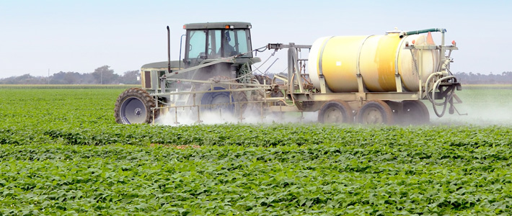
Glyphosate Pretending to be Glycine: Devastating Consequences
Stephanie Seneff, MIT CSAIL
AutismOne 2016
Notes:
Brendan Penwarden Australia

Slide 2
In a time of universal deceit,
telling the truth is a revolutionary act.
— George Orwell

Slide 3
Outline
Review
Glyphosate Insertion Into Peptides
Neurological Diseases
Neural Tube Defects
Diabetes, Obesity and Adrenal Insufficiency
Impaired Blood Flow
Kidney Disease
Liver Disease
Hyperkeratosis
How to Safeguard Yourself and Your Family

Slide 4
Review

Slide 5
1 in 68

Slide 6
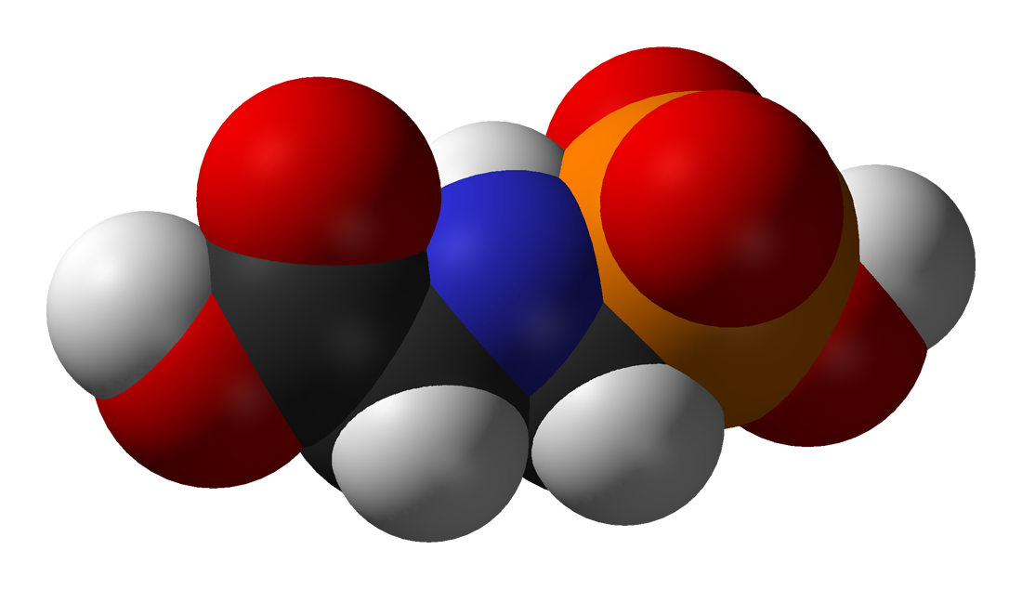
GLYPHOSATE

Slide 7
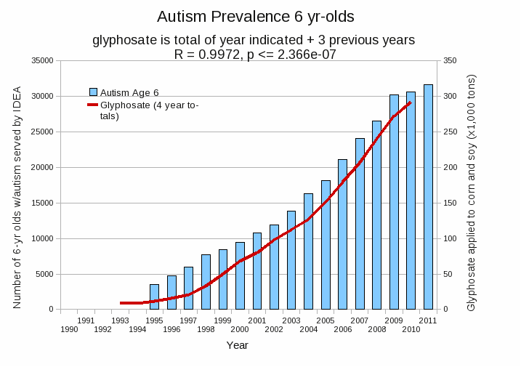
Autism Prevalence: 6 year olds*
R = 0.9972
* Figure 15, Seneff et al., Agricultural Sciences, 2015, 6, 42-70
Notes:
Nancy/latest_plots/6-yr-old autism.gif
autism: USDE
oil consumption: USDA
glyphosate: USDA
GE crops: USDA
Mortality data: CDC

Slide 8
Is Glyphosate Toxic?
Monsanto has argued that glyphosate is harmless to humans because our cells don’t have the shikimate pathway, which it inhibits
However, our gut bacteria DO have this pathway
We depend upon them to supply us with essential amino acids (among many other things)
Other ingredients in Roundup greatly increase glyphosate’s toxic effects and are themselves toxic
Insidious effects of glyphosate accumulate over time
Most studies are too short to detect damage

Slide 9
Main Toxic Effects of Glyphosate*
Interferes with function of cytochrome P450 (CYP) enzymes
Chelates important minerals (iron, cobalt, manganese, etc.)
Interferes with synthesis of aromatic amino acids and methionine
Leads to shortages in critical neurotransmitters and folate
Disrupts sulfate synthesis and sulfate transport
*Samsel and Seneff, Entropy 2013, 15, 1416-1463

Slide 10
Glyphosate and Autism: Some Biological Mechanisms
Disruption of gut microbes¹
Children with autism suffer from many digestive issues
Disruption of sulfur metabolism, glutathione deficiency, impaired methylation pathways¹
Metal chelation (especially manganese)²
Manganese deficiency leads to impaired mitochondrial function and glutamate toxicity in the brain
Inhibition of pituitary release of thyroid stimulating hormone → hypothyroidism³
Moms with hypothyroidism have 4-fold increased risk to autism in the fetus
1. Samsel and Seneff, Entropy 2013;15(4):1416-1463.
2. Samsel and Seneff, Surg Neurol Int. 2015;6:45.
3. Beecham and Seneff, Journal of Autism 2016;3:1.

Slide 11
“Glyphosate Now the Most-Used Agricultural Chemical Ever”* By Douglas Main, Feb 2, 2016 Newsweek
Glyphosate usage has increased 50-fold since 1996, when GMO glyphosate-resistant crops were introduced in the US.
Today, 50 times more glyphosate is allowed by the EPA on corn grain than in 1996
Half of the American farmers' fields have weeds that are resistant to glyphosate
New GMO crops offer dual resistance to glyphosate & 2,4-D → Enlist Duo
*www.newsweek.com/glyphosate-now-most-used-agricultural-chemical-ever-422419
Notes:
./Newsweek_on_glyphosate_overuse.text

Slide 12
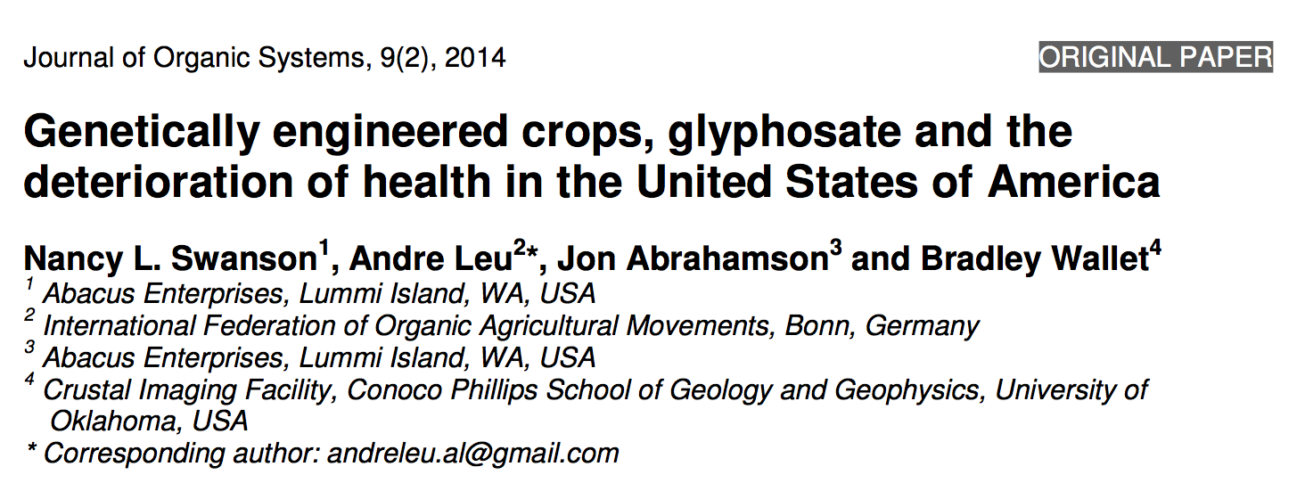
Paper Showing Strong Correlations between Glyphosate Usage and Chronic Disease

Slide 13
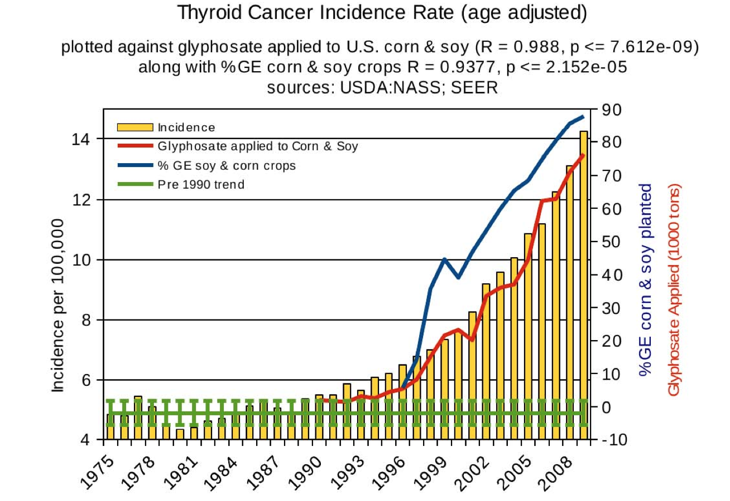
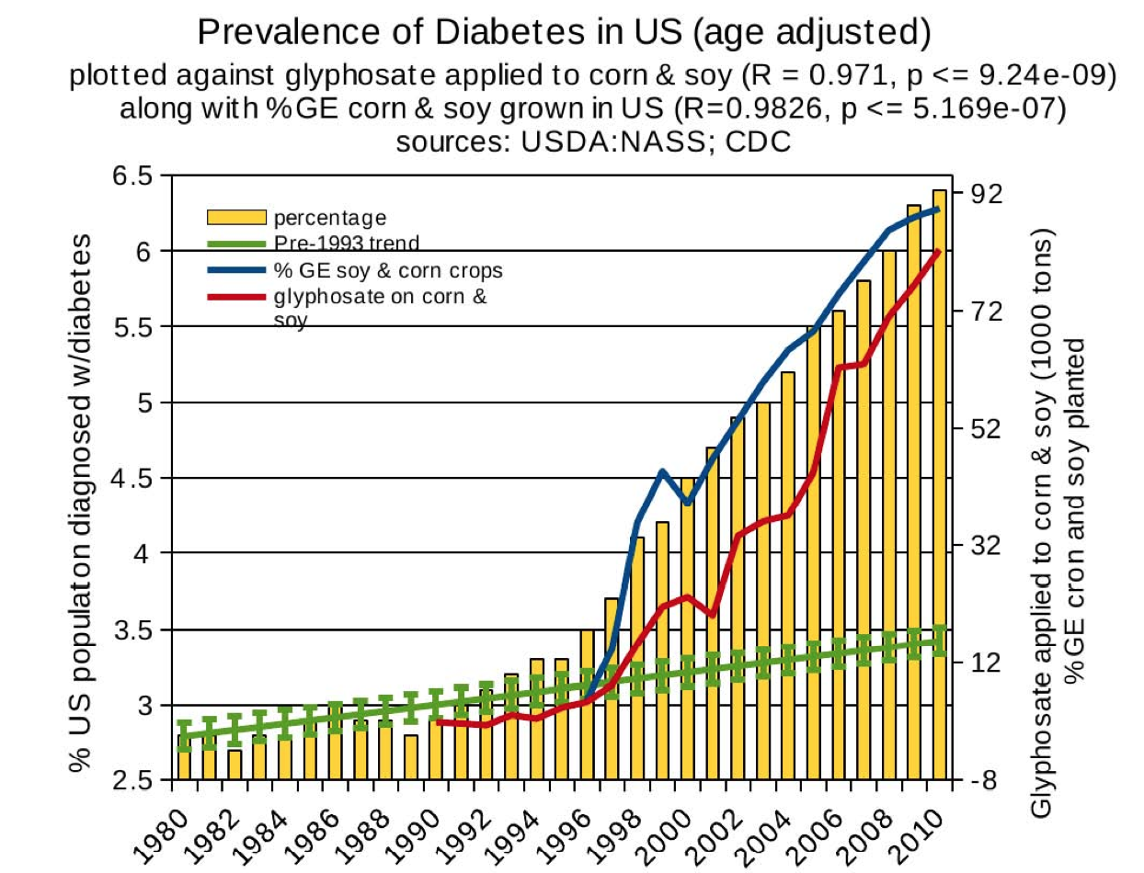
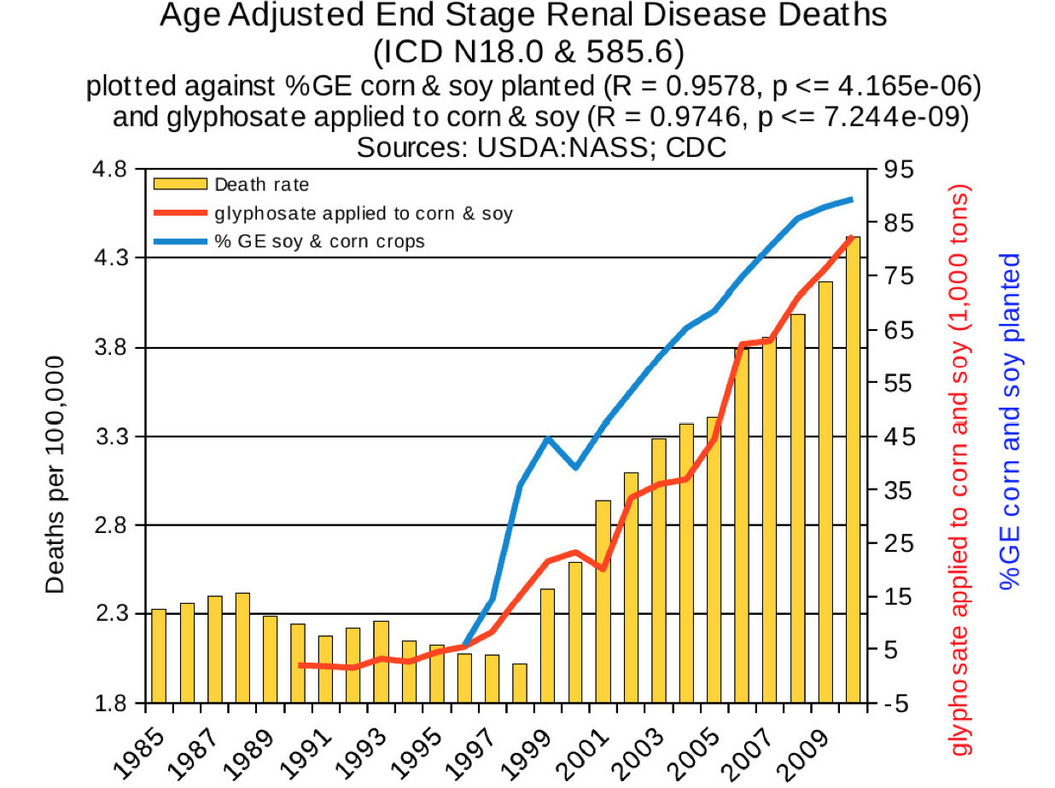
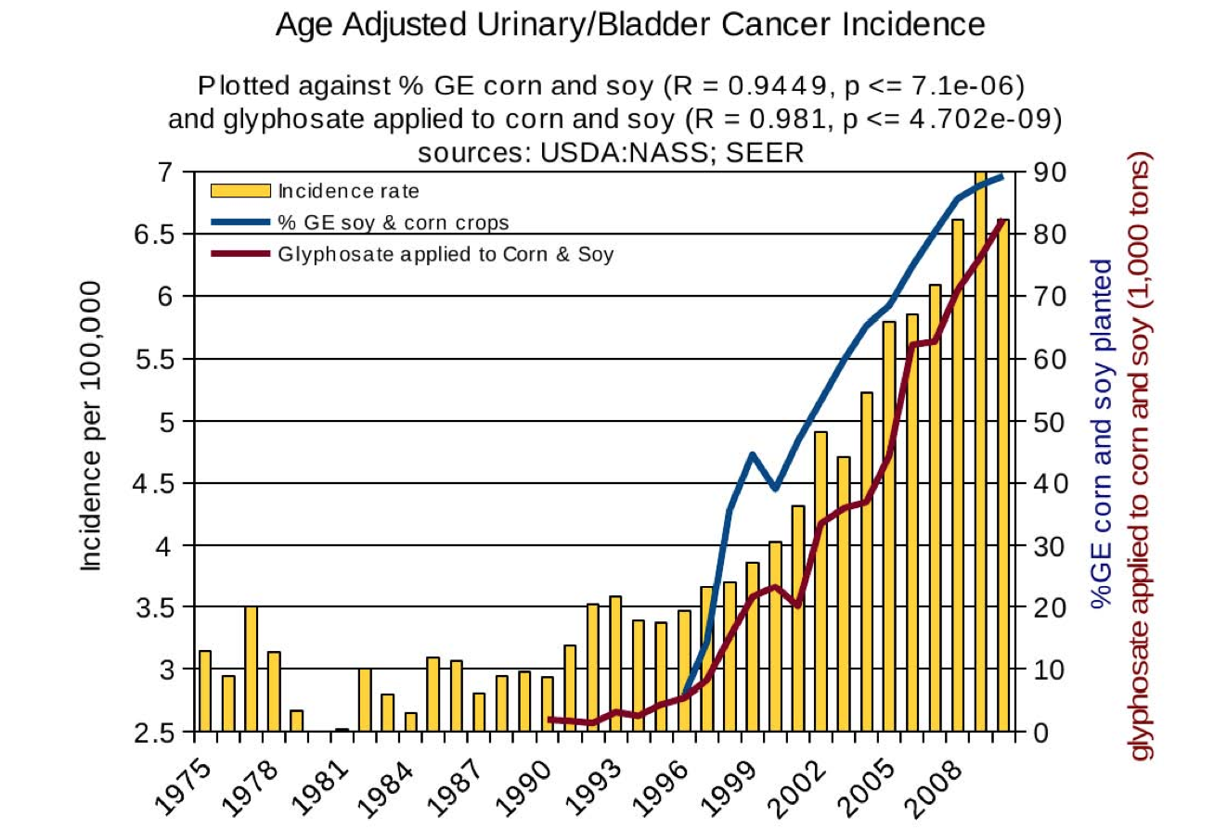
Thyroid cancer
Diabetes
End stage
renal disease
Urinary/bladder
cancer

Slide 14
Glyphosate insertion
into peptides

Slide 15
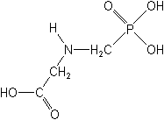
What If Glyphosate Could Insert Itself Into Protein Synthesis???
glyphosate
Code for glycine
GGC
mRNA
. . .
. . .
Glyphosate
Alanine
Proline
Any proteins with conserved glycine residues are likely to be affected in a major way

Slide 16
Extra Piece Sticks Out at Active Site
Substrate no longer fits in active site
Active Site
Extra Stuff
Glyphosate
Alanine
Proline
glycine
Peptide chain

Slide 17
Some Predicted Consequences
Neurological diseases
Neural tube defects
Celiac disease
Impaired collagen → osteoarthritis
Steatohepatitis (fatty liver disease)
Obesity and adrenal insufficiency
Impaired iron homeostasis and kidney failure
Insulin resistance and diabetes
Impaired sulfate synthesis & transport
Cancer

Slide 18
Circumstantial Evidence from the Rhizosphere*
Used RNA sequence analysis to quantify changes in microbial protein expression in presence of glyphosate
Found significant increase in production of enzymes related to protein synthesis and protein breakdown
Rhizosphere
* MM Newman et al., Science of the Total Environment 553 (2016) 32–41
Notes:
Glyphosate/Changes\ in\ microbial\ pops\ due\ to\ glyphosate\ -\ Mollie\ 2016.pdf

Slide 19
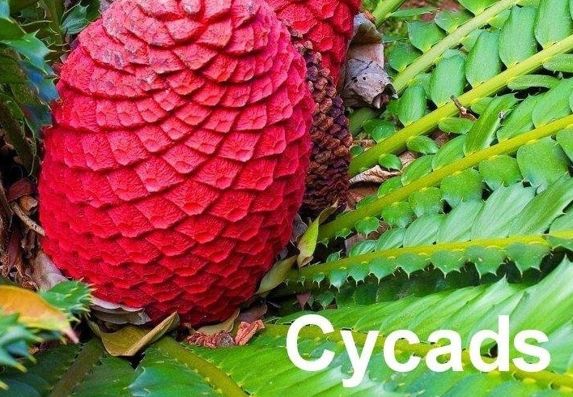
An Analogy: ALS in Guam
An epidemic in ALS in Guam was traced to a natural toxin found in cycads
BMAA is a non-coding amino acid that gets inserted by mistake in place of serine
Defective versions of a glutamate transporter have been linked to ALS*
The transporter has an essential serine-rich region in its sequence**
*Antioxidants & Redox Signaling 2009;11: 1587-1602.
**DJ Slotboom et al., PNAS 1999; 96(25): 14282-14287.
Notes:
cyanobacteria_BMAA_article.pdf
Slotbloom_1999_conserved_serine_glutamate_transporter.pdf
Dunlop.pdf
ALS_glutamate_transporter_link_2009.pdf
Guam/
*ALS_glutamate_transporter_link_2009.pdf
ChrisShawChapter7GuamFantastic.docx
Dunlop.pdf
**Slotbloom_1999_conserved_serine_glutamate_transporter.pdf

Slide 20
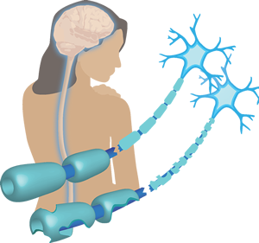
Another Analogy: Multiple Sclerosis & Sugar Beets*
Sugar beets contain an analogue of proline called Aze
Remarkable correlation between MS frequency and proximity to sugar beet agriculture
Myelin basic protein contains a cluster of proline residues that are absolutely essential for its proper function
*E. Rubenstein, J Neuropathol Exp Neurol 2008;67(11): 1035-1040.
Notes:
./misincorporation_of_proline_analogue_MS.pdf

Slide 21
Vulnerable Proteins: Resulting Pathologies
Conserved Glycines | Disease Profile
Hormone-sensitive Lipase | Obesity
Insulin Receptor | Diabetes
Amyloid Beta Plaque | Alzheimer’s Disease
OGG1 | DNA Damage → Cancer
Lipocalin | Kidney Failure
ACTH | Adrenal Insufficiency
Cytochrome C Oxidase | Mitochondrial Disease
Alpha Synuclein | Parkinson’s Disease
TDP-43 | ALS

Slide 22
Vulnerable Proteins: Resulting Pathologies
Conserved Glycines | Disease Profile
Hormone-sensitive Lipase | Obesity
Insulin Receptor | Diabetes
Amyloid Beta Plaque | Alzheimer’s Disease
OGG1 | DNA Damage → Cancer
Lipocalin | Kidney Failure
ACTH | Adrenal Insufficiency
Cytochrome C Oxidase | Mitochondrial Disease
Alpha Synuclein | Parkinson’s Disease
TDP-43 | ALS
Glyphosate insertion by mistake in place of glycine during protein synthesis can easily explain the alarming correlations between glyphosate usage on core crops and a long list of debilitating chronic diseases

Slide 23
Neurological Diseases

Slide 24
Glyphosate in Vaccines?
For MMR, flu vaccine, and rabies vaccine, live virus is grown on gelatin derived from ligaments of cows
Cows are fed GMO Roundup-Ready corn and soy feed
Gelatin contains significant amounts of both glycine and glutamate
These two neurotransmitters excite the NMDA receptors in the brain
Glyphosate substitution in the protein for glycine is a possibility!
Glyphosate stimulation of NMDA receptors could cause neuronal burnout

Slide 25
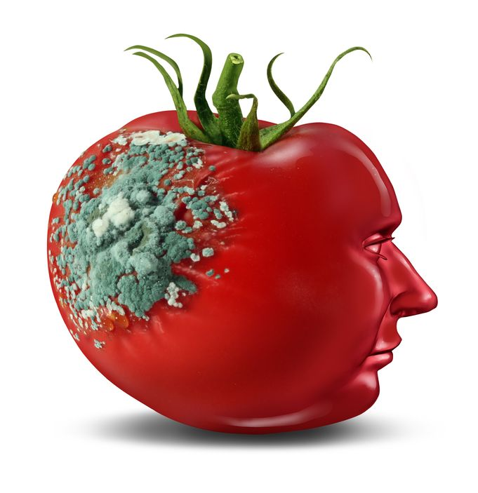
Glyphosate and Glutamate*
Acute exposure activates NMDA receptors and voltage-dependent calcium channels
Oxidative stress and neural cell death
Increased glutamate release into the synaptic cleft → excessive extracellular glutamate levels
Decreased glutathione content
Increased peroxidation of lipids (fats)
*http://www.greenmedinfo.com/blog/roundup-weedkiller-brain-damaging-neurotoxin
Notes:
http://www.greenmedinfo.com/blog/roundup-weedkiller-brain-damaging-neurotoxin
acute exposure (30 minutes) and chronic (pregnancy and lactation) exposure.
Why was this referenced??
T. Bohn et al. Food Chemistry 153, 15 June 2014, 207-215.

Slide 26
Neurological Diseases
At least four neurological diseases related to misfolded proteins involve conserved glycine residues
Disease | Protein | Reference
Alzheimer’s | Amyloid beta | Munter et al.
Parkinson’s disease | Alpha synuclein | Du et al.
ALS | TDP-43 | Pesiridis et al.
Prion diseases | Prion proteins | Harrison et al.
L-M Munter et al. The EMBO Journal 2007; 26: 1702-1712.
H-N Du et al., Biochemistry 2003; 42: 8870-8878.
S Pesiridis et al., Hum Mol Genet 2009; 18(R2): R156-R162.
CF Harrison et al., J Biol Chem 2010; 285(26): 20213-20223.
Notes:
Munter:
Anthony/GxxxG_motif_Abeta_2007.pdf
glycine_alpha_synuclein.pdf
Pesiridis_2009_ALS_glycine_conserved_region_TDP_43.pdf
transactive response DNA binding protein
TAR DNA binding protein

Slide 27
Neurological Diseases
At least four neurological diseases related to misfolded proteins involve conserved glycine residues
Disease | Protein | Reference
Alzheimer’s | Amyloid beta | Munter et al.
Parkinson’s disease | Alpha synuclein | Du et al.
ALS | TDP-43 | Pesiridis et al.
Prion diseases | Prion proteins | Harrison et al.
In all cases, the issue is a RARE SOLUBLE peptide rather than the precipitated plaque.
Glyphosate increases the protein’s solubility
L-M Munter et al. The EMBO Journal 2007; 26: 1702-1712.
H-N Du et al., Biochemistry 2003; 42: 8870-8878.
S Pesiridis et al., Hum Mol Genet 2009; 18(R2): R156-R162.
CF Harrison et al., J Biol Chem 2010; 285(26): 20213-20223.
Notes:
Munter:
Anthony/GxxxG_motif_Abeta_2007.pdf
glycine_alpha_synuclein.pdf
Pesiridis_2009_ALS_glycine_conserved_region_TDP_43.pdf
transactive response DNA binding protein
TAR DNA binding protein

Slide 28
Deaths from Senile Dementia*
*Plot provided by Dr. Nancy Swanson

Slide 29
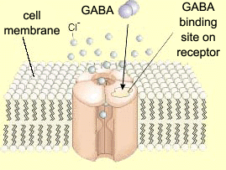
Impaired GABA Receptor Activity and Autism
Autism has been linked to a weakened response of the inhibitory GABA receptor to stimuli*
The GABA receptor has a conserved glycine at the entrance to the first membrane-spanning domain that is essential for its function**
*CD Robertson et al., Current Biology 2016;26: 80-85
**BX Carlson et al., Mol Pharmacol. 2000;57(3):474-84
Notes:
2016/Anthony/
reduced_GABAergic_activity_autism_brain.pdf
ABA_conserved_glycine_2000.pdf

Slide 30
Neural Tube Defects

Slide 31
Glyphosate and Anencephaly*
Yakima, Benton and Franklin counties in Washington State have an unusually high number of pregnancies affected by the birth defect, anencephaly
75 pesticides were analyzed in studying contamination due to surrounding agriculture
47 (63%) of these were detected
Glyphosate was applied in large amounts, but was not studied
5% solution of glyphosate was also used heavily around irrigation ditches to control weeds
Main herbicide recommended due to its “low toxicity”
Glyphosate has been linked to anencephaly due to its effect on retinoic acid
*Barbara H. Peterson. Farm Wars, http://farmwars.info/?p=11137

Slide 32
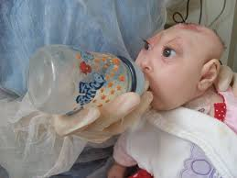
“Glyphosate, Brain Damaged Babies, and
Yakima Valley - A River Runs Through It”*
8
6
4
2
0
Noxious aquatic weed
control program with
Glyphosate ‘Rodeo’
1980 1990 2000 2010 2020
“Glyphosate, Three Rivers, and Anencephaly”
Yakima Harold Republic
Slide thanks to Prof. Don Huber, with permission
*Farm Wars 3/6/14
Notes:
From Don Huber:
Attached/LondonGlyphosate/
2014-0618_Huber_short.ppt

Slide 33
How might glyphosate cause anencephaly?
Neural tube defects linked to folate deficiency
Impaired methylation pathway
Folate production by gut microbes depends on the shikimate pathway (blocked by glyphosate)
Gut microbes that synthesize folate are especially sensitive to glyphosate
Glyphosate interferes with retinoic acid metabolism → toxic accumulation
Disruption of glycine cleavage system
Source of methyl groups

Slide 34
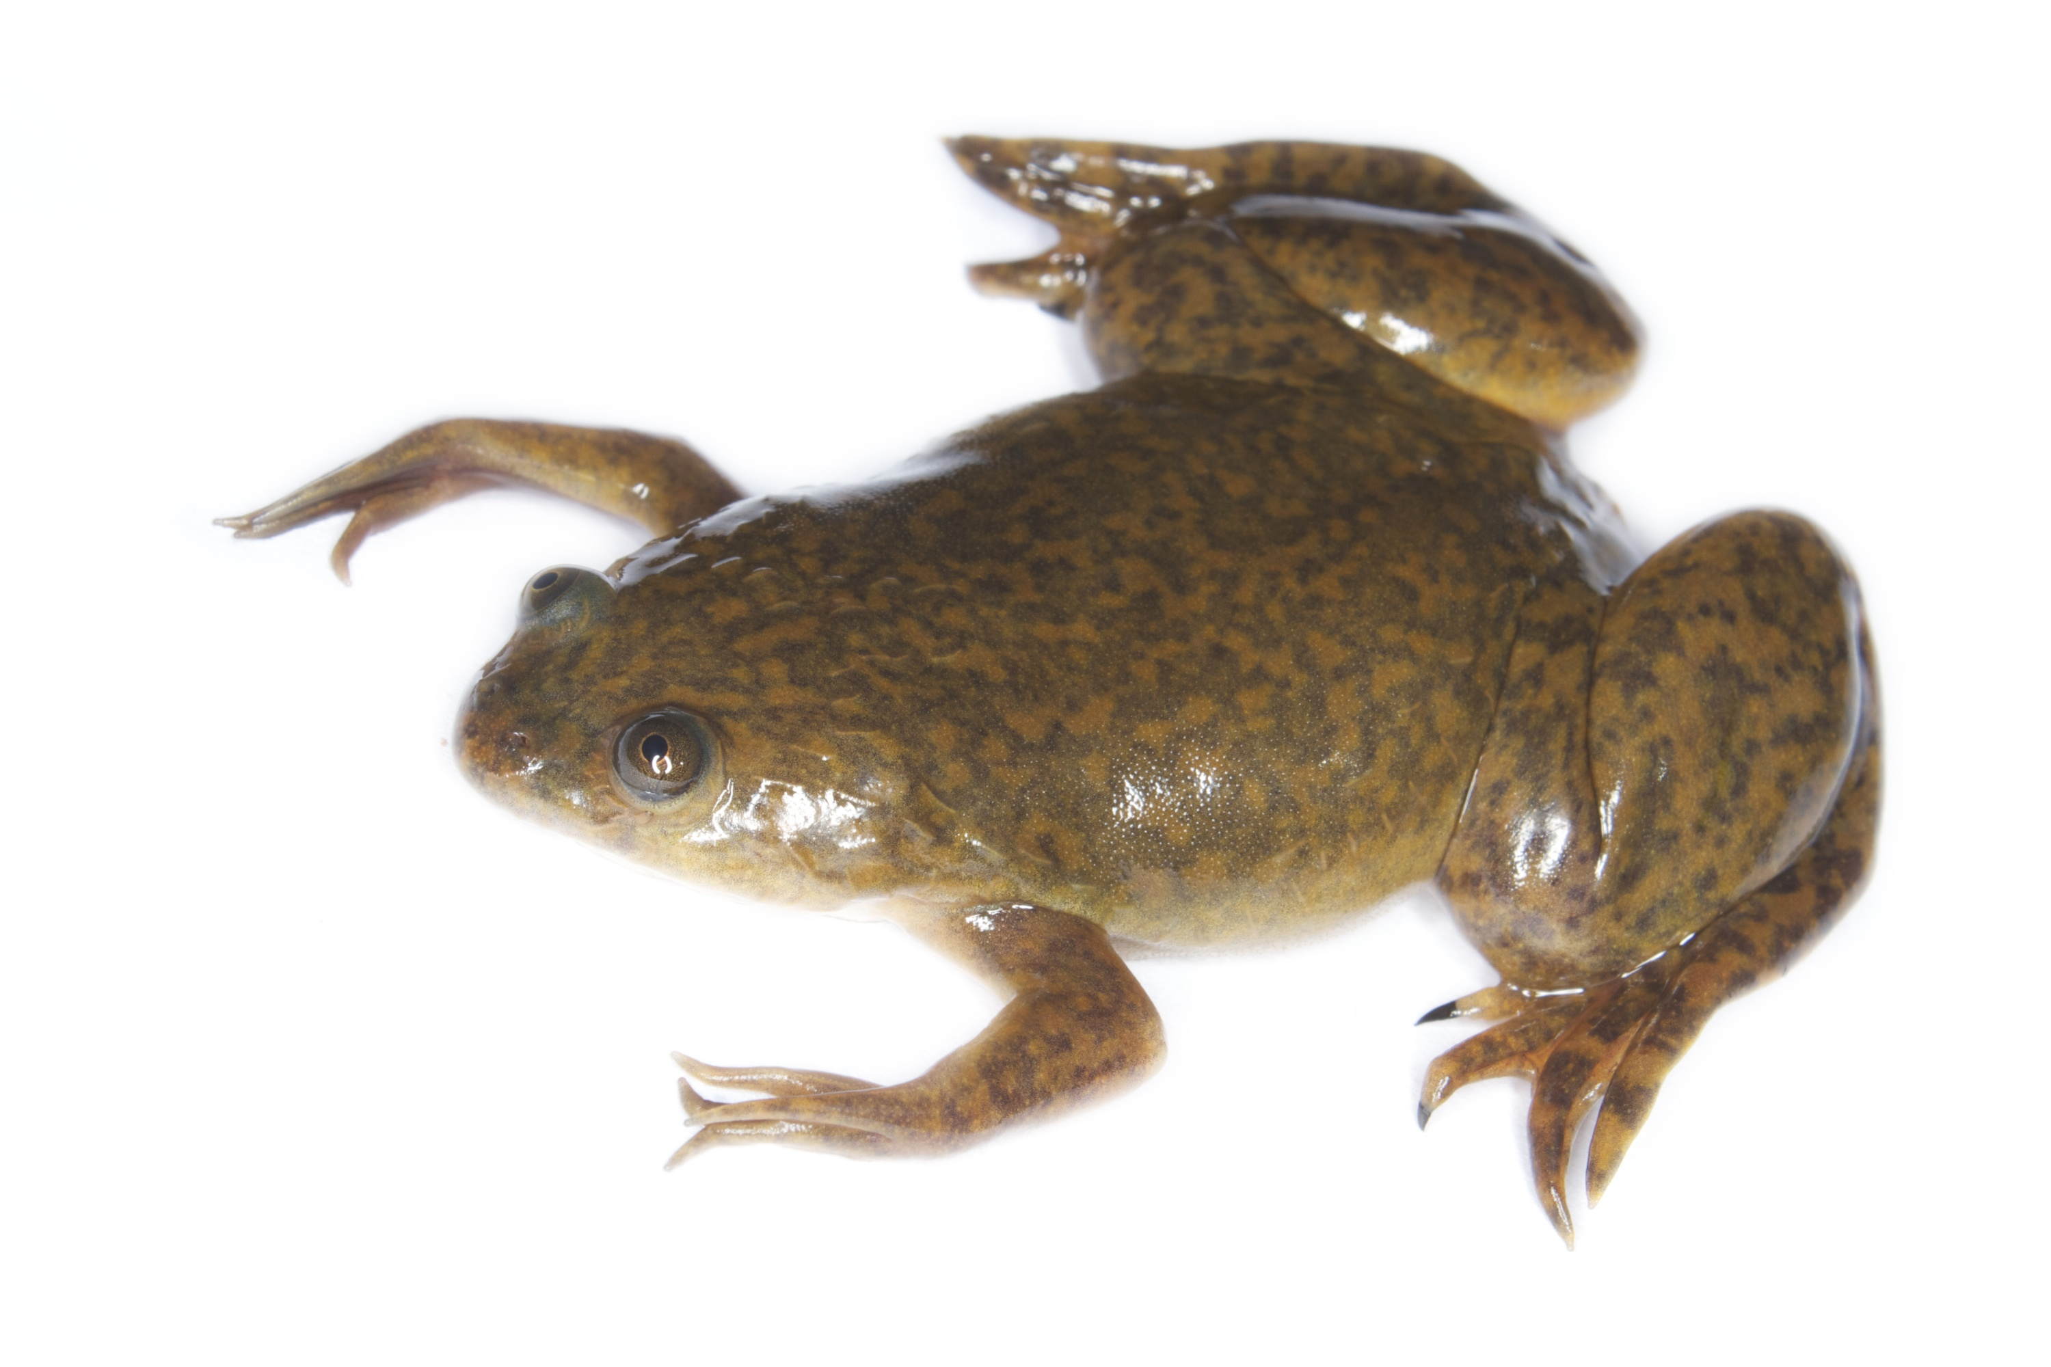
Glyphosate Upregulates Retinoic Acid*
CYP Enzyme Repression
Small Brain
*A. Carrasco, Teratogenesis by glyphosate based herbicides and other pesticides. Relationship with the retinoic acid pathway. In Breckling, B. & Verhoeven, R. (2013) GM-Crop Cultivation – Ecological Effects on a Landscape Scale. Theorie in der Ökologie 17. Frankfurt, Peter Lang.

Slide 35
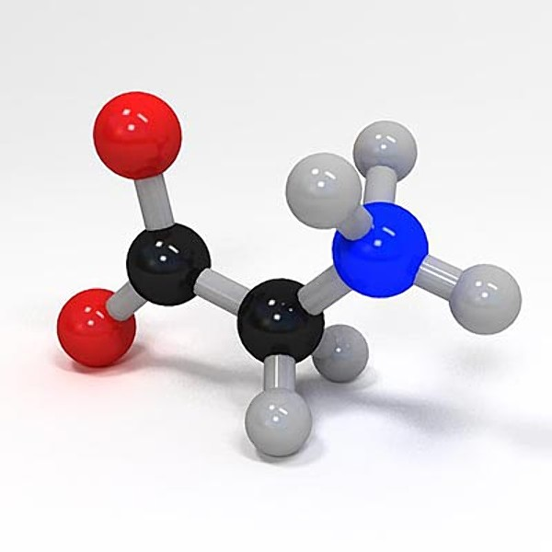
Glycine, Methyl-folate and One-carbon Metabolism
Glycine is a key source of methyl groups for the one-carbon cycle via the glycine cleavage system
A glycine-rich region maintains shape and flexibility of glycine decarboxylase, a key enzyme in the glycine cleavage system*
Methyl group
Methyl Folate
*A Kume et al., JBC 1991; 266(5): 3323-3329.

Slide 36
Diabetes, Obesity
and Adrenal Insufficiency

Slide 37
Regulating Fat Release
Fats released from fat cells
Hormone sensitive lipase

Slide 38
Impaired Fatty Acid Release from Fat Cells
Hormone sensitive lipases (aka triacylglycerol lipases)
Release fatty acids from fat cells
Supply cholesterol to adrenal glands and sex glands for hormone synthesis
Respond to glucagon, adrenalin, dopamine, and ACTH
Depend on multiple conserved glycines*:
Contain HGGG motif as “oxyanion hole”
Member of the class of “serine proteases” that contain a GXSXG motif essential for enzyme activity
*RC Wilmouth et al. Nat. Struct. Biol 2001;8: 689-694.

Slide 39
Impaired Fatty Acid Release from Fat Cells
Hormone sensitive lipases (aka triacylglycerol lipases)
Release fatty acids from fat cells
Supply cholesterol to adrenal glands and sex glands for hormone synthesis
Respond to glucagon, adrenalin, dopamine, and ACTH
Depend on multiple conserved glycines*:
Contain HGGG motif as “oxyanion hole”
Member of the class of “serine proteases” that contain a GXSXG motif essential for enzyme activity
Impaired hormone sensitive lipases have been linked to obesity, atherosclerosis and type II diabetes**
**SJ Yeaman, Biochem. J. (2004) 379, 11-22.
*RC Wilmouth et al. Nat. Struct. Biol 2001;8: 689-694.

Slide 40
Glyphosate Usage & Death due to Obesity*
*N Swanson et al.,J ournal of Organic Systems, 9(2), 2014

Slide 41
Adrenal Insufficiency
Roundup has been shown to severely impair adrenal hormone synthesis*
*A Pandey and M Rudraiah, Toxicology Reports 2 (2015) 1075-1085.

Slide 42
Insulin Receptor & Diabetes*,**
Glucagon release is regulated by insulin receptors (IRs)
When IRs are dysfunctional in mice, excess glucose is released from the liver, leading to elevated blood sugar and diabetes
Eight repeats of a glycine-centered motif determine IR 3-D structure
ATP-binding site contains a GXGXXG motif***
*PE Cryer, Endocrinology 2012;153(3):1039-1048.
**D Kawamori et al., Cell Metab 2009;9:350-361.
***DR Knighton et al., Proc Natl Acad Sci U S A. 1993;90(11):5001-5.
Notes:
%./insulin_signaling_alpha_cells_glucagon_secretion_2009.pdf

Slide 43
Diabetes and Glyphosate*
*Figure 14, Swanson et al. Journal of Organic Systems 2014; 9(2):6-37.

Slide 44
Celiac Disease and Prolyl Aminopeptidase
Gluten intolerance and Celiac disease result from inability to break down gluten, which is enriched in proline*
Prolyl aminopeptidase, the enzyme that breaks down proline-containing peptides, depends on manganese as a catalyst
Prolyl aminopeptidase also contains a highly conserved GxSxGG motif plus two other regions with conserved glycines**
Malabsorption due to celiac disease can lead to nutritional deficiencies and symptoms of autism***
*G. Janssen et al., PLoS One 2015; 10(6): e0128065
**F Morel et al., Biochimica et Biophysica Acta 1999;1429: 501-505
***SJ Genuis and TP Bouchard, J Child Neurol. 2010;25(1):114-9
Notes:
Plos One:
Ineffective Degradation of Immunogenic Gluten Epitopes by Currently Available Digestive Enzyme Supplements
Glyphosate/ineffective_proteolysis_of_proline_in_gluten_digestive_enzymes.pdf

Slide 45
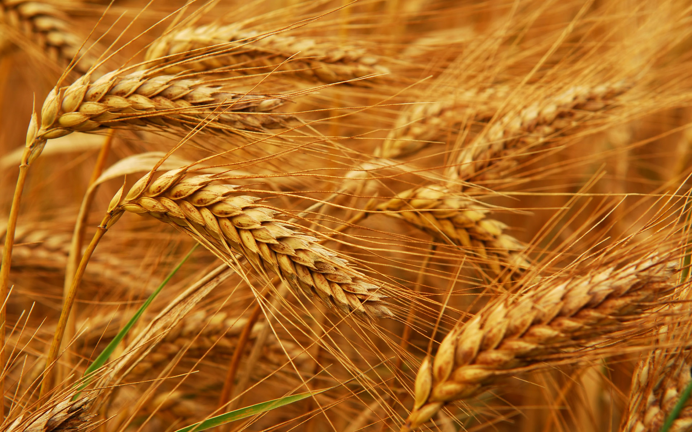
Glyphosate and Celiac Disease*
Glyphosate
Use on wheat
Celiac disease
*Samsel and Seneff, Interdiscip Toxicol. 2013;6(4): 159–184.

Slide 46
Impaired Blood Flow

Slide 47
Endothelial Nitric Oxide Synthase (eNOS)
eNOS produces nitric oxide which relaxes blood vessels and promotes blood flow
We hypothesize that eNOS produces sulfate when it is membrane-bound as a dimer, with sunlight as a catalyst*
eNOS depends on conserved glycines both for dimer formation and for binding to the membrane
Replacement of the glycines with larger molecules disrupts both dimer formation and membrane attachment: impairing eNOS function
This explains the “pathology” of superoxide release
*Seneff et al., Entropy 2012, 14, 2492-2530

Slide 48
Endothelial Nitric Oxide Synthase (eNOS)
eNOS produces nitric oxide which relaxes blood vessels and promotes blood flow
We hypothesize that eNOS produces sulfate when it is membrane-bound as a dimer, with sunlight as a catalyst*
eNOS depends on conserved glycines both for dimer formation and for binding to the membrane
Replacement of the glycines with larger molecules disrupts both dimer formation and membrane attachment: impairing eNOS function
This explains the “pathology” of superoxide release
Impaired eNOS function leads to oxidative damage in the artery wall, as well as deficient supply of both nitric oxide and sulfate to the vasculature
*Seneff et al., Entropy 2012, 14, 2492-2530

Slide 49
Kidney Disease

Slide 50
Bacterial Siderophores & Kidney Disease
Alarming incidence of kidney failure among agricultural workers in sugar cane fields
Characterized by proximal tubular necrosis
Sugar cane sprayed with glyphosate preharvest
Defective iron uptake from bacterial siderophores in the proximal renal tubule can cause simultaneous iron deficiency and iron toxicity*
*K Mori et al. The Journal of Clinical Investigation 2005;115(3):610-621.

Slide 51
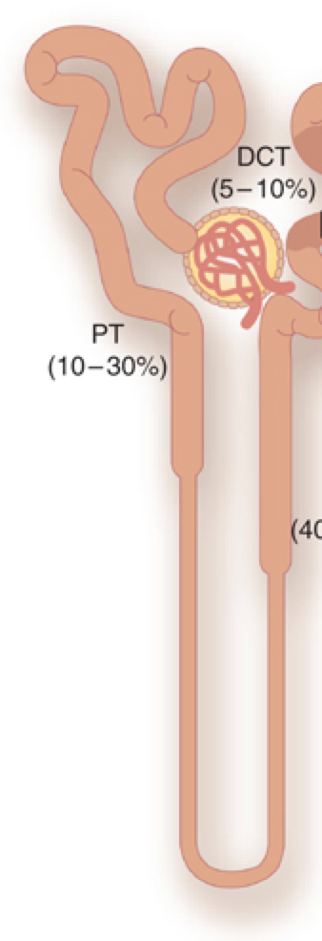
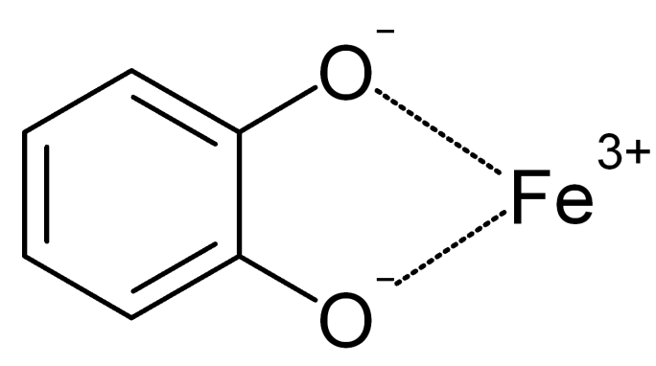
How Proximal Tubule Gets Iron*
Proximal Tubule
Protein that synthesizes siderophore in bacillus depends on two conserved glycines
Protein that uptakes siderophore in renal tubule contain a conserved GXW motif
Bacillus
siderophore
*K Mori et al. The Journal of Clinical Investigation 2005;115(3):610-621.
Notes:
W is tryptophan

Slide 52
From Samsel and Seneff: Glyphosate IV*
*A Samsel and S Seneff, Journal of Biological Physics and Chemistry 15 (2015) 121–159

Slide 53
Liver Disease

Slide 54
Liver Cancer & Glyphosate*
*N Swanson et al.,J ournal of Organic Systems, 9(2), 2014

Slide 55
Liver Cancer & Glyphosate*
Fatty liver disease is a strong risk factor
for liver cancer
*N Swanson et al.,J ournal of Organic Systems, 9(2), 2014

Slide 56
Steatohepatitis (Fatty Liver Disease)*
Mallory-Denk bodies (MDBs) are liver cell inclusions associated with steatohepatitis (fatty liver disease)
Keap1 has a conserved double glycine repeat that anchors it to the cytoskeleton
Mallory-Denk Bodies
keratin
*A Singla et al., Hepatology 2012 July ; 56(1): 322–331.
Notes:
./Nrf2_keratin_upregulation_2012.pdf

Slide 57
Hyperkeratosis

Slide 58
Beak Deformities in Chickadees*
Beak deformities involving excess keratin synthesis have been appearing among chickadees and other birds in the Great Lakes region, in central Alaska and in areas exposed to California agricultural run-off
No link could be found with investigated toxic chemicals and metals
Glyphosate was not investigated
*CM Handel and C van Hemert, Environ Toxicol Chem 34, 2015; 314-327.

Slide 59
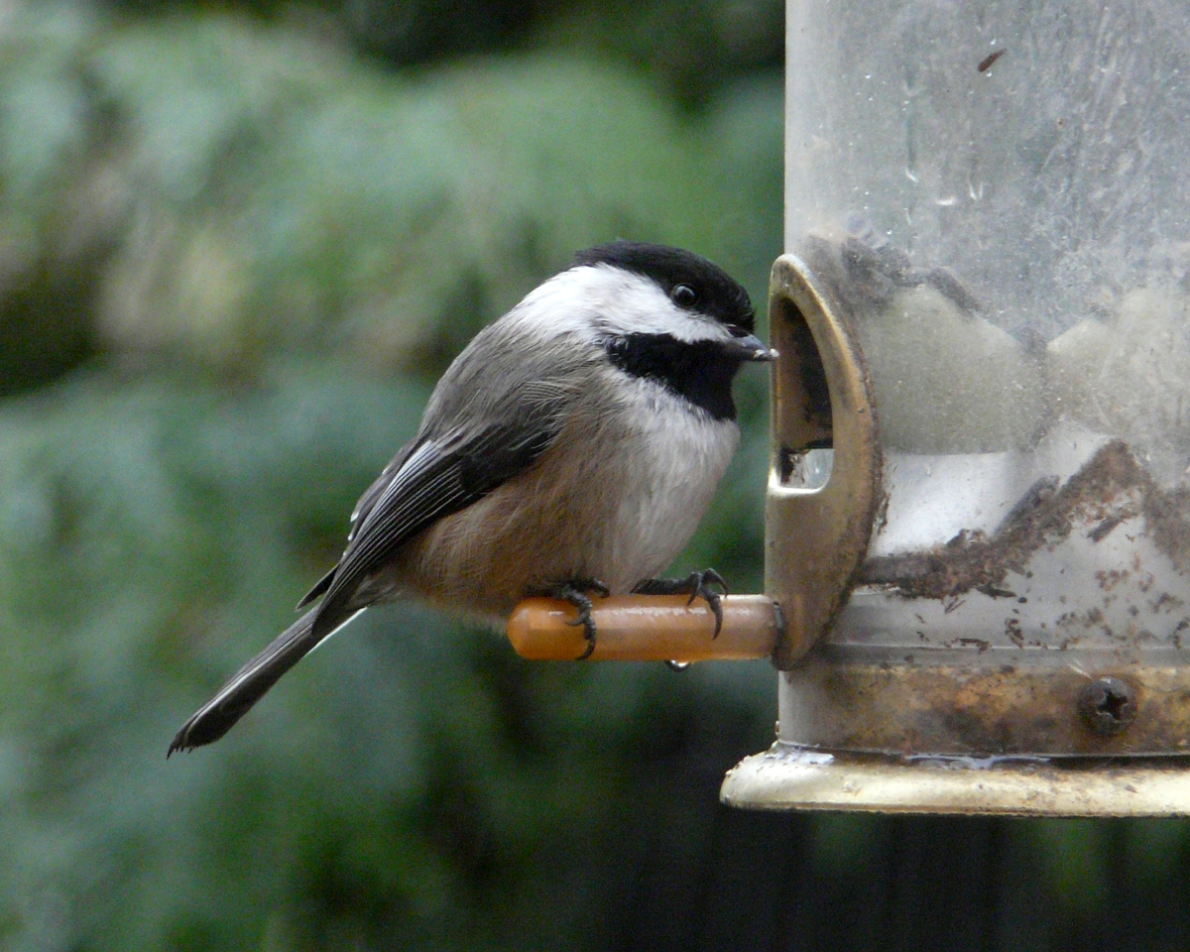
Beak Deformities in Chickadees*
Beak deformities involving excess keratin synthesis have been appearing among chickadees and other birds in the Great Lakes region, in central Alaska and in areas exposed to California agricultural run-off
No link could be found with investigated toxic chemicals and metals
Glyphosate was not investigated
Chickadees frequent bird feeders to consume sunflower seeds sprayed with glyphosate just before harvest
*CM Handel and C van Hemert, Environ Toxicol Chem 34, 2015; 314-327.

Slide 60
How to Safeguard Yourself
and Your Family

Slide 61
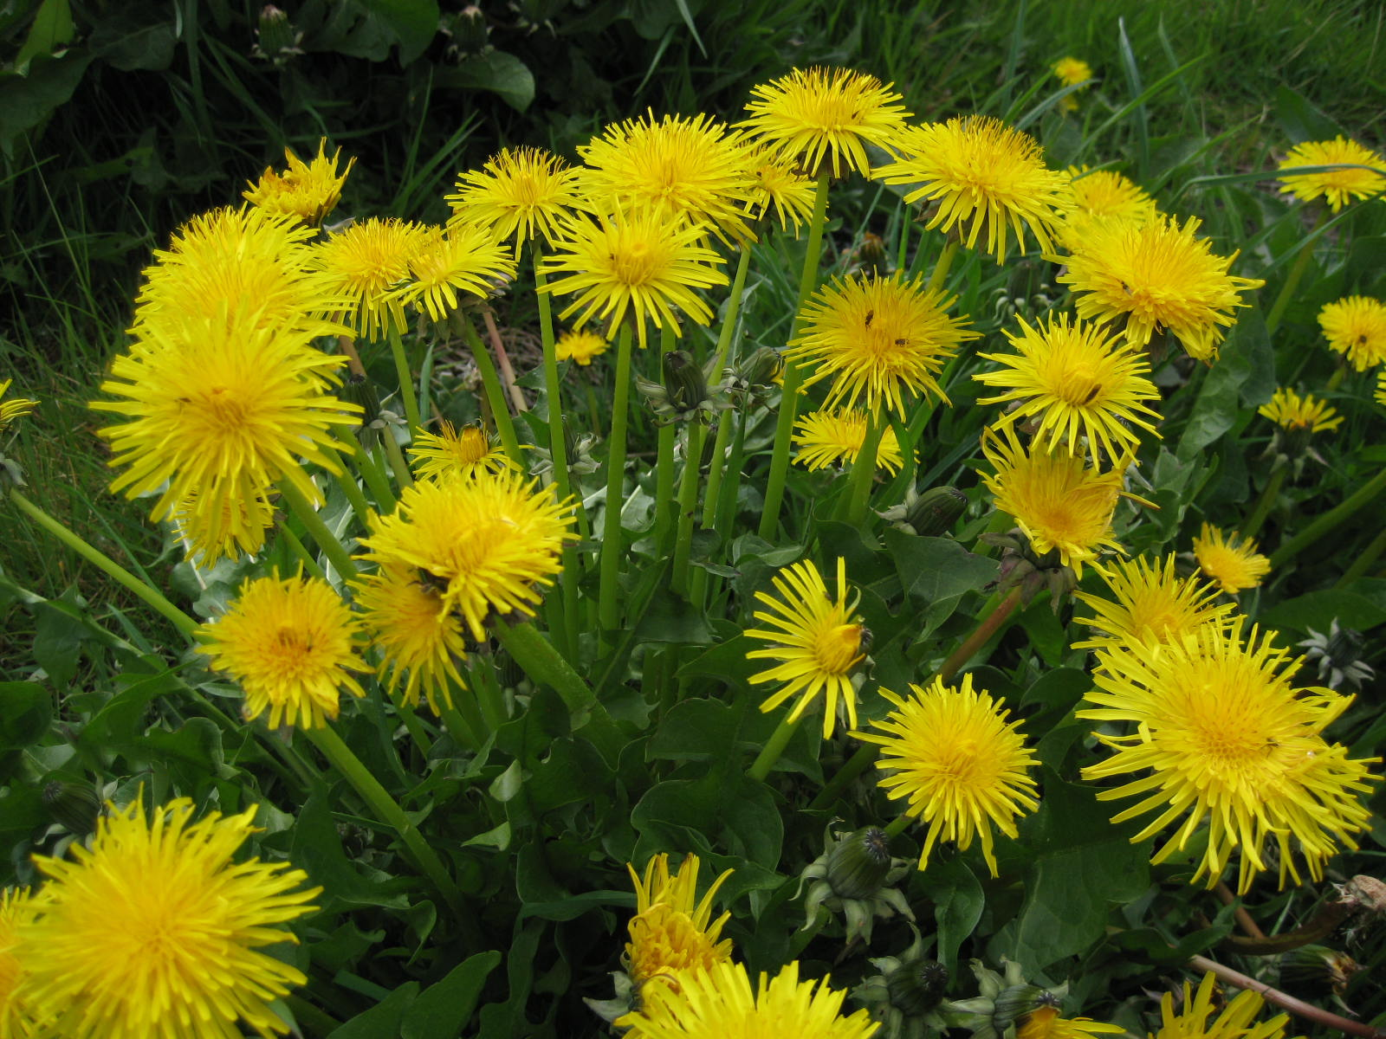
Extracts from Common Plants Can Treat Glyphosate Poisoning*
Roundup is toxic to hepatic and embryonic cells at doses far below those used in agriculture and at residue levels present in some GM food.
Extracts from common plants such as dandelions, barberry, and burdock can protect from damage, especially if administered prior to exposure.
*C Gasnier et al. Journal of Occupational Medicine and Toxicology 2011, 6:3

Slide 62
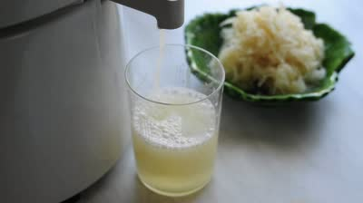
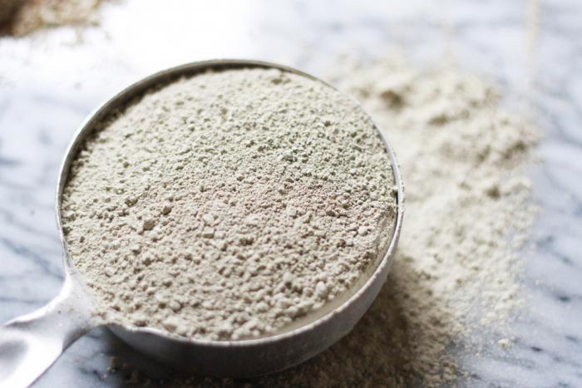
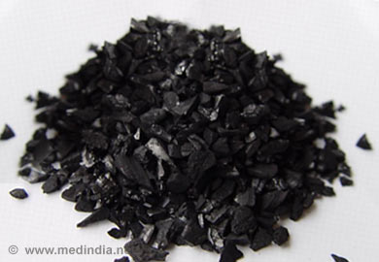
Treating Glyphosate Poisoning in Animals (e.g., cows) *
Activated charcoal, bentonite clay, humic and fulvic acids, and sauerkraut juice have been shown to be effective in reducing urinary levels of glyphosate and improving animal health
Sauerkraut
Juice
Fulvic Acid
Activated Charcoal
Bentonite Clay
*H Gerlach et al., J Environ Anal Toxicol 2014, 5:2
Notes:
Glyphosate/Monika_cows_humic_acid_fulvic_acid_treat_glyphosate.pdf
Activated charcoal
活性炭
clay
粘土
Niántǔ
Huóxìngtàn

Slide 63
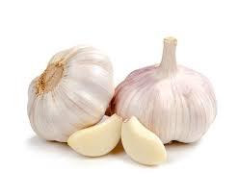
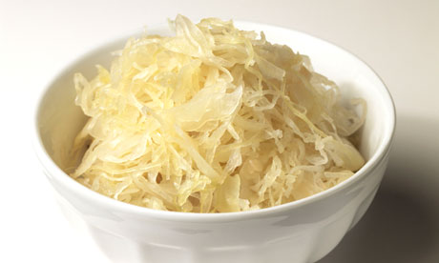
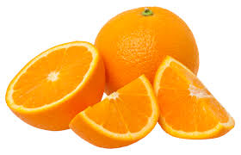
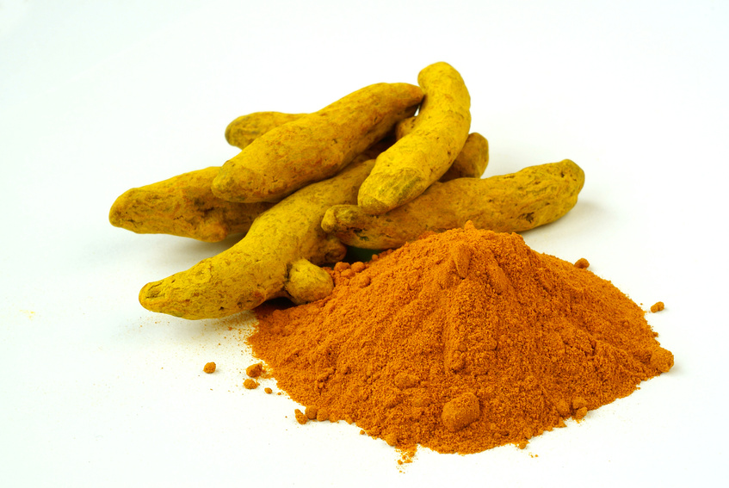
Some Important Nutrients
Curcumin
Garlic
Vitamin C
Probiotics
Methyl tetrahydrofolate
Cobalamin
Glutathione
Taurine
Epsom salt baths

Slide 64
Get Grounded

Slide 65
Go Organic!

Slide 66
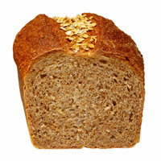
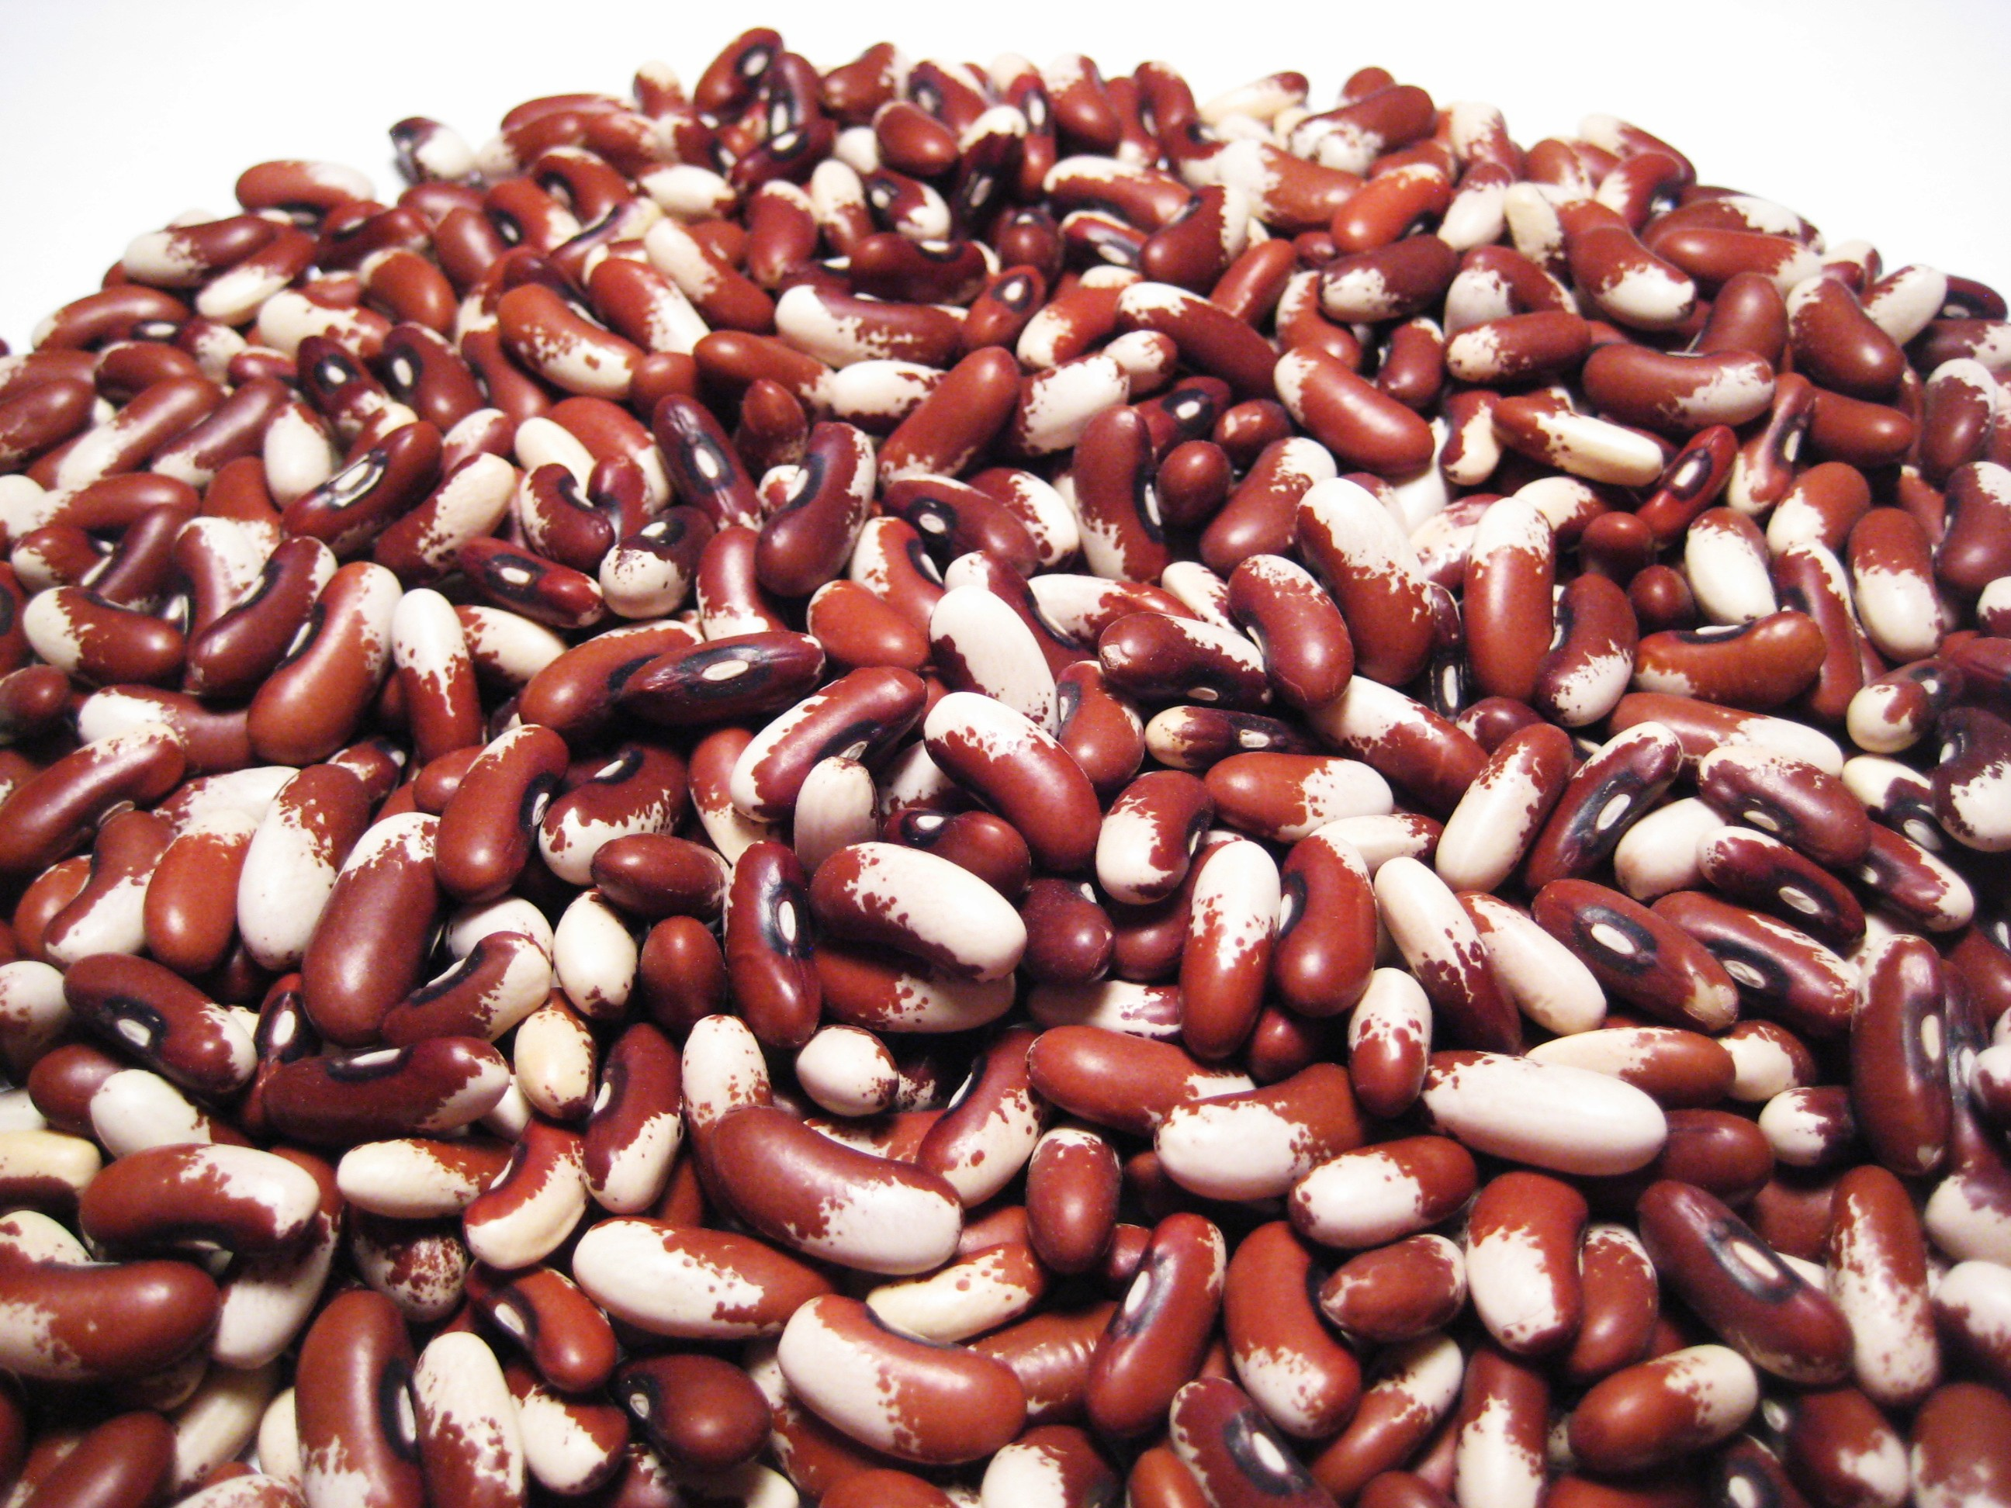
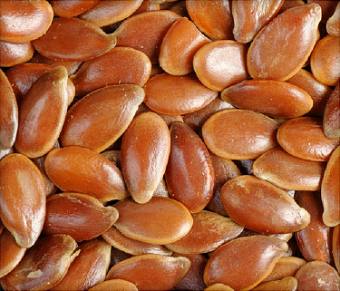
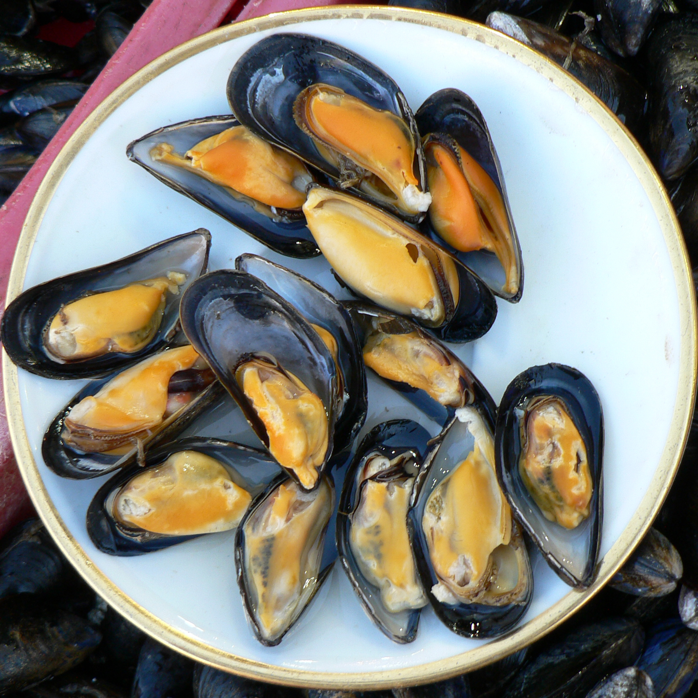
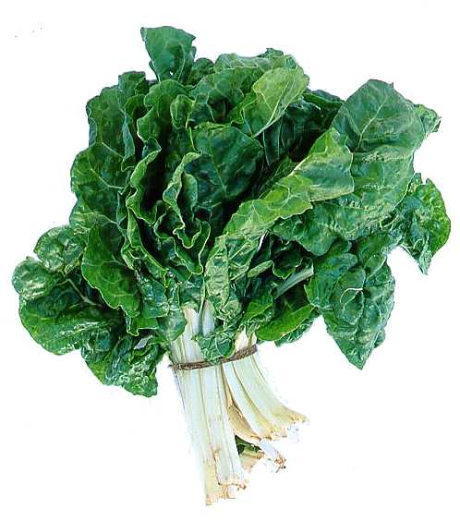
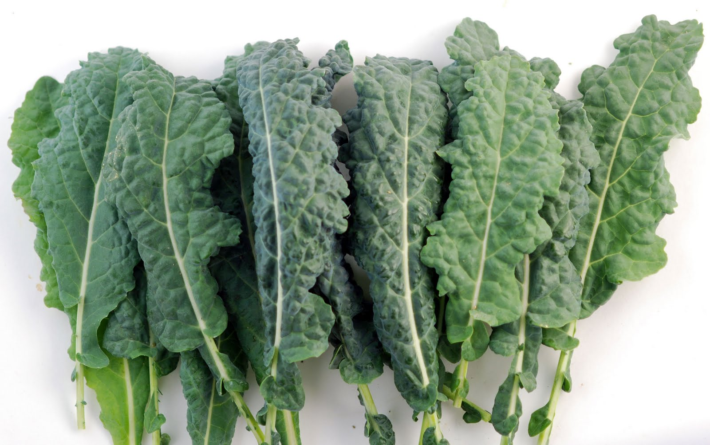
Eat Foods Containing Manganese

Slide 67
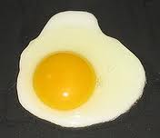
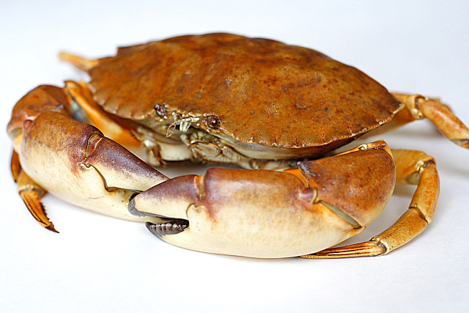
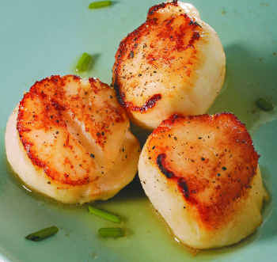
Eat Foods Containing Sulfur
Notes:
http://healthyeatingclub.com/info/books-phds/books/foodfacts/html/data/data5g.html

Slide 68
Summary
Glyphosate contamination in our food supply is a serious threat to health
Toxic mechanisms include mineral chelation, disruption of CYP enzymes, and disruption of gut microbes
I believe glyphosate is the most important factor in the autism epidemic
Glyphosate may erroneously replace glycine during protein synthesis
Huge consequences to multiple diseases whose incidence is going up in step with glyphosate usage on core crops: diabetes, obesity, Alzheimer’s and other neurological diseases, liver and kidney disease, vascular diseases, Celiac disease, etc.
Eating an organic diet rich in sulfur and manganese and probiotics can help protect from glyphosate poisoning

