Slide 1
Download These Slides
http://people.csail.mit.edu/seneff/2017/AutismOne2017_Seneff.pptx

Slide 2
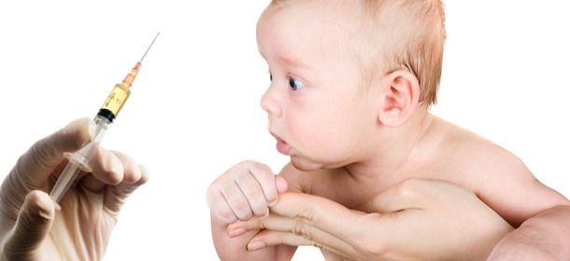
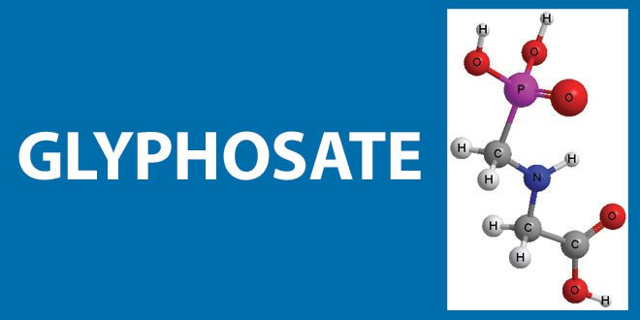
Glyphosate in MMR: Does This Explain the Autism Link?
Stephanie Seneff
CSAIL, MIT
AutismOne
Friday, May 19, 2017

Slide 4
On Glyphosate Contamination in Food Products …
“It is heartbreaking to see how this toxic, dangerous and unnecessary technology can strong arm its way into every facet of a supposedly democratic system and pollute its science, regulatory mechanism, academia, media, and the widest imaginable swath of political process, leaving virtually no clear avenue for the people to correct this wholesale chemical attack on society and an assault on nature.”
Tony Mitra, Canadian activist
Notes:
http://www.tonu.org/2017/02/01/wheat/

Slide 5
Outline
Introduction
Glyphosate in proteins
Gluten intolerance
MMR and autism: the evidence
Glyphosate in MMR?
Political developments
How to safeguard yourself and your family
Summary

Slide 6
Introduction

Slide 7
Life Expectancy vs Health Expenditure

Slide 8
Some Statistics*
Less than 0.1% of pesticides applied to crops worldwide reach their specific targets
The rest is spilled out into the environment
There are more than 7750 formulations of glyphosate
Until 2008, U.S. was the world's largest consumer of pesticides
Brazil took that distinction since 2008.
*L de Brito Rodrigues et al., Environ Toxicol Chem Aug 12, 2016:1-9 [Epub ahead of print].
Notes:
Glyphosate/Rodrigues_glyphosate_ecotoxicity_2016.pdf

Slide 9
Genetically Modified Crops: Distribution*
Other
United States
Argentina
Brazil
*N Wagner et al., Environ Toxicol Chem 32:1688-1700.
Notes:
13 in Glyphosate/Rodrigues_glyphosate_ecotoxicity_2016.pdf
*N Wagner et al., Environ Toxicol Chem 32:1688-1700.
Wagner N, Reichenbecher W, Teichmann H, Tappeser B, Lotters S. 2013. Questions concerning the potential impact of glyphosate-based
herbicides on amphibians. Environ Toxicol Chem 32:1688–1700.

Slide 10
America’s Children are in Trouble!
It is now "normal" for a kindergarten child to have 12 colds every year and for a baby to have nine.
Fourfold increase in childhood obesity
Double the asthma rate since the 1980's
"Chronic illnesses" rose from 1.8% in 1960 to 7% in 2004.
Today, 43% of US children are chronically ill.
1 in 6 children in the USA has a neurodevelopmental disability
1 in 38 boys are autistic
US has the worst neonatal death rate of all industrialized countries.
Today's children in the US will have a shortened life span compared to their parents.
Notes:
https://www.facebook.com/groups/1409306052710440/
./TheOutliers.text
Page removed!!
— Joanna Karpasea Jones

Slide 11
Autoimmune Disease: An Invisible Epidemic*
“Taken together, the number of people suffering from autoimmune diseases is 24–50 million Americans, 16% of the US population. To put it in perspective, autoimmune disease prevalence equals heart disease and cancer combined.”
*Feldman B, Martin EM, Simms T. An Invisible Epidemic — When your body attacks itself — Autoimmune Disease; How Reframing the Data Unveils a Public Health Crisis Bigger than Cancer and Heart Disease Combined. www.tincture.io.
Notes:
Feldman B, Martin EM, Simms T. An Invisible Epidemic — When your body attacks itself — Autoimmune Disease; How Reframing the Data Unveils a Public Health Crisis Bigger than Cancer and Heart Disease Combined. www.tincture.io.
IN Beecham Seneff paper. Ref. 13.

Slide 12
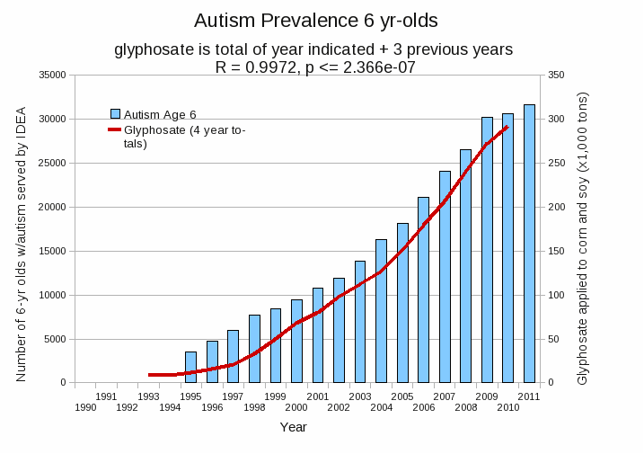
Autism Prevalence: 6 year olds*
R = 0.9972
* Figure 15, Seneff et al., Agricultural Sciences, 2015, 6, 42-70
Notes:
Nancy/latest_plots/6-yr-old autism.gif
autism: USDE
oil consumption: USDA
glyphosate: USDA
GE crops: USDA
Mortality data: CDC

Slide 13
Autism Rates in California Public Schools*
*http://www.sacbee.com/site-services/databases/article55928865.html
Notes:
./AutismSchoolsCalifornia.pdf

Slide 14
*
Triplets: two boys, one girl. Both boys have autism and girl has seizure disorder
Very high levels of glyphosate in urine in all three
Clostridia overgrowth due to glyphosate disruption of gut microbes
Toxic Clostridia metabolites lead to excess dopamine expression
Damage to neuronal mitochondria and neurofibrils through oxidative stress
*W. Shaw. Integrative Medicine 2017;16(1);50-57.
Notes:
./Shaw_on_glyphosate_triplets_autism.text

Slide 15
Autism, Glyphosate, Vaccine Reactions*
Glyphosate application to corn and soy, US
Children with Autism, US
# Adverse Reactions in VAERS
*Collaboration with Dr. Nancy Swanson
Notes:
Individuals with Disabilities Education Act

Slide 16
Source: J.B. Handley, with permission
Notes:
Images/fullyvaccinated.jpg
https://medium.com/@jbhandley/dr-peter-hotez-asked-me-for-an-apology-and-a-retraction-about-his-vaccine-profits-cab1e05106c5#.8u8b0saa0

Slide 17
1986

Slide 18
Glyphosate in Proteins

Slide 19
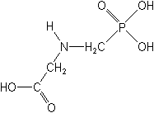
What If Glyphosate Could Insert Itself Into Protein Synthesis by mistake???
glyphosate
Code for glycine
GGC
mRNA
. . .
. . .
Glyphosate
Alanine
Proline
Any proteins with conserved glycine residues are likely to be affected in a major way

Slide 20
Glyphosate is a non-coding amino acid analogue of glycine
H
Glycine
Glyphosate

Slide 21
Extra Piece Sticks Out at Active Site
Substrate no longer fits in active site
Active Site
Extra Stuff
Glyphosate
Alanine
Proline
glycine
Peptide chain

Slide 22
Extra Piece Sticks Out at Active Site
Substrate no longer fits in active site
This explains how glyphosate disrupts EPSPS in the shikimate pathway: Multiple bacteria have developed resistance by replacing active site glycine with alanine and this is the basis for GMO Roundup Ready crops*
Active Site
Extra Stuff
Glyphosate
Alanine
Proline
glycine
Peptide chain
*T Funke et al., Molecular basis for the herbicide resistance of Roundup Ready crops. PNAS 2006;103(35):13010-13015.
Notes:
glyphosate/Padgette_1991_EPSPS_conserved_glycine_modified_resistant_to_glyphosate.pdf

Slide 23
Inhibition of EPSPS by glyphosate: Resistant E coli mutant*
Mutant with alanine substituted for glycine 96
Wild type with glycine 96
*Figure 3, S Eschenburg et al. Planta 2002;216:129-135.

Slide 24
Some Predicted Consequences*
Neurological diseases
Autoimmune diseases
Chronic fatigue syndrome
Impaired collagen → osteoarthritis
Fatty liver disease
Obesity and adrenal insufficiency
Impaired iron homeostasis and kidney failure
Insulin resistance and diabetes
Cancer
*Samsel A and Seneff S. Journal of Biological Physics and Chemistry 2016;16:9-46.

Slide 25
Some Predicted Consequences*
Neurological diseases
Autoimmune diseases
Chronic fatigue syndrome
Impaired collagen → osteoarthritis
Fatty liver disease
Obesity and adrenal insufficiency
Impaired iron homeostasis and kidney failure
Insulin resistance and diabetes
Cancer
All of these diseases can be linked to proteins that absolutely depend on glycine to function properly
*Samsel A and Seneff S. Journal of Biological Physics and Chemistry 2016;16:9-46.

Slide 26
Neurological Diseases
At least four neurological diseases related to misfolded proteins involve conserved glycine residues
Disease | Protein | Reference
Alzheimer’s | Amyloid beta | Munter et al.
Parkinson’s disease | Alpha synuclein | Du et al.
ALS | TDP-43 | Pesiridis et al.
Prion diseases | Prion proteins | Harrison et al.
L-M Munter et al. The EMBO Journal 2007; 26: 1702-1712.
H-N Du et al., Biochemistry 2003; 42: 8870-8878.
S Pesiridis et al., Hum Mol Genet 2009; 18(R2): R156-R162.
CF Harrison et al., J Biol Chem 2010; 285(26): 20213-20223.
Notes:
Munter:
Anthony/GxxxG_motif_Abeta_2007.pdf
glycine_alpha_synuclein.pdf
Pesiridis_2009_ALS_glycine_conserved_region_TDP_43.pdf
transactive response DNA binding protein
TAR DNA binding protein

Slide 27
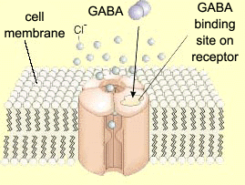
Impaired GABA Receptor Activity and Autism
Autism has been linked to a weakened response of the inhibitory GABA receptor to stimuli*
The GABA receptor has a conserved glycine at the entrance to the first membrane-spanning domain that is essential for its function**
*CD Robertson et al., Current Biology 2016;26: 80-85
**BX Carlson et al., Mol Pharmacol. 2000;57(3):474-84
Notes:
2016/Anthony/
reduced_GABAergic_activity_autism_brain.pdf
ABA_conserved_glycine_2000.pdf

Slide 28
Protein Phosphatase I and Autism
Glyphosate exposure to rat dams led to thyroid deficiency in pups*
Attributed to suppressed release of thyroid stimulating hormone (TSH) from the dam’s pituitary
Thyroid deficiency in mom during pregnancy predicts significant increased risk to autism in child**
Glyphosate link to impaired TSH due to disruption of protein phosphatase I***
*JS deSouza et al., Toxicology To Appear, 2017
**GC Román, Ann Neurol 2013;74(5):733-42.
***JE Beecham and S Seneff. Journal of Autism 2016;3:1.
Notes:
deSouza_glyphosate_suppresses_thyroid_stimulating_hormone_pituitary_2017.pdf
BeechamSeneff2_2016.pdf

Slide 29
Protein Phosphatase 1 Has Many Highly Conserved Glycines!*
Glycines!!
Protein Phosphatase I
*Figure 1, Y. Shi, Cell 2009;139: 468-484.
Notes:
serine_threonine_phosphatase_conserved_glycine_2009.pdf

Slide 30
Protein Phosphatase 1 Has Many Highly Conserved Glycines!*
Glycines!!
Protein Phosphatase I
PP1 also depends on manganese as a catalyst, which glyphosate chelates, making it unavailable
*Figure 1, Y. Shi, Cell 2009;139: 468-484.
Notes:
serine_threonine_phosphatase_conserved_glycine_2009.pdf

Slide 31
“Association of Gestational Maternal Hypothyroxinemia and Increased Autism Risk”*
*GC Román, Ann Neurol 2013;74(5):733-42.

Slide 32
Recapitulation
Glyphosate may substitute for glycine by mistake during protein synthesis – coding error
This has huge consequences everywhere
Mutating to lose an active-site glycine is how the bacterial enzyme, EPSPS, gets protected from glyphosate suppression
This forms the basis of GMO Roundup Ready crops
Nearly all of the strong correlations between glyphosate usage on core crops and the rapid rise in incidence of a number of debilitating diseases can be explained through protein disruption by glyphosate incorporation
GABA receptor impairment in autism can be explained by glyphosate substituting for highly conserved glycine residue
Protein phosphatase I inhibition by glyphosate can result in thyroid deficiency which is linked to autism in the fetus of an affected woman

Slide 33
Gluten Intolerance

Slide 34
Hypothesis
Glyphosate exposure sets up a weakened immune system, a leaky gut barrier and a leaky brain barrier
Glyphosate contamination in proteins makes them hard to break down
Person develops overactive antibody response to foreign protein contaminated with glyphosate and, through molecular mimicry, this leads to autoimmune disease
This easily explains gluten intolerance and other food allergies

Slide 35
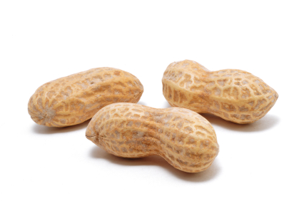
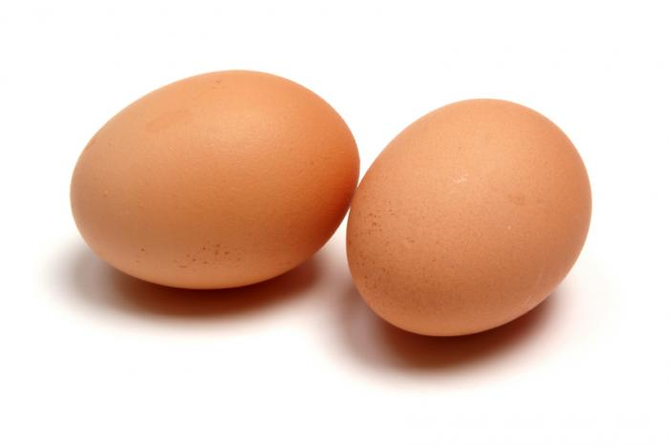
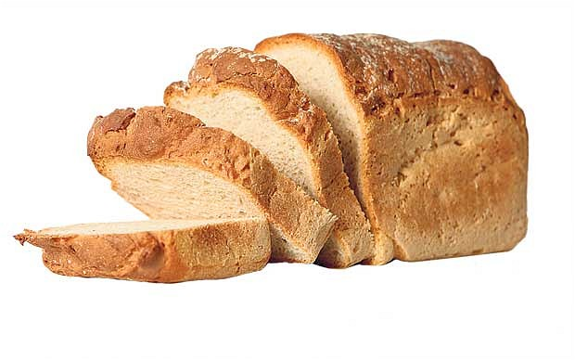
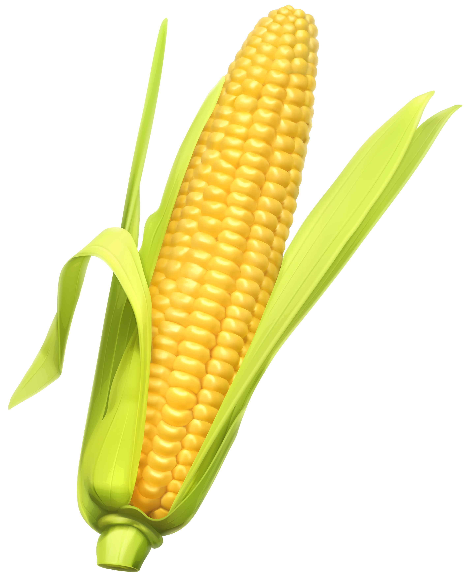
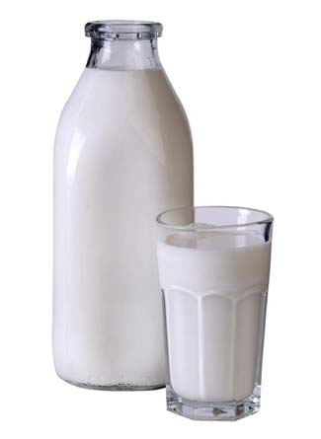
Food Allergies

Slide 36
Food Allergies
All of these foods can be expected to be contaminated with glyphosate, given how they’re produced

Slide 39
Celiac Disease, Glyphosate and Non Hodgkin’s Lymphoma
Glyphosate preferentially kills bifidobacteria*
Bifidobacteria are depleted in Celiac disease**
Celiac disease is associated with increased risk to non Hodgkin’s lymphoma***
Glyphosate itself is also linked directly to non Hodgkin’s lymphoma****
*A.A. Shehata et al., Curr Microbiol. 2013 Apr;66(4):350-8.
** M. Velasquez-Manoff, NY Times Sunday Review, Feb. 23, 2013.
*** C. Catassi et all, JAMA. 2002 Mar 20;287(11):1413-9.
****M. Eriksson et al., Int J Cancer. 2008 Oct 1;123(7):1657-63.
Notes:
**./ bifidobacteria_celiac_disease.text
Cancer/Celiac_disease_increases_hodgkins_lymphoma.text
./Celiac_and_bacteria.text

Slide 40
“Herbicide Resistant Ryegrass Troubling for Wheat Growers”*
“If you see ryegrass at harvest following an Axial XL application, it may be resistant. And you can scatter seed all over the field with the combine.”
“A reduced-tillage approach, using a burndown herbicide ahead of planting in a stale seedbed, also holds promise for improved control.”
“ ‘We may be able to knock out 80% to 90% of the resistant ryegrass with glyphosate.’ ”
-- Jim Swart, integrated pest management specialist
*Ron Smith, Western Farm Press, Mar. 23, 2013

Slide 41
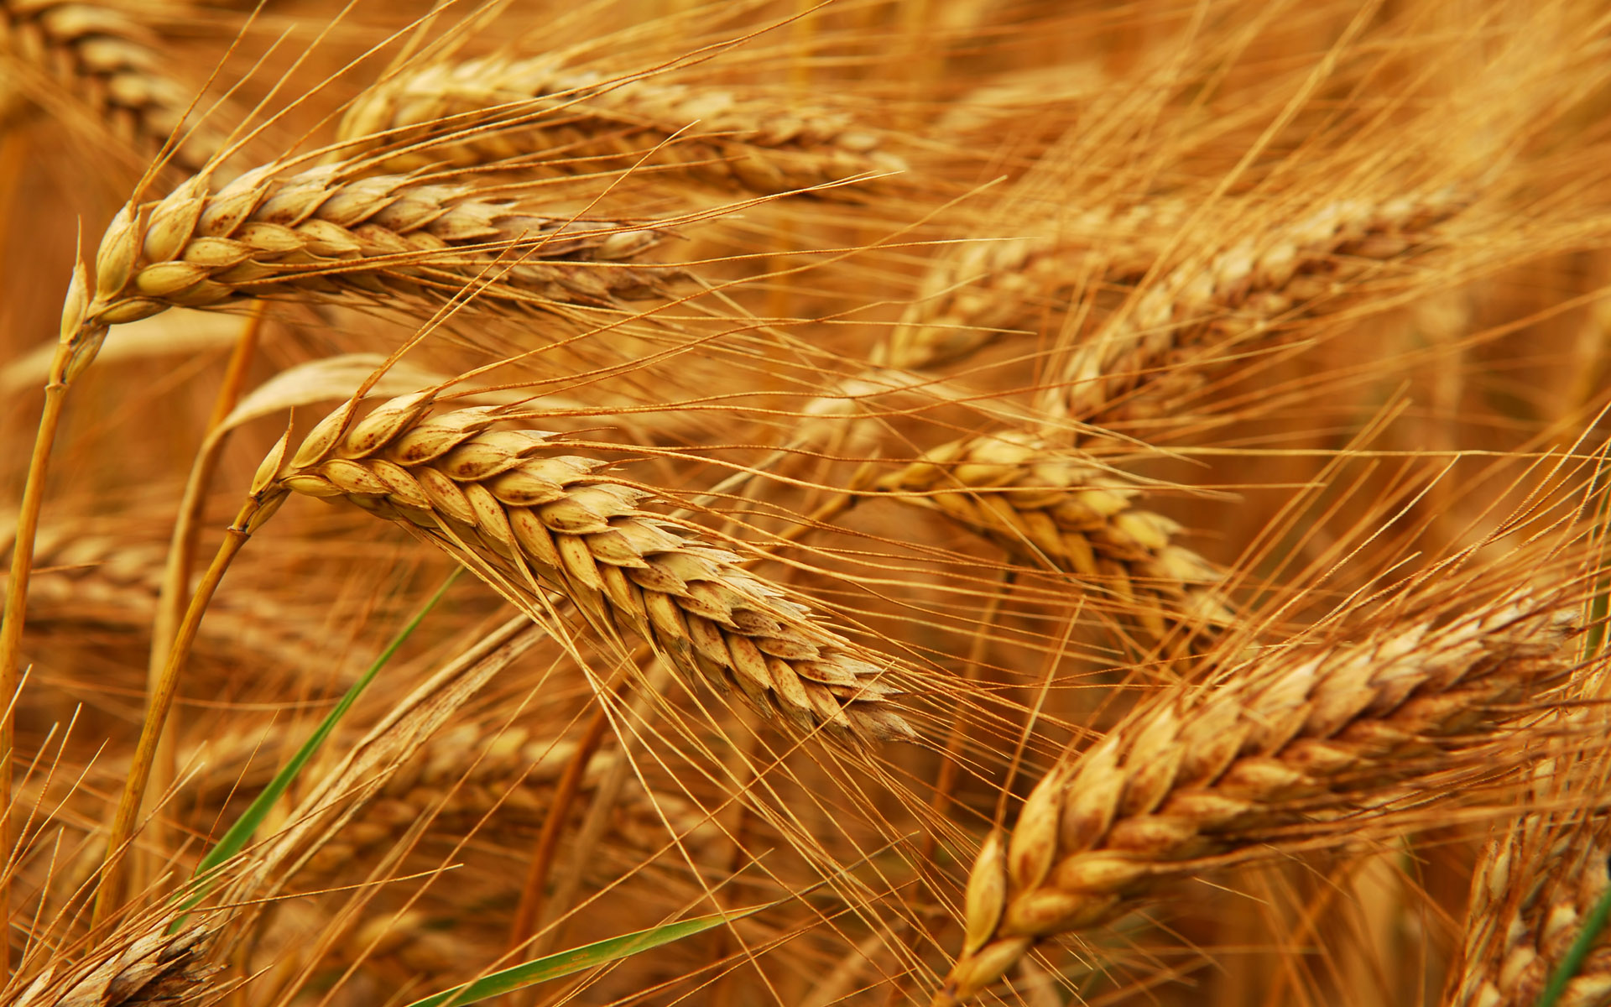
Glyphosate and Celiac Disease*
Glyphosate
Use on wheat
Celiac disease
*Samsel and Seneff, Interdiscip Toxicol. 2013;6(4): 159–184.

Slide 42
MMR and Autism:
The Evidence

Slide 43
Benefits of Infectious Diseases
A large Japanese study found that a history of measles and mumps in childhood is significantly protective against deadly heart attacks and strokes during adulthood*
Adults who had contracted chicken pox were 33% less likely to develop coronary heart disease
Each additional contagious disease contracted during childhood, such as measles, mumps or rubella, increased the protective effect against acute coronary events by 14%**
Tumor remissions after measles infection are well documented in the medical literature
*Y. Kubota et al., Atherosclerosis 2015;241(2):682-686.
** E. Pesonen et al., Atherosclerosis 2007;192(2): 370-375.
Notes:
./first_do_no_harm_vaccine_disease_comparison_NeilMiller_2016.pdf
19. Kubota Y, Iso H, Tamakoshi A; JACC Study Group. Association of measles and mumps with cardiovascular disease: The Japan Collabo- rative Cohort (JACC) study. Atherosclerosis 2015;241(2):682–686
20 Pesonen E, Andsberg E, Ohlin H, et al. Dual role of infections as risk factors for coronary heart disease. Atherosclerosis 2007;192(2): 370–375
*Y. Kubota et al., The Japan Collaborative Cohort (JACC) study. Atherosclerosis 2015;241(2):682-686.
** E. Pesonen et al., Atherosclerosis 2007;192(2): 370-375.

Slide 44
Some Adverse Reactions of MMR*
“A shortened version of the vaccine damage associated with the MMR vaccine includes vomiting, diarrhea, anaphylaxis, ear pain, nerve deafness, diabetes, arthritis, myalgia, encephalitis, febrile seizures, pneumonia, and death.”
*https://vactruth.com/2016/06/23/japanese-government-bans-mmr-vaccine/
http://www.merck.com/product/usa/pi_circulars/m/mmr_ii/mmr_ii_pi.pdf
http://www.merck.com/product/usa/pi_circulars…pdf
Notes:
./JapanesegovernmentCautiousVaccines.pdf

Slide 45
Dr. Andrew Wakefield
Lancet, 1998

Slide 46
Dr. Andrew Wakefield
“We have identified a chronic enterocolitis in children that may be related to neuropsychiatric dysfunction. In most cases, onset of symptoms was after measles, mumps, and rubella immunisation.
Further investigations are needed to examine this syndrome and its possible relation to this vaccine.”
Lancet, 1998

Slide 47
“The Impact of the Gut Microbiota on Humoral Immunity to Pathogens and Vaccination in Early Infancy”*
Gut microbiota are a dynamic community of intestinal bacteria, viruses, fungi, and archaea
They play an important role in activating the developing immune system and inducing protective antibody responses
Germ-free mice have low antibody response to flu vaccine
Bifidobacteria enhance oral vaccine efficacy
Protective antibodies from mom’s milk interfere with vaccine response
* QN Nguyen et al., PLOS Pathogens 12(12): e1005997
Notes:
./gut_microbiome_vaccines_interplay_infants_2016.;pdf

Slide 48
“Inhibition of Vaccine Responses by Maternal Antibodies”*
“The only clinical solution to stimulating a protective B cell response in the presence of maternal antibodies is to immunize children repeatedly”
*Stefan Niewiesk, J Pediatr Inf 2013; 7: 157-61.
Notes:
./maternal_antibodies_vaccines_2013.pdf

Slide 49
Probiotics and the immunological response to infant vaccinations: a prospective, placebo controlled pilot study*
Oral probiotics given to infants during the period of immunization do not interfere with the immune response, and may improve sero-conversion rates.
Probiotics may potentially reduce vaccine- related adverse effects in infants.
* I. Youngster et al., Arch Dis Child 2011;96:345–349.
Notes:
Youngster_2011_probiotics_vaccines.pdf

Slide 50
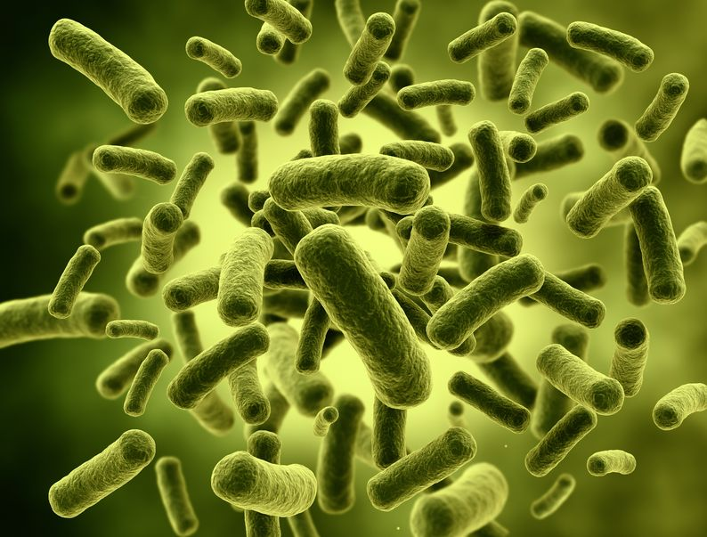
“Probiotics and the immunological response to infant vaccinations: a prospective, placebo controlled pilot study”*
*I Youngster et al.
Arch Dis Child 2011
96:345-349
Notes:
Youngster_2011_probiotics_vaccines.pdf

Slide 51
“Deep sequencing reveals persistence of cell‐associated mumps vaccine virus in chronic encephalitis”*
Child diagnosed with severe immune deficiency 4 months after MMR vaccine
10 months post-vaccine: rash, diarrhoea, lethargy and seizures, with evidence of encephalitis on magnetic resonance imaging (MRI)
Deep sequencing of brain biopsy revealed match to mumps strain of MMR vaccine
Common pathogenic process with measles encephalitis
*S Morfopoulou et al., Acta Neuropathol (2017) 133:139-147.
Summary: http://www.greenmedinfo.com/blog/vaccine-did-it-mutated-
mmr-mumps-virus-brain-child-caused-his-death-british-resea
Notes:
mumps_vaccine_virus_chronic_encephalitis_2017.pdf
MMR_mumps_virus_child_died_2017.pdf
Male – died before 6th birthday

Slide 52
Time Chart*
*S Morfopoulou et al., Acta Neuropathol (2017) 133:139-147.
Notes:
mumps_vaccine_virus_chronic_encephalitis_2017.pdf

Slide 53
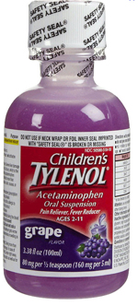
"Empirical Data Confirm Autism Symptoms Related to Aluminum and Acetaminophen Exposure”*
We found a significant link between MMR and autism ( p = 0.007)
We were puzzled, because it doesn’t contain aluminum and it doesn’t contain mercury
We blamed it on the acetaminophen
We were partly right!
Glyphosate suppresses the liver CYP enzymes that are needed to metabolize acetaminophen
*S Seneff et al., Entropy 2012, 14, 2227-2253.

Slide 54
“Sulphation deficit in `low-functioning’ autistic children: a pilot study.”*
Specifically looked at ability to metabolize acetaminophen
Found highly statistically significant result:
Autistic kids were unable to conjugate acetaminophen with sulfate! (p < .00002)
Glyphosate disrupts multiple enzymes involved in sulfation pathway in E coli**
*AA Pirrone et al., Biol Psychiatry. 1999 Aug 1;46(3):420-4.
**W. Lu et al., Mol. BioSyst., 2013, 9, 522-530.
Notes:
Sulfation_deficit_autism.text
glyphosate_alters_expression_of_many_genes_E_coli_2013.pdf

Slide 55
"A Population-Based Study of Measles, Mumps, and Rubella Vaccination and Autism"*
Danish study,2004 – claimed no relationship
Flawed study:
The “not vaccinated” group are a biased group (not randomly selected)
They put all the autistic kids younger than 15 months into the “not vaccinated” group (should have thrown them out)
They divided up age groups such that the key date (15 months) was buried in the middle of the 0-3 age group.
“not-vaccinated” group had substantially fewer autism cases in the 3-5 yr age group
41% increased risk of autism in vaccinated group
*KM Madsen et al., N Engl J Med 2002;347:1477-1482.
Notes:
Danish_study_MMR_autism)_2004.pdf

Slide 56
Recapitulation
Measles, mumps and rubella are childhood diseases that carry long-term benefit in protecting from heart disease and stroke
MMR vaccine has an alarming list of adverse reactions
Andrew Wakefield published a seminal paper in 1998 (later retracted) that linked MMR to autism in children with impaired gut microbiome
Gut microbiome plays important role in immune system maturation
A case study showed indisputable link between mumps virus in MMR vaccine and an autoimmune encephalopathy leading to autism-like symptoms and premature death
Acetaminophen administered following vaccination can be toxic when sulfation capacity is impaired
Glyphosate inhibits sulfation capacity
A Danish study claiming MMR has no link to autism was flawed

Slide 57
Glyphosate IN MMR?

Slide 58
Glyphosate in Vaccines?
For MMR, flu vaccine, and rabies vaccine, live virus is grown on gelatin derived from ligaments of pigs
Pigs are fed GMO Roundup-Ready corn and soy feed
Gelatin (derived from collagen) contains significant amounts of both glycine and glutamate
These two neurotransmitters excite the NMDA receptors in the brain
Glyphosate substitution by mistake for glycine is a possibility!
Glyphosate stimulation of NMDA receptors could cause neuronal burnout

Slide 59
*A Samsel and S Seneff, Journal of Biological Physics and Chemistry 2017;17:8-32.

Slide 60
Glyphosate Contamination in Vaccines (Parts Per Billion)*
Merck ZOSTAVAX 0.62 Shingles
Merck MMR-II 3.74 Measles, Mumps and Rubella
Merck VARIVAX 0.56 Varicella, Chicken Pox
MERCK PNEUMOVAX ND Pneumococcal 18
MERCK PROQUAD 0.66 Measles, Mumps, Rubella, Varicella
GSK ENERGIX-B 0.34 Heptatitis B
*A Samsel and S Seneff, Journal of Biological Physics and Chemistry 2017;17:8-32.

Slide 61
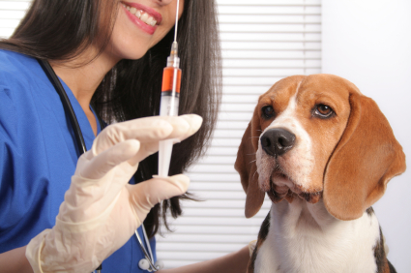
The Purdue Vaccination Studies and Auto-antibodies*
“The Purdue studies also found that vaccinated dogs were developing autoantibodies to their own collagen”
*http://www.dogsnaturallymagazine.com/purdue-vaccination-studies/

Slide 62
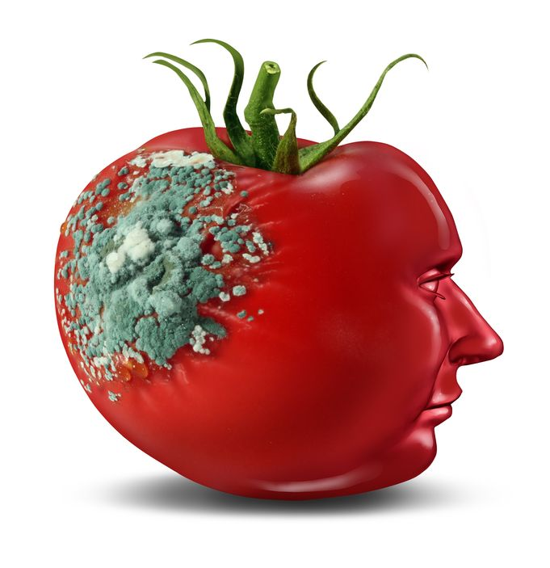
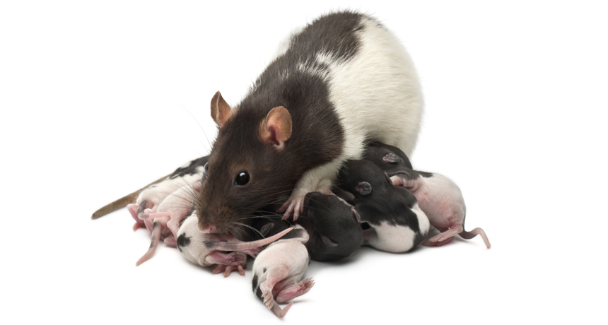
Glyphosate and Glutamate*
Acute exposure activates NMDA receptors and voltage-dependent calcium channels
Oxidative stress and neural cell death
Increased glutamate release into the synaptic cleft → excessive extracellular glutamate levels
Decreased glutathione content
Increased peroxidation of lipids (fats)
*http://www.greenmedinfo.com/blog/roundup-weedkiller-brain-damaging-neurotoxin
Notes:
http://www.greenmedinfo.com/blog/roundup-weedkiller-brain-damaging-neurotoxin
acute exposure (30 minutes) and chronic (pregnancy and lactation) exposure.
Why was this referenced??
T. Bohn et al. Food Chemistry 153, 15 June 2014, 207-215.

Slide 63
Symptoms of Adverse Reactions to MMR before and after 2002*
*Data analyzed from the VAERS database

Slide 64
Symptoms of Adverse Reactions to MMR before and after 2002*
Joint pain
seizures
shortness of breath
hives
These are all characteristic symptoms of allergies to MSG
eczema
anaphylactic shock
Facial swelling
swelling
swelling
*Data analyzed from the VAERS database

Slide 65
Measles Virus and Hemagglutinin*
The measles virus synthesizes the protein hemagglutinin
Antibodies to hemagglutinin are essential following MMR vaccination to induce immunity
Hemagglutin bears a sequence resemblance to myelin basic protein (MBP) → potential for autoimmune reaction
MBP is essential for the formation of the myelin sheath surrounding nerve fibers
Children with a rare genetic defect involving deletion of MBP can suffer from microcephaly**
Autoantibodies to MBP along with excessive levels of antibodies to measles hemagglutinin are linked to autism***
*Oldstone, MBA, Ed. Molecular mimicry: Infection inducing autoimmune disease.
Springer Berlin Heidelberg; January 9, 2006.
**AD Kline et al., Am J. Hum. Genet. 1993;52:895-906.
***VK Singh et al., J Biomed Sci 2002;9(4):359-64.

Slide 66
Autism and Measles Hemagglutinin*
125 autistic children and 92 control children
60% of the children with autism had high levels of antibodies to measles hemagglutinin specific to the MMR vaccine
90% of these had autoantibodies to myelin basic protein (MBP)
0% of the control children had high antibody titers to either hemagglutinin or MBP
There were no elevations in antibodies detected against any proteins in the mumps or rubella viruses
*VK Singh et al., J Biomed Sci 2002;9(4):359-64.

Slide 67
Notes:
./vaccine_protein_causes_food_allergies.pdf

Slide 68
Large Proteins in Vaccines: Allergenic*
“Vaccines clog our lymphatic system and lymph nodes with large protein molecules which have not been adequately broken down by our digestive processes, since vaccines bypass digestion with injections. This is why vaccines are linked to allergies, because they contain large proteins which as circulating immune complexes (CICs) or 'klinkers’ cause our body to become allergic.”
*Dave Mihalovic, ND, http://whale.to/v/vaccines_cause_allergies.ht

Slide 69
Precedent: Glyphosate in Drugs?*
Trasylol (aprotinin) is a protein derived from bovine lung used to reduce bleeding during open heart surgery
Rare acute reaction to Trasylol involves precipitous drop in blood pressure, acute kidney failure, and sudden death
Piglets injected with glyphosate salts had similar acute reaction with high mortality rate
Cows fed GMO Roundup-Ready feed had highest residue levels of glyphosate in lungs
*S Seneff et al., Agricultural Sciences 2015; 6:1472-1501.
Notes:
Trypsin inhibitor

Slide 70
Recapitulation
Glyphosate has been detected in multiple vaccines, with highest concentrations in MMR
Many vaccines include gelatin and fetal bovine serum as ingredients, both of which are contaminated with glyphosate
Glyphosate incorporated into a virus protein can lead to resistance to breakdown and autoimmune disease through molecular mimicry
A causal link between MMR and autism can be explained through autoimmune attack on myelin basic protein through molecular mimicry with measles hemagglutinin
Multiple large proteins found in vaccines are allergenic
Glyphosate is likely also present in certain biological drugs and may explain rare bizarre life-threatening adverse reactions

Slide 71
Political Developments

Slide 72
Robert F. Kennedy may head a new commission to study vaccine safety

Slide 74
RFK, Jr. on Mercury & Vaccines
“I’ve spent my life working on energy issues, environmental issues, and global warming, but I’ve taken a hiatus to do just this issue because I cannot stand by and watch these children being poisoned—an entire generation of kids that is being poisoned now by government policies and greed. We’re going to take them on and beat them.”
Robert F. Kennedy, Jr.
Vaccines Revealed

Slide 75
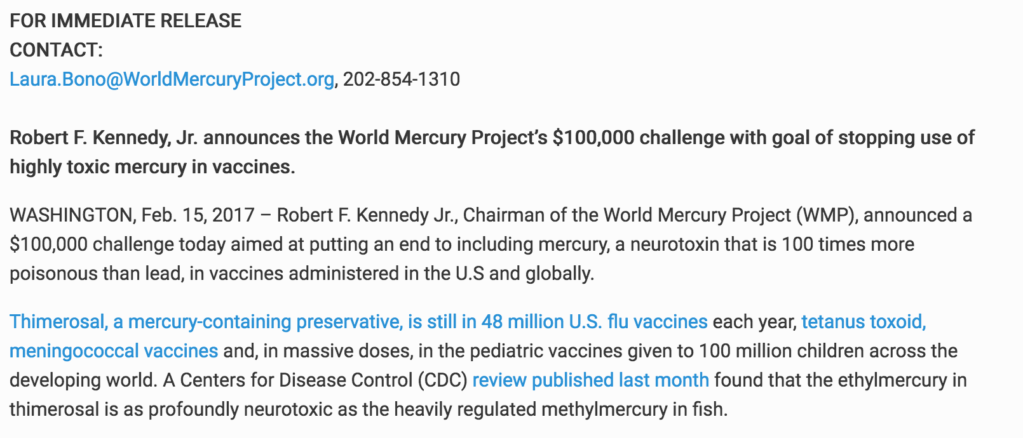
Robert F. Kennedy, Jr. announces the World Mercury Project’s $100,000 challenge

Slide 76
*Ginger Taylor, MS, GreenMedInfo, Jan 17, 2017
Notes:
http://www.greenmedinfo.com/blog/examining-rfk-jrs-claim-cdc-owns-over-20-vaccine-patents

Slide 77
Some Examples of CDC Vaccine Patents*
CDC patents applicable to vaccines for Flu, Rotavirus, Hepatitis A, HIV, Anthrax, Rabies, Dengue fever, West Nile virus, Group A Strep, Pneumococcal disease, Meningococcal disease, RSV, Gastroenteritis, Japanese encephalitis, SARS, Rift Valley Fever, and chlamydophila pneumoniae.
Nucleic acid vaccines for prevention of flavivirus infection, which has applications in vaccines for Zika, West Nile virus, Dengue fever, tick-borne encephalitis virus, yellow fever, Palm Creek virus, and Parramatta River virus.
Several patents for administering various “shots” via aerosol delivery systems for vaccines.
*greenmedinfo.com/blog/examining-rfk-jrs-claim-cdc-owns-over-20-vaccine-patents

Slide 78
Jeffrey Dach, MD, on Autism and Vaccines*
Autism is a Public Health Issue
The Science is NOT Settled
Vaccine Makers are Exempt from Liability
Vaccines Should Be Regulated Like Any Other Drug
Some Vaccines Work, Others Are not Worth the Risks
*jeffreydachmd.com/2017/01/donald-trump-autism-vaccination-and-robert-kennedy-jr/
Notes:
*jeffreydachmd.com/2017/01/donald-trump-autism-vaccination-and-robert-kennedy-jr/

Slide 79
Dr. Jeffrey Dach on Autism and Vaccines*
“Authoritarian rulers typically enforce discipline by making an example of dissenters, who are accused of being `enemies of the state’ and summarily executed. Such an example was made of Dr. Wakefield whose career was destroyed after his research came up with the `wrong findings.’ Perhaps this weighs heavily on the minds of academics thinking of studying autism.”
*jeffreydachmd.com/2017/01/donald-trump-autism-vaccination-and-robert-kennedy-jr/

Slide 81
VaxXed Movie Story Line
In 2013, William Thompson, PhD called Dr. Brian Hooker, autism parent, because he was wracked with guilt about his participation in a falsified CDC study on MMR and autism
In African-American boys, autism was 3.4 times as common in children who received the MMR before 3 years than in children who received it after 3 years.
Among children who had been developing normally up to 1 year old, those who regressed into autism were more than 7 times as likely to have had MMR before the age of 3.
All the children in the study had been given the MMR vaccine
Notes:
/CDC\ gets\ rid\ of\ data.docx .

Slide 82
Dr. Thompson: Whistle Blower
Metropolitan Atlanta Developmental Disabilities Surveillance Program (MADDPSP) Study - conducted in US in response to Wakefield’s Lancet paper*
Allegedly claimed no link between MMR and autism
The race effect problem (particularly black boys)
statistical significance was huge
All authors met in 2002 and decided not to report any race effects
A big garbage can was brought into the room, and documents containing the evidence were discarded (Thompson kept a copy)
Added requirement for in-state birth certificate to get rid of over half the data on the black boys
*AJ Wakefield et al., Lancet. 1998 Feb 28;351(9103):637-41
Notes:
/CDC\ gets\ rid\ of\ data.docx .

Slide 83
Brian Hooker’s Article

Slide 85
Recapitulation
The CDC found a statistically significant link between MMR and autism in black males, but chose to bury that information
This cover-up has come to light through revelations by Dr. Thompson of the CDC
The CDC owns many patents related to vaccines that constitute a conflict of interest
Vaccines are not treated with as much scrutiny as drugs, in large part because the industry is protected from lawsuits
Dr. Wakefield’s career was destroyed because he discovered a plausible link between MMR and autism
A new verb has emerged in the vernacular: “to get Wakefielded”
Research advances on autism have been set back severely

Slide 86
How to Safeguard Yourself
and Your Family

Slide 87
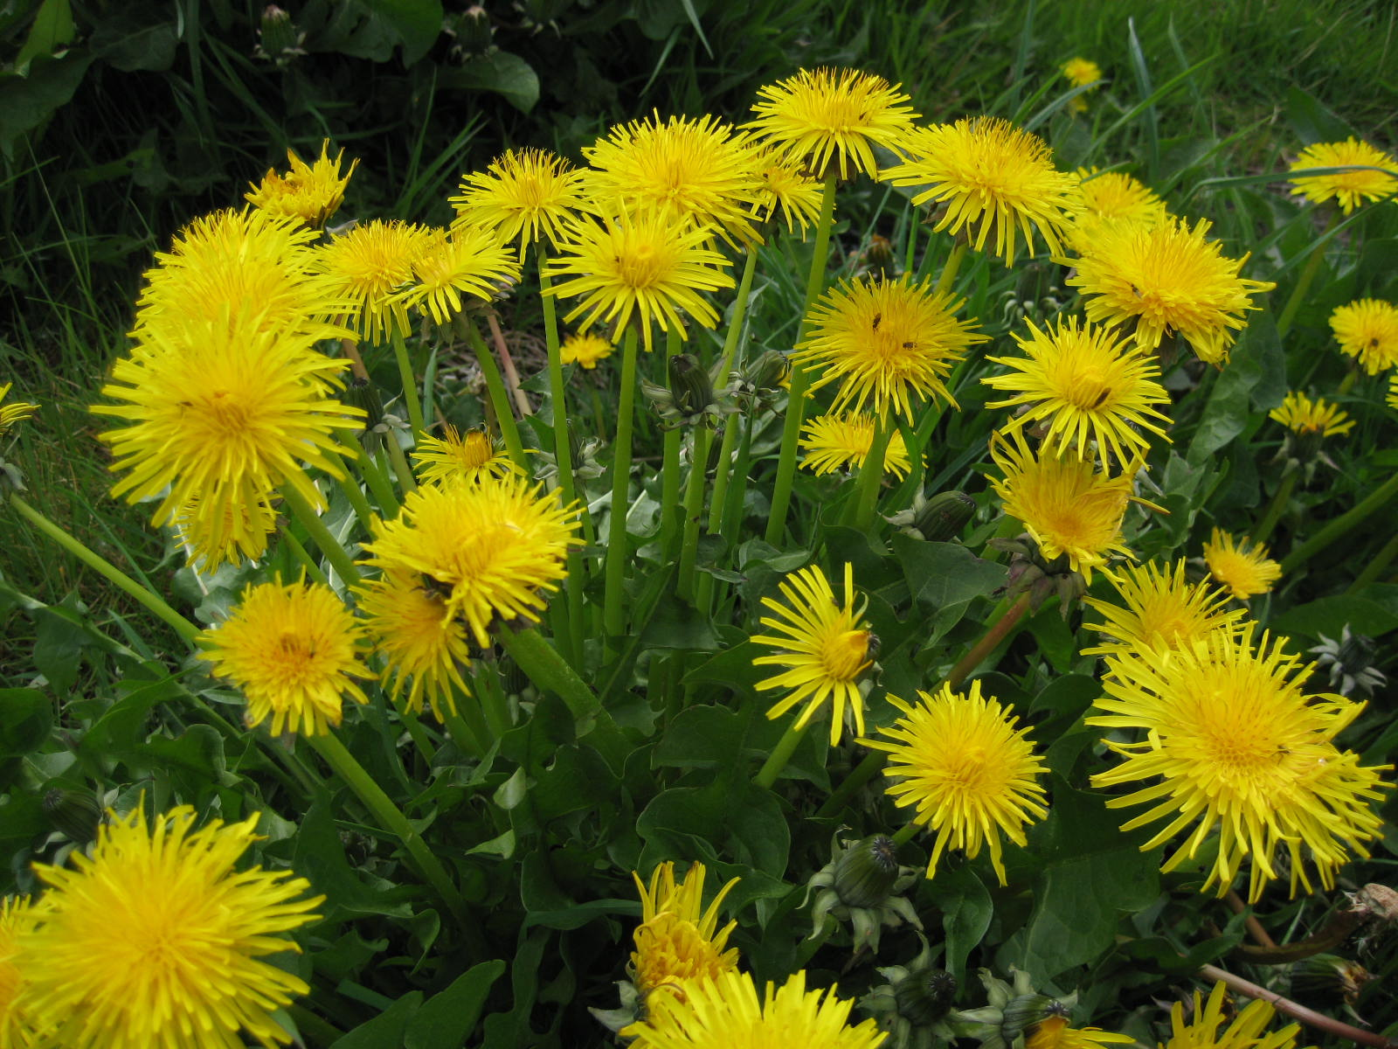
Extracts from Common Plants Can Treat Glyphosate Poisoning*
Roundup is toxic to hepatic and embryonic cells at doses far below those used in agriculture and at residue levels present in some GM food.
Extracts from common plants such as dandelions, barberry, and burdock can protect from damage, especially if administered prior to exposure.
*C Gasnier et al. Journal of Occupational Medicine and Toxicology 2011, 6:3

Slide 88
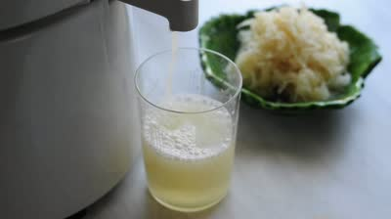
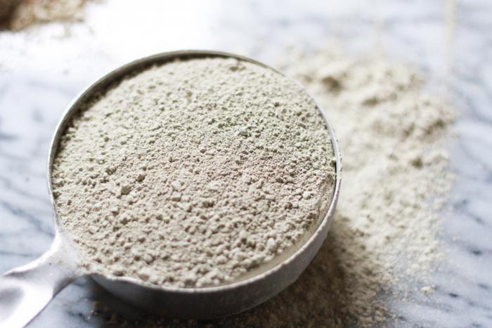
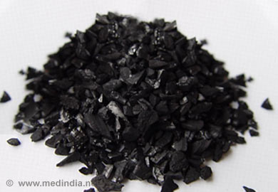
Treating Glyphosate Poisoning in Animals (e.g., cows) *
Activated charcoal, bentonite clay, humic and fulvic acids, and sauerkraut juice have been shown to be effective in reducing urinary levels of glyphosate and improving animal health
Sauerkraut
Juice
Fulvic Acid
Activated Charcoal
Bentonite Clay
*H Gerlach et al., J Environ Anal Toxicol 2014, 5:2
Notes:
Glyphosate/Monika_cows_humic_acid_fulvic_acid_treat_glyphosate.pdf
Activated charcoal
活性炭
clay
粘土
Niántǔ
Huóxìngtàn

Slide 89
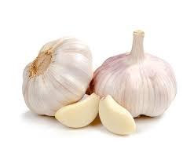
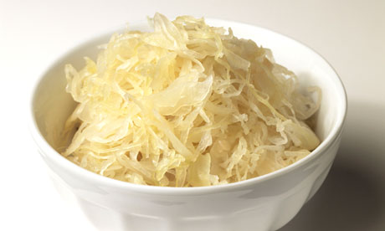
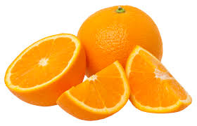
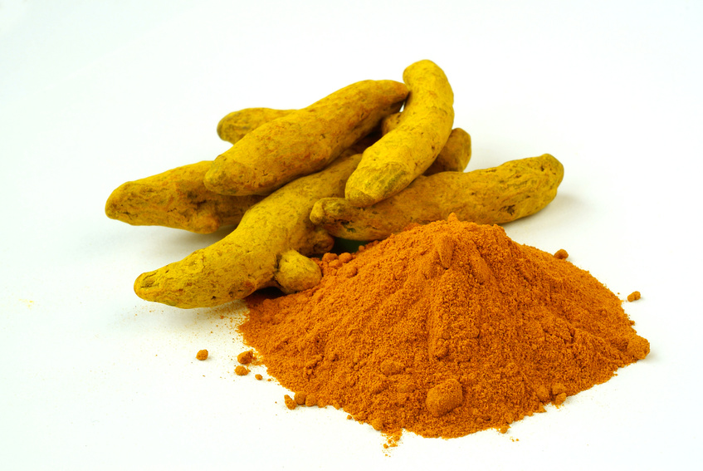
Some Important Nutrients
Curcumin
Garlic
Vitamin C
Probiotics
Methyl tetrahydrofolate
Cobalamin
Glutathione
Taurine
Epsom salt baths

Slide 90
Go Organic!

Slide 91
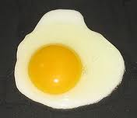
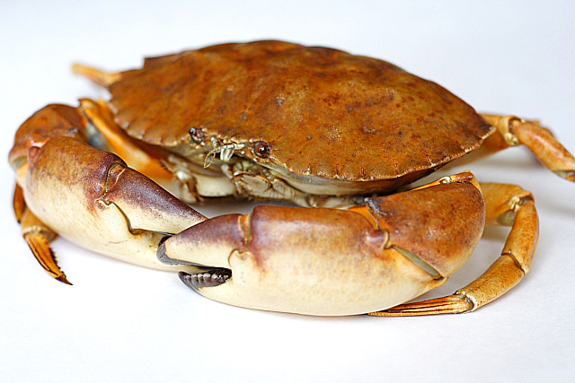
Eat Foods Containing Sulfur
Notes:
http://healthyeatingclub.com/info/books-phds/books/foodfacts/html/data/data5g.html

Slide 92
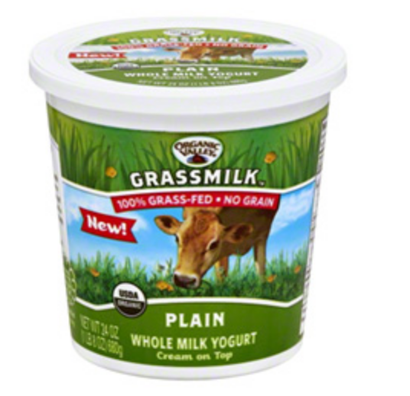
Sauerkraut and apple cider vinegar contain acetobacter, one of the very few microbes that can metabolize glyphosate
Yogurt and kimchi probably do too

Slide 93
Kefir: Natural Probiotics*
Kefir is a fermented milk product originating in the Caucasus mountains centuries ago
Can be made from milk from cows, sheep and goats
Slightly sour and carbonated
One of the most potent probiotic foods available
*https://chriskresser.com/kefir-the-not-quite-paleo-superfood/

Slide 94
Summary
MMR vaccine in collaboration with glyphosate is a major player in the autism epidemic
Autoimmune disease induced by glyphosate-contaminated viral proteins
Leaky brain barrier due to chronic glyphosate exposure in food
Glyphosate’s likely ability to get into proteins by mistake in place of glycine can explain the strong correlations we are seeing between glyphosate usage and a long list of debilitating autoimmune diseases
Celiac disease, rheumatoid arthritis, Alzheimer’s, Parkinson’s, diabetes, ALS, non Hodgkin lymphoma, etc.
Switching to an organic high-sulfur diet and probiotic foods are simple steps to improve your family’s health

