Slide 1
Download These Slides
people.csail.mit.edu/seneff/2017/WAPFSeneff2.pptx

Slide 2
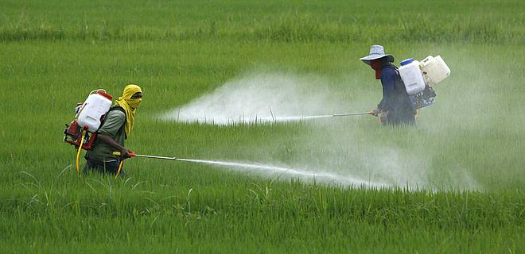
Everything You Wanted to Know about Glyphosate But Were Afraid to Ask
PART II
Stephanie Seneff
MIT CSAIL
November 11, 2017

Slide 3
“It is no measure of health to be well adjusted to a profoundly sick society.”
-Jiddu Krishnaumurti

Slide 4
Outline: Part II
Autoimmune Disease Epidemic
How Glyphosate Affects the Gut Barrier
Glyphosate in Vaccines
Gut Microbes and Flu Vaccine
Glyphosate and MMR Vaccine
Autoimmune disease through molecular mimicry
How to Safeguard Yourself and Your Family
Signs of Hope

Slide 5
Autoimmune Disease
Epidemic

Slide 6
America’s Children are in Trouble!
It is now "normal" for a kindergarten child to have 12 colds every year and for a baby to have 9
Childhood obesity has increased fourfold since the 1980s
Asthma rate has doubled since the 1980s
"Chronic illnesses" rose from 1.8% in 1960 to 7% in 2004
Today, 43% of US children are chronically ill
1 in 6 children in the USA has a neurodevelopmental disability
1 in 38 boys are autistic
US has the worst neonatal death rate of all industrialized countries
Today's children in the US will have a shortened life span compared to their parents
Source: http://www.vaccineviolence.com/
Notes:
https://www.facebook.com/groups/1409306052710440/
./TheOutliers.text
Page removed!!
— Joanna Karpasea Jones

Slide 7
Autoimmune Disease: An Invisible Epidemic*
“Taken together, the number of people suffering from autoimmune diseases is 24–50 million Americans, 16% of the US population. To put it in perspective, autoimmune disease prevalence equals heart disease and cancer combined.”
*Feldman B, Martin EM, Simms T. An Invisible Epidemic — When your body attacks itself — Autoimmune Disease; How Reframing the Data Unveils a Public Health Crisis Bigger than Cancer and Heart Disease Combined. www.tincture.io.
Notes:
Feldman B, Martin EM, Simms T. An Invisible Epidemic — When your body attacks itself — Autoimmune Disease; How Reframing the Data Unveils a Public Health Crisis Bigger than Cancer and Heart Disease Combined. www.tincture.io.
IN Beecham Seneff paper. Ref. 13.

Slide 8
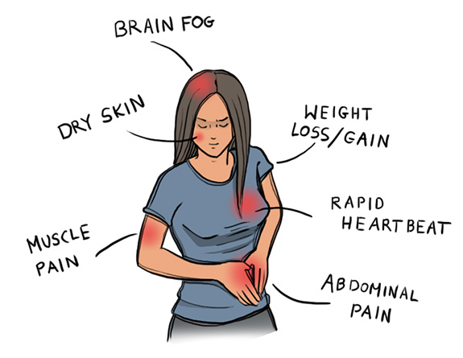
Autoimmune Disease Statistics*
Autoimmune Disease (AD) is a major health problem
Annual direct health care costs for AD in US estimated to be ~$100 billion
At least 23.5 million Americans suffer from one or more autoimmune diseases
Among the top-10 causes of death in females under 64 years old
Immunosuppressant treatments have devastating side effects
*https://www.aarda.org/autoimmune-information/autoimmune-statistics/

Slide 9
Why do we have an epidemic in
autoimmune disease in America today?

Slide 10
Hypothesis
Glyphosate exposure sets up a weakened immune system, a leaky gut barrier and a leaky brain barrier
Glyphosate contamination in proteins makes them hard to break down
Person develops overactive antibody response to foreign protein contaminated with glyphosate
Through molecular mimicry, this leads to autoimmune disease
This easily explains gluten intolerance and other food allergies

Slide 11
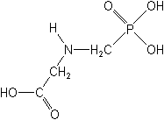
What If Glyphosate Could Insert Itself Into Protein Synthesis by Mistake???
glyphosate
Code for glycine
GGC
mRNA
. . .
. . .
Glyphosate
Alanine
Proline
Any proteins with conserved glycine residues are likely to be affected in a major way

Slide 12
Glyphosate is a non-coding amino acid analogue of glycine
H
Glycine
Glyphosate

Slide 13
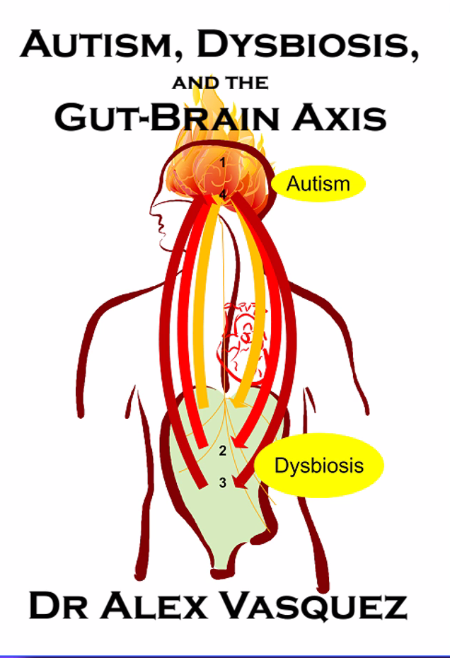
"We now know that autism is a multifaceted disorder associated with gastrointestinal inflammation, nutritional deficiencies, multiple food allergies and intolerances, impairments in liver detoxification and resultant accumulation of xenobiotics, the majority of which have neurotoxic and/or immunotoxic effects. ...
The behavioral/cognitive abnormalities are symptoms of the underlying complex and interconnected pathophysiology.”*
*Dr. Alex Vasquez. Biological Plausibility of the Gut-Brain Axis in Autism
https://vimeo.com/235896380
Notes:
https://vimeo.com/235896380
Vasquez A. Web-like interconnections of physiological factors. Integrative Medicine 2006 Apr.

Slide 14
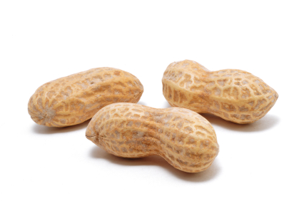
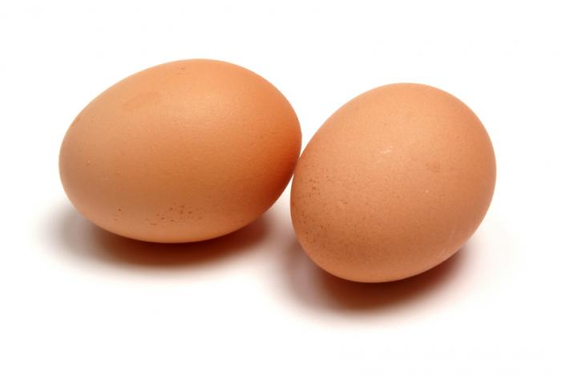
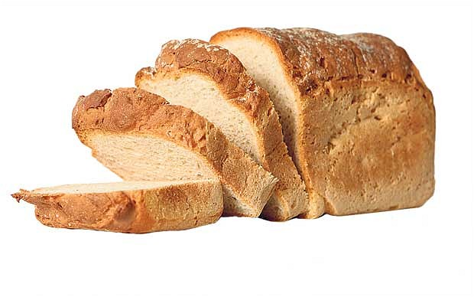
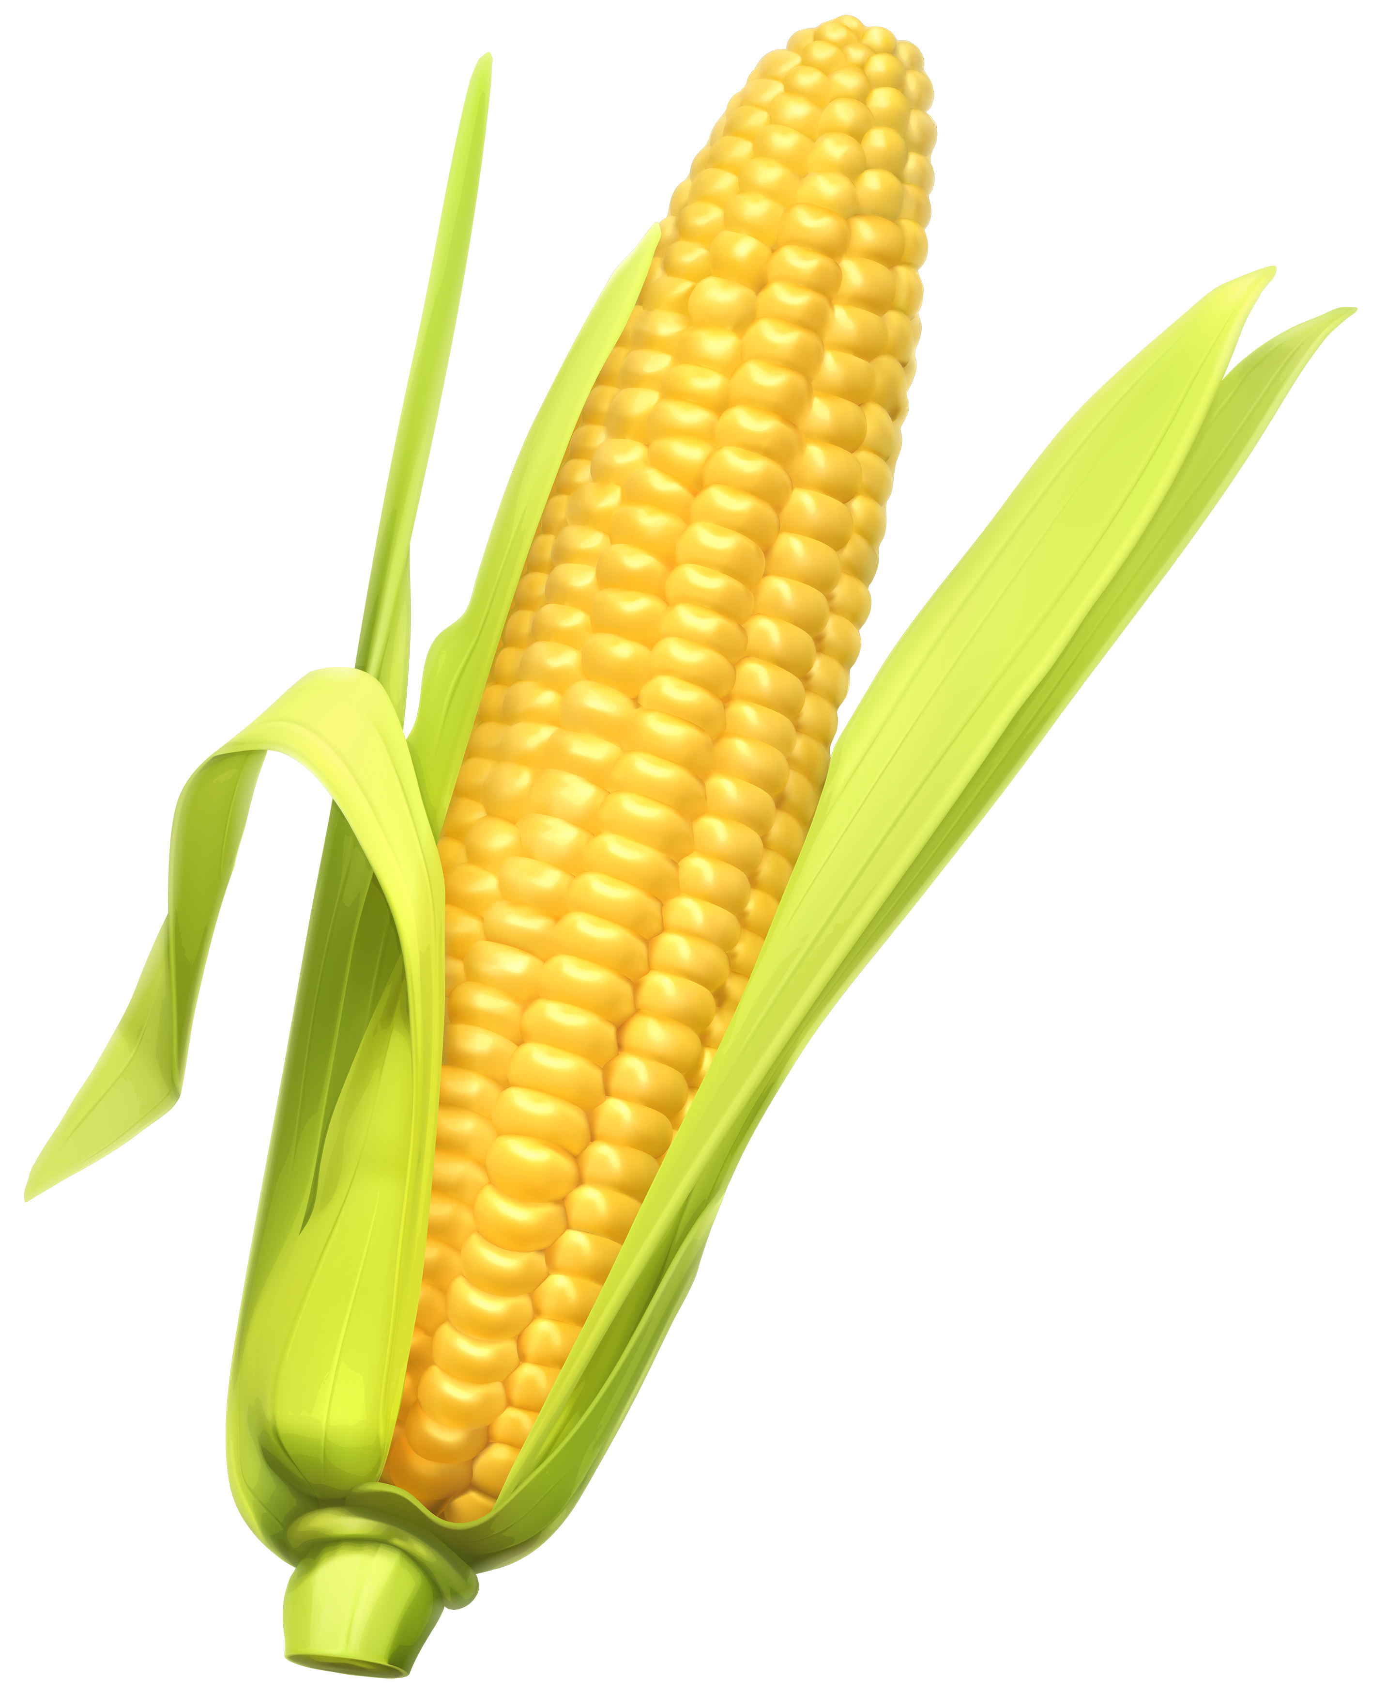
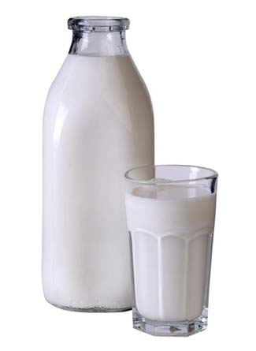
Food Allergies

Slide 15
Food Allergies
All of these foods can be expected to be contaminated with glyphosate, given how they’re produced

Slide 16
Food Allergies
"In our study, with the largest case number reported thus far, the results supported the significant association between ASDs [Autism Spectrum Disorders] and allergic diseases.”*
*J Chen et al. Int J Dev Neurosci. 2014 Jun;35:35-41.

Slide 17
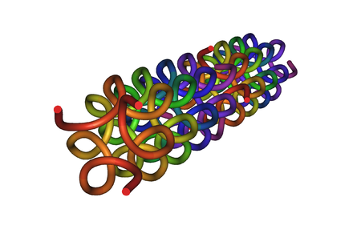
Collagen and Gelatin
25% of the protein in our body is collagen
25% of the amino acids in collagen are glycines
Glyphosate substitution for glycine will disrupt triple-helix formation and lead to diseases of the vasculature, joints and bones
Gelatin is derived from collagen in bones and ligaments sourced from cows and pigs fed glyphosate-contaminated GMO Roundup-Ready feed

Slide 18
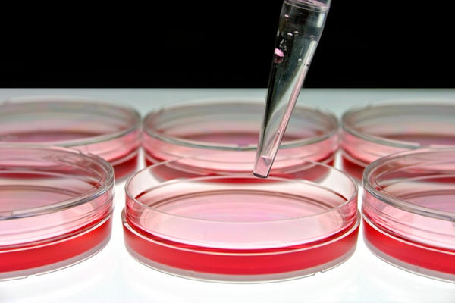
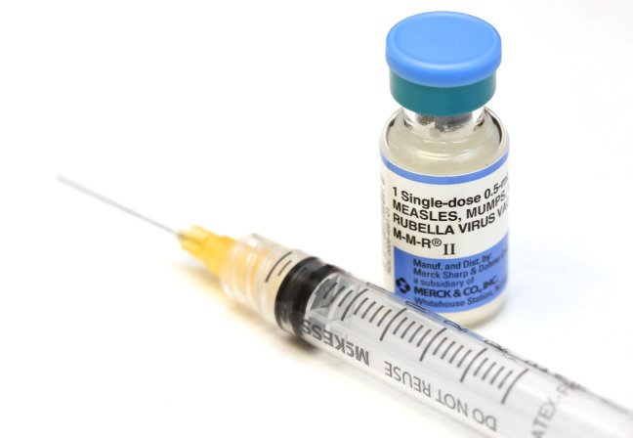
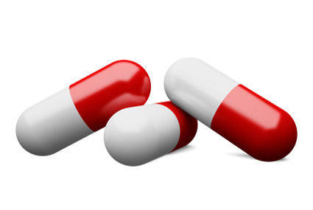
Products Containing Gelatin !!

Slide 19
Drugs and Autoimmune Disease*
Drugs that treat autoimmune disease have a huge problem with side effects
They suppress the immune system, and increase risk to tuberculosis, invasive fungal infections and lymphomas (cancers of the immune system)
Humira is a TNF-alpha inhibitor, which blocks the immune response
It costs about $3,100 per month
U.S. prescriptions for Humira have taken off in recent years: 1.5 million in 2011; 2.4 million in 2015.
It was linked to more than 209,000 adverse event reports since 2013, including more than 4,200 deaths.
* usatoday.com/story/news/nation-now/2017/03/19/
analysis-reports-drug-side-effects-increase-fivefold-12-years/99384190/
Notes:
rug_side_effects_rising_2017.text

Slide 20
Chronic Pain*
“The list of different types of chronic pain syndrome seems to be growing every day, including complex regional pain syndrome, failed back syndrome, fibromyalgia, interstitial cystitis, myofascial pain syndrome, postvasectomy pain, vulvodynia, pelvic pain syndrome – and on and on.“
*P. 42, Anna Lembke, Drug dealer, MD
.John’s Hopkins U Press, Baltimore, MD
Notes:
Book:

Slide 21
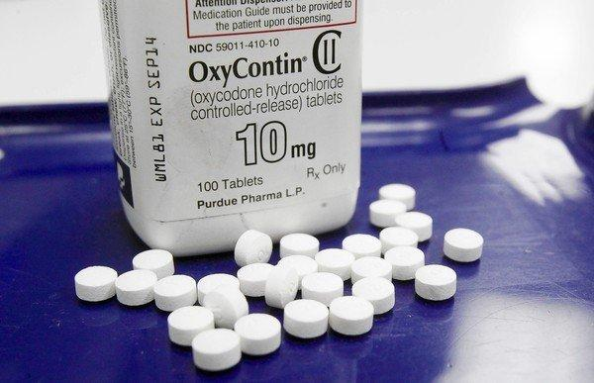
US Department of Health and Human Services Data on Pain-Killer Drug Abuse*
Drug overdose is the leading cause of injury death in the United States
Heroin, morphine, and prescription pain relievers
More people died from drug overdoses in 2014 than in any previous year on record
More than 6 out of 10 involved an opioid drug
More than 650,000 opioid prescriptions are dispensed every day
*http://www.hhs.gov/opioids/about-the-epidemic/
Notes:
./Factsheet-opioids-061516.pdf

Slide 22
US Department of Health and Human Services Data on Pain-Killer Drug Abuse*
Drug overdose is the leading cause of injury death in the United States
Heroin, morphine, and prescription pain relievers
More people died from drug overdoses in 2014 than in any previous year on record
More than 6 out of 10 involved an opioid drug
More than 650,000 opioid prescriptions are dispensed every day
According to PBS Evening News (Sept. 29, 2017), 64,000 deaths in the U.S. were attributed to opioid drug overdose in 2016
*http://www.hhs.gov/opioids/about-the-epidemic/
Notes:
./Factsheet-opioids-061516.pdf

Slide 23
How Glyphosate Affects
the Gut Barrier

Slide 24
Glyphosate and the Gut: Digestive Enzymes
Glyphosate has been found as a contaminant in digestive enzymes trypsin, pepsin and lipase*
Trypsin impairment prevents proteins like gluten in wheat from being digested
Undigested proteins induce release of zonulin which opens up gut barrier**
Zonulin lingers because trypsin is defective
*A Samsel and S Seneff. J Biol Phys Chem 2017;17:8-32
** JJ Gildea et al. J Clin Nutr Diet. 2017, 3:1.
Notes:
Glyphosate/ZachBushPaper_tight_junctions_glyphosate_2017.pdf

Slide 25
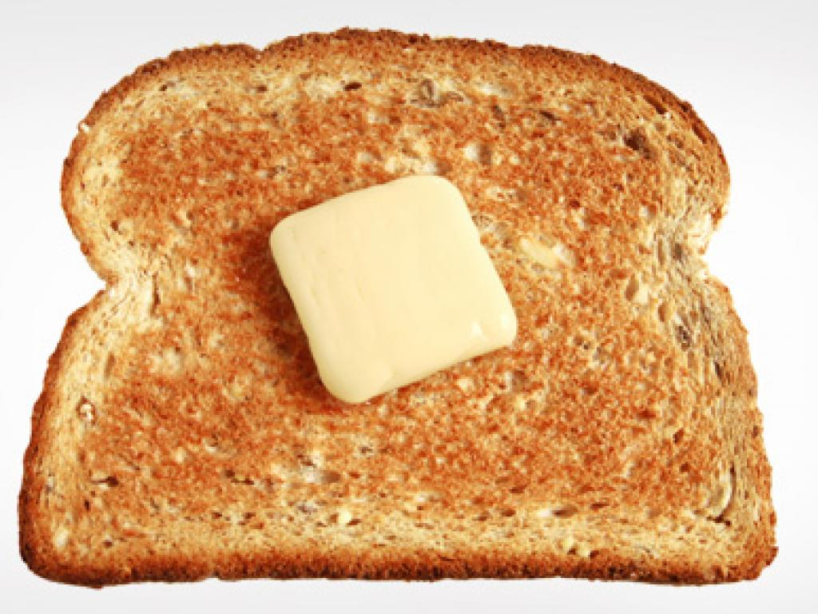
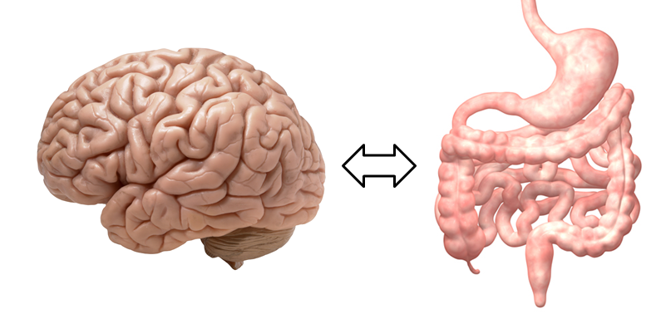
A Scenario
Glyphosate in wheat
Leaky brain barrier
Zonulin
Trypsin defective
Autoimmune disease
Zonulin released
Gliadin
Leaky barrier

Slide 26
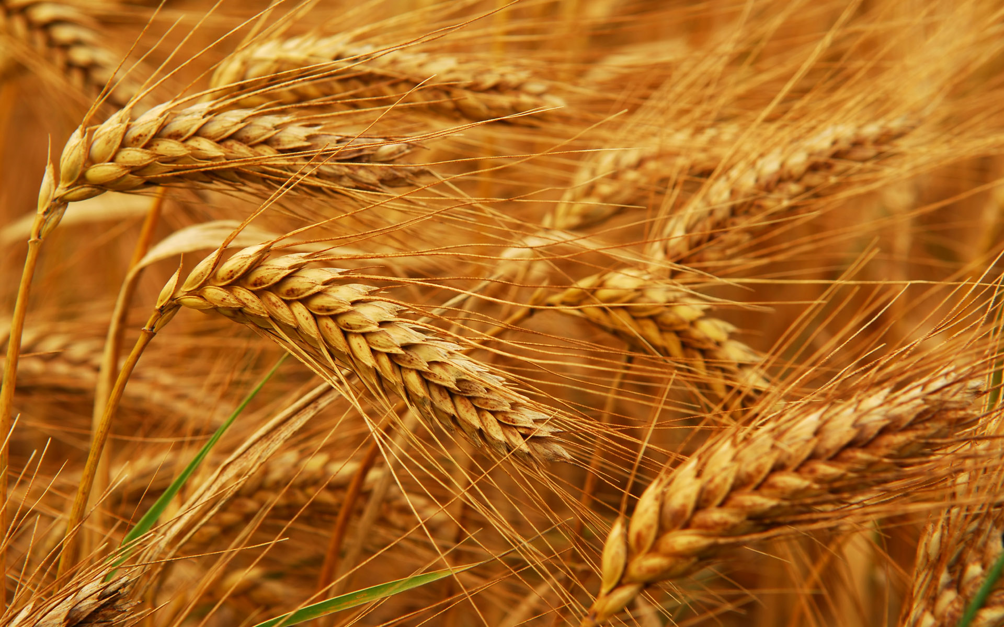
Glyphosate and Celiac Disease*
Glyphosate
Use on wheat
Celiac disease
*Samsel and Seneff, Interdiscip Toxicol. 2013;6(4): 159–184.

Slide 27
Glyphosate and the Gut: Pathogen Overgrowth
Glyphosate is an antimicrobial agent that preferentially kills beneficial microbes, allowing pathogens to flourish in the gut*
Immune cells invade the gut and release inflammatory cytokines
This causes increased risk to inflammatory bowel diseases such as Crohn’s and ulcerative colitis
* Samsel and Seneff. Entropy 2013; 15: 1416-1463.

Slide 28
*Figure 20, NL Swanson et al. Journal of Organic Systems 9(2), 2014, p. 25.

Slide 29
Evidence Linking Autism to Clostridia Overgrowth*
14 autistic children with gut disorder compared to 21 controls
Significant increase in Clostridia species in the gut in autistic children
Associated with reduced tryptophan levels and increased expression of inflammatory markers
Tryptophan is a product of the shikimate pathway, which glyphosate blocks
Macrophages in inflamed tissue take up tryptophan, reducing bioavailability to the brain
Proposed role for antibiotics
Glyphosate is a patented antimicrobial agent (2010)
*RA Luna et al., Cellular and Molecular Gastroenterology and Hepatology 2017;3(2): 218-230

Slide 30
*
Triplets: two boys, one girl. Both boys have autism and girl has seizure disorder
Very high levels of glyphosate in urine in all three
Clostridia overgrowth due to glyphosate disruption of gut microbes
Clostridia produce toxins HPHPA and p-cresol, which block the conversion of dopamine to norepinephrine.
Damage to neurons in the brain through oxidative stress
*W. Shaw. Integrative Medicine 2017;16(1);50-57.
Notes:
./Shaw_on_glyphosate_triplets_autism.text

Slide 31
Pathogen Overgrowth in Poultry Microbes Exposed to Glyphosate*
Clostridia
Salmonella
*Plot provided by Dr. Martin Michener
Notes:
From Marty Michener!
Sheehata paper.

Slide 32
Recapitulation
Glyphosate contamination in food proteins makes them hard to break down
Glyphosate contamination in digestive enzymes makes them defective
Undigested proteins induce leaky gut barrier
Glyphosate induces overgrowth of Clostridia species in gut
Clostridia release toxins that induce an inflammatory response and prevent dopamine metabolism
Studies on poultry microbiome confirm glyphosate disrupts gut microbes
Tryptophan deficiency can be explained by shikimate pathway disruption and inflammatory response
Inflammation in the brain and excessive neurostimulation by dopamine damages neurons

Slide 33
Gut Microbes
And Flu Vaccine

Slide 34
*
Jun Huh (Harvard) & Gloria Choi (MIT)
* YS Yim et al. Nature. 2017 Sep 13. [Epub ahead of print]
Notes:
reversing_autism_mice_maternal_inflammation_korean_couple.pdf
Korean_couple_study_mice_pups_2017.pdf

Slide 35
“Reversing Behavioural Abnormalities in Mice Exposed to Maternal Inflammation”*
Viral infection during pregnancy induces autism
Experiment in mice: simulated maternal viral infection (poly (I:C))
Concurrent with overexpression of specific filamentous pathogen in the mouse gut: a Clostridium species
These bacteria induce T helper 17 cell responses, a necessary factor for inducing autism
Associated with overactivation of neurons in the primary somatosensory cortex of the brain
Without the filamentous pathogen, autistic features were suppressed
*YS Yim et al. Nature 2017 [Epub ahead of print]
Notes:
reversing_autism_mice_maternal_inflammation_korean_couple.pdf
segmented filamentous bacteria

Slide 36
“Reversing Behavioural Abnormalities in Mice Exposed to Maternal Inflammation”*
Viral infection during pregnancy induces autism
Experiment in mice: simulated maternal viral infection (poly (I:C))
Concurrent with overexpression of specific filamentous pathogen in the mouse gut: a Clostridium species
These bacteria induce T helper 17 cell responses, a necessary factor for inducing autism
Associated with overactivation of neurons in the primary somatosensory cortex of the brain
Without the filamentous pathogen, autistic features were suppressed
Note that the experiment DID NOT INVOLVE live virus, but rather a molecule that simulates viral RNA (poly (I:C))
*YS Yim et al. Nature 2017 [Epub ahead of print]
Notes:
reversing_autism_mice_maternal_inflammation_korean_couple.pdf
segmented filamentous bacteria

Slide 37
"The Centers for Disease Control and Prevention currently recommend that all pregnant women get flu shots -- a dangerous proposition if immune response, rather than infection itself, is responsible for harming the fetal brain.”*
*Melinda Wenner. Scientific American Mind. pp. 46-47
Notes:
./Scientific\ American\ MIND\ article0001.pdf

Slide 38
CDC Study Shows Up to 7.7 Times the Risk of Miscarriage After Influenza Vaccine*,**
“Most alarmingly, in women who received the H1N1 vaccine in the previous flu season, the odds of spontaneous abortion in the 28 days after receiving a flu vaccine was 7.7 times greater”
*https://worldmercuryproject.org/news/cdc-study-shows-up-to-7-7-
times-the-risk-of-miscarriage-after-influenza-vaccine/
**Donahue et al. 2017 Vaccine 35:5314
Notes:
Kennedy_on_7_fold_increase_miscarriage_flu_vaccine.pdf
CDC\ spontaneous_abortion_following_second_flu_vaccine_2017.pdf

Slide 39
Association Between Influenza Infection and Vaccination During Pregnancy and Risk of Autism Spectrum Disorder*
Kaiser Permanente Study, Northern California
196,929 children; 0.7% of mothers had flu during pregnancy, 23% got flu vaccine
First-trimester influenza vaccine was associated with 20% increased ASD (Autism Spectrum Disorder) risk
Flu infection was not associated with ASD
*O Zerbo et al. JAMA Pediatr. 2017 Jan 2;171(1):e163609.
Notes:
http://jamanetwork.com/journals/jamapediatrics/article-abstract/2587559

Slide 40
Guillain-Barré after Flu Shot*
"The most commonly compensated injury in the US National Vaccine Injury Compensation Program is Guillain-Barré Syndrome occurring after the flu shot. GBS is an autoimmune reaction in which the body attacks itself causing paralysis.”
-- Andre Angelantoni. Sep 30, 2017.
*https://medium.com/@andreangelantoni/there-are-several-significant-errors-the-doctor-includes-in-her-article-6dfc196afd9b
Notes:
./flu_after_flu_shot_WOW.text

Slide 41
Glyphosate, Mercury and Autism
Glyphosate induces excess of Desulfovibrio species in gut (reduce sulfite)
Desulfovibrio converts mercury to toxic form: methyl mercury*
Desulfovibrio is associated with autism**
Flu vaccine often contains mercury***
*D Shao et al. Sci Total Environ. 2012 May 1;424:331-6.
**SM Finegold. Med Hypotheses. 2011 Aug;77(2):270-4.
*** CDC: https://www.cdc.gov/flu/protect/vaccine/thimerosal.htm
Notes:
Samantha/sulfate_reducing_bacteria_methyl_mercury.text
KeithBell_on_mercury_sulfate_reducing_bacteria_autism_WOW.text
Vaccines_thimerosal_sulfation_pathway_Geiers.pdf

Slide 42
Glyphosate, Mercury and Autism
Glyphosate induces excess of Desulfovibrio species in gut (reduce sulfite)
Desulfovibrio converts mercury to toxic form: methyl mercury*
Desulfovibrio is associated with autism**
Flu vaccine often contains mercury***
"Results of the current meta-analysis revealed that mercury is an important causal factor in the etiology of ASD. It seems that the detoxification and excretory mechanisms are impaired in ASD patients which lead to accumulation of mercury in the body.”*
*T Jafari et al. Journal of Trace Elements in Medicine and Biology 2017;44: 289-297.
Notes:
./mercury_autism_link.text
Meta analysis 44 studies.
Samantha/sulfate_reducing_bacteria_methyl_mercury.text
KeithBell_on_mercury_sulfate_reducing_bacteria_autism_WOW.text
Vaccines_thimerosal_sulfation_pathway_Geiers.pdf

Slide 43
Glyphosate and MMR Vaccine

Slide 44
Vaxxed/Unvaxxed Study*
Children aged 6-12; home-schooled
Vaccinated children were significantly less likely than the unvaccinated to have had chickenpox and pertussis
However, the vaccinated had higher rates of allergies and autism, ADHD, and/or a learning disability than the unvaccinated
*AR Mawson et al. J Transl Sci 2017; 3(3): 1-12.
Notes:
Mawson_et_al_vaxxed_unvaxxed_study_2017.pdf

Slide 45
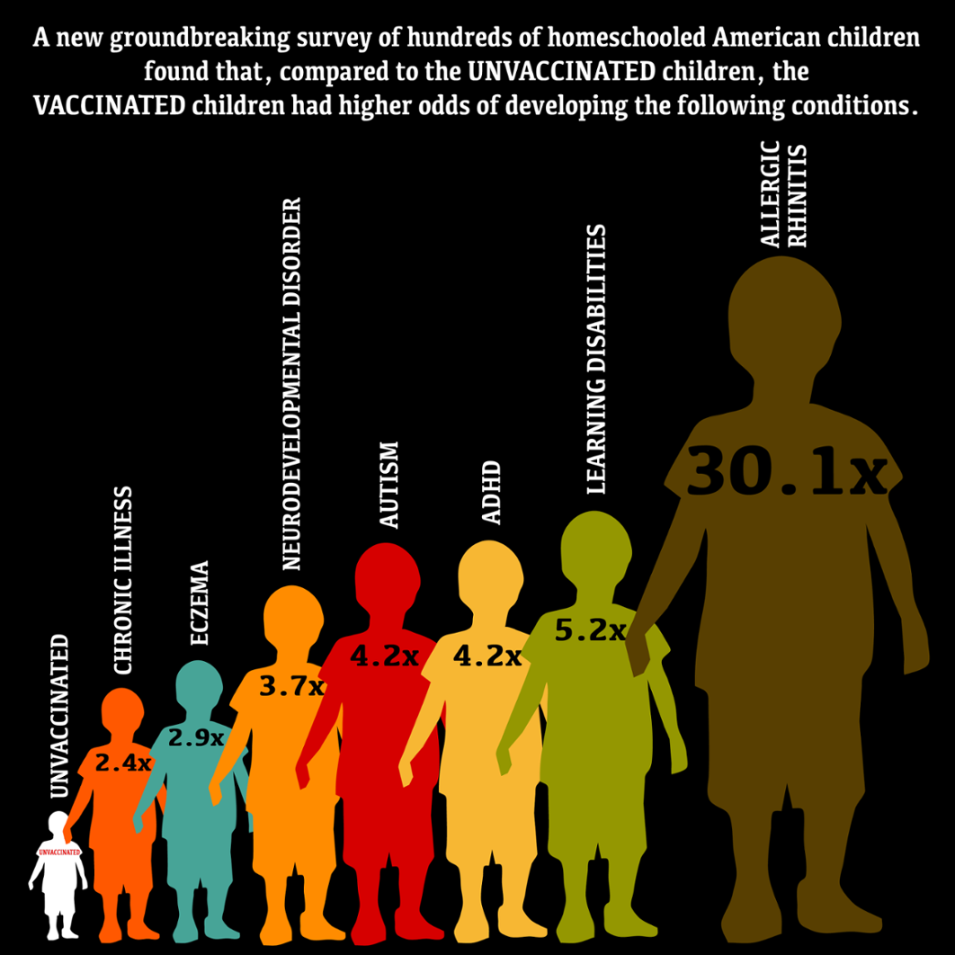
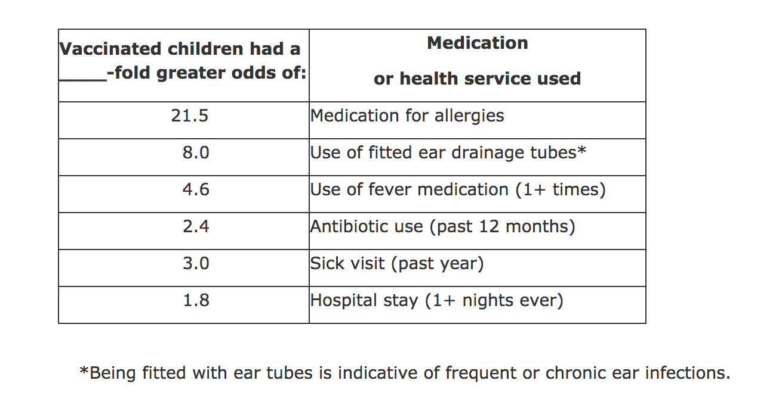
Vaxxed/Unvaxxed Study, Results*
*AR Mawson et al. J Transl Sci 2017; 3(3): 1-12.
Notes:
NDD = neurodevelopmental delay

Slide 46
MMR and Autism
Andrew Wakefield found a connection in 1998 in a now retracted publication*
CDC claimed proof of no link in 2004 paper**
Whistleblower, Dr. William Thompson, has stated:
Data supported significant increased risk for autism in black males with early vaccine
Demand for birth certificate hid this finding
*A Wakefield et al., The Lancet 1998; 351 (9103): 637–41. (RETRACTED)
**F DeStefano et al., Pediatrics 2004;113;259-266 .

Slide 47
Somali Parents’ Rational Concerns About Vaccine Safety*
Measles outbreak in Minnesota blamed on low vaccination rate among Somalis.
79 confirmed cases, no deaths or disabilities
Risk of death from measles is 1 in 1,785,000.
Only 1 confirmed death from measles in US since 2003
Risk of disability from measles is 1 in 2 million.
Risk of severe autism in Somalis in Minnesota is 1 in 32 (highest rate in the world).
Somalis don't have a word for autism in their language.
*RF Kennedy, Jr. worldmercuryproject.org/news/somali-parents-rational-concerns-vaccine-safety
Oct. 19,2017
Notes:
./Minneapolis_somalis.text

Slide 48
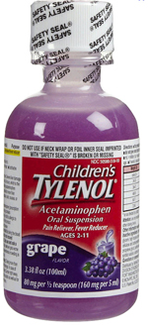
"Empirical Data Confirm Autism Symptoms Related to Aluminum and Acetaminophen Exposure”*
We found a significant link between MMR and autism ( p = 0.007)
We were puzzled, because it doesn’t contain aluminum and it doesn’t contain mercury
We blamed it on the acetaminophen
We were partly right!
Glyphosate suppresses the liver CYP enzymes that are needed to metabolize acetaminophen
*S Seneff et al., Entropy 2012, 14, 2227-2253.

Slide 49
“Sulphation Deficit in `Low-Functioning’ Autistic Children: a Pilot Study.”*
Specifically looked at ability to metabolize acetaminophen
Found highly statistically significant result:
Autistic kids were unable to conjugate acetaminophen with sulfate! (p < .00002)
Glyphosate disrupts multiple enzymes involved in sulfation pathway in E coli**
*AA Pirrone et al., Biol Psychiatry. 1999 Aug 1;46(3):420-4.
**W. Lu et al., Mol. BioSyst., 2013, 9, 522-530.
Notes:
Sulfation_deficit_autism.text
glyphosate_alters_expression_of_many_genes_E_coli_2013.pdf

Slide 50
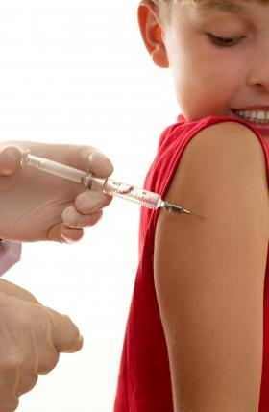
Glutamate is an Additive in Vaccines!
Flu vaccines (FluMist), MMR (measles, mumps and rubella), Rabies vaccine and Varicella vaccine (chicken pox) all contain glutamate
Anecdotal evidence links these vaccines with autism
My own studies on VAERS revealed a correlation between autism and MMR*
Glyphosate’s depletion of manganese prevents glutamate breakdown
*S. Seneff et al., Entropy 2012, 14, 2227-2253.
Notes:
Seizures facial swelling anaphylactic shock
Joint pain

Slide 51
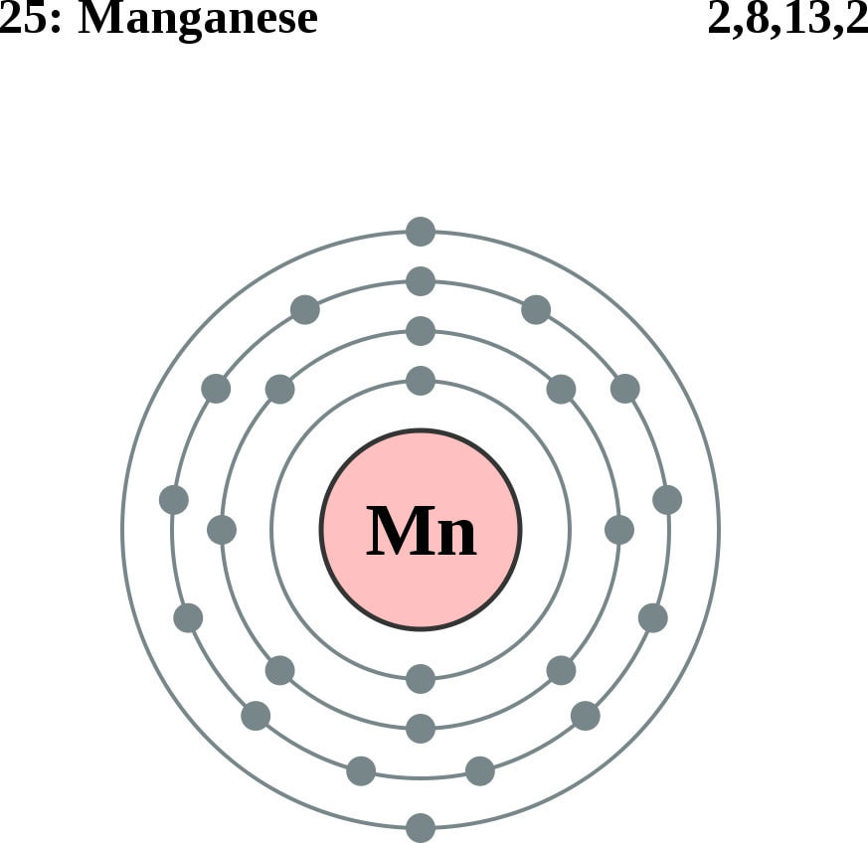
Glutamate Detoxification Depends on Manganese!
Glutamine synthetase
glutamate
glutamine
water
ammonium
Ammonium and glutamate toxicity in the brain
can arise because of insufficient manganese

Slide 52
“Alteration of Plasma Glutamate and Glutamine Levels in Children with High-Functioning Autism”*
*C. Shimmura et al. PLoSone October 2011 6(1):e25340
Notes:
Table 1. Plasma Levels of Amino Acids and related compounds in Control Subjects and Individuals with HFA.
Glyphosate/glutamate_glutamine_autism_2011.pdf

Slide 53
Glyphosate in Vaccines?
For MMR, flu vaccine, and rabies vaccine, live virus is grown on gelatin derived from ligaments of pigs and fetal bovine serum
Cows and pigs are fed GMO Roundup-Ready corn and soy feed
Gelatin is derived from collagen which is highly enriched in glycine and also contains glutamate
These two neurotransmitters excite the NMDA receptors in the brain
Glyphosate stimulation of NMDA receptors could cause neuronal burnout

Slide 54
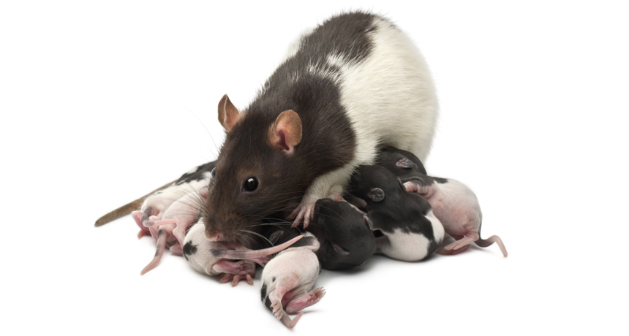
Glyphosate Excites NMDA Receptors in Hippocampus*,**
Excess glutamate in synapse leads to neuronal burnout
*D Cattani et al. Toxicology 2014; 320:34-45.
**D Cattani et al. Toxicology 2017 [Epub ahead of print]
Notes:
./glyphosate_rat_hippocampus_glutamate_depression_2017.pdf
70 mg of glyphosate/Kg/day. 0- way below alleged level of toxicity.
Acetylcholinase inhibition as well.
On the other hand, the activity of GGT was induced by GBH exposure (Figure 7G),

Slide 55
Glyphosate Excites NMDA Receptors in Hippocampus*,**
Excess glutamate in synapse leads to neuronal burnout
Rats exposed to glyphosate perinatally exhibited depressive behaviors
*D Cattani et al. Toxicology 2014; 320:34-45.
**D Cattani et al. Toxicology 2017 [Epub ahead of print]
Notes:
./glyphosate_rat_hippocampus_glutamate_depression_2017.pdf

Slide 56
Glyphosate Excites NMDA Receptors in Hippocampus*,**
Excess glutamate in synapse leads to neuronal burnout
Glutamate is elevated in the blood in association with autism, and blood glutamate levels correlate with brain glutamate levels.*
*Z Zheng et al. PLOS ONE 2016; 11(7): e0158688.
Notes:
./glyphosate_rat_hippocampus_glutamate_depression_2017.pdf

Slide 57
Intranasal glyphosate-based herbicide caused behavioral disorders in mice
Decreased locomotor activity
Caused anxiety
Produced memory deficits

Slide 58
Autism, Glyphosate, Vaccine Reactions*
Glyphosate application to corn and soy, US
Children with Autism, US
# Adverse Reactions in VAERS
*Data readily available from the CDC, FDA (VAERS) and USDA
Notes:
Individuals with Disabilities Education Act

Slide 59
*A Samsel and S Seneff, Journal of Biological Physics and Chemistry 2017;17:8-32.

Slide 60
… Most disturbing is the presence of glyphosate in many popular vaccines including the measles, mumps and rubella (MMR) vaccine, which we have verified here for the first time.
*A Samsel and S Seneff, Journal of Biological Physics and Chemistry 2017;17:8-32.

Slide 61
Glyphosate Contamination in Vaccines (Parts Per Billion)*
Merck ZOSTAVAX 0.62 Shingles
Merck MMR-II 3.74 Measles, Mumps and Rubella
Merck VARIVAX 0.56 Varicella, Chicken Pox
MERCK PNEUMOVAX ND Pneumococcal 18
MERCK PROQUAD 0.66 Measles, Mumps, Rubella, Varicella
GSK ENERGIX-B 0.34 Heptatitis B
Novartis INFLUENZA 0.23 Flu
*A Samsel and S Seneff, Journal of Biological Physics and Chemistry 2017;17:8-32.

Slide 62
Symptoms of Adverse Reactions to MMR before and after 2002*
Data analyzed from the VAERS database
*A Samsel and S Seneff. J Biol Phys Chem 2017;17:8-32

Slide 63
Symptoms of Adverse Reactions to MMR before and after 2002*
Joint pain
seizures
shortness of breath
hives
These are all characteristic symptoms of allergies to MSG
eczema
anaphylactic shock
Facial swelling
swelling
swelling
Data analyzed from the VAERS database
*A Samsel and S Seneff. J Biol Phys Chem 2017;17:8-32

Slide 64
Recapitulation
Vaxxed/Unvaxxed study reveals neurological and autoimmune disease prevalence among the vaxxed
MMR vaccine may be causal factor in autism epidemic
Glutamate toxicity
Acetaminophen toxicity (impaired sulfation)
Glyphosate contamination
Glyphosate and glutamate are synergistically neurotoxic through excitation of NMDA receptors

Slide 65
Autoimmune Disease through
Molecular Mimicry

Slide 66
“Nobel Laureate Charles Richet demonstrated over a hundred years ago that injecting a protein into animals or humans causes immune system sensitization to that protein. Subsequent exposure to the protein can result in allergic reactions or anaphylaxis. This fact has since been demonstrated over and over again in humans and animal models.”
Notes:
./vaccine_protein_causes_food_allergies.pdf

Slide 67
Large Proteins in Vaccines: Allergenic*
“Vaccines clog our lymphatic system and lymph nodes with large protein molecules which have not been adequately broken down by our digestive processes, since vaccines bypass digestion with injections. This is why vaccines are linked to allergies, because they contain large proteins which as circulating immune complexes (CICs) or 'klinkers’ cause our body to become allergic.”
*Dave Mihalovic, ND, http://whale.to/v/vaccines_cause_allergies.html

Slide 68
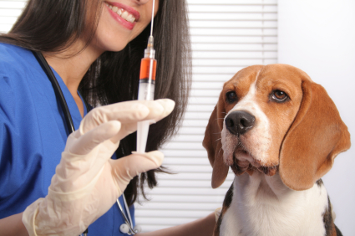
The Purdue Vaccination Studies and Autoantibodies*
“The Purdue studies … found that vaccinated dogs were developing autoantibodies to their own collagen”
*http://www.dogsnaturallymagazine.com/purdue-vaccination-studies/

Slide 69
A Scenario
1. Child is vaccinated with MMR
2. Live measles virus infects gut
6. Zonulin induces leaky brain barrier
3. Measles haemagglutinin undigested
6. Measles virus infects brain
4. Induces leaky gut
7. Brain’s immune system produces antibodies
5. Measles virus
8. Autoantibodies attack myelin sheath
5. Zonulin

Slide 70
Measles Virus and Haemagglutinin*
The measles virus synthesizes the protein haemagglutinin
Antibodies to haemagglutinin are essential following MMR vaccination to induce immunity
Measles virus infects brain due to leaky barrier
Haemagglutin bears a sequence resemblance to myelin basic protein (MBP) → potential for autoimmune reaction
MBP is essential for the formation of the myelin sheath surrounding nerve fibers
Autoantibodies to MBP along with excessive levels of antibodies to measles haemagglutinin are linked to autism**
*Oldstone, MBA, Ed. Molecular mimicry: Infection inducing autoimmune disease.
Springer Berlin Heidelberg; January 9, 2006.
**VK Singh et al., J Biomed Sci 2002;9(4):359-64.

Slide 71
Autism and Measles Haemagglutinin*
125 autistic children and 92 control children
60% of the children with autism had high levels of antibodies to measles haemagglutinin specific to the MMR vaccine
90% of these had autoantibodies to myelin basic protein (MBP)
0% of the control children had high antibody titers to either haemagglutinin or MBP
There were no elevations in antibodies detected against any proteins in the mumps or rubella viruses
*VK Singh et al., J Biomed Sci 2002;9(4):359-64.

Slide 72
Recapitulation
Many vaccines contain proteins that can be allergenic, including food proteins such as soy, casein, peanuts
Injected proteins bypass gut metabolism
Vaccinated dogs are developing autoimmune attack on collagen – glyphosate connection?
Is this a problem with humans as well?
Measles haemagglutinin in MMR is linked to autism through molecular mimicry
Myelin sheath attacked by brain’s immune system
Autistic children had much higher titers of antigens to haemagglutinin, as well as autoantibodies to myelin basic protein

Slide 73
How to Safeguard Yourself
and Your Family

Slide 74
Some Strategies Clinicians are Using to Treat Autism and Other Diseases
Switch to 100% certified organic diet rich in sulfur, fermented foods and flavonoids (colorful fruits and vegetables), herbs, spices
Vancomycin antibiotic (preferentially kills Clostridia species) followed by …
Fecal transplant and/or probiotic supplements
Treat glyphosate-contaminated water with reverse osmosis filter and then add back minerals
Fulvic acid and humic acid (soil organic matter) and bentonite clay can bind glyphosate and clear it through feces

Slide 75
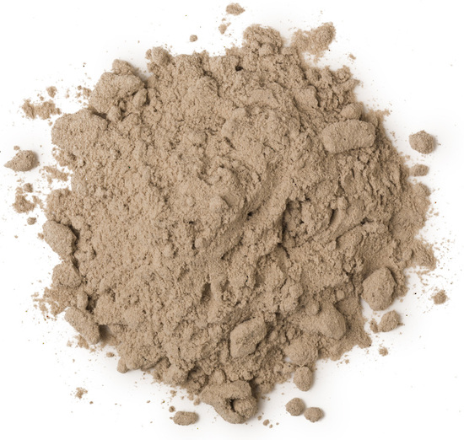
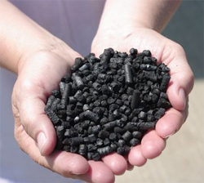
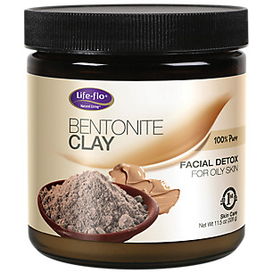
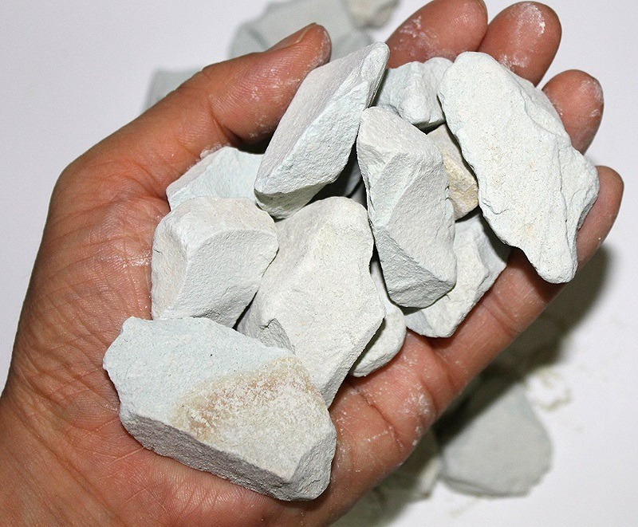
Biochar, Bentonite and Zeolite to Maintain Healthy Microbial Distribution in Poultry*
*TP Prasai et al. PLoS ONE 11(4): e0154061.
Notes:
Moore\ et\ al\ 2016\ Biochar,\ bentonite\ and\ zeolite\ supplemented\ feeding\ for\ layer\ chickens\ alters\ intestional\ microbiota.pdf .
Reduce need for antibiotics
Redistribute gut microbes

Slide 76
Anecdotal Evidence of Benefits of Fulvic Acid*
"In the last year I have become increasingly sick with ataxia, balance problems, muscle weakness, numbness in the hands and feet and a 'foggy' brain
… To cut a long story short, Jim suggested Fulvic Acid as a detox.
At 10 days the effects started to 'kick in' and by 14 days it was as if a fog had been lifted from my brain. My muscle weakness has gone, I can walk for 2 hours and I can swim in the sea.”
"It is a miracle."
*Shared by Nico DaVinci, personal communication concerning a patient
Notes:
Check with Nico DaVinci before showing this
THIS IS ROSEMARY MASON – she is getting a cholinesterase test.
See: RosemaryMason_story.text
Testimony_fulvic_acid.text

Slide 77
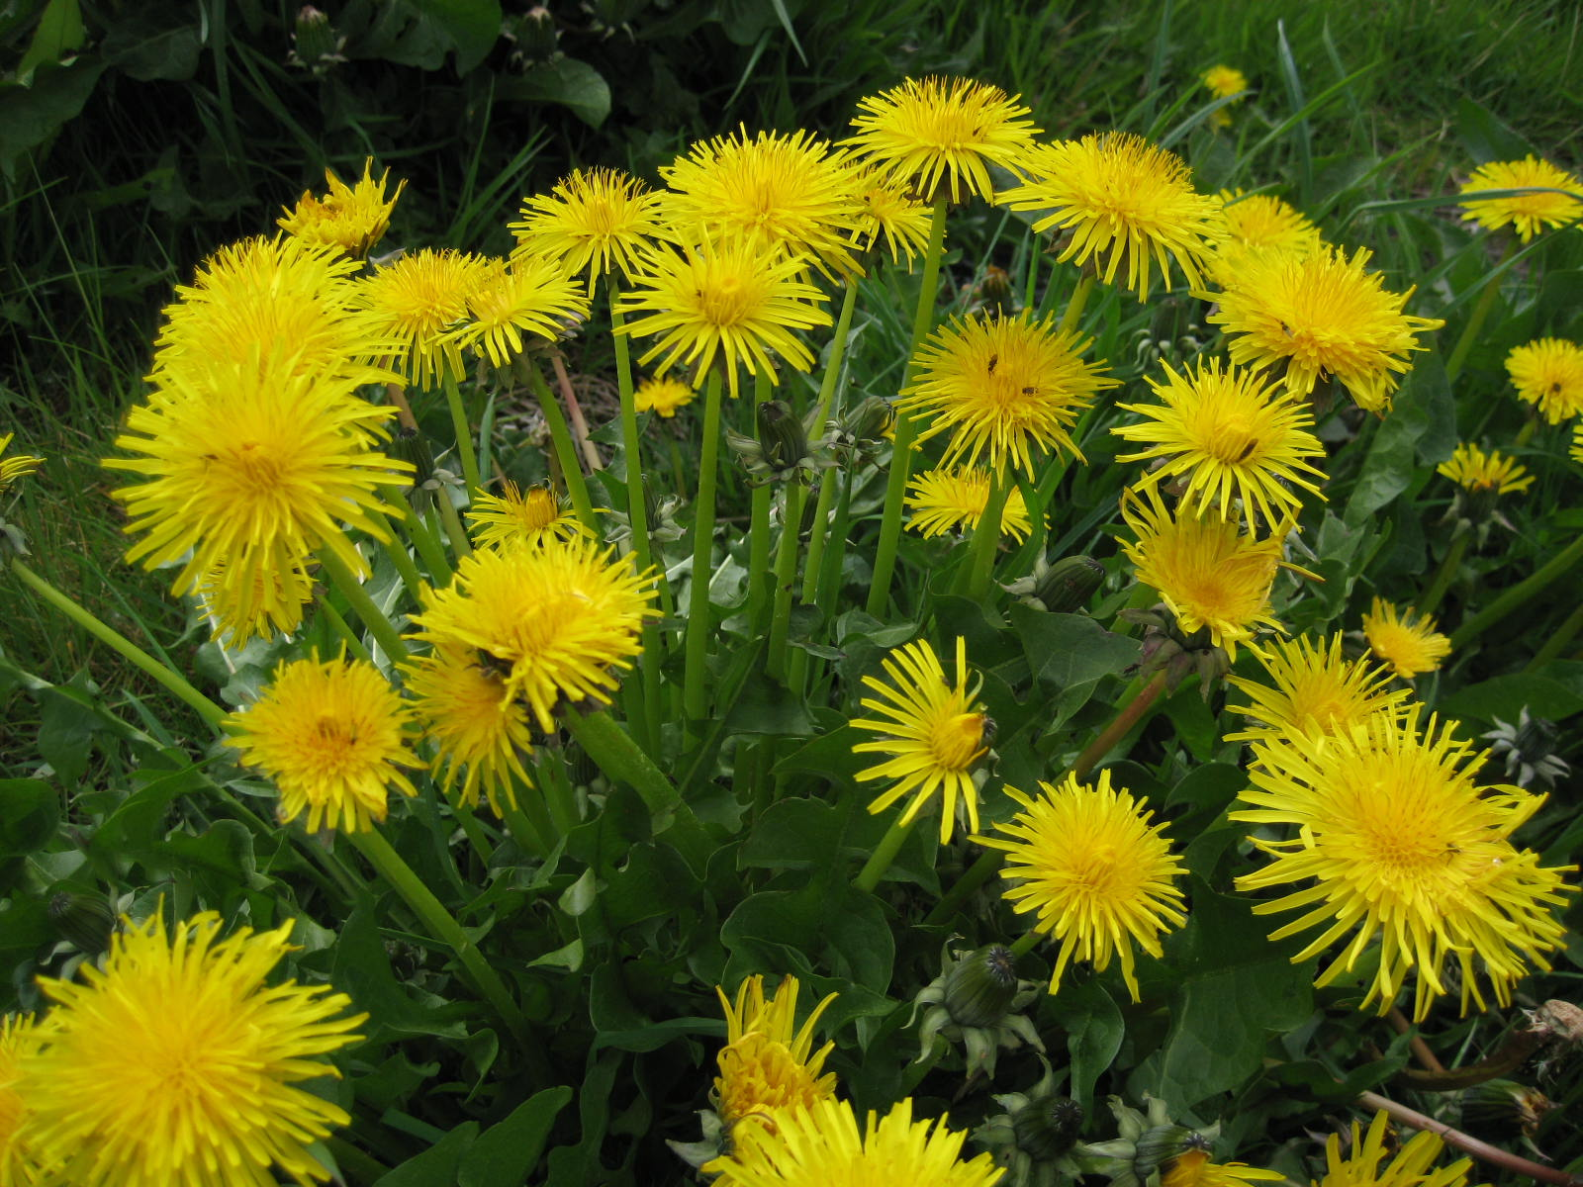
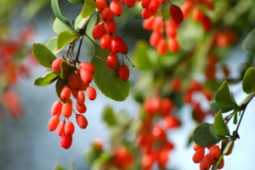
Extracts from Common Plants Can Treat Glyphosate Poisoning*
Roundup is toxic to hepatic and embryonic cells at doses far below those used in agriculture and at residue levels present in some GM food.
Extracts from common plants such as dandelions, barberry, and burdock can protect from damage, especially if administered prior to exposure.
*C Gasnier et al. Journal of Occupational Medicine and Toxicology 2011, 6:3

Slide 78
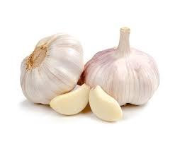
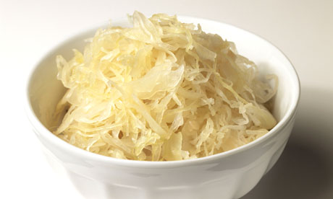
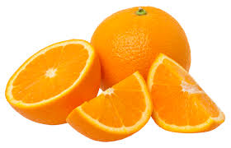
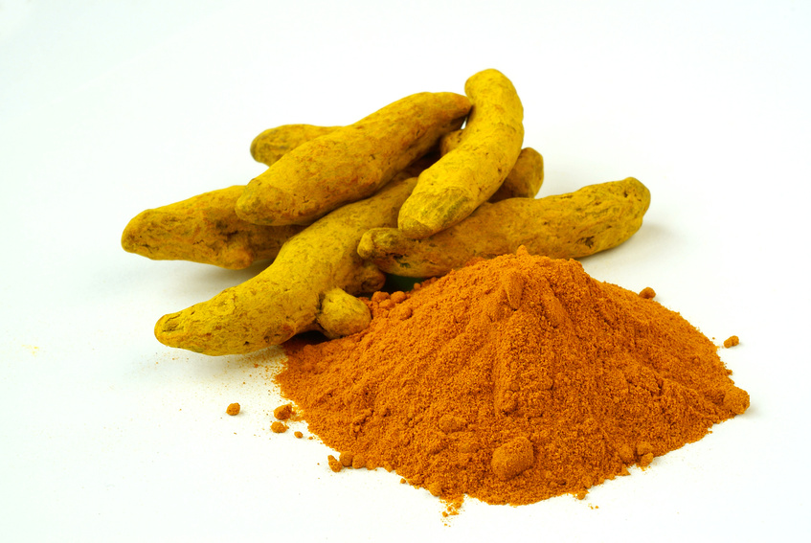
Some Important Nutrients
Curcumin
Garlic
Vitamin C
Probiotics
Methyl tetrahydrofolate
Cobalamin
Glutathione
Taurine
Epsom salt baths

Slide 79
Go Organic!

Slide 80
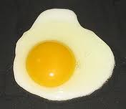
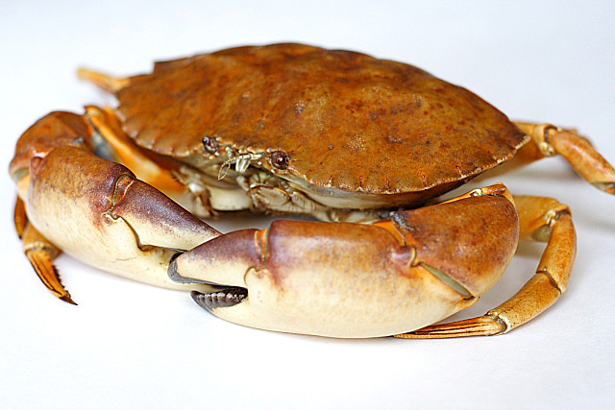
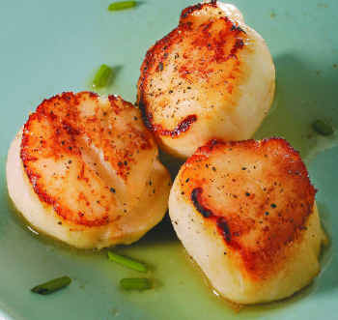
Eat Foods Containing Sulfur
Notes:
http://healthyeatingclub.com/info/books-phds/books/foodfacts/html/data/data5g.html

Slide 81
Sauerkraut and apple cider vinegar contain acetobacter, one of the very few microbes that can metabolize glyphosate
Yogurt and kimchi probably do too

Slide 82
Kefir: Natural Probiotics*
Kefir is a fermented milk product originating in the Caucasus mountains centuries ago
Can be made from milk from cows, sheep and goats
Slightly sour and carbonated
One of the most potent probiotic foods available
*https://chriskresser.com/kefir-the-not-quite-paleo-superfood/

Slide 83
Summary
Glyphosate’s insidious cumulative toxicity may be due to its ability to get into proteins by mistake in place of glycine
Autoimmune disease leading to excessive pain may explain the opioid drug abuse epidemic
Glyphosate has been detected in multiple vaccines, with highest concentrations in MMR
Glyphosate and glutamate (from the vaccine) can excite NMDA receptors, and cause neuronal burnout
Glyphosate contamination leads to resistance to breakdown and autoimmune disease through molecular mimicry
A causal link between MMR and autism can be explained through autoimmune attack on myelin basic protein via molecular mimicry with measles haemagglutinin
Multiple large proteins found in vaccines are allergenic and they may be a causal factor in food allergies and anaphylaxis

Slide 84
Signs of Hope…

Slide 85
The Big Picture
Background
Weeds → Roundup → Glyphosate
Mega farms => GMOs (Roundup-Ready Crops)
The Problem
We were told glyphosate is safe, since it disrupts the shikimate pathway that humans do not have
But our gut bacteria have it, and they provide essential services to us
Consequences
Incidence of many diseases has sky-rocketed
Many creatures are affected; the earth is suffering
What to do
Change the way we grow and consume food
Educate and investigate
Advocate → legislate, litigate
Extend our time horizon → for our grandchildren's’ grandchildren

Slide 88
This is Good News!*
*https://www.ams.usda.gov/press-release/
2016-count-certified-organic-operations-shows-continued-growth-us-market

Slide 89
Certified Glyphosate Free
The certification was granted by The Detox Project, an independent research and certification organization

Slide 90
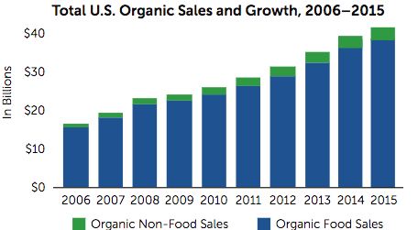
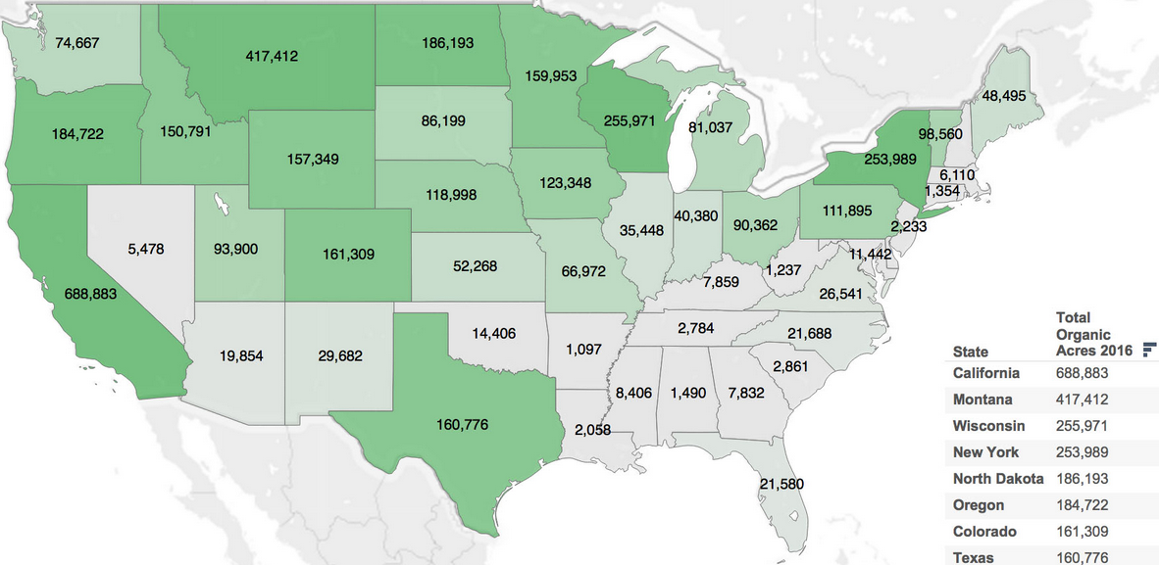
Growth of Organic Farms and Foods

Slide 91
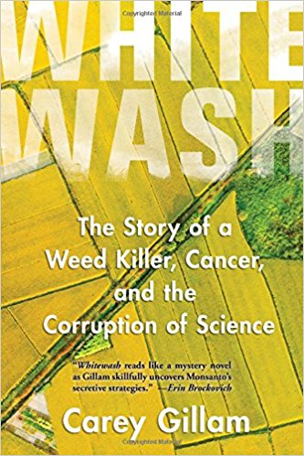
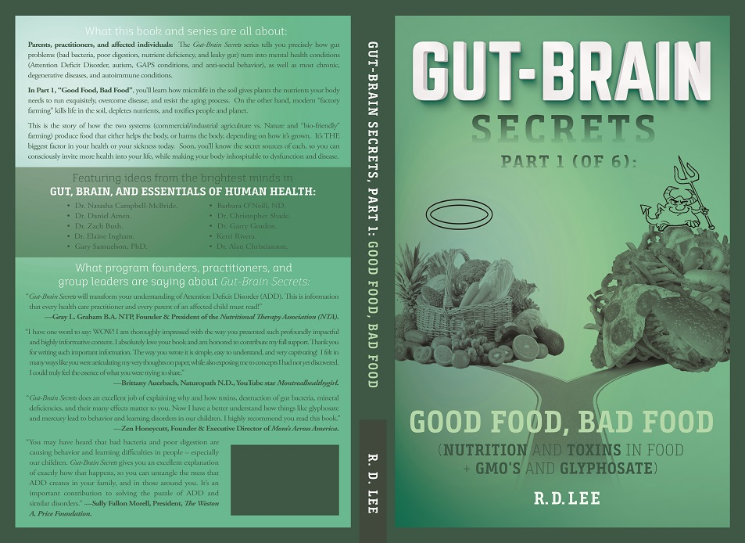
Educate

Slide 92
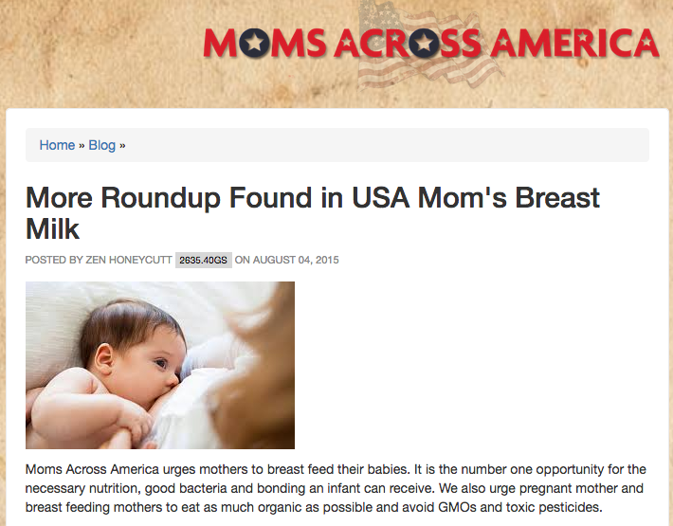
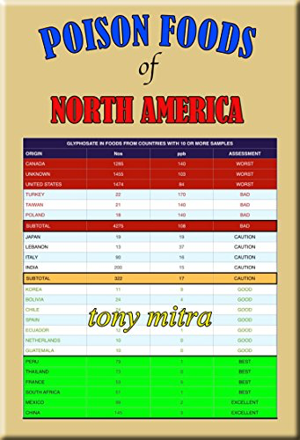
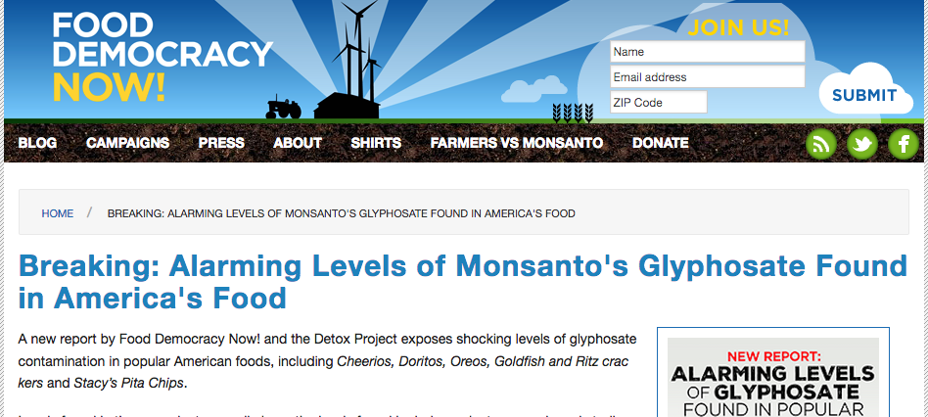
Investigate and Advocate

Slide 93
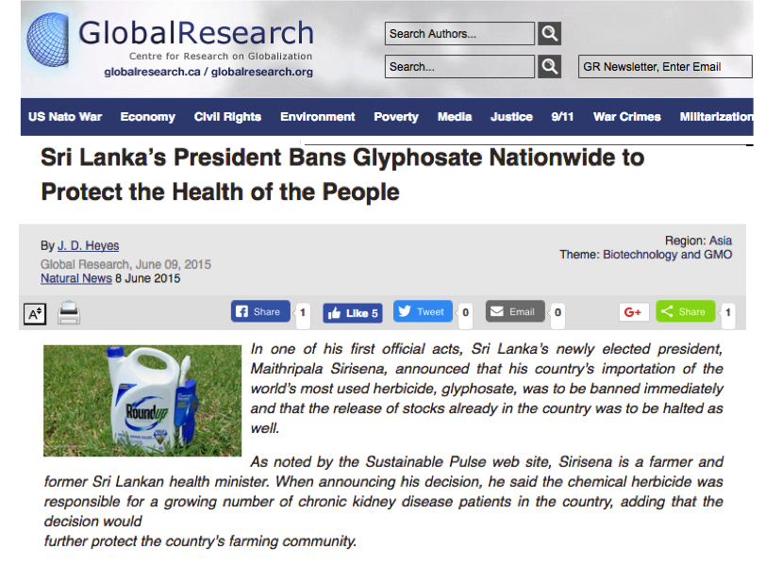
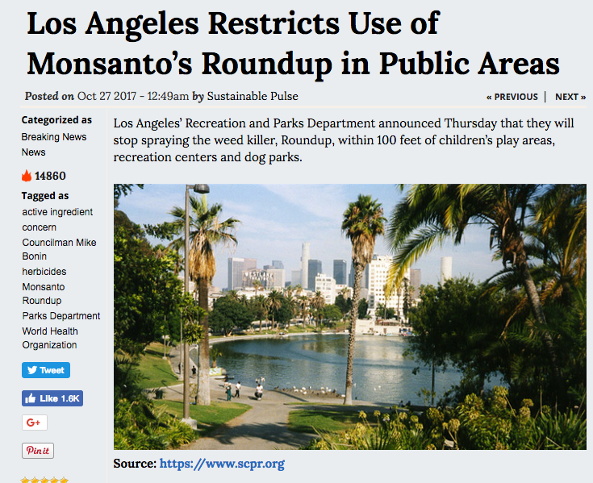
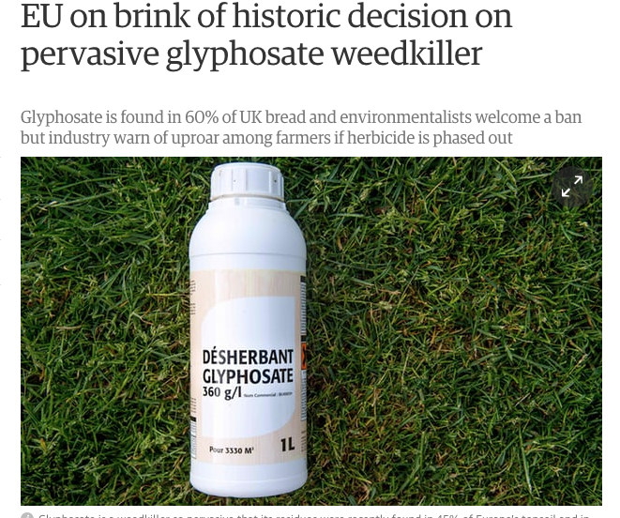
Legislate

Slide 94
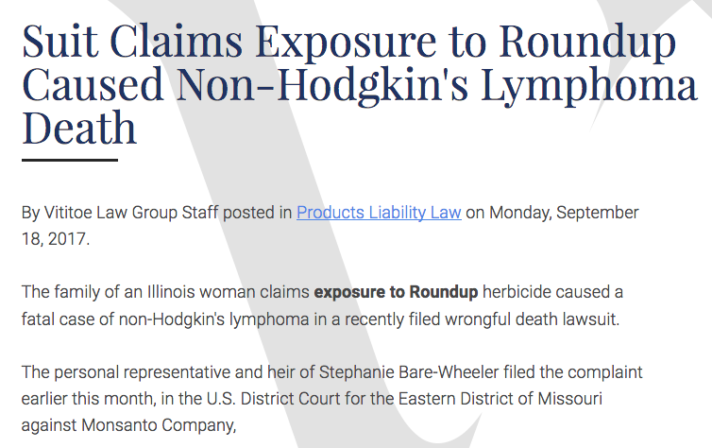
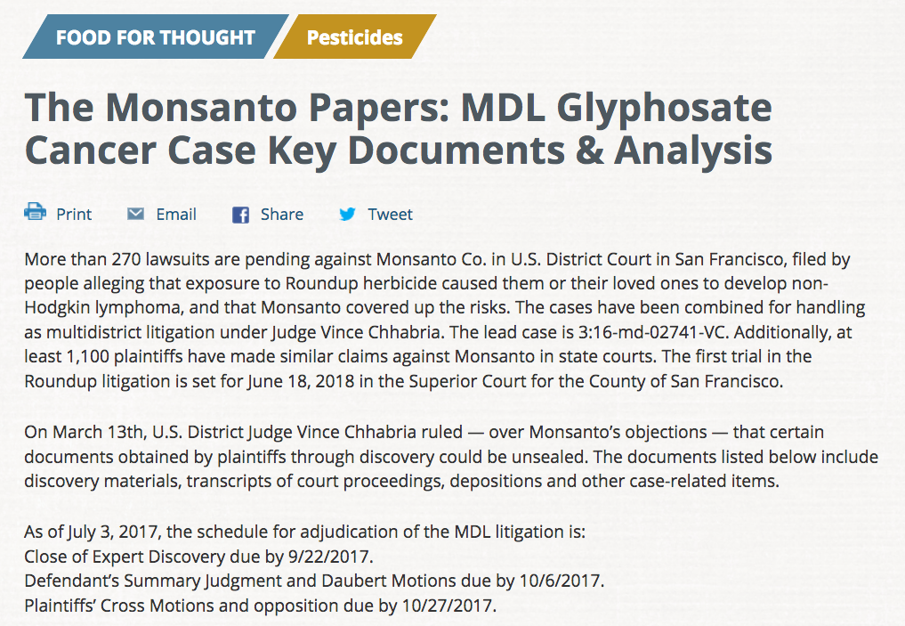
Litigate

Slide 95
A Hopeful Message*
“It’s interesting that in 2016, for the first time in almost 20 years, what we saw is a decrease in the amount of acreage where genetically engineered crops are growing around the world. This represents the fact that this technology is failing, in the sense of superweeds and superpests are popping up all over the world.”
Ronnie Cummins, founder of the Organic Consumers Association
*articles.mercola.com/sites/articles/archive/2017/03/26/market-rejection-of-gmos-grows.aspx
Notes:
http://articles.mercola.com/sites/articles/archive/2017/03/26/market-rejection-of-gmos-grows.aspx

