Slide 1
Download these slides!people.csail.mit.edu/seneff
….
….
Download individual files from these links:
people.csail.mit.edu/seneff/Indianapolis/
Drugs.pdf Nutrition.pdf antibiotics_vaccines.pdf glyphosate_new.pdf
Drugs.pptx Nutrition.pptx antibiotics_vaccines.pptx glyphosate_new.pptx
Notes:
Drugs.pdf Nutrition.pdf antibiotics_vaccines.pdf glyphosate_new.pdf
Drugs.pptx Nutrition.pptx antibiotics_vaccines.pptx glyphosate_new.pptx

Slide 2
Outline
Very brief overview
Nutrition and health
Pesticides: focus on Roundup
Vaccines, antibiotics and microbes
Pharmaceutical drugs: focus on statins

Slide 3
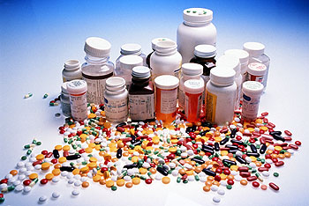
Prescription Drugs
Stephanie Seneff
MIT CSAIL

Slide 5
A substance that interferes with normal system function is a drug.
A substance that restores normal system function is a nutrient.
Marty Hinz, MD
Notes:
http://www.neurosciencemyths.com/index.htm
From John B.

Slide 6
“The maxim, ‘He who has the gold makes the rules’ needs revising:
‘He who has the gold makes the rules and gets more gold.’”
David Moyer, Beyond Mental Illness,
Chapter 5: March of the Corporations, p. 71
Notes:
I got this book from him!!

Slide 7
“Dr. Tejal Gandhi, president of the National Patient Safety Foundation, said studies show that medication errors, adverse drug events and injuries due to drugs occur in up to 25% of patients within 30 days of being prescribed a drug.”*
*http://easyhealthoptions.com/still-tracking-patient-harm/

Slide 8
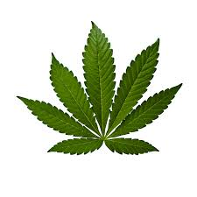
Drugs Kill*
Pharmaceuticals are among the leading causes of death in the US
Some medicines have killed tens of thousands of people
Vioxx killed over 60,000 before being pulled
Avandia diabetes drug pulled from European market in 2010
800,000 people in Europe were killed from inappropriate use of beta-blockers in non-cardiac surgery patients
Deaths attributed to cannabis barely register in comparison.
*Dr. Merola, The Benefits of Medical Cannabis. March09,2014
Notes:
./MedicalCannabisMercola.pdf

Slide 9
Outline
Corruption
Statin Backlash
Statin Drugs
How Statins Really Work
Statin Drug Side Effects
No Benefit for the Sick and Elderly
Other Drugs
Obesity Paradox

Slide 10
Corruption

Slide 11
Recent Episode on Jon Stewart*
Michael Che: Oxycontin pain killer is as bad as heroin
*thedailyshow.cc.com/videos/qrq3eo/the-pharmaceutical-drug-epidemic
Notes:
http://thedailyshow.cc.com/videos/qrq3eo/the-pharmaceutical-drug-epidemic

Slide 12
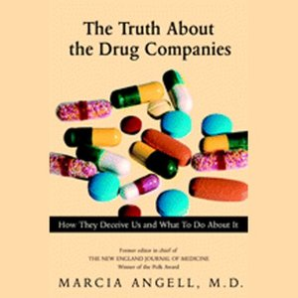
The Truth about Drug Companies
“.. This [pharmaceutical] industry uses its wealth and power to co-opt every institution that might stand in its way, including the US Congress, the Food and Drug Administration, academic medical centers and the medical profession itself.”
-- Dr. Marcia Angell, former editor of the New England Journal of Medicine
From her book:
The Truth about the Drug Companies: How They Deceive Us and What to Do about It.

Slide 13
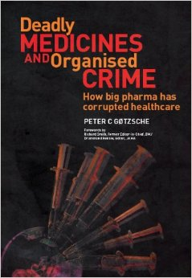
Deadly Medicines and Organised Crime: How big pharma has corrupted healthcare*
“The main reason we take so many drugs is that drug companies don t sell drugs, they sell lies about drugs. This is what makes drugs so different from anything else in life... Virtually everything we know about drugs is what the companies have chosen to tell us and our doctors… If you don t think the system is out of control, please email me and explain”
-- Peter C Gotzsche
*PC Gotzsche, Radcliffe Publishing, 2013

Slide 14
How to Make a Drug a Blockbuster*
Pharmaceutical companies paid at least 1,644 local health care professionals in Palm Beach County $2.8 million in fees for speaking, traveling and consulting from 2009 through the first half of 2011.
Often, the companies give them the slides and the key talking points.
10 health care providers in Palm Beach received nearly $1.1 million from drug companies for speaking, traveling and consulting in a span of just over two years
Charles H Hennekins was one of those doctors
*The Palm Beach Post, Thursday, Nov. 22, 2012

Slide 15
How to Make a Drug a Blockbuster*
Pharmaceutical companies paid at least 1,644 local health care professionals in Palm Beach County $2.8 million in fees for speaking, traveling and consulting from 2009 through the first half of 2011.
Often, the companies give them the slides and the key talking points.
10 health care providers in Palm Beach received nearly $1.1 million from drug companies for speaking, traveling and consulting in a span of just over two years
Charles H Hennekins was one of those doctors
*The Palm Beach Post, Thursday, Nov. 22, 2012

Slide 16
Last sentence in the conclusions:
“Thus, one of the major clinical and public health challenges in the United States today is to increase the use of statins as an adjunct to lifestyle changes to treat and prevent CVD.”
Charles H Hennekins, MD
Clin Cardiol. Vol. 24 (Suppl. II), 11-2-11-5 (2001)

Slide 17
Statins are already the most-prescribed drug category in the US
Their use has climbed recently by 17% to more than 214 million monthly prescriptions annually

Slide 18
Statins: The Good, the Bad, and the Unknown*
“In an editorial in the Journal of the American Medical Association (JAMA), Dr John Ioannidis estimated that the total sales of statins may approach $1 trillion worldwide by 2020; the most commercially successful drug in history, atorvastatin (Lipitor®), had sales exceeding $120 billion between 1996 and 2011.”
*http://www.medscape.com/viewarticle/832841

Slide 20
Communicating the risk reduction achieved by cholesterol reducing drugs*
"200 men without any prior heart disease have to swallow 357,700 tablets over five years to save one of them from dying from coronary heart disease. ” p. 1957
*John-Arne Skolbekken, BMJ 316, 27 JUNE, 1998; 1956-1958.
Notes:
./Editorial_statins_winder_drug_NOT_1998.pdf

Slide 21
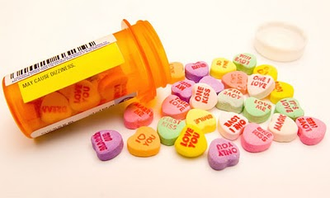

Slide 22
Statin Drugs: Should Healthy People Take Them?
Newest recommendations from NICE, the National Institute for Health Care Excellence (in UK), would lead to millions more apparently healthy people in mid-life being offered the drugs by their GP.
… to be taken for the rest of their lives.

Slide 23
NICE: Health Watchdog in UK
"The Sunday Express revealed eight out of 12 members of the NICE panel which drew up the guidance have financial ties to companies that make statins or the next generation of cholesterol-lowering drugs.”*
*express.co.uk/news/health/485510/
Statins-scandal-Health-watchdog-Nice-told-to-clean-up-its-act
Notes:
Publishes guidelines on drugs

Slide 24
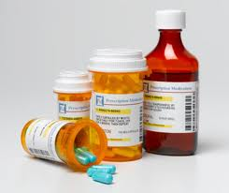
Corruption in the FDA*
Drug companies purchased special access onto FDA Advisory panels where they were "given the keys to the kingdom in swaying decision-makers about official drug policy."
Companies gladly pay upwards of $25,000 per meeting
These panels are instrumental in shaping how drugs are safety tested and approved
One consequence is a flood of dangerous analgesic drugs to the market, approved following questionable safety studies.
*Drug Companies Bought their Way onto FDA Advisory Panels
March 20, 2014 by Ethan Huff
Notes:
./drug_companies_corrupt.text

Slide 25
Scientific panel funded by pharmaceutical companies: They pay for the chance to affect FDA’s thinking*
“20k is small change, and they can justify it easily if they want to be at the table.” “Everybody has been very happy with [the meetings] and they are getting a huge amount for very little money (impact on FDA thinking, exposure to FDA thinking, exposure to academic opinion leaders and their expertise, journal article authorship, etc.) and they know it.”
Robert Dworkin, organizer
*Peter Whoriskey, The Washington Post, October 6, 2013 at 9:07 PM.
Notes:
./DrugCompanies_pay_FDA_pain_killers.pdf

Slide 26
Muscle Aches and Statins: Case Challenge*
*medscape.com/viewarticle/827967?src=emailthis
Notes:
Myalgia = muscle pain

Slide 27
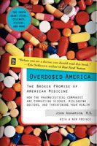
BMJ Withdraws Statement on Statin-Related Adverse Events, but Papers Stand, Pending Review. -- Medscape. May 15, 2014.
The Paper:
Abramson JD, Rosenberg HG, Jewell N, Wright JM. Should people at low risk of cardiovascular disease take a statin? BMJ; 2013;
The Issue:
The claim that statins cause side effects in 18-20% of people taking them
Notes:
./BMJ\ withdrawal\ of\ statin\ adverse\ event\ statement.pdf .
Dr Rory Collins (Oxford University, UK), the head of the CTT collaboration, alerted BMJ to the error and has asked that both papers be retracted.
John Abramson is a prof at Harvard, author of Overdosed America

Slide 28
Review Result
The panel were unanimous in their decision that the two papers do not meet any of the criteria for retraction. The error did not compromise the principal arguments being made in either of the papers. These arguments involve interpretations of available evidence and were deemed to be within the range of reasonable opinion among those who are debating the appropriate use of statins
Notes:
./AbramsonWasFineNotCollinsBMJ8.pdf

Slide 29
The Real Scandal*
“The real scandal is that a research body holds data, which could provide vital information for patients and doctors about the serious adverse effects for the most widely prescribed drugs in the Western world and the body will not release the data.”
*zoeharcombe.com/2014/08/ctsu-funding-from-drug-companies
Notes:
./Collins_scandal_Zoe.pdf

Slide 30
Statin Backlash

Slide 32
De Lorgeril’s Book
Scathing indictment of pharmaceutical industry for lies and disinformation regarding statins
Oversell benefit
Downplay side effects
Distinguishes pre- and post- Vioxx scandal (2004)
No studies after Vioxx scandal have shown benefit
He maintains that statin drugs are a poison and should be banned.
Notes:
I read it!

Slide 33
Growing doubt on statin drugs — the problem of drug-lifestyle interaction*
“When statins are used in low-risk patients without heart disease (primary prevention) there is no mortality benefit. That’s right. Your chance of dying are the same on or off the drug, regardless of how much the statin lowers the cholesterol level.”
*Dr. John Mandrola, DrJohn.org, June 16, 2014
Notes:
if statin users consume more calories, gain weight and exercise less it becomes easy to see why cardiovascular benefits are so small.

Slide 34
One in Four Adults in UK on Statins?*
“I have just stopped taking statins and I am much more agile than I was when I was on them. I want to know why, what is the evidence for it. I am not going back on statins unless I have the evidence.”
“You imagine all this creaking and aching is a matter of aging, and it might not be.”
Prof McPherson
Chair, UK Health Forum
*telegraph.co.uk/health/healthnews/10900296/
Evidence-for-NHS-statins-advice-wholly-inadequate-says-expert.html
Notes:
http://www.telegraph.co.uk/health/healthnews/10900296/Evidence-for-NHS-statins-advice-wholly-inadequate-says-expert.html

Slide 35
Mortality and Cholesterol in Japan*
Graph provided by Eddie Vos, with permission
*M Matsuzaki et al., Circ J 2002; 66: 1087-1095
Notes:
For_vic/J-Jit_Eddie_low_cholesterol_death_Japan.pdf

Slide 36
Low Cholesterol Associated with Violent Behavior and Early Death*
Finnish study of 250 criminal offenders
Average cholesterol level was below national average
Violent criminal offenders who had lower than average cholesterol levels were
7 times more likely to die before the average age of death
8 times more likely to die of unnatural causes
Low cholesterol levels are associated with conduct disorder in childhood
*E Repo-Tiihonen et al., European Archives of Psychiatry and Clinical Neuroscience 252(1), 8-11
Notes:
http://healthydietsandscience.blogspot.com/2011/02/low-cholesterol-levels-associated-with.html This study can be accessed at: http://www.springerlink.com/content/7cktb3d2haf4p15y/

Slide 37
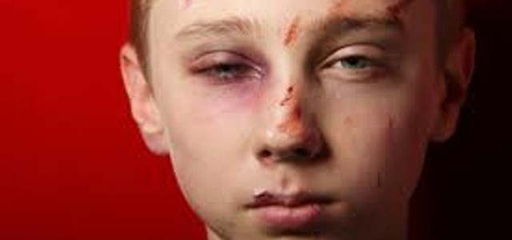
Low Cholesterol during Childhood Promotes “Cycle of Violence”*
“In summary, we found a significant correlation between exposure to violence as a child and expression of violence as an adult (i.e. cycle of violence), only in the group with cholesterol levels below the median.”
*P Asellus et al., Psychiatry Research 215 (2014) 646–650
Notes:
For_vic/Cholesterol_suicide_PR_2014.pdf

Slide 38
Low Serum Cholesterol and Suicide*
Primary prevention trials involving lowering serum cholesterol report increase in deaths due to suicide or violence
Number of serotonin receptors in mouse brain synaptosomal membrane depends on cholesterol concentration
Decrease in serotonin leads to aggressive behavior
*H Engelberg, Lancet 1992 Mar 21;339(8795):727-9.

Slide 39
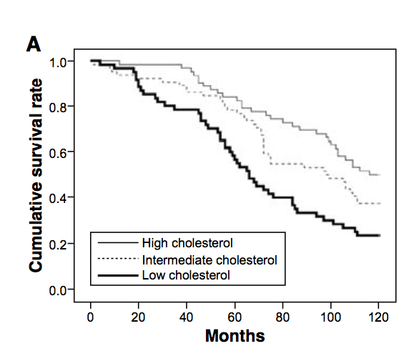
High Cholesterol is Protective in the Elderly*
Lowest cholesterol;
lowest survival
*Figure 1A, Y. Takata et al., Clinical Interventions in Aging 2014:9 293–300
Notes:
For_vic/ten_year_mortality_85_years_old_cholesterol_2014.pdf

Slide 40
The statin-low cholesterol- cancer conundrum*
“Matsuzaki et al. followed 47,294 hyper-cholesterolemic Japanese patients on low dose (5–10mg) simvastatin per day for 6 years, and found that the number of cancer deaths was more than three times higher in patients whose total cholesterol was <160 mg/dl at follow-up compared with those whose cholesterol was normal or high (P<0.001).”
*U Ravnskov, KS McCully and PJ Rosch, QJ Med 2012 Apr;105(4):383-8
Notes:
./QJ_Med_Uffe_Cancer_Statins.pdf

Slide 41
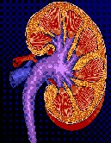
Low Cholesterol Increases Death Rate in Kidney Cancer*
867 kidney cancer patients studied
Low cholesterol before surgery associated with more advanced cancer and greater cancer spread after surgery
High cholesterol → 43% less likely to die after surgery
* M de Martino et al., BJUI, 23 July, 2014 [Epub ahead of print]
Notes:
./Low\ Cholesterol\ Increases\ Kidney\ k\ Deaths.docx
cancer/low_cholesterol_poor_prognosis_kidney_cancer.pdf

Slide 42
Low Cholesterol High Mortality in Heart Failure*
Conclusion:
“Low LDL-c levels are associated with a reduced survival in elderly patients with clinically controlled moderate and severe HF. Statins were independently and significantly associated with a higher risk of mortality.”
Notes:
./low_cholesterol_bad_heart_failure.pdf

Slide 43
Cholesterol Loss in Hippocampus with Aging Impairs Cognition in Mice*
Loss of cholesterol induces PI3K/Akt signaling
Theory: Increased calcium permeability due to cholesterol loss in membrane
Impaired NMDA signaling and long-term potentiation (learning)
Cholesterol depletion in neurons in vitro demonstrates same effect
Cholesterol perfusion into lateral ventricle rescues learning and memory in old rats
*MG Martin et al., EMBO Mol Med. 2014 May 30. pii: e201303711.
Notes:
Treasures/cholesterol_loss_hippocampus_mouse_alzheimers.pdf

Slide 44
How Statins Really Work

Slide 45
Bilirubin is Protective in Heart Disease
Bilirubin is the breakdown product of heme in red blood cells
Bilirubin is a potent antioxidant that reduces the risk to heart attacks
But: it’s an indicator that red blood cells are not healthy
Notes:
For_vic/bilirubin_protective_heart_disease.text

Slide 46
Statins Induce Bilirubin Synthesis*
Antioxidant effects of statins are likely the real reason why they protect from heart attacks
“We demonstrate that the generation of biliverdin and ferritin, following HO-1 [heme oxygenase 1] activation, accounts for the antioxidant effect of statins”
Biliverdin rapidly reduces to bilirubin
→ Statins cause red blood cells to die, releasing hemoglobin into the blood stream?
*F Ali et al., Journal of Thrombosis and Haemostasis, 5: 2537–2546
Notes:
-hemoglobin is a potent inducer of HO-1
-statins deplete cholesterol, and low membrane cholesterol in RBCs leads to hemolysis?
For_vic/Statin-mediated\ cytoprotection\ of\ human\ vascular\ endothelial\ cells_marked.pdf
~/Desktop/Presentations/Project/from_luca/for_vic/

Slide 47
Statins Induce Bilirubin Synthesis*
I believe statin drugs are a cholesterol sulfate mimetic: they promise the delivery of cholesterol and sulfate but they can deliver neither!
Red blood cells die due to insufficient cholesterol sulfate in their membranes
Antioxidant effects of statins are likely the real reason why they protect from heart attacks
“We demonstrate that the generation of biliverdin and ferritin, following HO-1 [heme oxygenase 1] activation, accounts for the antioxidant effect of statins”
Biliverdin rapidly reduces to bilirubin
→ Statins cause red blood cells to die, releasing hemoglobin into the blood stream?
*F Ali et al., Journal of Thrombosis and Haemostasis, 5: 2537–2546
Notes:
-hemoglobin is a potent inducer of HO-1
-statins deplete cholesterol, and low membrane cholesterol in RBCs leads to hemolysis?
For_vic/Statin-mediated\ cytoprotection\ of\ human\ vascular\ endothelial\ cells_marked.pdf
~/Desktop/Presentations/Project/from_luca/for_vic/

Slide 48
Inverse Relationship between Cholesterol in RBCs and Hemolysis Rate *
Rate of Hemolysis
Cholesterol/phospholipid
*Figure 2, K Araki and JM Rifkind, Life Sciences 1980 Jun 30;26(26):2223-30
Notes:
Treasures/cholesterol_in_RBCs_protects_hemolysis_1980.pdf

Slide 49
Trickery in Statin Trials*
“Exclusion criteria included ..., bilirubin values >1.5 times the upper limit of normal during the dietary lead-in period.”
“Serum bilirubin is a potent antioxidant within the serum and thus may decrease the rate of oxidation of low density lipoproteins which are necessary for the formation of atherosclerosis.”**
*P H Jones et al., Am J Cardiol 2003;93:152–160
**LJ Horsfall et al., Circulation. 2012;126:2556-2564
Notes:
For_vic/STELLAR_Crestor\ bilirubin\ 1.4\ times\ -marked.pdf
From Gerry
Heart/bilirubin_is_protective_heart_disease.pdf

Slide 50
Statin Side Effects

Slide 51
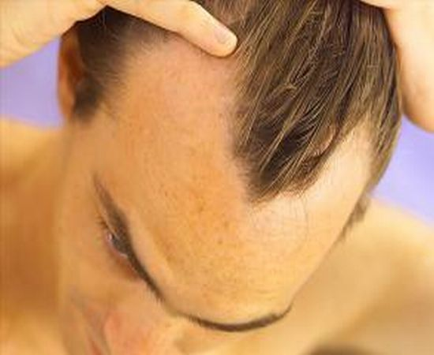
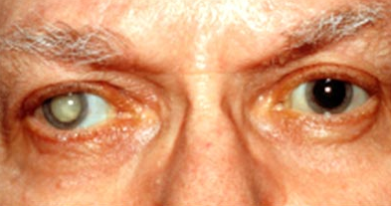
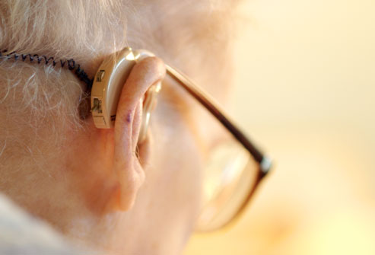
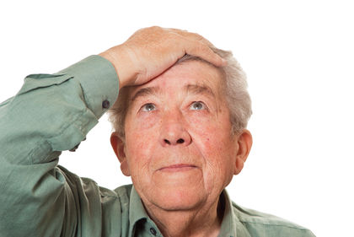
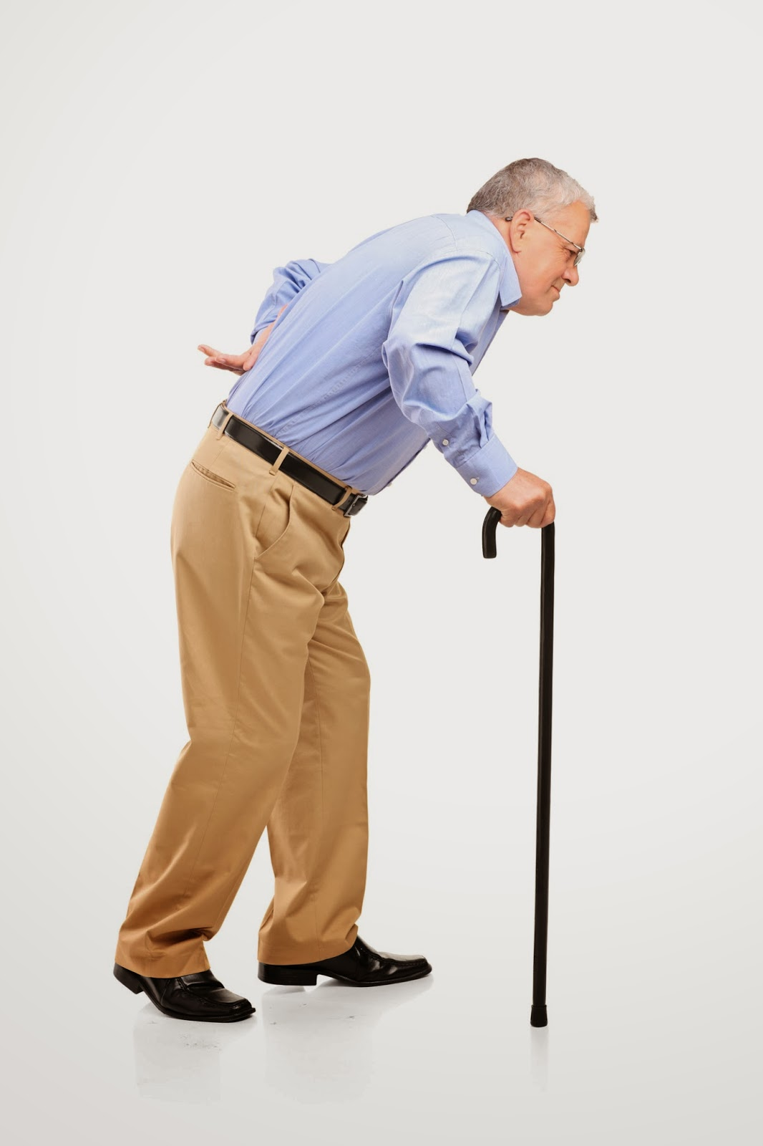
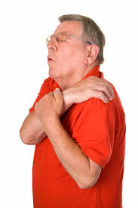
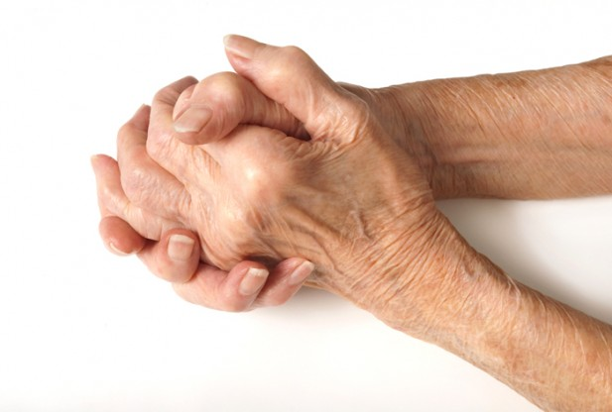
Statins Make You Grow Older Faster*
*J Liu and S Seneff, Proc. IMMM, Barcelona, Spain, Oct. 2011.
Notes:
Reference IMMM_Paper.pdf

Slide 52
“I am haunted by an image drawn from the many experiences of readers related to me over the last few years. It is of a woman in her mid-seventies whose physical aches and pains, progressive immobility and deteriorating memory are, her family doctor has advised her, only to be expected at her age. That evening before retiring to bed she takes a daily dose of the most commonly prescribed drug in Britain.”
Dr. James Le Fanu,
The Spectator, May 31, 2014
Notes:
./statins_bad.pdf
http://www.spectator.co.uk/health/features-health/cover-feature/9216461/magic-bullet-or-massive-missfire/

Slide 53
Statins are Not Worth the Risk of Side Effects*
Side effects include muscle pain, fatigue, increased risk for new-onset diabetes, insomnia, increased cancer risk, memory problems, and cognitive deficits
These are most likely a function of CoQ10 depletion coupled with dose-dependent lowering of the essential nutrient in both the body and the brain—cholesterol
Are statins neurotoxic?
The short answer is, yes.
Both cholesterol and CoQ10 are neuroprotective and essential for healthy neuronal function and repair processes
*TM Marshall, J Amer Physicians and Surgeons 19(2), 2014, 43-46
Notes:
For_vic/marshall_statins_bad.pdf

Slide 54
Analysis of Case Reports*
Side effects of statins include peripheral neuropathy, sexual dysfunction, gynecomastia, irritability, aggression, behaviour change, memory loss, depression, psychosis, interstitial lung disease, heart failure, Parkinson syndrome, lupus-like syndrome, dermatomyositis, other autoimmune syndromes, pancreatitis and others.
*BA Golomb and MA Evans, Am J Cardiovasc Drugs 2008; 8:373-418
Notes:
./Drug\ Safety\ 2007.pdf
Gynecomastia:
benign enlargement of breast tissue in males.^{[1]}
Therapeutics_letter_statin_side_effects_2014.pdf
Reference 1 = Golomb
Gynecomastia – enlargement of breasts in males
Dermatomyositis – inflammation of muscles and skin
Golomb BA, Evans MA. Statin adverse effects: a review of the literature and evidence for a mitochondrial mechanism. Am J Cardiovasc Drugs 2008; 8:373-418.

Slide 55
Doctors Deny Patient Side Effects*
650 adult patients taking statins completed extensive survey
87% of patients spoke to their physician about potential link of health deterioration to statins
Doctors were more likely to deny than affirm the statin connection
Even for symptoms with strong literature support
Targeting patients rather than doctors will boost yield on adverse drug reaction reporting systems
*BA Golomb et al., Drug Saf. 2007;30(8):669-75
Notes:
./Patient_side_effects_doctors_deny_statins.text
For_vic/2007_Golomb_patient_doctor_relationship_statins_2014.pdf

Slide 56
Livalo, 55-64 Female on Treatment for 1 to 6 months
“Started 2 mg Livalo in mid-Feb. 2014 and in 2 weeks my cholesterol dropped dramatically from 317 to 213; LDL from 224 to 99; HDL went from 69 to 80. Even though every day I had flu like symptoms I vowed to stay on it until I couldn't stand it any longer. … I had headaches all day and night, my body aches never stopped, queasy/nauseated, and extremely tired all the time. …. Three days after stopping my headaches went away, then my body aches, tiredness and queasiness.”
Notes:
Livalo is supposed to be a newer statin with fewer side effects.

Slide 57
Statins, Lactate and Diabetes
Statins increase serum lactate levels, suggesting mitochondrial dysfunction*
Lactate predicts incident diabetes independent of many other risk factors**
Lactate is associated with atherosclerosis***
Likely linked to insulin resistance
*G. de Pinieux et al., Br J Clin Pharmacol 1996; 42: 333–337
**SP Juraschek et al., PLOS ONE 2013 8(1), e55113.
***GPS Shantha et al., Atherosclerosis 228 (2013) 249-255
Notes:
./lactate/ three papers.

Slide 58
Reuters Press – Women Suing Pfizers for Diabetes*
*By Jessica Dye, Fri Aug 8, 2014 1:22am EDT

Slide 59
Statins and Diabetes*
Statins suppress electron transport and ATP generation
Statins inhibit selenoprotein synthesis and dolichol-mediated glycation of insulin receptor
insulin resistance and heart failure
Statins decrease blood ketone bodies and enhance glucose intolerance
"We urgently propose that statins are contraindicated in diabetes"
*H Okuyama et al., Journal of Lipid Nutrition 22(2), 173-186, 2013
Notes:
Japanese study – published in Japanese except for abstract
./Contraindicated_in_DiabeticsOkuyama.pdf from Eddie

Slide 60
Statins and Diabetes*
Statins suppress electron transport and ATP generation
Statins inhibit selenoprotein synthesis and dolichol-mediated glycation of insulin receptor
insulin resistance and heart failure
Statins decrease blood ketone bodies and enhance glucose intolerance
"We urgently propose that statins are contraindicated in diabetes"
*H Okuyama et al., Journal of Lipid Nutrition 22(2), 173-186, 2013
Notes:
Japanese study – published in Japanese except for abstract
./Contraindicated_in_DiabeticsOkuyama.pdf from Eddie

Slide 61
Statins and Selenoproteins*
*Bernd Moosmann and Christian Behl, TCM 14(7), 2004, 273-281.
Notes:
./statins_and_selenoproteins.pdf

Slide 62
Selenium Inhibition and Statins*
“The clinical picture of statin induced myopathies include a non-uniform pattern of muscle aches and pains, weakness and tenderness with easy fatigability. It can vary from mild to very severe, even disabling. This pattern of signs and symptoms is very similar clinically and pathologically to those induced by severe selenium (selenoprotein) deficiency.”
Duane Graveline, MD
*http://www.spacedoc.com/selenium_statins.html
Notes:
Duane Graveline
Spacedoc/spacedoc/Duane_on_selenoproteins.email.text

Slide 63
Statins and Selenium*
“Statin induced myopathy shares with selenium induced myopathy a microscopic picture of myofibril disorganization, loss of mitochondrial function and the common observation that muscle pain follows muscle activity.”
-- Duane Graveline, MD
*http://www.spacedoc.com/selenium_statins.html
Notes:
Duane Graveline
Spacedoc/spacedoc/Duane_on_selenoproteins.email.text

Slide 64
Benefits of Activity*
“Benefits of activity and fitness extend beyond metabolic and cardiovascular outcomes, to mood, cognition, behavior, sleep, bone, respiration, functional preservation, resilience in settings of injury, illness, or surgery, as well as death from all causes.”
*BA Golomb, JAMA Internal Medicine Published online June 9, 2014
Notes:
./BeatriceGolomb_on_statins_exercise.pdf

Slide 65
Statins and Exercise*
“Exercise has worsened muscle injury with statins, and statins have worsened pain and injury with exercise.[4]”
“Women older than 65 years have shown significant weakness with statin use, with the magnitude of effect increasing with still older age.[7]”
*BA Golomb, JAMA Internal Medicine Published online June 9, 2014
Notes:
./BeatriceGolomb_on_statins_exercise.pdf

Slide 66
Results from My Studies on Consumer Side Effect Reports: Muscle Issues*
*J. Liu et al. Proc. IMMM}, Barcelona, Spain, Oct. 2011.

Slide 67
Statins and Cancer*
Low cholesterol predisposes to cancer.
9 cohort studies involving more than 140,000 people found that cancer was inversely associated with cholesterol measured 10–30 years earlier
Increase in non-melanoma skin cancer in two early statin trials is statistically significant when they are combined
A study showed increasing prostate cancer risk with increasing cumulative statin dose (p=0.007).
*U. Ravnskov et al., BMJ, February 3, 2014
Notes:
For_vic/UffeOnStatinsCancer2014.pdf

Slide 68
Statins and Breast Cancer*
“Twelve out of 286 women in the statin group but only one out of 290 in the placebo group had BC at follow-up [39].** After that, most statin investigators took care not to include high-risk women in their trials [37]”
(**double blind placebo-controlled CARE trial)
*de Lorgeril and Salen BMC Medicine 2014, 12:94
Notes:
Cancer/statins_and_breast_cancer_2014.pdf

Slide 69
Statins increase breast cancer in women by over 200%*
Why do one in seven women in the U.S. have breast cancer?
"Among women diagnosed with hyper-cholesterolemia, current users of statins for ten years or longer had a 204% increased risk of invasive ductal carcinoma and a 243% increased risk of invasive lobular carcinoma."
*Dr. Brownstein, blog.drbrownstein.com/statins-increase-breast-cancer-by-over-200/
Notes:
./statins_increase_breast_cancer.text
For_vic/Statins_cause_breast_cancer.pdf

Slide 70
“Recently a trial in women 55–75 years of age on a ten year or more statin treatment had more than double risk of lobular and ductal breast carcinoma [35].”
*ST Sinatra et al., Journal of the American College of Nutrition, Vol. 33, No. 1, 79–88 (2014)
Notes:
Quote from:
./Sinatra_sat_fat_LDL_cholesterol_heart_disease.pdf
35. McDougall JA, Malone KE, Daling JR, Cushing-Haugen KL, Porter PL, Li CI. Long-term statin use and risk of ductal and lobular breast cancer among women 55 to 74 years of age. Cancer Epidemiol Biomarkers Prev. 2013 Sep;22(9):1529–37.

Slide 71
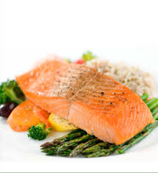
Statins and Fatty Acids*
Concurrent statin therapy annihilates the benefit of omega-3 fatty acid supplements
Statins increase serum levels of omega-6 FAs compared to omega-3 FAs
Omega-6 FAs are precursors to arachidonic acid which induces an inflammatory response
Omega-3’s are essential for neuronal health
*greenmedinfo.com/blog/cholesterol-lowering-statins-may-kill-omega-3-heart-benefits
Notes:
./SayerJi_on_statins_omega_6.pdf
./statins_reduce_omega_3_fats.text

Slide 72
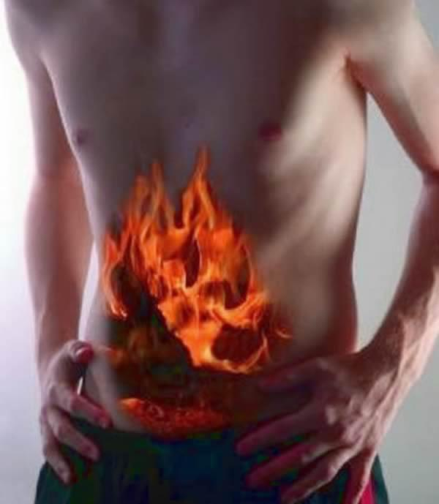
Statins Increase Risk to Pancreatitis*
Observational studies identify odds ratio of 1.41 for risk of acute pancreatitis in patients who have taken statins.
20 published case reports and 33 spontaneous reports from the Canadian Adverse Drug Event Monitoring System database
Very uncommon early on but occurs after many months of therapy (insidious)
*S Singh and YK Loke. Drug Saf. 2006;29(12):1123-32.
Notes:
./statin_induced_pancreatitis.text

Slide 73
Statins Increase Risk to Pancreatitis*
Observational studies identify odds ratio of 1.41 for risk of acute pancreatitis in patients who have taken statins.
20 published case reports and 33 spontaneous reports from the Canadian Adverse Drug Event Monitoring System database
Very uncommon early on but occurs after many months of therapy (insidious)
“Conclusions: The risk of pancreatic cancer is significantly elevated in subjects with chronic pancreatitis and appears to be independent of sex, country, and type of pancreatitis.”**
*S Singh and YK Loke. Drug Saf. 2006;29(12):1123-32.
**AB Lowenfels et al., New England Journal of Medicine, 328(20), 1993.
Notes:
./statin_induced_pancreatitis.text

Slide 74
Effect of statin drugs on sperm*
Total sperm count down 31%
Morphology abnormalities
Impaired acrosome reaction
Release of enzymes from the acrosome that promote fusion and fertilization
Reduced levels of seminal concentrations of several enzymes critical for fertilization
“Such data indicate clearly that atorvastatin therapy affects testicular, epididymal and prostatic functions.”
*H Pons-Rejraji et al., Reproductive Biology and Endocrinology 2014, 12:65
Notes:
for_vic/statins_kill_sperm_DYNAMITE_2014.pdf
Atorvastatin administered to relatively young men.

Slide 75
Duane Graveline (“Spacedoc”) on Cholesterol, Statins, and the Brain
The prevalence of Lou Gehrig’s disease, Parkinsonism, Alzheimer’s disease and Multiple Sclerosis has increased nearly 50% compared to 1982.
40 million people in the US take statin drugs
Is there a connection?
Statins inhibit the mevalonate pathway and this leads to the production of tau protein --> tauopathies.
Notes:
./DuaneGraveline_on_cholesterol_tau_protein.text

Slide 76
Duane Graveline (“Spacedoc”) on Cholesterol, Statins, and the Brain
The prevalence of Lou Gehrig’s disease, Parkinsonism, Alzheimer’s disease and Multiple Sclerosis has increased nearly 50% compared to 1982.
40 million people in the US take statin drugs
Is there a connection?
Statins inhibit the mevalonate pathway and this leads to the production of tau protein --> tauopathies.
"If I know the above to be true, you can be certain our drug companies also know this to be true and are no doubt busy with damage control as they decide what to do. One thing they have not done as yet is to inform our practicing physicians with at least a black box warning. Statin sales have never been higher."
Notes:
./DuaneGraveline_on_cholesterol_tau_protein.text

Slide 77
Dolichol and Parkinson’s Disease*
Substantia nigra in the brain stem is the seat of Parkinson’s disease pathology
Neuromelanin is a dark brown pigment found in high concentrations in dopaminergic neurons in the substantia nigra
Neuromelanin contains significant concentration of dolichol
Dolichol is a product of the mevalonate pathway that statin drugs disrupt
*H Fedorow et al., J Neurochem. 2005 Feb;92(4):990-5.

Slide 78
Over 9,000 cases of statin associated transient global amnesia have been reported to Medwatch since statins were first marketed.
Notes:
Duane Graveline said this

Slide 79
“Statin-Related Cognitive Impairment in the Real World: You’ll Live Longer, but You Might Not Like It”
Patient’s account of how he was suffering from many memory and cognitive problems until he finally recognized the link to statin drugs and decided that any protection from a heart attack was not worth the risk to his brain health
*Jonathan McDonagh, JAMA Internal Medicine, Published online October 27, 2014, p. e1.
Notes:
./cognitive_impairment_statins.pdf

Slide 80
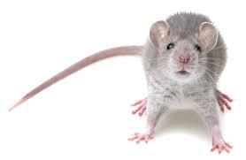
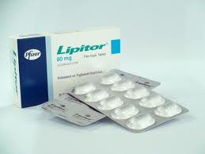
Statins Cause Memory Problems via Changes in Hippocampus*
Mice treated with atorvastatin for 7 months
Behavioral deficits in:
basic exploration
cognitive function
Significant changes in membrane lipid raft proteins in hippocampus
*JM Schilling et al., Behavioural Brain Research 267 (2014) 6-11.
Notes:
For_vic/Schilling_statins_cause_hippocampal_problems_memory_cognition.pdf

Slide 81
Results from My Studies on Consumer Side Effect Reports: Brain Issues*
*J. Liu et al. Proc. IMMM}, Barcelona, Spain, Oct. 2011.

Slide 82
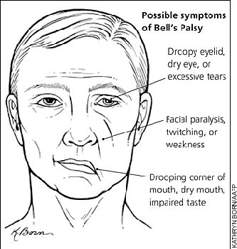
Statins and Bell’s Palsy*
Bell’s palsy is the most common cause of acute facial nerve paralysis (>80%)
Study in Taiwan: case/matched control model
Odds ratio of 1.47 for prior regular statin use
*SH Hung et al., Drug Saf. 2014 Jul 31. [Epub ahead of print]
Notes:
http://www.ncbi.nlm.nih.gov/pubmed/25079142
./Bells_palsy.text

Slide 83
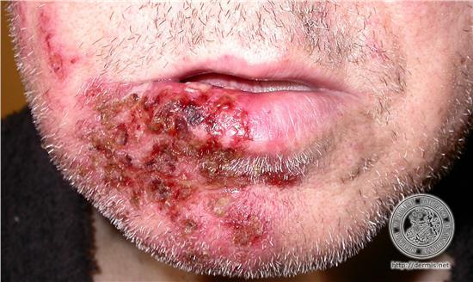
Statins and Shingles*
Shingles is caused by the virus, Herpes zoster (HZ)
It’s the same virus that causes chicken pox, and it produces a painful infection of nerve axons, often in the face, many years after the initial infection
Quote from study: “We found that prior statin use was significantly associated with HZ occurrence across all age and gender groups in the present study”
*S-D Chung et al., PLOS ONE 2014, 9(10):e111268.
Notes:
For_vic/statins_and_Herpes.pdf

Slide 84
Statins Increase Risk to Suicide*
“The prevalence of suicide ideation was more than 2.5 times in those taking statins”
“The association between statins and suicidal ideation seems biologically plausible given that statins lower blood cholesterol, which can lead to altered cholesterol–serotonin impulsivity”
*K. M. Davison & B. J. Kaplan Crisis 2014; Vol. 35(4):278–282
Notes:
For_vic/statins_linked_to_suicide_2014.pdf

Slide 85
Alarming increase in stroke risk in recent times*
Number of discharge diagnoses of stroke
*US CDC Hospital Discharge Data

Slide 86
“Regarding long-term statin therapy: Are we trading stronger hearts for weaker brains?”*
Statin drugs
Decrease cellular geranylgeranyl pyrophosphate, leading to an increase in Aβ40 within neurons
Increase the risk of hyperglycemia, hyperinsulinemia, prediabetes and diabetes
Both of these lead to cerebral microbleeds
Spontaneous intracerebral hemorrhages
Present in 36% of people over 80 years old
*MR Goldstein and L Mascitelli, Medical Hypotheses 2014 [Epub ahead of print]
Notes:
Luca!
For_vic/Luca_new_article_microbleeds_brain_statins_2014

Slide 87
“Regarding long-term statin therapy: Are we trading stronger hearts for weaker brains?”*
Statin drugs
Decrease cellular geranylgeranyl pyrophostate, leading to an increase in Aβ40 within neurons
Increase the risk of hyperglycemia, hyperinsulinemia, prediabetes and diabetes
Both of these lead to cerebral microbleeds
Spontaneous intracerebral hemorrhages
Present in 36% of people over 80 years old
It’s not even stronger hearts because the heart suffers from increased risk to heart failure following chronic exposure to toxic statin drugs
*MR Goldstein and L Mascitelli, Medical Hypotheses 2014 [Epub ahead of print]
Notes:
Luca!
For_vic/Luca_new_article_microbleeds_brain_statins_2014

Slide 88
Review Paper on Heart Failure (HF)*
“HF poses an especially large public health burden. It represents a new epidemic of cardiovascular disease, affecting nearly 5.8 million people in the United States, and over 23 million worldwide. “
*L Liu and HJ Eisen, Cardiol Clin 2014 Feb;32(1):1-8,

Slide 89
CoQ10 Protects Heart Failure Patients*
10 year study on patients with heart failure
100 mg of CoQ10 three times daily, compared with control subjects were:
Significantly less likely to die from heart failure,
Less than half as likely to die from any cause at all
Half as likely to have a major adverse cardiac event during the study period
Statin drugs interfere with CoQ10 synthesis (mevalonate pathway)
*S Mortensen et al., European Journal of Heart Failure. 2013;15(S1):S20.
Notes:
./CoQ10_supplements_heart_failure.text Reference to something rather obscure but recent:: Mortensen S, Kumar A, Filipiak K, et al. The effect of coenzyme Q10 on morbidity and mortality in chronic heart failure. Results from the Q-SYMBIO study. European Journal of Heart Failure. 2013;15(S1):S20. From the link above:
This new study shows that CoQ10 supplementation can restore deficient CoQ10 levels in patients with moderate-to-severe heart failure, extend lifespan, and improve quality of life.
The compelling results from this 10-year-long study found that patients who took 100 mg of CoQ10 three times daily were…
Significantly less likely to die from heart failure,
Less than half as likely to die from any cause at all, and
Half as likely to have a major adverse cardiac event during the study period, compared with control subjects

Slide 90
“When a statin reduces synthesis of cholesterol by 40%, it is, at the same time, reducing our synthesis of CoQ10, dolichols, selenoproteins, Rho, glutathione and normal phosphorylation by similar substantial amounts. This is the cause of our thousands of side effect reports. It has taken us years to discover this, a simple bit of biochemical detective work that drug company researchers and, no doubt, management knew from the beginning.”
Dr. Duane Graveline
“Spacedoc”

Slide 91
“When a statin reduces synthesis of cholesterol by 40%, it is, at the same time, reducing our synthesis of CoQ10, dolichols, selenoproteins, Rho, glutathione and normal phosphorylation by similar substantial amounts. This is the cause of our thousands of side effect reports. It has taken us years to discover this, a simple bit of biochemical detective work that drug company researchers and, no doubt, management knew from the beginning.”
Dr. Duane Graveline
“Spacedoc”

Slide 92
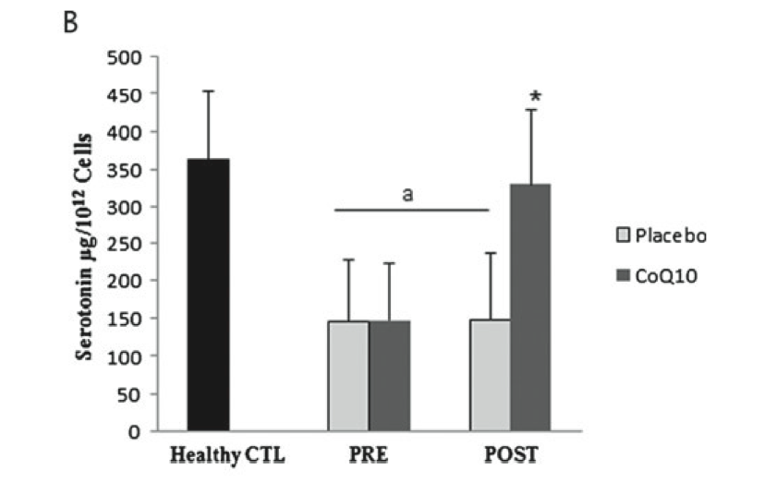
Relationship Between Coenzyme Q10 and Serotonin*
Platelets of patients with fibromyalgia are low in both serotonin and Coenzyme Q10
Platelet levels track levels in cerebrospinal fluid
Co Q10 supplements alleviate depression and restore platelet levels
*E. Alcocer-Go ́mez et al., ournal of Clinical Psychopharmacology 34(2), April 2014,
Notes:
Alzheimers/Alcocer_2014_serotonin_Q10_platelets_fibromyalgia.pdf

Slide 93
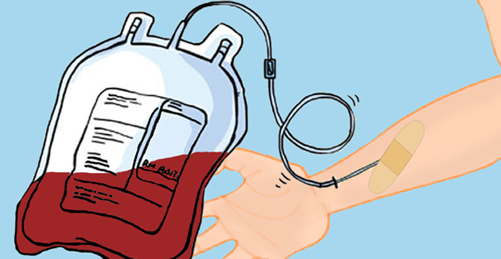
Phlebotomy Just as Effective as Statin Therapy?*
Conclusions: “There are commonalities between the clinical benefits of statins and the maintenance of physiologic iron levels. Iron reduction may be a safe and low-cost alternative to statins.”
*LR Zacharski et al., American Journal of Public Health, 2014 [Epub ahead of print]
Notes:
For_vic/The_Statin–Iron_Nexus_-_Anti-Inflammatory_Intervention_for_Arterial_Disease_Prevention__library.pdf

Slide 94
No Benefit for the Sick and the Elderly

Slide 95
Statins and Sepsis/COPD*
"The ARDS trial was stopped for futility after 745 of the planned 1,000 patients had been enrolled at 44 participating hospitals.”
Compared statin vs placebo following hospital admission
Mortality:
In shock at baseline:
36% statins; 32% placebo
Used statin before critical illness:
31% statins; 20% placebo.
*http://www.medpagetoday.com/MeetingCoverage/ATS/45826
Notes:
./Statins_fail_sepsis_COPD.pdf

Slide 96
Prior Statin Use & Traumatic Injury*
Pre-injury statin use is associated with an 80% increase in the risk of multiple organ failure following traumatic injury cases
This was one of the strongest independent risk factors for this outcome.
* MD Neal et al., J. Trauma 2009 67(3), 476-82.
Notes:
For_vic/statins_increase_risk_to_multiple_organ_failure.text

Slide 97
“Stopping statins may benefit terminally ill patients”*
“Statin withdrawal produced a significantly improved quality of life and a non-significant increase in survival and reduction of symptoms”
*Sciencecodex.com/stopping_statins_may_benefit_terminally_ill_patients-134678
Notes:
http://www.sciencecodex.com/stopping_statins_may_benefit_terminally_ill_patients-134678
./Terminal Patients and Statins.docx
./stopping_statins_good_if_cancer.pdf
./discontinue_statins_if_youre_dying.text

Slide 98
“Questioning the Benefits of Statin Therapy in Older People without Established Cardiovascular Disease”*
“The only two randomized trials designed to recruit only elderly people [4, 6] have shown a trend of an increased mortality from all causes in primary prevention”
Inverse relationship between mortality and LDL cholesterol in the elderly [10].
*A Battaglio et al., Heart, Lung and Circulation (2014)
Notes:
For_vic/Luca_Letter_statins_bad_elderly_2014.pdf
Authored by three MD’s.

Slide 99
Aggressive Lipid Management in Very Elderly Adults: Less Is More* Michael W. Rich, MD
“The findings of these studies suggest that, in very elderly adults, higher cholesterol levels are associated with better survival.”
“This phenomenon, referred to as ‘reverse epidemiology,’ has also been observed with other CV risk factors, including hypertension and obesity, in older adults.”
* NJ Stone et al., Statins in Very Elderly Adults (Debate)
JAGS 2014, 3-5
Notes:
For_vic/statins_elderly_bad.pdf – second article!!

Slide 100
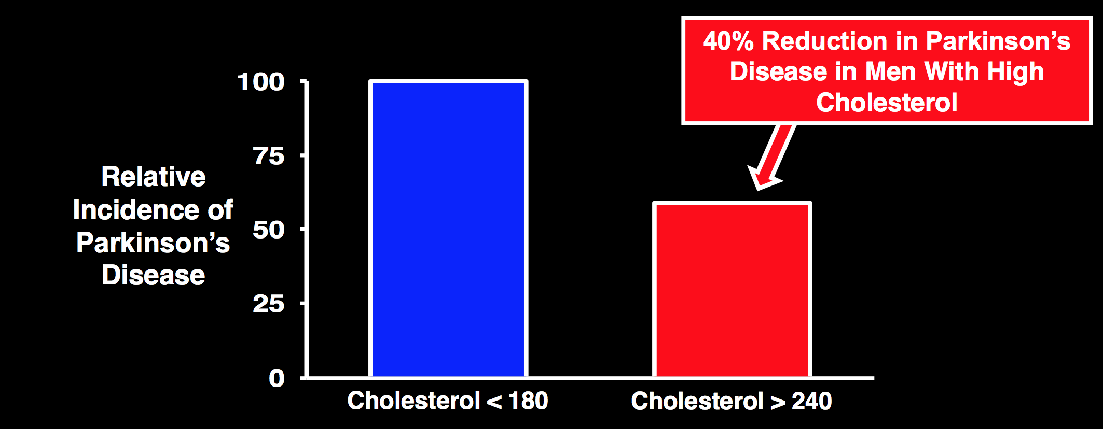
High Cholesterol Protects from Parkinson’s*
P. 7 Diamonds’ slides
*X Huang, PLoS One, 2011;6(8):e22854.
Notes:
THINCS – Brain Slides.pdf
p. 7
PS Sever et all, Lancet. 2003 Apr 5;361(9364):1149-58.
Prevention of coronary and stroke events with atorvastatin in hypertensive patients who have average or lower-than-average cholesterol concentrations, in the Anglo-Scandinavian Cardiac Outcomes Trial--Lipid Lowering Arm (ASCOT-LLA): a multicentre randomised controlled trial.
./low_cholesterol_and_Parkinsons.pdf
*PS Sever et all, Lancet. 2003 Apr 5;361(9364):1149-58.
Sever PS1, Dahlöf B, Poulter NR, Wedel H, Beevers G, Caulfield M, Collins R, Kjeldsen SE, Kristinsson A, McInnes GT, Mehlsen J, Nieminen M, O'Brien E, Ostergren J; ASCOT investigators.

Slide 101
Other Drugs

Slide 102
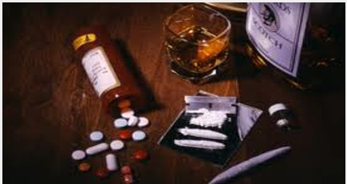
Drug deaths outnumber traffic fatalities in U.S.*
US CDC data from 2009
“Fueling the surge are prescription pain and anxiety drugs that are potent, highly addictive and especially dangerous when combined with one another or with other drugs or alcohol.”
*LA Times, September 17, 2011 | By Lisa Girion, Scott Glover and Doug Smith
Notes:
./drug_deaths.pdf

Slide 103
The Epidemic in Pain Killer Abuse*
Morphine use in US increased 600% from 1997 to 2007
Prescription drugs account for 75% of all drug overdose deaths
Deaths from prescription drugs increased 400% among women and 265% among men from 1999 to 2010
Opioids, amphetamines and benzodiazepines are the worst offenders
*articles.mercola.com/sites/articles/archive/2014/08/06/hydrocodone-medication.aspx
Notes:
Opioids, such as Vicodin, OxyContin, Percocet, codeine and Fentora, which are used for pain relief
Benzodiazepines, such as Xanax, Valium and Ativan, which are used as sedatives to induce sleep, prevent seizures and relieve anxiety
Amphetamine-like drugs, such as Ritalin, Concerta and Adderall, which are used to treat attention deficit hyperactivity disorder (ADHD)
./MercolaOnPainKillers.pdf
http://articles.mercola.com/sites/articles/archive/2014/08/06/hydrocodone-medication.aspx

Slide 104
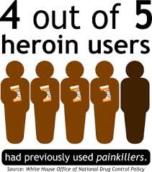
Heroin Deaths Jumped 44% in One Year*
From 2010 to 2011 – latest data available from CDC
Deaths from prescription opiates have been rising by 2% per year for the past decade
Hypothesis: People are in much greater pain due to health issues
*medpagetoday.com/PublicHealthPolicy/PublicHealth/46594
Notes:
http://www.medpagetoday.com/PublicHealthPolicy/PublicHealth/46594
Heroin_deaths_Up.pdf

Slide 105
"The popular current model of drug management for so-called chronic inflammatory disorders is highly inefficacious, expensive, inefficient, wrought with adverse effects, and it promotes dependence on the part of doctors and patients to rely almost exclusively on the pharmaceutical industry.”
--Alex Vasquez, clinician, lecturer, and author in functional medicine
Notes:
./vasquez_2013_mitochondrial_medicine_interview.pdf .

Slide 106
SAMe vs Celebrex for Arthritis Pain*
SAMe
SAMe worked just as well as celebrex in a head-to-head experiment
Celebrex is a COX inhibitor and has side effects
*WI Najm et al., BMC Musculoskeletal Disorders 2004:5.
Notes:
./SAMe_versus_celecoxib_for_arthritis.pdf

Slide 107
Androgen Deprivation Therapy for Prostate Cancer Doesn’t Work*
People who decided to adopt a “wait and see” attitude towards prostate cancer
Some took anti-androgen therapy (ADT group)
Analysis of > 15,000 men showed no benefit
The ADT group had higher mortality associated with other types of cancer and with cardiovascular disease
*Charles Bankhead, Staff Writer, MedPage Today , Mar. 17, 2014
Notes:
./hormone_therapy_no_good_prostate_cancer.pdf

Slide 108
Androgen Deprivation Therapy for Prostate Cancer Doesn’t Work*
I have spoken in previous WAPF meetings about the fact that prostate cancer cells produce cholesterol sulfate
People who decided to adopt a “wait and see” attitude towards prostate cancer
Some took anti-androgen therapy (ADT group)
Analysis of > 15,000 men showed no benefit
The ADT group had higher mortality associated with other types of cancer and with cardiovascular disease
*Charles Bankhead, Staff Writer, MedPage Today , Mar. 17, 2014
Notes:
./hormone_therapy_no_good_prostate_cancer.pdf

Slide 109
Pancreatic Cancer*
Pancreatic cancer will be the second leading cause of cancer death by 2030
Cachexia (muscle wasting) is usually associated with pancreatic cancer and is often the cause of death
5-year survival rate is 6%!
Tumor maintains stiff and impenetrable stroma (extracellular matrix complex)
Idea: develop drugs to attack the stroma so that other drugs can more easily gain access
*J Gore and M Korc, Cancer Cell 25, June 16, 2014, 711-712.

Slide 110
Cancer Treatments Fail*
When you use drugs that attack the stroma (extracellular matrix), other drugs have easier access to the tumor
However, this leads to increased risk to metastasis and cachexia
*Figure 1 in J Gore and M Korc, Cancer Cell 25, June 16, 2014, 711-712.
Notes:
Figure 1. Deleterious Consequences of Targeting the Stroma in Pancreatic Cancer
(A) Highly desmoplastic PDAC. These tumors exhibit activated cancer-associated fibroblasts (CAFs) that synthesize and release collagens, laminin, and fibronectin (desmoplasia); are infiltrated by various inflam- matory cells including macrophages (Macs); and produce excess growth factors and cytokines. Cancer cells in these lesions may be well, moderately, or poorly differentiated.
(B) Stroma-depleted PDAC. Engineered myofibroblast (MFB) depletion, genetic deletion of sonic hedge- hog (Shh), or Smoothened receptor targeting with IPI-926 were used to dramatically decrease the pres- ence of MFBs and CAFs in several genetically-engineered mouse models (GEMMs) of PDAC. Each of these strategies yielded undifferentiated PDAC, enhanced EMT, increased pancreatic cancer cell prolif- eration, and altered immune cell infiltrate profiles. Direct MFB depletion was associated with attenuated angiogenesis and an increased response to immune checkpoint blockade with an anti-CTLA-4 antibody. Shh deletion or IPI-296 treatment was associated with increased angiogenesis (Endo) and metastasis, a greater incidence of cachexia, and increased responsiveness to DC101, which targets VEGFR2. Thus, in several GEMMs and with different strategies, targeting the stroma unmasks a previously unrecognized protective effect in PDAC.

Slide 111
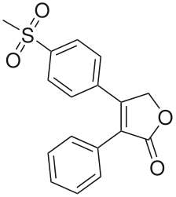
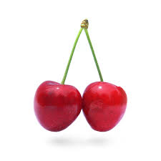
Ibuprofin inhibits COX Enzymes*
COX inhibitors cause COX-1 to digest the stomach lining
Death from internal bleeding from stomach wall – 1 in 1200 who take the drug for at least two months will die!
Vioxx – COX-2 only! BUT killed tens of thousands of people (heart failure)
Manufacturer responded by neutralizing doctors who tried to warn people
If that didn’t work: discredit them
Cherries: suppress COX-2 without suppressing COX-1.
Anthocyanins and phytonutrients transport sulfate
Fake!
Vioxx
*youtube.com/watch?feature=player_embedded&v=pkPhH1RSkds#t=3
Notes:
You need to find this!
What does it mean: “neutralize”??

Slide 112
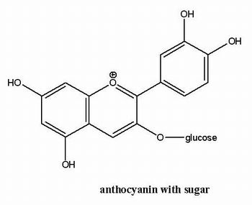
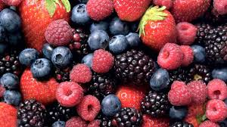
Anthocyanin*
Found in high concentrations in fruits: especially berries
“Glucuronidation, methylation and sulfation are the most typical metabolic reactions”
SULFATE
*A Cisowska et al., Nat Prod Commun. 2011 Jan;6(1):149-56.
Notes:
./anthocyanin_sulfate.text

Slide 113
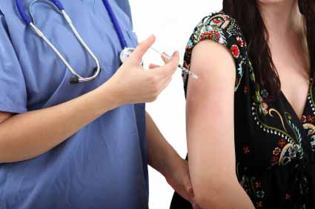
Managing Diabetes with Insulin*
Study weighed reduction in risk to complications of diabetes against overall "quality-adjusted” life years"
Conclusion:
Practice of broadly advocating insulin treatment for increased glycemic control should be reconsidered
Most patients older than 50 years with an HbA1c level less than 9% experience little gain
Low blood sugar can result in coma
Adverse effects result in net harm in older patients
*S. Vijan et al., JAMA Intern Med, June 30, 2014 [Epub ahead of print]
Notes:
For_vic/diabetes_drugs_not_useful_over_50.text
Full article: diabetes_treatment_too_aggressive.pdf
./Diabetes\ drugs\ do\ more\ harm\ than\ good.pdf
75 and above = older

Slide 114
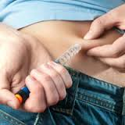
GMO Insulin Causes Type 1 Diabetes in Type 2 Diabetics*
“Giving genetically susceptible type 2 diabetes patients recombinant insulin can trigger their bodies to target their own insulin producing cells for autoimmune destruction, effectively producing 'double diabetes': type 1 and type 2, as a result.”
*Sayer Ji , GreenMedInfo.com, Saturday, June 28th 2014, 7:00 am
greenmedinfo.com/blog/gmo-insulin-causes-type-1-diabetes-type-2-diabetics-study-finds
Notes:
./GMO_insulin_causes_type_1_diabetes.pdf
Japanese study

Slide 115
Blood Pressure Control: A U Curve*
Overly aggressive BP lowering can lead to orthostatic hypotension and hypoperfusion of vital organs (11)
Patients assigned to intensive treatment (<120 mm Hg) had greater declines in total brain volume compared to those treated to more modest goal (<140 mm HG)
Notes:
Andersson\ 14\ Lower\ Is\ Not\ Always\ Better_\ Blood\ Pressure.pdf

Slide 116
Hazard Ratio for Mortality or End Stage Renal Disease*
*Figure 2 in JJ Sim et al., J Am College Cardiol 64(6), 2014, 588-597
Notes:
For_vic/U_shape_blood_pressure_curve_2014.pdf

Slide 117
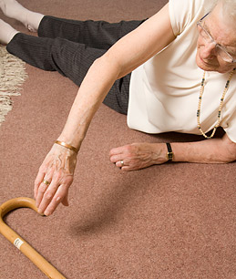
Blood Pressure Medicine Linked to Increased Risk of Falling in Elderly*
Falls account for 10% of emergency department visits and 6% of hospitalizations among those over age 65
Medications to control blood pressure increase risk of serious fall injuries by 30-40% in the elderly.
These falls have a similar effect on mortality and functional loss as the strokes and heart attacks that the drugs are meant to prevent
e.g., head injuries and hip fractures
*ME Tinetti et al., JAMA Internal Medicine, Feb 24, 2014, 588-595.
Notes:
./blood_pressure_medicine_falls_elderly.text
blood_pressure_medicine_falls_elderly_commentary_2014./pdf
blood_pressure_medicine_and_falls_elderly_2014.pdf

Slide 118
High Blood Pressure Protects from Dementia in Very Elderly*
Almost perfectly linear trend line connecting the point estimates for relative dementia risk in four categories of blood pressure (P-value = 0.05).
This potential benefit of high blood pressure should be taken into account when clinicians consider the treatment options for new-onset hypertension in the very elderly.
*medpagetoday.com/MeetingCoverage/AAIC/46770

Slide 119
Are β Blockers Overprescribed?*
“We did not see an association with reduced CV events, even in the prior-MI (myocardial infarction) group. And for some of the outcomes, being on a beta blocker was associated with worse outcomes; for example, there was an increased risk of the primary composite end point--CV death, nonfatal MI, or nonfatal stroke--in patients with just risk factors but no CAD,”
Dr Sripal Bangalore, New York University School of Medicine
*S. Bangalore et al., JAMA 2012; 308:1340-1349
Notes:
http://www.medscape.com/viewarticle/771995
Bangalore S, Steg PHG, Deedwania P, et al. Beta blocker use and clinical outcomes in stable outpatients with and without coronary artery disease. JAMA 2012; 308:1340-1349. Available at: http://jama.jamanetwork.com/journal.aspx.

Slide 120
β-blockers After Heart Attack*
“In contemporary treatment of MI [myocardial infarction, i.e., heart attack], β-blockers have no mortality benefit but reduce myocardial infarction and angina (short-term) with increase in heart failure, cardiogenic shock and drug discontinuation.”
*S Bangalore et al.m The American Journal of Medicine (2014), Epub ahead of print
Notes:
./beta_blockers_after_heart_attack_bad.pdf

Slide 121
Beta-Blockers Post-Operation*
”Perioperative initiation of a course of β-blockers appears to increase postoperative mortality by 27%.”
This practice emerged due to fraud:
Don Poldermans, a Dutch cardiovascular medicine researcher, had published a series of DECREASE studies claiming peri-operative benefit of beta blockers.
It was later found that these studies were fraught with fraud
*Bouri S, et al. Heart 2014;100:456–464.
Notes:
./beta_blockers_post_operative_bad_idea.pdf

Slide 122
“Acetaminophen Overdose Is Far Easier Than You Might Think”*
Acetaminophen poisoning is responsible for nearly half of all acute liver failure cases in the US.
Acetaminophen is the leading cause of calls to Poison Control Centers
"Acetaminophen, which includes Tylenol and other generic brands, causes more than 80,000 emergency room visits each year because people often aren't aware they're taking too much.”
Time Magazine, July 31, 2014
*articles.mercola.com/sites/articles/archive/2014/08/14/
tylenol-opioid-acetaminophen-overdose.aspx
Notes:
From cytochrome_P450_metabolizing_drugs_and_toxins_review.pdf
The “drug-metabolizing” P450s can convert some drugs to toxic products; that is, the role of P450 2E1 in acetaminophen toxicity is well-established (77).
Lee, S. S. T., Buters, J. T. M., Pineau, T., Fernandez-Salguero, P., and Gonzalez, F. J. (1996) Role of CYP2E1 in the hepatotoxicity of acetaminophen. J. Biol. Chem. 271, 12063–12067.
(78) Mitchell, J. R., Jollow, D. J., Potter, W. Z., Davis, D. C., Gillette, J. R., and Brodie, B. B. (1973) Acetaminophen-induced hepatic necrosis. I. Role of drug metabolism. J. Pharmacol. Exp. Ther. 187, 185–194.

Slide 123
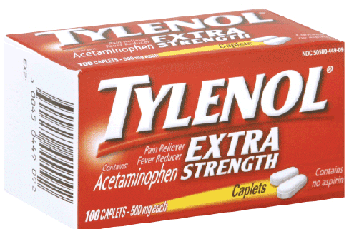
Taking Acetaminophen During Pregnancy May Increase Your Child’s Risk of ADHD*
More than half of all mothers reported acetaminophen use during pregnancy
Children of these mothers were at higher risk to hyperkinetic disorders, use of ADHD medications, or having ADHD-like behaviors at age 7.
Stronger association with more frequent use (P < 0.001)
Potential confounders were taken into account
*Mercola.com, March 23, 2014
Z. Liew et al., JAMA Pediatrics Feb 24, 2014, Epub ahead of print
Notes:
MercolaAcetaminophenADHD.pdf

Slide 124
Taking Acetaminophen During Pregnancy May Increase Your Child’s Risk of ADHD*
More than half of all mothers reported acetaminophen use during pregnancy
Children of these mothers were at higher risk to hyperkinetic disorders, use of ADHD medications, or having ADHD-like behaviors at age 7.
Stronger association with more frequent use (P < 0.001)
Potential confounders were taken into account
Acetaminophen is sulfated for export
through the kidneys:
This depletes serum sulfate levels
*Mercola.com, March 23, 2014
Z. Liew et al., JAMA Pediatrics Feb 24, 2014, Epub ahead of print
Notes:
MercolaAcetaminophenADHD.pdf

Slide 125
“Does Psychostimulant Use Increase Cardiovascular Risk in Children with ADHD?”*
60% of 8300 ADHD children in Denmark were taking drugs (e.g., Ritalin)
Those taking drugs had over twice the risk of cardiovascular disease
Discontinuation of treatment may shorten the QTc interval or cause heart rate variability
Short QTc interval is associated with AFIB, loss of consciousness, and sudden cardiac arrest
Reduced heart rate variability is a known risk factor of heart disease
*S Dalsgaard et al., Journal of Child and Adolescent Psychopharmacology. [Epub ahead of print]
Notes:
./ADHD_drugs_cause_heart_disease.pdf
./ADHD_meds_heart_disease.pdf – article about it.

Slide 126
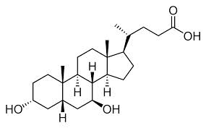
Toxicity of Ursodeoxycholic Acid*
Used to treat impaired bile flow
Off-label use in children was disastrous:
60% of 734 infants with neonatal hepatitis received drug
Failure rate: 59% in treatment group compared to 30% in control
Drug improved all kinds of parameters but caused the liver to fail!
*MA Kotb, Int. J. Mol. Sci. 2012, 13, 8882-8914
Notes:
Treasures/ursodeoxycholic_acid_toxicity_explained_2012.pdf
Causes liver cancer

Slide 127
Toxicity of Ursodeoxycholic Acid*
Used to treat impaired bile flow
Off-label use in children was disastrous:
60% of 734 infants with neonatal hepatitis received drug
Failure rate: 59% in treatment group compared to 30% in control
Drug improved all kinds of parameters but caused the liver to fail!
“Lithocholic acid (breakdown product) causes cholestatic liver injury and can cause death from liver failure in patients with compromised sulfation. Lithocholic acid induces DNA strand breakage, is uniquely co-mutagenic, promotes cell transformation, leads to segmental bile duct injury, liver cell failure and death”
*MA Kotb, Int. J. Mol. Sci. 2012, 13, 8882-8914
Notes:
Treasures/ursodeoxycholic_acid_toxicity_explained_2012.pdf
Causes liver cancer

Slide 128
Drug Induced Oxidative Stress*
*DG Deavall et al. Journal of Toxicology Volume 2012, Article ID 645460
Notes:
Treasures/drug_induced_oxidative_stress.pdf

Slide 129
Obesity Paradox

Slide 130
Obesity Paradox*
For patients with diabetes and concurrent heart disease, obesity is protective!
*Figure 3, W.. Doehner et al. , International Journal of Cardiology 162 (2012) 20–26
Notes:
GerryKoenig/Doehner_obesity_paradox_T2D_2012_marked_2.pdf

Slide 131
Another Study: Same Results*
“Participants with normal-weight diabetes experienced a significantly elevated total mortality (HR, 2.08; 95% CI, 1.52-2.85) and noncardiovascular mortality (HR, 2.32; 95% CI, 1.55- 3.48).”
They also experienced higher cardiovascular mortality risk but the results were not significant
*MR Carnethon et al., JAMA, August 8, 2012; 308(6), 581-590.

Slide 132
Clinicians are Puzzled!*
“How can the very risk factors that lead to the development of coronary artery disease suddenly become protective once the coronary artery disease event has occurred?”
This includes obesity, hypertension, dyslipidemia, and diabetes
* Kamyar Kalantar-Zadeh, Mayo Clin Proc. August 2014;89(8):1033-1035

Slide 133
My Answer
These “risk factors” are actually protective measures that are initiated by the body following exposure to toxic environmental chemicals
They are an indicator of toxic chemical exposure, and that is why they appear to be risk factors
The corollary is that the only important risk factors are the environmental chemicals
Treating the biological risk factors through drugs is a dangerous proposition

Slide 134
Weight Loss Leads to Toxins In Blood*
*AC Dirtu et al., Environ. Sci. Technol., 2013, 47 (21), pp 12441–12449
Notes:
DDE – breakdown product of DDT
PCB and PCB (hydroxylated)
Obese people also have lower levels in their blood, generally
From Gerry:
./Dynamics_of_Organohalogenated_Contaminants_in_Human_Serum_from_ObeseIndividuals_during_One_Year_of_Weight_Loss_Treatment.pdf

Slide 135
Weight Loss Increases Mortality*
“Paradoxically, weight loss was related to higher mortality and weight gain was related to lower mortality when compared with stable weight over 7 years. Approximately 60% of the deaths in the weight loss group were attributable to conditions associated with muscle wasting.”
*J Myers et al., The American Journal of Medicine 124(10), October 2011, 920-930
Notes:
./The_Obesity_Paradox_and_Weight_Loss_marked.pdf
From Gerry

Slide 136
Obesity Protects from Mortality from Pneumonia*
*Nie et al. BMC Medicine 2014, 12:61
Notes:
GerryKoenig/Obesity_survival_paradox_in_pneumonia_-_a_meta-analysis.pdf
Dashed lines – 95% confidence intervals.
Linear model in middle.

Slide 137
Summary
Prescription drugs come with many risks, including death
They act by disrupting crucial biological pathways
Statin drugs are among the worst offenders
They essentially make you grow older faster
The best way to treat illness is through healthy nutrition and reducing exposure to environmental toxins
Obesity is protective in many diseases – likely due to fat tissue’s ability to sequester toxins

