Slide 1
The Silver Lining in Chronic Disease
Wise Traditions London
March 17, 2012
Stephanie Seneff
MIT

Slide 2
A Review from This Morning
Cholesterol sulfate supplies oxygen, sulfur, cholesterol, energy energy and negative charge to all the tissues
Sulfate is synthesized from sulfide in the skin and blood stream utilizing energy in sunlight
Protects from UV damage and keeps microbes out
Western society lifestyle derails this process

Slide 3
A Proposal
Widespread deficiency of cholesterol and sulfate in the blood stream and in the tissues is the source of most chronic diseases
The diseases reflect last-ditch efforts to fix the problem
Notes:
./fructose_and_fat.text

Slide 4
Cholesterol and Cholesterol Sulfate
Sulfation makes the molecule water-soluble and therefore much easier to transport
SULFATE
Notes:
From cholesterol_sulfate_agile.pdf – this was the original article on that topic.

Slide 5
Outline
Why we are unhealthy
Inflammation and disease
SiNiC: The slide from sulfur into nitrogen into carbon as we age
Glucose metabolism and infection
The silver lining in cardiovascular disease
The silver lining in cancer
Summary

Slide 6
Why we are unhealthy

Slide 7
Why We Are Unhealthy!
too little sun exposure
too much sugar
too little dietary fat, cholesterol and sulfur

Slide 8
A Biological Definition of Aging
Excess glycation damage to proteins (AGEs)
Cholesterol and sulfate depletion in cell membranes
CELL
Increased susceptibility to infection and cancer
Dysfunctional blood system leading to blood clots and hemorrhages

Slide 9
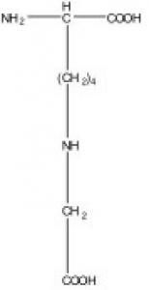
Glycation of Serum Proteins
Due to excess sugars in the blood stream
Especially high fructose corn syrup
Glycated hemoglobin is less efficient at delivering oxygen to tissues
Glycated LDL is less efficient at delivering cholesterol to tissues
Glycated LDL can’t be recycled through LDL receptors in liver
Builds up in blood serum as “small dense particles” (The bad kind)
Cells become deficient in cholesterol
Notes:
Carboxy methyl lysine

Slide 10
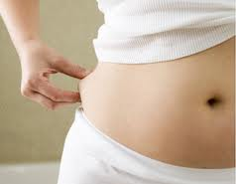
Study Shows Fructose is Bad for your Health*
559 adolescents in the study
Found that high fructose intake was associated with:
Increased visceral fat
Increased blood pressure
Increased C-reactive protein (inflammation indicator)
Reduced HDL (good lipid marker)
* N.K. Pollack et al., J. Nutr. 142(2):251-257, Feb 1, 2012.

Slide 11
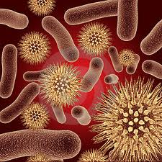
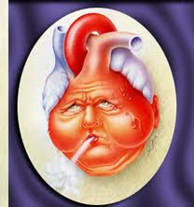
Some Bad Consequences
Pathogenic microbes can penetrate skin and then blood vessel walls and invade tissues
Inflammation to fight infection leads to widespread damage
Especially problematic for the heart muscle:
Arrhythmias and tachycardia
Heart failure (cardiomyopathy)
Infection in heart muscle (myocarditis)

Slide 12
Acid-Base Management in Liver

Slide 13
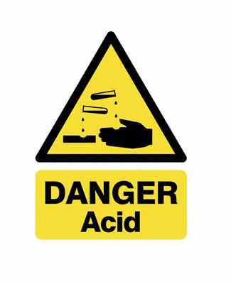
“Acidity Theory of Atherosclerosis”*
Atherosclerosis is due to too much acid in the blood: low blood pH → acidosis
Triggers uptake of LDL by macrophages
Essentially all known risk factors can be shown to induce sympathetic nervous system response: “fight or flight”
Over time, blood becomes acidic due to excess energy expenditure in cells
* Book by Carlos Monteiro, available on Amazon, published 2012

Slide 14
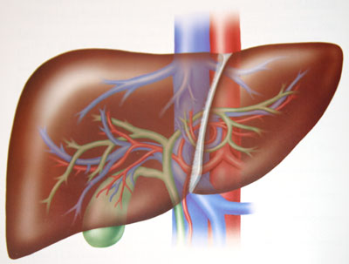
Liver Controls Acid Build-up
Excess carbonic acid build-up in blood leads to acidosis
Liver solves the problem by converting bicarbonate to sulfate or nitrate
Switches from sulfate to nitrate production when cysteine (sulfur-containing amino acid) is in short supply
This requires muscle breakdown to supply nitrogen
Notes:
Arterial pH below 7.35

Slide 15
The Liver is Grand Central Station*
Cysteine transforms bicarbonate into sulfate
Deplete Amino Acid Pool: Muscle Wasting Diseases
Amino Acid Pool
Cysteine
H₂O CO₂
Glutamine
Bicarbonate
SO₄⁻²
H+ HCO₃⁻
NH₄⁺ + Glutamate
Sulfate
L-Arginine
Nitrate
NO₃⁻²
*Droge and Holm, The Faseb Journal 11:1077-1089, Nov. 1997
Notes:
Cancer/HIV/cysteine_glutathione_HIV.pdf

Slide 16
Inflammation and Disease

Slide 17
Inflammation and Disease
Alzheimer’s is an inflammatory disease (Griffin, The Scientist, Aug 31, 2011)
Cancer is an inflammatory disease (Coussens and Werb, Nature, Dec. 19, 2002)
Heart disease is an inflammatory disease (Ravnskov and McKully, Annals of Clinical and Laboratory Science, 2009; Libby, et al., Circulation 105:1135-1143, 2002)
Notes:
Spacedoc/Ravnskov mucCully vulnerable plaque formation.pdf
Cancer/alzheimers_inflammation.pdf
Cancer/inflammation_and_cancer.pdf

Slide 18
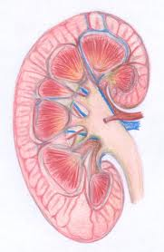
End Stage Kidney Disease and Cardiovascular Disease*
Dialysis patients have extreme risk
to cardiovascular disease
High serum cholesterol
High blood pressure
High serum homocysteine
Obesity
Inflammation
Abnormally low
homocysteine
Abnormally low blood pressure
Abnormally low cholesterol
Emaciated
* Kalantar-Zadeh et al., American Journal of Kidney Diseases 42:5 864-881, 2003
Notes:
Cancer/malnutrition_inflammation_dialysis_review.pdf
Because MICS leads to a low body mass index, hypocholesterolemia, hypocreatininemia, and hypohomocysteinemia, a “reverse epidemiology” of cardiovascular risks can occur in dialysis patients.
However, it’s also associated with IL-6, inflammation and muscle wasting, i..e,
A switch to nitrogen-based oxygen transport!!
Low serum albumin suggests low zeta potential

Slide 19
My Conclusion from This
Inflammation is the ONLY “Risk Factor” that counts:
All the other “Risk Factors” are protective measures!

Slide 20
What causes inflammation??

Slide 21
How to Avoid Inflammation
Make sure dietary sources of sulfur and cholesterol are abundant
Avoid dietary sources of sugars and starches
Get lots of sun exposure
Production of cholesterol sulfate by skin, red blood cells, endothelial cells and platelets maintains abundant supply to all tissues
When cholesterol sulfate is in short supply, inflammation is required to synthesize it and to fight infection

Slide 22
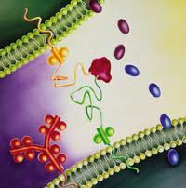
Interleukins (Cytokines)
Important signaling molecules associated with the immune response
Synthesized mainly by white blood cells, fat cells, and endothelial cells
Influence amount of inflammation in surrounding tissues
Interleukin-1 (IL-1) is the primary inducer of inflammation (triggered by TNF-α)

Slide 23
Other Interleukins to Remember
IL-6
Stimulated by exercise
Suppresses IL-1
Eventually leads to muscle wasting disease
IL-8
Responds to an invasion by pathogens such as E. coli or Staphylococcus
IL-10
An anti-inflammatory agent: A cell releases it to signal that it can’t handle inflammation (probably due to depleted membrane cholesterol)

Slide 24
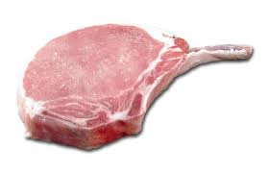
IL-6: “Ill from Six Lean Pork Chops”
IL-6 shifts from sulfate to nitrate based acid management, and leads to cachexia (muscle wasting disease)

Slide 25
IL-8 “Ill because I 8 an E-coli contaminated hamburger”
IL-8 is a response to an invasive pathogen such as E-coli:
Inflammation is needed to help destroy the pathogen

Slide 26
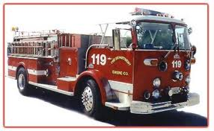
IL-10: “Ill from Ten Raging Fires”
IL-10 signals that the cell is too vulnerable to inflammation damage – most likely due to insufficient cholesterol in cell membrane

Slide 27
IL-10 and Autoimmune Disease
“In virtually every murine (mouse) model of autoimmunity, including experimental autoimmune encephalitis, rheumatoid arthritis, and inflammatory bowel disease, disease is dramatically exacerbated in mice lacking IL-10. These studies illustrate the power of IL-10 in limiting an over-exuberant immune response.”*
* Mosser and Zhang, Immunological Reviews, p. 213, 2008

Slide 28
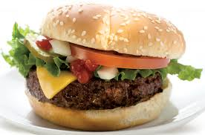
Other Interleukins to Remember
IL-6
Stimulated by exercise
Suppresses IL-1
Eventually leads to muscle wasting disease
IL-8
Responds to an invasion by pathogens such as E. coli or Staphylococcus
IL-10
An anti-inflammatory agent: A cell releases it to signal that it can’t handle inflammation

Slide 29
Recapitulation
Inflammation is a key factor in many diseases: Alzheimer’s, cancer, heart disease
Inflammation is required to synthesize cholesterol sulfate when sunlight exposure is inadequate
Deficiency in cholesterol and sulfate leads to increased microbial infection
Different interleukins control strategies to deal with infections
Cholesterol deficiency in cell membranes leads to increased vulnerability to inflammation
This ultimately results in autoimmune diseases
Notes:
Spacedoc/Ravnskov mucCully vulnerable plaque formation.pdf
Cancer/alzheimers_inflammation.pdf
Cancer/inflammation_and_cancer.pdf

Slide 30
SiNiC:
The Slide from
Sulfur
into Nitrogen
into Carbon
as We Age

Slide 31
Signaling Gas Molecules and Oxygen*
2O₂⁻
Sulfur-based
Superoxide and hydrogen peroxide are both highly reactive and sources of inflammation damage
H₂S
H₂SO₄
Superoxide or hydrogen peroxide reacts
with a gas to produce a stable anion
Nitrogen-based
H₂O₂
NO
H₂NO₃
Carbon-based
H₂O₂
CO
H₂CO₃
* Mancuso et al., J. Neurochem. 113, 563–575, 2010.
Notes:
See:
Cancer/CO_NO_H2S_Pituitary.pdf

Slide 32
Signaling Gases
Hydrogen sulfide (H₂S), nitric oxide (NO), and carbon monoxide (CO) are all released into the blood stream in small amounts
All of these gases have the effect of relaxing the artery wall and increasing oxygen supply to the tissues

Slide 33
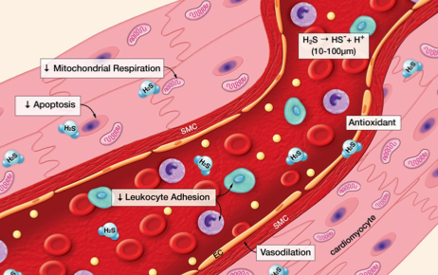
Hydrogen Sulfide as a Signaling Molecule*
“It appears that H₂S possesses all of the positive effects of NO without the capacity to form a toxic metabolite.”
* D. Lefer, PNAS 104(46), 17907–17908, 2007
Notes:
vitaminK/h2s_signaling_molecule.pdf

Slide 34
Hydrogen Sulfide Protects from Cardiovascular Disease*
BCA blocks H₂S Synthesis
This causes white blood cell adherence to the artery wall and infiltration beyond it, leading to atherosclerosis
* Renada et al., The Faseb Journal, 20, E1411-E1418, 2006.
Notes:
vitaminK/H2s_inflammation_leukocyte_infiltration.pdf
beta-cyano-L-Alanine (BCA) is a reversible inhibitor of the Hydrogensulfide-synthesizing enzyme cystathionine gamma lyase (CSE).

Slide 35
eNOS and Caveolae*
When calcium enters the cell, eNOS stops making sulfate and starts making nitrate instead
sulfate
nitrate
* Michel and Feron, J. Clin. Invest. 100(9) 2146-2152, 1997
Notes:
Cancer/NOS_review.pdf
Michel (Series Editor) and Olivier Feron
J. Clin. Invest. © The American Society for Clinical Investigation, Inc. 0021-9738/97/11/2146/07 $2.00 Volume 100, Number 9, November 1997, 2146–2152 http://www.jci.org
Michel and Feron, J. Clin. Invest. 100(9) 2146-2152, 1997
Palmitoylation contributes to membrane association.

Slide 36
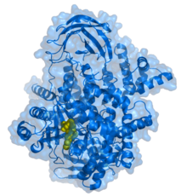
Transition to Nitrogen-based Oxygen Transport*
eNOS Requires L-Arginine as Substrate for NO Synthesis
VEGF
PI3K
Cell Interior
PI3K
Ca⁺²
Ca⁺²
Ca⁺²
CaM
CaM
Akt
Caveola
Ca⁺²
Ca⁺²
Ca+: Calcium
NO: Nitric Oxide
CaM: Calmodulin
VEGF: Vascular endothelial growth factor
PI3K: Phosphatidylinositol-3-kinase
eNOS: endothelial nitric oxide synthase
Ca⁺²
eNOS
P
Ca⁺²
NO
NO
NO
NO
NO
* Navarro et al., The Faseb Journal 18, 2004
Notes:
Cancer/caveolae_in_cell_migration.pdf

Slide 37
Protamine Treatment*
Protamine causes eNOS to detach from the membrane and start profusely producing nitric oxide
Protamine is a cationic polypeptide highly enriched in L-arginine
Protamine treatment can lead to extreme systemic hypotension, pulmonary hypertension, anaphylactic shock and cardiac failure
Excess nitric oxide is highly toxic, especially under well-oxygenated conditions
* Viaro et al., Chest 122;1061-1066, 2002
Notes:
vitaminK/protamine_sulfate_cardiac_crisis.pdf
Wiki:
The cardinal symptom of hypotension is lightheadedness or dizziness. If the blood pressure is sufficiently low, fainting and often seizures will occur.

Slide 38
The Relationship with Pathogens
Keep the pathogens out
2O₂⁻
H₂S
H₂SO₄
Fight the pathogens
H₂O₂
NO
H₂NO₃
Let the pathogens win
H₂O₂
CO
H₂CO₃
Notes:
See:
Cancer/CO_NO_H2S_Pituitary.pdf

Slide 39
How it Works
Keep the pathogens out (sulfur)
Both cholesterol sulfate in the skin and sulfate ions surrounding individual cells protect from bacterial invasion
Fight the pathogens (nitrogen)
Once the pathogens get in, nitric oxide is a good toxin to kill them
Let the pathogens win (carbon)
When cells themselves are too vulnerable to damage, it’s better to just learn to live with the pathogens –> autoimmune disease

Slide 40
Interleukins Control Strategy
IL-1, TNF-α; superoxide
2O₂⁻
H₂S
H₂SO₄
IL-6; muscle loss, anemia
H₂O₂
IL-6; muscle loss, anemia
NO
H₂NO₃
IL-10; autoimmunity
H₂O₂
CO
H₂CO₃
Notes:
See:
Cancer/CO_NO_H2S_Pituitary.pdf
Paper in endocrinology, 1991: (title)
Manganese superoxide dismutase: a hepatic acute phase protein regulated by interleukin-6 and glucocorticoids.
“they are thought to be the main enzymes in the antioxidant defense system”
O2- ➔ H2O2 !!!!!

Slide 41
How Insufficient Sulfate Leads to Anemia*
Bacterial infections rage in blood stream
Triggers IL-6 synthesis by macrophages
Induces mechanisms to deplete blood of iron
Iron feeds the bacteria!
Iron is drawn into macrophages, to lure bacteria to their death through nitric oxide poisoning
Serum iron is depleted → anemia
* Paradkar et al. Blood, 112:3, 866-874, 2008

Slide 42
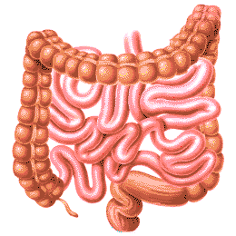
How Bacterial Infection Leads to Anemia through IL-6*
bacteria
hepcidin
IRON
hepcidin
IRON
IL-6
IRON
IRON
IRON
IRON
* Paradkar et al. Blood, 112:3, 866-874, 2008
Notes:
vitaminK/macrophages_iron_bacteria.pdf
Introduction
Hypoferremia is a hallmark of inflammation and results from increased secretion of the liver hormone hepcidin (for review, see Nemeth and Ganz1). Hepcidin is secreted by hepatocytes in response to inflammatory stimuli, notably interleuklin-6 (IL-6).2–4 Hepcidin binds to the iron exporter ferroportin (Fpn), leading to its internalization and degradation.5 Fpn is the only identified cellular iron exporter and is present on macrophages, absorptive enterocytes, and placenta. Loss of cell surface Fpn results in hypoferremia, which, if persistent, leads to iron-limited erythropoiesis.6 The hypoferremia of inflammation is thought to represent an antibacterial defense response, as iron acquisition proteins are virulence factors for many species of bacteria.7

Slide 43
Conditions Associated with Deficiencies
Obesity, heart disease, arthritis
2O₂⁻
H₂S
H₂SO₄
Anorexia, cachexia, ALS
H₂O₂
NO
H₂NO₃
Lupus, AIDS, cancer
H₂O₂
CO
H₂CO₃
Notes:
See:
Cancer/CO_NO_H2S_Pituitary.pdf

Slide 44
Recapitulation
Three signaling gases relate to three systems of oxygen/acid management: S, N, and C
Adequate sunlight exposure to skin allows S system to thrive
When S is deficient, bacteria invade
N based system fights bacteria
C based system gives up →
autoimmune disease

Slide 45
Glucose Metabolism and Infection

Slide 46
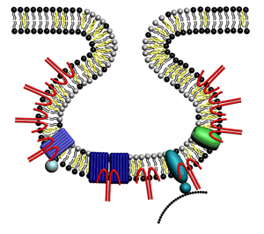
Tipped off by a 1936 Paper!!*
Ferrous sulfate is an excellent agent to break down complex carbohydrates into small molecules nonenzymatically
Reactive oxygen species are needed (hydrogen peroxide!)
Biological activities that take place in the caveolae of the lipid rafts are perfect for this reaction
Macrophages can also use this technique to break down bacterial walls in lysosomes
* W. R. Brown, The Hydrolysis of Starch by Hydrogen peroxide and Ferrous Sulfate, J. Biol. Chem. 1936 113: 417-425.

Slide 47
Why is this significant?
If the macrophages can’t degrade the cell walls of bacteria they ingest, the cell walls will stick around and cause an inflammatory immune reaction

Slide 48
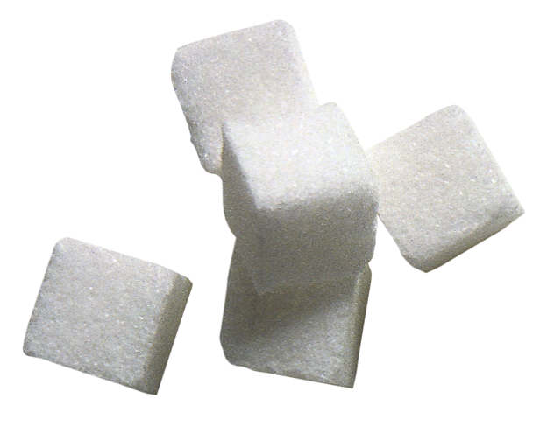
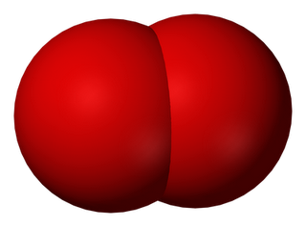
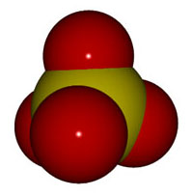
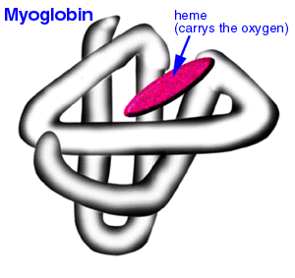
In the Muscle Cell….
sulfide
Ferrous iron and hydrogen peroxide catalyze reduction of glucose to pyruvate
Glucose reduces sulfate to sulfide
Myoglobin picks up the oxygen
glucose
Glucose’ reducing power is deflected to sulfur in sulfate rather than causing glycation damage to cell proteins
Fe⁺²
H₂O₂
GLUT4
oxygen
sulfate

Slide 49
How Sulfate can Become Sulfide: A Highly Speculative Theory
Ferrous sulfate catalyzes breakdown of glucose to pyruvate and releases hydrogen sulfide gas to the blood stream
hydrogen sulfide gas
Oxygen is safely delivered to myoglobin!!!
SO₄⁻²
S⁻²
glucose
3-mercapto-pyruvate
pyruvate
Fe⁺²
sulfur
Fe-O₄
myoglobin

Slide 50
Without Adequate Cholesterol Sulfate …..
Skeletal muscle cells become insulin resistant!

Slide 51
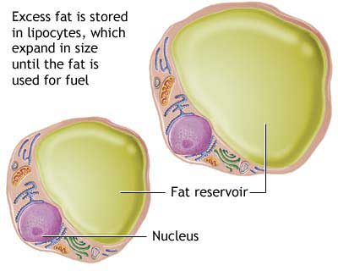
Fat Cells Stay Up Late!
Skeletal muscles can no longer safely metabolize glucose
Fat cells furiously take up glucose and convert it to fat, storing it in a “silo”
Fat cells supply muscle cells with safe alternative fuel: fat!
Person becomes obese

Slide 52
The same method can be applied to break down bacterial cell walls!!

Slide 53
Ceramide in Bacterial Infections *
Bacteria enter membrane at cholesterol- and sphingomyelin-enriched lipid raft areas
Sphingomyelin is converted to ceramide to trap bacteria
Bacteria are then killed and digested in acidic cavities (lysosomes)
I propose that the digestion of the complex sugars in the bacterial membranes depends on ferrous sulfate and hydrogen peroxide
* Grassmé et al. Biol Chem 389, 1371-1379, 2008
Notes:
Cancer/ceramide_bacterial_infections_cystic_fibrosis.pdf – a super article!!!

Slide 54
Phagocytes: Three Strategies in War against Pathogens
Cholesterol Sulfate +
“Cannibals”: Phagocyte traps the bacterium, kills it and eats it (using breakdown products as fuel)
“Chickens”: Phagocyte ignores the bacterium, but furiously reproduces itself
“Suicide bombers”: Phagocyte commits suicide, releasing toxins to kill the bacterium
Cholesterol Sulfate -
Cholesterol Sulfate - -

Slide 55
Depleting Membrane Cholesterol during Infection*
Expose macrophages to endotoxin (from bacteria)
Pretreat with MβCD (extracts membrane cholesterol)
Lipid rafts disintegrate
Switches off inflammatory agents
TNF-α goes down 4-fold
Interleukin-10 goes up 2-fold (immune suppression)
Can’t fight infection
* Cuschieri, Surgery, 169-175, 2004
Notes:
Cancer/macrophage_cholesterol_depletion_response.pdf

Slide 56
How Cells React to Infection
Cell has sufficient membrane cholesterol
T Helper 1
TNF-α
Inflammatory
pERK 1/2
T Helper 2
IL-10
Anti-Inflammatory
Cell has insufficient membrane cholesterol
Cell with insufficient cholesterol cannot survive an inflammatory attack on the bacterium

Slide 57
Recapitulation
Muscle cells depend on cholesterol sulfate to process glucose and deliver oxygen to myoglobin
With deficiency comes insulin resistance
Fat cells pitch in to convert glucose to fat
Cells with sufficient cholesterol and sulfate can capture and kill bacteria, consuming them as fuel
Cells with depleted cholesterol and sulfate become defenseless – they must signal other cells to hold off on fighting infection because they can’t survive the toxic gases in an attack

Slide 58
The Silver Lining in Cardiovascular Disease

Slide 59
A Wild Theory
Why do skeletal muscles, but not the heart muscle, develop insulin resistance?
Cholesterol sulfate deficiency!
The heart has a specialized service that supplies it with a private stash of cholesterol sulfate!

Slide 60
When a cell is deprived of cholesterol, it faces two tough choices:
Reduce the number of caveolae
Allow more ion leaks
This leads to insulin resistance (fewer caveolae) and excess reactive oxygen species (ROS) i.e., more energy requirements
Potassium
Sodium

Slide 61
What Happens when Cholesterol Sulfate Synthesis is Impaired??
Cardiovascular disease!!!
Activities in Plaque Produce Cholesterol Sulfate to Rescue the Heart from a Similar Fate

Slide 62
Steps in Atherosclerosis*
Inflamed endothelium provides adhesion molecules to trap and hold macrophages
Macrophages through scavenger process take up oxidized LDL and become foam cells
Interleukins and growth factors promote proliferation of smooth muscle cells (artery thickening)
Extracellular matrix proteins are degraded
Vulnerable plaque eruption : thrombosis
* Libby et al., Circulation 105:1135-1143, 2002
Notes:
Libby –
.cancer/libby_inflammation_heart_disease.pdf

Slide 63
Steps in Atherosclerosis
Entrapment of macrophages
Build up of fatty deposits
Rupture and thrombosis
Adapted from Libby, et al., Circulation 105:1135-1143, 2002
Notes:
Libby_inflammation_and_heart_disease.pdf

Slide 64
Many Good Reasons for ROS
ROS (reactive oxygen species) are a key component of inflammation in the artery
ROS are needed to produce sulfate *
Oxidation of glycated LDL makes it accessible to macrophages for breakdown**
Peroxynitrite (product of reaction between superoxide and nitric oxide) is toxic to pathogens***
* Mitsuhashi et al. Shock 24(6) 529-34, 2005.
** Kaplan and Aviram, Arterioscler Thromb Vasc Biol 21(3) 386-93 2001.
*** Alvarez et al., J. Biol. Chem. 286, 6627-6640, 2011.
Notes:
Vitamink/peroxynitrite_fights_infetion.text
vitaminK/ROS_h2s_to_sulfite_shock_2005.text

Slide 65
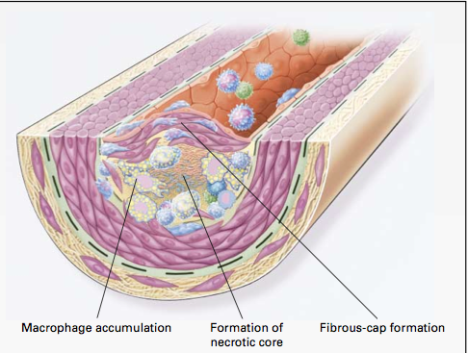
Macrophages and Cholesterol*
Macrophages in artery wall take up oxidized LDL and export extracted cholesterol to HDL-A1
Unsaturated fatty acids interfere with export process
Macrophages eventually become damaged by exposure to oxidizing and glycating agents → necrotic core
* Wang and Oram, J. Biol. Chem 277 (7) , 5692–5697, 2002

Slide 66
Pathway from Homocysteine to Sulfate*
When folate and B12 are deficient, nearly all homocysteine is converted to homocysteine thiolactone
homocysteine thiolactone
Vitamin A
thioretinamide
Superoxide:
Reactive oxygen species
(ROS)
Vitamin C
sulfite
alpha keto butyrate
retinoic acid
Sulfite oxidase
PAPS
*McCully, Annals of Clinical and Laboratory Science 41:4, 300-313, 2011
sulfate
Notes:
Spacedoc/McCully/ChemicalPathologyHomocysteineV_McCully.pdf
Figure 1. Hypothetical scheme for synthesis of thioretinamide, oxidation to sulfite and sulfate, and activation of sulfate to phosphoadenosine phosphosulfate, explains sulfation of glycosaminoglycans (GAG) to form sulfate esters [2]. In this scheme superoxide is synthesized from the heme oxygenase group of cystathionine synthase [34], catalyzing retinoic acid synthesis from retinol. Synthesis of thioretinamide from retinoic acid and homocysteine thiolactone is catalyzed by cystathionine synthase and dehydroascorbate.
is hydro- lyzed to Hcy by a calcium-dependent Hcy thiolactonase (HTase) tightly associated with HDL in serum (Jakubowski 1999a). !!
When methionine synthase activity is inhibited by folate or vitamin B-12 deprivation, almost all Hcy is converted to thiolactone.
!

Slide 67
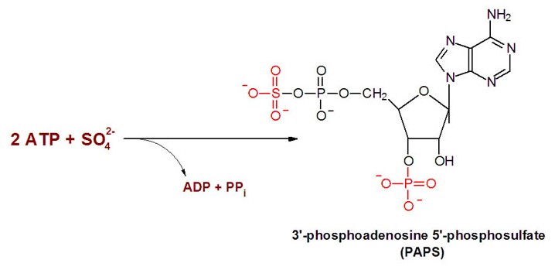
Synthesis of PAPS consumes ATP
I propose that eNOS’ synthesis of sulfate upon sunlight exposure in skin avoids loss of ATP by exploiting energy from light instead

Slide 68
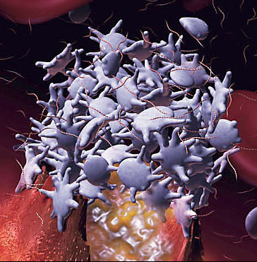
Platelets and Cholesterol Sulfate*
Platelets and RBCs both synthesize cholesterol sulfate (Ch-S)
Ch-S is present in the atherosclerotic lesions in the aorta
Platelets will accept cholesterol only from HDL-A1
Platelet synthesis rate increases 300-fold when PAPS is available.
PAPS is formed from ATP and sulfate
Platelet aggregation leads to thrombosis
HDL suppresses aggregation; LDL promotes it
* Yanai et al, Circulation 109, 92-96, 2004

Slide 69
Putting it All Together
homocysteine
Heart muscle cell
Synthesize sulfate
sulfate
ATP
Cholesterol protects the heart from ion leaks and sulfate allows it to safely metabolize glucose
PAPS
Lipid Raft
Red Blood Cell
Cholesterol Sulfate
RBC
insulin
Platelet
glucose
(3)
HDL-A1
macrophage
Ch
Ch
Artery Wall
oxLDL
LDL
ApoE
ROS
Inflammatory Agents
Endothelial Cell

Slide 70
Steps in Atherosclerosis
Endothelial cells lining artery walls feeding the heart release inflammatory agents
Macrophages infiltrate artery wall
Macrophages extract cholesterol from oxidized LDL and deliver it to HDL-A1.
Platelets extract cholesterol from HLD-A1 and convert it to cholesterol sulfate, with help from PAPS
Macrophages die and build up necrotic core

Slide 71
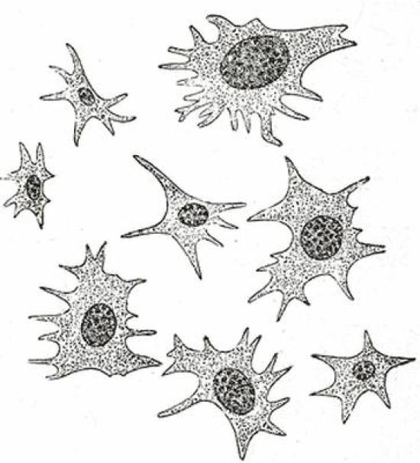
Two Paths for Homocysteine
homocysteine
When homocysteine must be used to make sulfate, protein synthesis is impaired.
Sulfate
Methionine
PAPS
Cholesterol Sulfate
Initiate protein synthesis
Notes:
I had a link between folate and cholesterol intake but I seem to have lost it!!
Dietary choline leads to sphingomyelin production; sphingomyelin is needed for GPI-anchored folate transport protein
Celiac disease – poor folate absorption
Cancer/fumonisins_sphingolipids_folate_neural_tube.pdf
cancer/./folate_homocysteine_heart_disease.text
Folate transporter is a GPI – anchored protein.
Folate is B9; associated with neural tube defects
Rich sources of folate include spinach, dark leafy greens, asparagus, turnip, beets, and mustard greens, Brussels sprouts, lima beans, soybeans, beef liver, brewer's yeast, root vegetables, whole grains, wheat germ, bulgur wheat, kidney beans, white beans, lima beans, mung beans, salmon, orange juice, avocado, and milk. In addition, all grain and cereal products in the U.S. are fortified with folic acid.

Slide 72
Vegetarian Diet is Problematic
Vegetarians have increased risk to heart disease*
Deficiency in choline and sulfur-containing amino acids: taurine, cysteine, methionine**
Deficiency in cobalamin (Vitamin B12)
Associated with:
Increased serum homocysteine and decreased serum cysteine**
Reduced muscle mass (IL-6)**
Increase of AGE products due to high fructose***
* Enas and Mehta, Clin. Cardiol. 18, 131-135 (1995)
** Ingenbleek and McCully, Nutrition. 2011 Aug 26. [Epub ahead of *print]
*** Krajcovicova-kudlakcova et al., Physiol. Res. 51: 313-316, 2002
**
***
Notes:
From_luca/vegetarian_heart_disease.pdf
Cancer/cardiovascular_disease_indian_vegan.pdf
Cancer/vegetarians_AGE.pdf
http://www.ncbi.nlm.nih.gov/pubmed/21872435

Slide 73
Recapitulation
Inflammation in the artery walls drives reactions and fights microbes
Cardiovascular plaque can be viewed as a factory to synthesize cholesterol sulfate
Vegetarians have increased risk to cardiovascular disease, due to dietary deficiencies in taurine, cysteine, cholesterol and choline, and excess exposure to fructose

Slide 74
The Silver Lining in Cancer

Slide 75
Chronic Infection Induces Cancer *
Many malignancies arise from areas of infection
Inflammation fights infection
Inflammation promotes proliferation
Inflammation (especially peroxynitrite) promotes gene mutations
Demethylation of DNA leads to increased vulnerability
Rheumatoid arthritis and inflammatory bowel disease exhibit similar rates of p53 oncogene mutation as in tumors
* Coussens and Werb, "Inflammation and Cancer" Nature 420(6917), 860–867, 2002.
Notes:
Cancer/inflammation_and_cancer.pdf

Slide 76
Endogenous Nitrite Carcinogenesis in Man*
* From The MIT Nitric Oxide Homepage: http://web.mit.edu/noppg/

Slide 77
“Cancer as a Metabolic Disease” *
Turns cancer theory upside down!
Impaired mitochondrial function leads to switch to aerobic glycolysis
Cancer cells convert glucose to lactate, producing a tiny amount of energy
Consume lots of glucose
Metabolic dysfunction precedes genetic mutations
*T.N. Seyfried and L.M. Shelton, Nutrition and Metabolism 7:7, 2010

Slide 78
Cancer Cells Have a Purpose!
Cancer cells are tasked with two assignments:
Make more cancer cells
Convert all major fuel sources to lactate
Without their contribution, a major organ, such as the liver, the heart, the kidney, or the blood system, would likely fail

Slide 79
The Logic Behind It
Proliferation induces aerobic glycolysis
Aerobic glycolysis consumes lots of glucose and methylglyoxal to make
Lactate: safe fuel for other cells; protect from acidosis
Glutathione: potent antioxidant
CANCER SERVES POSITIVE ROLE IN REDUCING BLOOD SUGAR AND METHYLGLYOXAL AND PROTECTING FROM ACIDOSIS

Slide 80
Tumor cells escape death sentence while chowing down on toxins

Slide 81
The Strange Metabolism of a Tumor Cell *
30 times as much as a normal cell
Fatty Acids
Glucose
Acidic pH
No Oxygen Needed!!
Protein
Lactate
Negatively charged molecule
* M. Israel and L. Schwartz, Biomedical Research, 2011.
Notes:
Metabolism_in_cancer_LONG.pdf in cancer/

Slide 82
The Many Benefits of Lactate
Does not glycate proteins like sugars
Does not cause oxidative damage like fats
Carries its own negative charge (protects from acidosis)
Combines with iron to form lactoferrin, a potent antibiotic
This depends on adequate vitamin K2
Helps protect from acidosis

Slide 83
The Liver is Grand Central Station*
Cysteine
H₂O CO₂
Glutamine
Bicarbonate
SO₄⁻²
H+ HCO₃⁻
NH₄⁺ + Glutamate
Arginine
Amino Acid Pool
Lactate!
Nitrate
NO₃⁻²
*Droge and Holm, The Faseb Journal 11:1077-1089, Nov. 1997
Notes:
Cancer/HIV/cysteine_glutathione_HIV.pdf
Proton generating process: cysteine → sulfate; this depletes supply of HCO3- which then favors glutamine and protein synthesis rather than degradation.

Slide 84
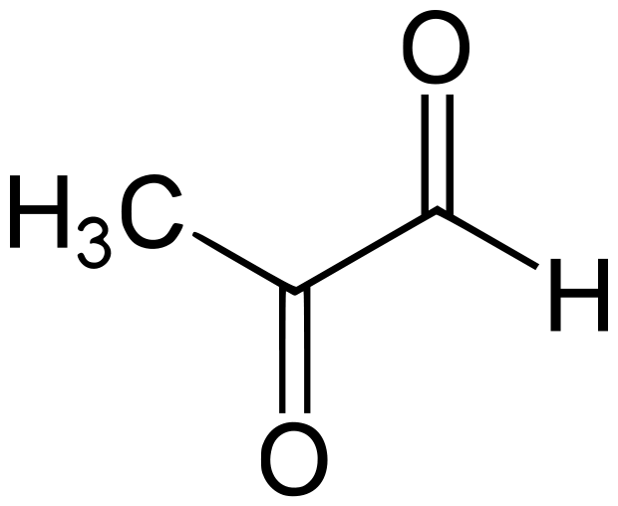
Methylglyoxal*
The most damaging source of AGE products
Found in carbonated beverages
Produced as by-product in glycolysis of glucose
Cancer cells can protect themselves from its damage by inducing an enzyme, GLO1, which detoxifies it (and produces lactate)
Cancer cells can then handle high glycolysis rates
* W. B. Bair et al. Melanoma Res. 20(2):85–96, 2010
Notes:
Cancer/glyoxalase_overexpression_tumor.pdf

Slide 85
How Tumor Cell Protects Itself and the World at Large*
Lactate
Glutathione
Methylglyoxal
Glutathione
Lactate
GLO1
Programmed Cell Death
Methylglyoxal
Glycation Damage
Heat Shock Protein
Tumor Cell
Oxygen
GLO1 = Glyoxalase: a ubiquitous cellular defense enzyme involved in the detoxification of methylglyoxal
* W. B. Bair et al., Melanoma Res 20:2, 85-96, Apr. 2010
Notes:
Cancer/glyoxalase_overexpression_tumor.pdf
Tumor cells makes lots of GLO1; methylglyoxal preferentially glycates heat shock protein, which interferes with its ability to function in its role of signaling cell death because there’s too little oxygen.
Tumor cell processes tons of methylgloxal, converting it to lactate and releasing glutathione as well (a valuable anti-oxidant).

Slide 86
Tumor Cells Self-destruct when Methylglyoxal Supply is Short
Lactate
Glutathione
Methylglyoxal
Glutathione
Lactate
GLO1
Programmed Cell Death
Methylglyoxal
Glycation Damage
Heat Shock Protein
Tumor Cell
GLO1 = Glyoxalase: a Ubiquitous cellular defense enzyme involved in the detoxification of methylglyoxal
* W. B. Bair et al., Melanoma Res 20:2, 85-96, Apr. 2010
Notes:
Cancer/glyoxalase_overexpression_tumor.pdf
Tumor cells makes lots of GLO1; methylglyoxal preferentially glycates heat shock protein, which interferes with its ability to function in its role of signaling cell death because there’s too little oxygen.
Tumor cell processes tons of methylgloxal, converting it to lactate and releasing glutathione as well (a valuable anti-oxidant).

Slide 87
Recapitulation
Cancer develops as a consequence of damage to cell’s mitochondria
Methylgyoxal, a by-product of fructose synthesis, is a toxic glycating agent
Tumor cells perform a very useful service by removing methylglyoxal from the circulation and boosting the supplies of glutathione and lactate, two extremely beneficial molecules
Tumor will self destruct when methylglyoxal supply is exhausted

Slide 88
Cancer and Cholesterol Sulfate

Slide 89
How Cholesterol Protects from Cancer*
Tyr-P
Signaling cascade
mutation
Ras/Raf
ERK
Proliferate
Cancer
Thr-P
OSBP
Thr-P’ase
Tyr-P’ase
Thr-P’ase
OSBP
Thr-P’ase
Tyr-P’ase
Cholesterol
Tyr-P’ase
Cholesterol
OSBP
ERK (extracellular signal-regulatating kinase) must be phosphorylated to be active
Cholesterol induces oligomer with two phosphorylases and OBSP
Phosphorylases work jointly to remove phosphates and inactivate ERK
* Wang et al, Science 307(5714), 1472-6, 2005
Notes:
OSBP_cholesterol.pdf is the talk; laurie sent me the paper (I only have it on hard copy)

Slide 90
Prostate Tumors Produce Cholesterol Sulfate!
Cholesterol sulfate is concentrated in the head of spermatozoa*
Plays essential role in fertilization
Mass spectrometry used to detect cholesterol sulfate in normal tissues and diseased tissues extracted from prostate gland **
Cholesterol sulfate was found almost exclusively in cancerous tissues, including precancerous lesions.
I propose tumor is performing a useful function in providing cholesterol sulfate for sperm
*Langlais et al., Proc. Natl Acad. Sci. USA 78:12, 7266-7270, 1981.
** Livia et al. Anal. Chem. 82:9, 3430–3434, 2010.
Notes:
Cancer/Ch-s_fertilization.pdf
vitaminK/Prostate_cancer_cholesterol_sulfate.text

Slide 91
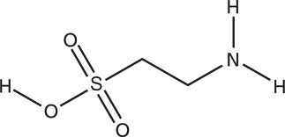
Taurine and Cancer
Taurine is the only sulfonic amino acid
Taurine is present in high concentration in the body
Taurine levels in the blood are depleted in association with many cancers:*
Breast tumors, liver cancer, uterine cancer, brain tumor, leukemia, colon cancer
* El Agouza and El Nashar, The Open Women’s Health Journal, 5: 1-6, 2011

Slide 92
Taurine, Fructose, Collagen, and Diabetes*
Collagen is highly susceptible to glycation damage from sugars
Experiment: feed mice fructose
Result:
cross-linked abnormal skin collagen
diabetes and hypertension
Supplement with taurine as well:
Prevents fructose-related diabetes
Protects collagen from damage
*Nandhini et al., Indian J Med Res 122, 171-177 Aug 2005.
Notes:
vitaminK/taurine_prevents_collagen_damage_fructose_fed_mice.pdf

Slide 93
Sulfate Depletion in Colitis *
GAGs in intestinal mucosa greatly depleted in sulfate in association with both colitis and Crohn’s disease
Colitis: mostly GAGs in luminal surface
Crohn’s: mostly GAGs near blood vessels
Serum albumin leaves vasculature and penetrates intestinal lining:
Insufficient negative charge results in easy access
Serum albumin depletion has severe consequences to blood stability
People with colitis or Crohn’s have greatly increased risk to colon cancer
* Murch et al., The Lancet 341:711-714, Mar 20, 1993
Notes:
vitaminK/sulfated_glycosaminoglycans_intestinal_inflammation.pdf

Slide 94
Colon cancer patients have steadily declining serum cholesterol levels for ten years prior to cancer appearing*
It has been claimed that this is due to a high-fat diet, but this is not true
Colon cancer patients have high levels of lithocholic acid in their gut
Colon cancer rates are very high in the United States
Colon cancer patients have high levels of methane in their gut
What’s lithocholic acid????
* Pique et al., Gastroenterology, 87(3):601-5, 1984
Notes:
Cancer/methane_and_colon_cancer.text

Slide 95
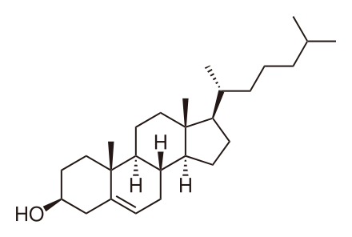
Cholesterol and Lithocholic Acid
methane
methane
Carbon-based Oxygen Transport
Cholesterol
Lithocholic Acid
Notes:
Sulfated_lithochoic_acid.pdf
Lithocholic acid is found in high concentrations in the colon associated with colon cancer!!!!

Slide 96
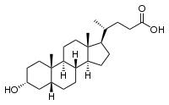
Adding Sulfate Makes it Better!*
Sulfation reduces capacity to metastasize
Sulfation reduces degradation of matrix proteins
Hypothesis: insufficient sulfur leads to tumor development
Sulfate
O₃SO
* Halvorsen et al., Biochem. J. 349:189–193, 2000.

Slide 97
What do Warfarin and Liver Cancer Have in Common?
Protection from deep vein thrombosis!! *
Warfarin interferes with liver enzymes that promote blood coagulation via thrombin activation
Liver cancer produces version of prothrombin that can’t be activated
Both protect blood from coagulating
There is a relationship with acidosis**
* Ona et al., Tumor Biol., 319-26, 1990
** Martini et al., RTO HFM Symposium, St. Pete Beach, USA, Aug. 2004
Notes:
Cancer/ionic composition and rbc interactions.pdf
Cancer/abnormal_prothrombin_liver_cancer.text
vitaminK/coagulation_acidosis_army.pdf
Splenic bleeding time was significantly prolonged by 41%, 57%, and 72% in the acidotic, hypothermic, and combined groups, respectively (P<0.05, Fig 2).
In summary, we investigated the independent and combined contributions of hypothermia and acidosis in the development of a clinical coagulopathy. Acidosis and /or hypothermia impair blood coagulation process. As a possible underlying mechanism, acidosis and hypothermia inhibit thrombin generation for clot formation by different kinetics. Further understanding of the mechanisms underlying the development of coagulopathy induced by different means may facilitate hemorrhage control in trauma patients.

Slide 98
Cancer and Deep Vein Thrombosis*
Deep vein thrombosis is the second-leading cause of death among cancer patients (after infection)
Chemotherapy increases risk of thrombosis 6.5x
A theory:
Removing the tumor removes the protective effect
*Previtali et al., “Risk Factors for Venous and Arterial Thrombosis”,
Blood Transfusion 9:120-38, 2011
Notes:
vitamink/thrombosis_review_BOB.pdf
Dvt_review_2001.pdf
Cancer patients undergoing surgical procedures have at least twice the risk of postoperative DVT and more than 3 times the risk of fatal PE than noncancer patients undergoing similar procedures.600

Slide 99
Recapitulation
Chronic inflammation and infection induce cancer
Tumor cells use anaerobic metabolism to produce lactate and glutathione from sugars
Cholesterol protects from cancer
Prostate cancer can synthesize much needed cholesterol sulfate
Colon cancer is associated with low LDL and sulfate depletion in the gut
Liver cancer can protect blood from coagulation

Slide 100
Summary
Inflammation is at the root of many human diseases
I believe it is brought on by a systemic deficiency in cholesterol sulfate
Insufficient sun exposure to the skin
Too much dietary sugar and carbohydrate
Cardiovascular disease has a silver lining which is to produce cholesterol sulfate
Cancer has a silver lining which is to detoxify sugars and protect blood from coagulation

Slide 101
Thank you!

