Slide 1
Glyphosate: The Elephant in the Room
Stephanie Seneff
Spoken Language Systems Group
May 17, 2013

Slide 2
The Autism Epidemic in the U.S.
One in 50 kids diagnosed on Autism Spectrum in Mar. 2013
One in 150 kids diagnosed on Autism Spectrum in 2007
One in 100 kids diagnosed on Autism Spectrum in 2009

Slide 3
One in Two in 2025?
The rate was 1 in 10,000 in 1970

Slide 4
Some Comorbidities with Autism
Disrupted gut bacteria
Impaired homeostasis of sulfur metabolites (especially sulfate)
Is there a toxic substance that is currently on the rise in our environment that could account for these comorbidities?

Slide 5
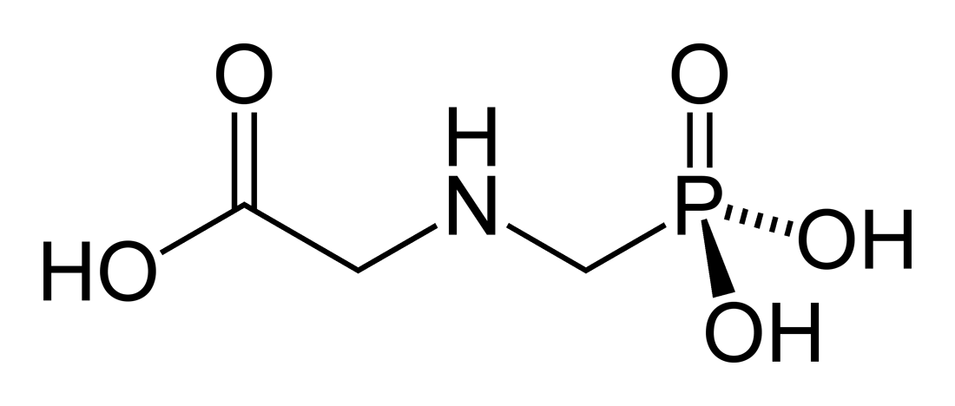
Glyphosate
Glyphosate is now the #1 herbicide in the U.S. and is increasingly used around the world
Developed and patented by Monsanto in the 1970’s
Came out from under patent in 2000
Inhibits an enzyme in the shikimate pathway involved in synthesis of tyrosine, tryptophan and phenylalanine (the three aromatic amino acids)
Huge expansion of GMO corn, soy, cotton and canola crops has led to sharp increases in the last decade
Notes:
WIKI

Slide 6
Is Glyphosate Nontoxic?
Monsanto has argued that glyphosate is harmless to humans because we don’t have the shikimate pathway
However, our gut bacteria DO have this pathway
We depend upon them to supply us with essential amino acids (among many other things)
Tryptophan → serotonin → melatonin
Tyrosine → dopamine, adrenaline, and melanin
Roundup contains surfactants that greatly increase glyphosate’s toxic effects
Insidious effects of glyphosate accumulate over time

Slide 7
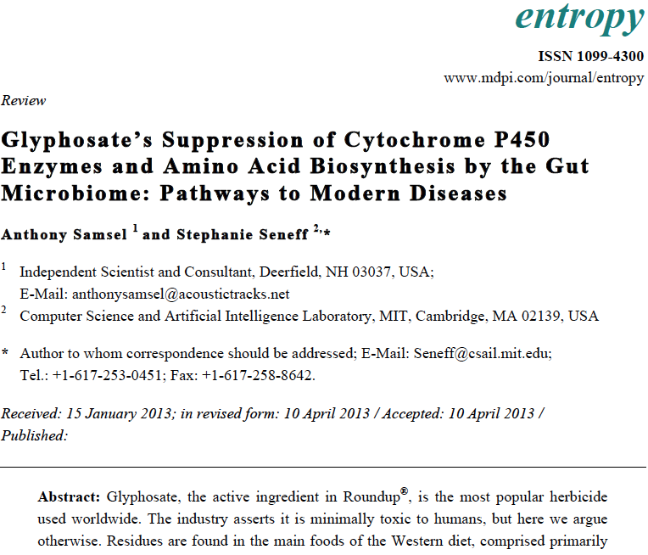
Recent Publication

Slide 8
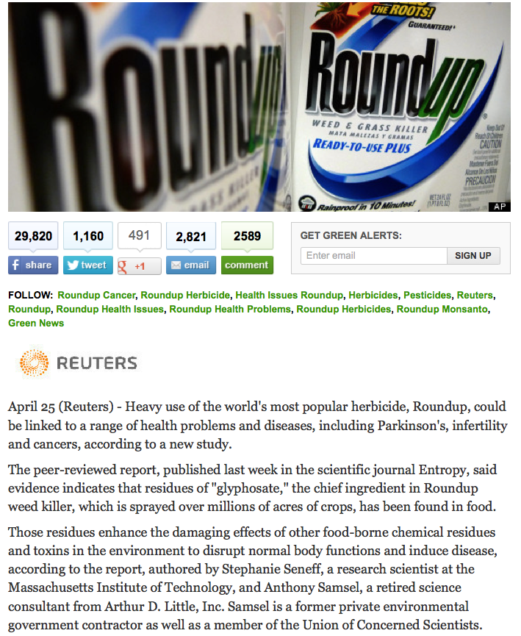
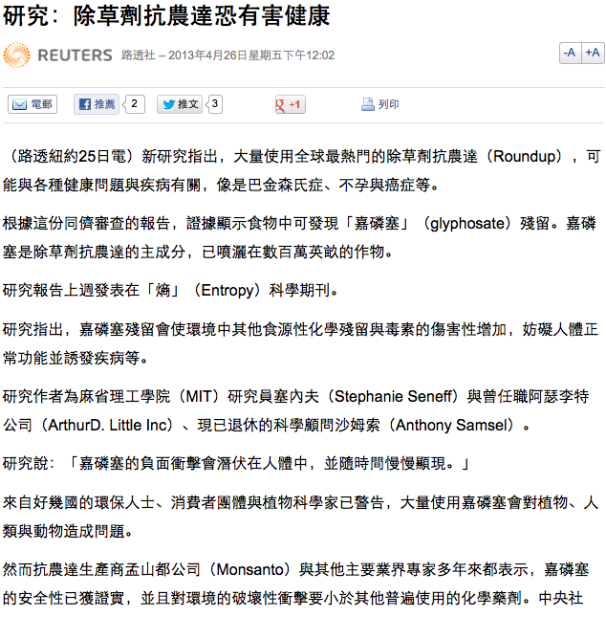

Slide 9
Glyphosate: Some Biological Effects
Depletes aromatic amino acids and methionine
Serotonin deficiency is linked to obesity, autism, Alzheimer’s disease, depression, and violent behavior
Dopamine deficiency leads to Parkinson’s disease
Methionine is an essential sulfur-containing amino acid
Disrupts gut bacteria
Studies with chickens and cows show overgrowth of pathogens in gut
Disrupts cytochrome P450 (CYP) enzymes which are involved in:
Homeostasis of sterols like vitamin D, cholesterol, and sex hormones
Bile acid production
Detoxifying environmental toxins
Stabilizing blood (hemorrhaging vs blood clots)
Depletes important minerals
Calcium, manganese, zinc, cobalt, iron, ….
Likely impairs sulfate synthesis and sulfate transport
Depletes aromatic amino acids and methionine
Serotonin deficiency is linked to obesity, autism, Alzheimer’s disease, depression, and violent behavior
Dopamine deficiency leads to Parkinson’s disease
Methionine is an essential sulfur-containing amino acid
Disrupts gut bacteria
Studies with chickens and cows show overgrowth of pathogens in gut
Disrupts cytochrome P450 (CYP) enzymes which are involved in:
Homeostasis of sterols like vitamin D, cholesterol, and sex hormones
Bile acid production
Detoxifying environmental toxins
Stabilizing blood (hemorrhaging vs blood clots)
Depletes important minerals
Calcium, manganese, zinc, cobalt, iron, ….
Likely impairs sulfate synthesis and sulfate transport

Slide 10
Some Biomarkers for Autism
Disrupted gut bacteria; inflammatory bowel
Low serum sulfate
Methionine deficiency
Serotonin and melatonin deficiency
Defective aromatase (CYP enzyme)
Zinc and iron deficiency
High serum nitrate and ammonia
Impaired immune function
Chronic low-grade inflammation in the brain
Notes:
Samantha/zinc_deficiency_autism.text

Slide 11
Some Biomarkers for Autism
Disrupted gut bacteria; inflammatory bowel
Low serum sulfate
Methionine deficiency
Serotonin and melatonin deficiency
Defective aromatase (CYP enzyme)
Zinc and iron deficiency
High serum nitrate and ammonia
Impaired immune function
Chronic low-grade inflammation in the brain
These can all be explained as potential effects of glyphosate on biological systems
Notes:
Samantha/zinc_deficiency_autism.text

Slide 12
Glyphosate and Autism*
R = 0.9898; p <= 2.6e-06
Pearson Correlation Coefficient = 0.985
*Nancy Swanson, http://www.examiner.com/article/
data-show-correlations-between-increase-neurological-diseases-and-gmos
Notes:
Nancy Swanson – I have a fanclub account for her.
Individuals with disabilities in education act IDEA

Slide 13
Glyphosate and Autism*
U.S. Market is 25% of World Market of Roundup
R = 0.9898; p <= 2.6e-06
Pearson Correlation Coefficient = 0.985
*Nancy Swanson, http://www.examiner.com/article/
data-show-correlations-between-increase-neurological-diseases-and-gmos
Notes:
Nancy Swanson – I have a fanclub account for her.
Individuals with disabilities in education act IDEA

Slide 14
Sulfate

Slide 15
Rosemary Waring on Autism (1990)*
“These results indicate that there may be a fault either in manufacture of sulphate or that sulphate is being used up dramatically on an unknown toxic substance these children may be producing” (p. 198).
*O’Reilly, B.A.; Waring, R.H. Enzyme and sulphur oxidation deficiencies in autistic children with known food/chemical intolerances. Xenobiotica. 1990, 20, 117–122.

Slide 16
Sulfated Glycosaminoglycans (GAGs)
Prominent in extracellular matrix of nearly all cells
Amount of sulfate depends on availability
Involved with ion and nutrient transport across plasma membrane
Crucial for maintaining healthy blood vessels
http://www.science-autism.org/sulphate.htm

Slide 17
Impaired heparan sulfation in mouse brains led to all the symptoms of autism*
*Irie, F.; Badie-Mahdavi, H.; Yamaguchi, Y. Autism-like socio-communicative deficits and stereotypies in mice lacking heparan sulfate. Proc. Natl. Acad. Sci. USA 2012, 109, 5052–5056.

Slide 18
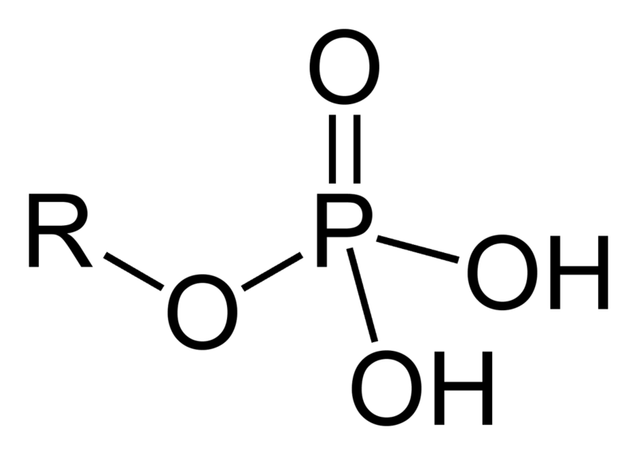
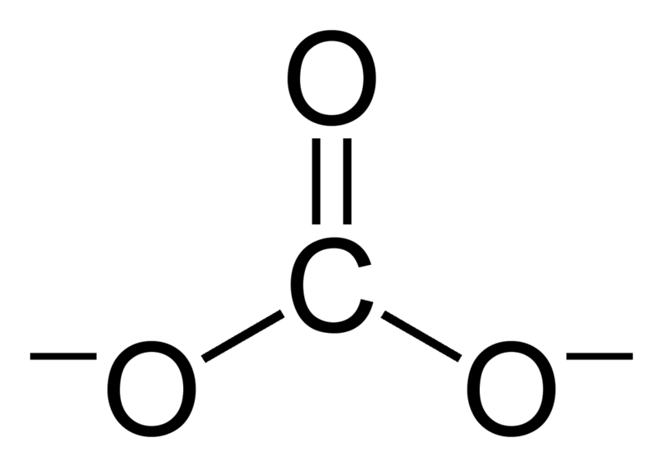
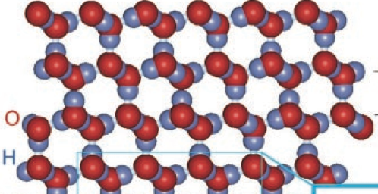
Kosmotropes Gel the Blood
carbonate
phosphate
sulfate
carbonyl
phosphonic
glyphosate
Notes:
Picture from treasures/interfacial_water_crystalline_structure.pdf

Slide 19
Kosmotropes Gel the Blood
Intentional poisoning by drinking glyphosate leads to death due to disseminated intravascular coagulation
carbonate
phosphate
sulfate
carbonyl
phosphonic
glyphosate

Slide 20
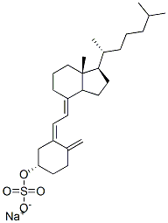
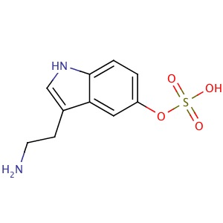
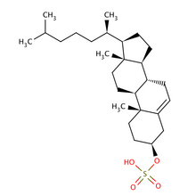
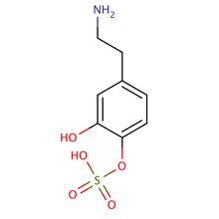
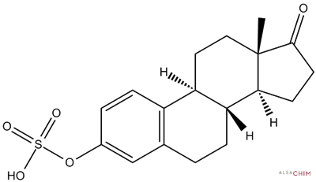
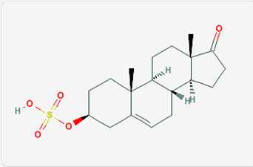
Safe Sulfate Transport: Carbon Rings
vitamin D sulfate
serotonin sulfate
cholesterol sulfate
dopamine sulfate
estrone
sulfate
DHEA sulfate

Slide 21
Safe Sulfate Transport: Carbon Rings
vitamin D sulfate
serotonin sulfate
cholesterol sulfate
Glyphosate depletes serotonin and dopamine and disrupts enzymes involved with sterol sulfation: Imperiled sulfate transport
dopamine sulfate
estrone
sulfate
DHEA sulfate

Slide 22
Alzheimer’s Disease,
Infant Mortality,
and Obesity

Slide 23
Changes in Causes of Death in U.S.

Slide 24
Changes in Causes of Death in U.S.
Alzheimer’s disease and autism have a great deal in common

Slide 25
Infant Mortality Rates: U.S. and Elsewhere
We are now #46 on infant mortality -- behind Cuba and Guam
Our rate is over 2.5x the rate in Japan and Sweden
Divergence began with introduction of glyphosate

Slide 26
Obesity in US over Time*
Glyphosate was introduced into the food chain in 1975
*Figure 1 in R.J. Johnson et al., Am J Clin Nutr 2007;86:899–906.
Notes:
Sugar intake per capita in the United Kingdom from 1700 to 1978 (30, 31; E) and in the United States from 1975 to 2000 (32; 􏰏) is compared with obesity rates in the United States in non-Hispanic white men aged60–69y(17;F).Valuesfor1880-1910arebasedonstudiesconducted in male Civil War veterans aged 50–59 y (18).

Slide 27
To my knowledge, no studies have been done assessing the effects of glyphosate on humans

Slide 28
The U.S. government does minimal monitoring of glyphosate residues in foods

Slide 29
Summary
I believe we need to be very worried about glyphosate in the food and water supplies
Glyphosate’s disruption of gut bacteria, depletion of essential amino acids and minerals, and interference with cytochrome P450 enzymes have widespread consequences
Glyphosate may be the most important factor in the U.S. health crisis related to obesity, autism, Alzheimer’s disease and infant mortality
Notes:
Mention paper has a lot more

Slide 30
Thank you!

