Slide 1
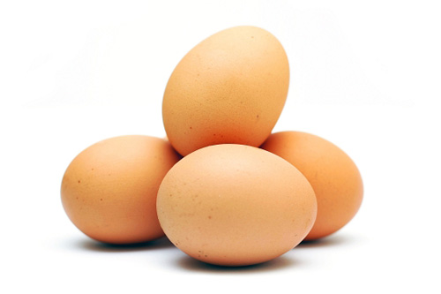
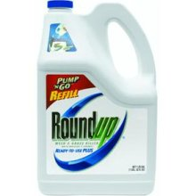
6. Nutrition: Fact and Fiction
Stephanie Seneff
Wise Traditions Workshop
Weston Price Foundation
Nov. 8, 2013
people.csail.mit.edu/seneff/WAPF_Slides_2013/6_nutrition.pdf

Slide 2
“Of all factors which make human health, the greatest single factor is perfectly constituted food.”
-- Sir Robert MacCarrison
The Cantor Lectures delivered before the Royal Society of Arts, 1936.

Slide 3
Outline
Sulfur!
Flavonoids
Animal-based fats
Shore-based foods
Fermented foods
What you can do!

Slide 4
Sulfur!

Slide 5
Sulfur: the Forgotten Nutrient*
“ … the available knowledge on elemental sulfur in human nutrition looks like a black hole. Despite the fact that S8 follows H, C, O, N, Ca and P as the seventh most abundant element in mammalian tissues, it appears as a forgotten item. Not the slightest attention is dedicated to S8 in the authoritative “Present Knowledge in Nutrition” series of monographs even though they go over most oligo- and trace-elements in minute detail.”
* p. 40, Y. Ingenbleek, The Open Clinical Chemistry Journal, 2011, 4, 34-44.
Notes:
vitaminK/oxidative_stress_homocysteine_sulfur_containing-reductants.pdf

Slide 6
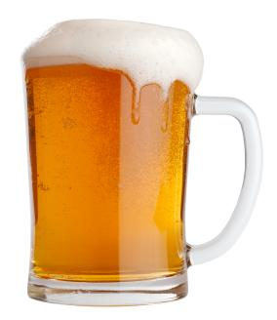
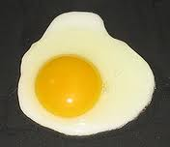
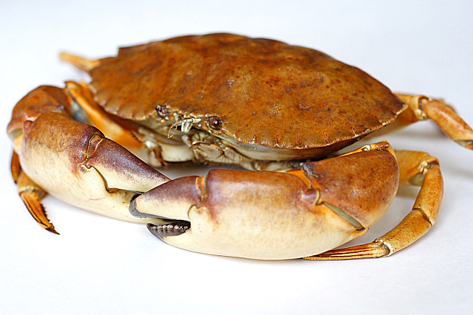
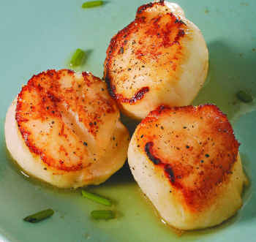
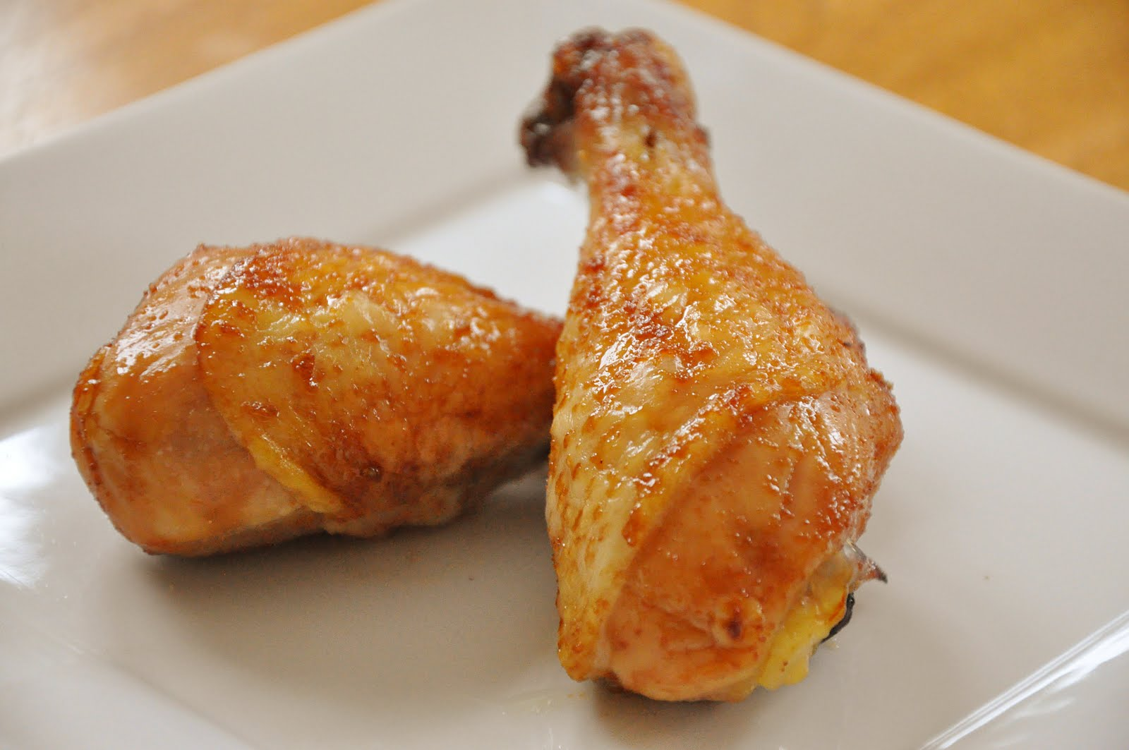
Foods Containing Sulfur
Notes:
http://healthyeatingclub.com/info/books-phds/books/foodfacts/html/data/data5g.html

Slide 7
Cruciferous Vegetables! The Really Healthy Vegetables
Sulforaphane!

Slide 8
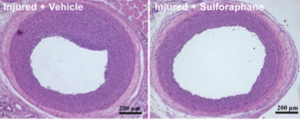
Sulforaphane*
Experiment conducted on rats subjected to carotid artery balloon injury
Half the rats were given sulforaphane as nasal gel
Treated rats had reductions in inflammatory markers
Artery wall 14 days after injury
+ sulforaphane
* J.-S. Kwon et al., Atherosclerosis, In Press
Notes:
./broccoli_protects_from_restenosis.pdf

Slide 9
Cruciferous Vegetables and Pancreatic Cancer*
“In this large population-based prospective study of Swedish women and men, overall fruit and vegetable consumption was not associated with pancreatic cancer risk. However, we observed an inverse association between consumption of cruciferous vegetables, especially of cabbage, and risk of pancreatic cancer.”*
* Larsson et al., Cancer Epidemiol Biomarkers Prev 2006, 15:301-305.
Notes:
Cancer/cruciferous_veggies_pancreatic_cancer.pdf

Slide 10
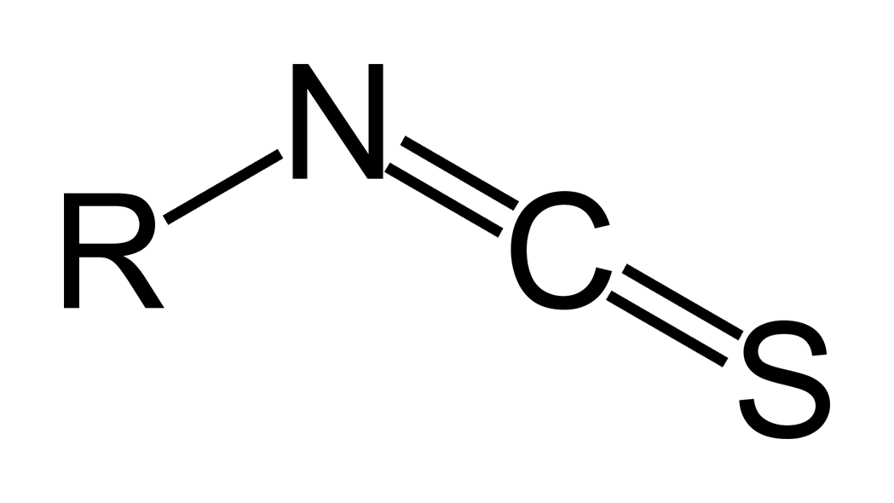
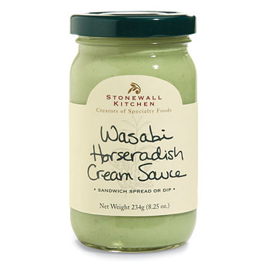
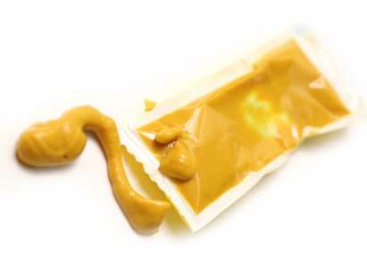
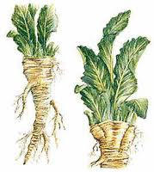
Healthy Spices!
Allyl Isothiocyanate
Horseradish garlic mustard?
wasabi
horseradish
mustard
Notes:
Wasabi mustard horseradish
Allyl isothiocyanate (AITC) is the organosulfur compound with the formula CH₂CHCH₂NCS. This colorless oil is responsible for the pungent taste of mustard, horseradish, and wasabi. This pungency and the lachrymatory effect of AITC is mediated through the TRPA1 and TRPV1 ion channels.^{[1][2][3]} It is slightly soluble in water, but well soluble in most organic solvents.^{[4]}

Slide 11
Isothiocyanates Inhibit Prostate Tumor Growth*
Isothiocyanates protect laboratory animals from chemically induced tumors
Expose human prostate tumor cells and normal prostate epithelial cells to isothiocyanates
Caused arrest of tumor cells in G2/M phase (aborted DNA duplication, arrested growth)
Non-toxic to normal cells
*D. Xiao et al., Carcinogenesis 24(5), 891-897, 2003
Notes:
./allyl_isothiocyanate_inhibits_prostate_tumor.pdf

Slide 12
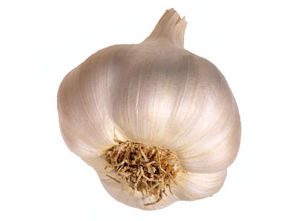
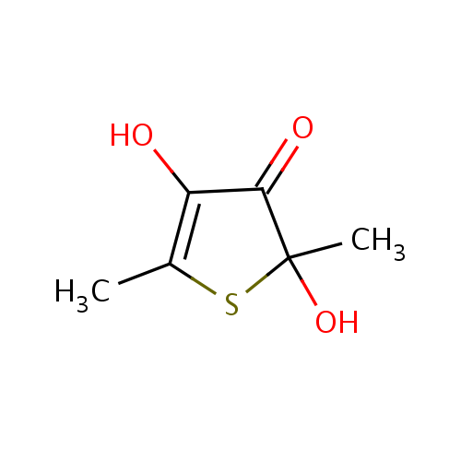
Garlic!*
Garlic has anti-cancer and anti-inflammatory effects
Experiment: feed thiacremonone (active sulfur compound in garlic) to genetically obese mice.
mice lost weight
triglyceride and glucose levels dropped
GLUT4 expression and glucose uptake were up-regulated.
fatty acid synthesis was suppressed in liver
*J.O. Ban et al., Phytother Res. 2012 Sep;26(9):1265-71.
Notes:
./garlic_induces_weight_loss.text

Slide 13
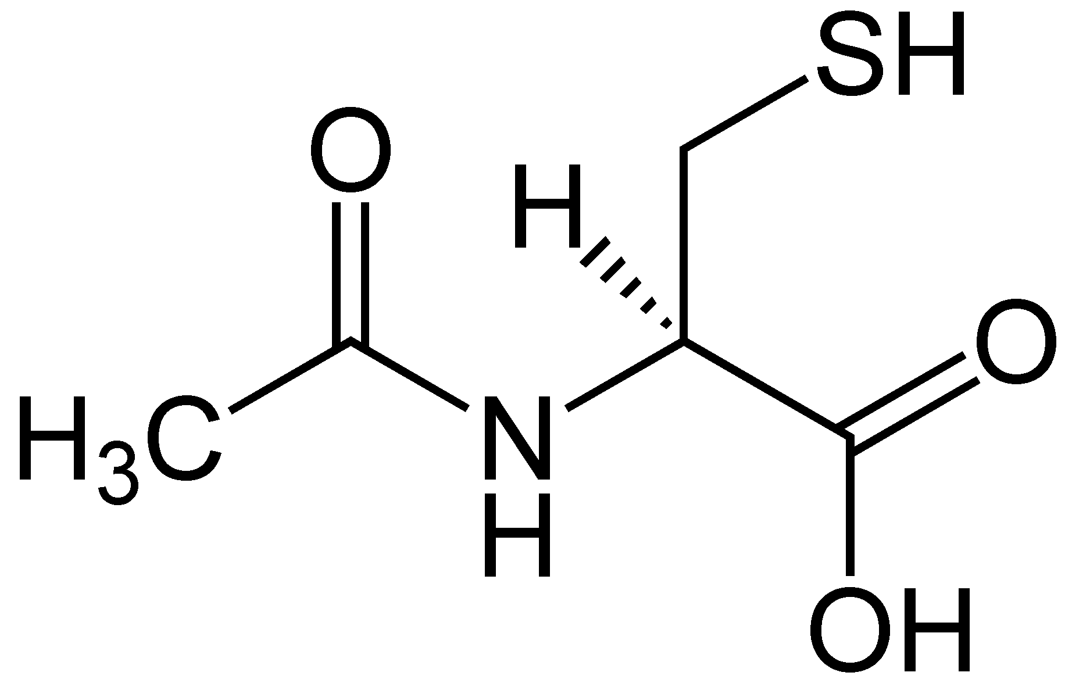
WebMD: Therapeutic Uses for N-acetyl cysteine (NAC)
Counteracts Tylenol and carbon monoxide poisoning
Repairs bile-duct blockage in infants
Treats ALS and Alzheimer's
Antidote to acute anti-seizure drug reactions
Reduces Lp(a) levels and homocysteine levels
Treats heart attack and stroke for those with severe kidney disease

Slide 14
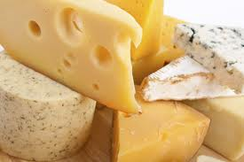
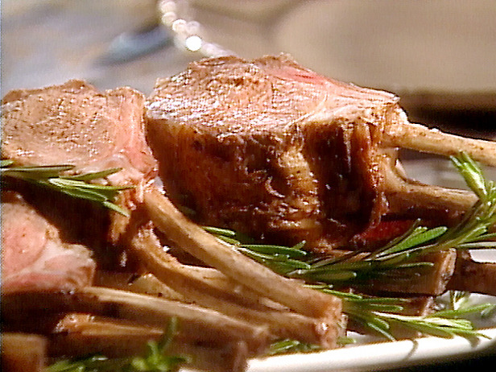
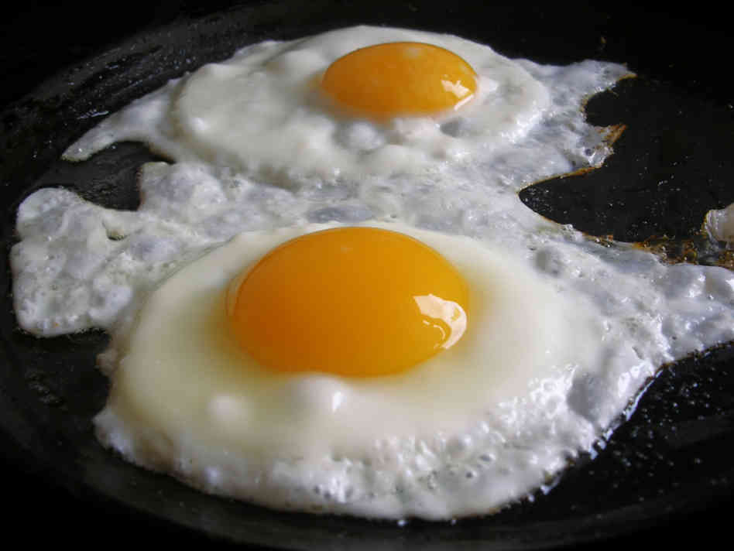
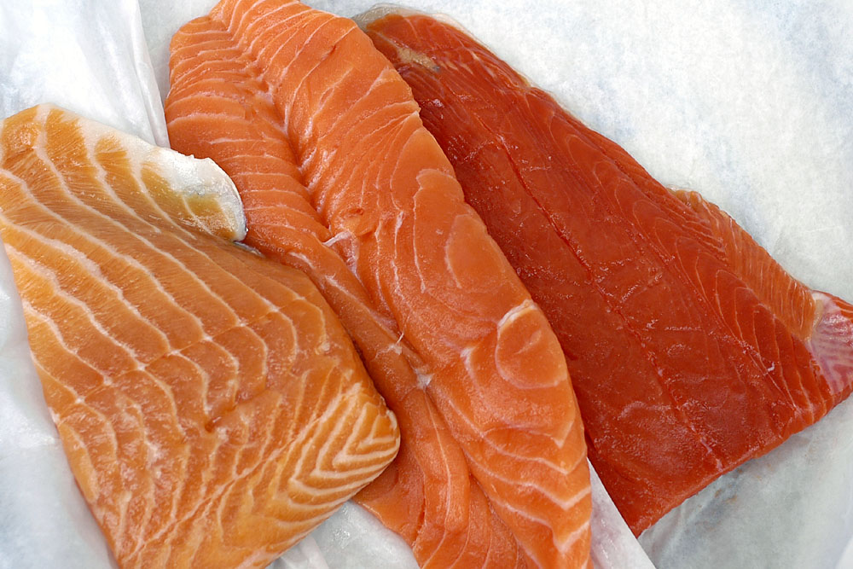
Food Sources of Taurine: The Only Sulfonated Amino Acid

Slide 15
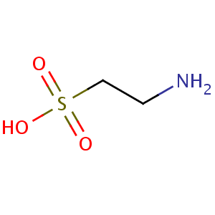
Taurine has Many Known Roles*
Maintains osmotic balance in cells
Bile acid formation (digest fats)
Roles in mitochondria
Helps them maintain their membrane potential
Suppresses superoxide synthesis (oxidation damage)
Clinical observations
Maintains healthy skin
Protects against diabetes and heart disease
Protects against heart arrhythmias
Low taurine in blood associated with many cancers
* Wesseling et al., Hypertension. 2009, 53, 909-911
Notes:
vitaminK/taurine_2009.pdf

Slide 16
Glucosamine SULFATE*
Glucosamine sulfate is the only formulation of glucosamine that’s patented
It’s also the only formulation that’s been shown to have benefit in treating arthritis in clinical trials
Studies on horses show that only 2% of the glucosamine actually gets into the blood stream
The sulfate is the benefit?
Gut
Liver
*S. Persiani et al., OsteoArthritis and Cartilage (2005) 13, 1041-1049
Notes:
./glucosamine_sulfate_supplements_LukeMilano.pdf

Slide 17
Recapitulation
Sulfur is an incredibly important but highly neglected nutrient
Cruciferous vegetables are an excellent source of sulfane sulfur, and protect from pancreatic cancer
Isothiocyante in mustard, wasabi and horseradish has antitumor properties
Garlic has anti-inflammatory and antitumor effects
Taurine is a sulfur-containing amino acid found only in animal-based foods

Slide 18
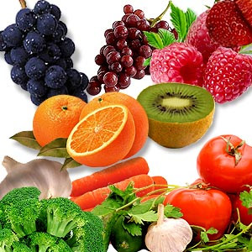
Flavonoids!

Slide 19
Flavonoids!*
Complex set of over 6,000 different substances
Impart color to fruits and vegetables
Also found in coffee, tea, wine, and beer
Enhance the effect of vitamin C
One of their potent effects may be through their ability to increase levels of glutathione
HOW DO THEY DO THIS??
*http://www.whfoods.com/genpage.php?tname=nutrient&dbid=119
Notes:
./flavonoids.pdf

Slide 20
Flavonoid Chemical Structure: Carbon Rings and a Place for Sulfate!

Slide 21
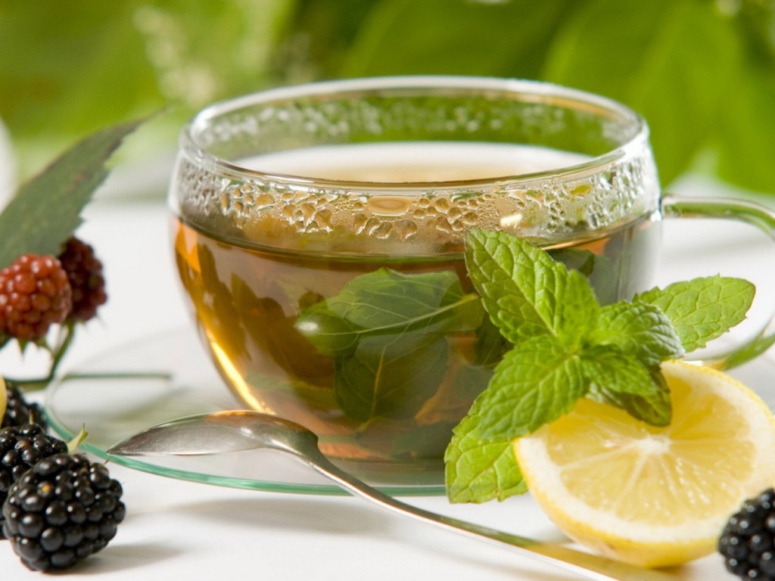
Polyphenols
Tannin in tea
Flavonoids in fruits
Resveratrol in wine
Curcumin in curries
Polyphenols in coffee and chocolate
These compounds all have significant health benefits, but it’s not clear why!

Slide 22
Coffee Chemistry*
*R. Fumeaux et al. Org. Biomol. Chem., 2010,8, 5199-5211
Notes:
http://pubs.rsc.org/en/content/articlelanding/2010/ob/c0ob00137f
A systematic investigation of the human metabolism of hydroxycinnamic acid conjugates was carried out. A set of 24 potential human metabolites of coffee polyphenols has been chemically prepared, and used as analytical standards for unequivocal identifications. These included glucuronide conjugates and sulfate esters of caffeic, ferulic, isoferulic, m-coumaric and p-coumaric acids as well as their dihydro derivatives. A particular focus has been made on caffeic and 3,4-dihydroxyphenylpropionic acid derivatives, especially the sulfate conjugates, for which regioselective preparation was particularly challenging, and have so far never been identified as human metabolites. Ten out of the 24 synthesized conjugates have been identified in human plasma and/or urine after coffee consumption. A number of these conjugates were synthesized, characterized and detected as hydroxycinnamic acid metabolites for the first time. This was the case of dihydroisoferulic acid 3′-O-glucuronide, caffeic acid 3′-sulfate, as well as the sulfate and glucuronide derivatives of 3,4-dihydroxyphenylpropionic acid.

Slide 23
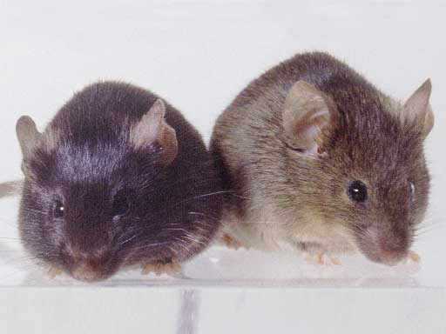
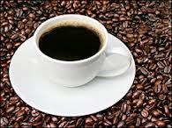
Polyphenols in Coffee*
"Supplementation with CPP [Coffee Polyphenols] significantly reduced body weight gain, abdominal and liver fat accumulation, and infiltration of macrophages into adipose tissues."
* T. Murase et al., Am J Physiol Endocrinol Metab 300: E122–E133, 2011
Notes:
./polyphenols_coffee_mice_2011.pdf

Slide 24
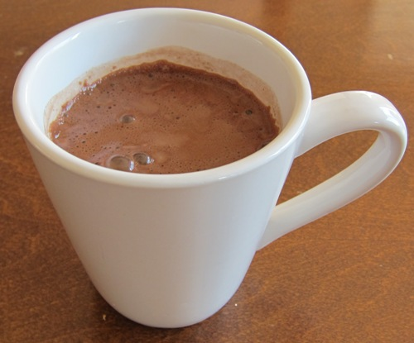
Cocoa Improves Lipid Measures!
“Regular consumption of cocoa powder with milk increases HDL cholesterol and reduces oxidized LDL levels in subjects at high-risk of cardiovascular disease” *
*N. Khan et al., Nutrition, Metabolism & Cardiovascular Diseases 22(12), 1046-1053, Dec. 2012.
Notes:
./Uffe/cocoa_reduces_cardiovascular_risk.pdf

Slide 25
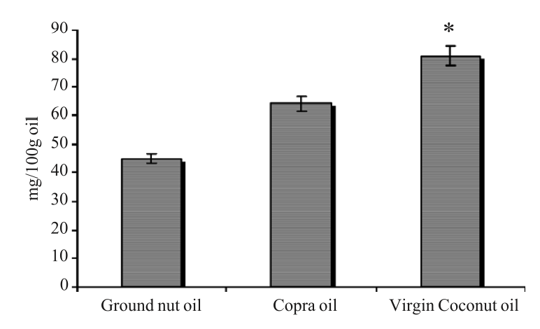
Polyphenols in Coconut Oil*
Total Polyphenol Content (mg/100g oil)
*Figure 2 in K.G. Nevin and T. Rajamohan, Clinical Biochemistry 2004, 37, 830–835.
Notes:
./coconut_oil_polyphenols.text
./Beneficial-effects-of-virgin-coconut-oil-on-lipid-parameters-and-in-vitro-LDL-oxidation.pdf
Figure 2:
Total polyphenol content of virgin coconut oil (VCO), copra oil (CO) and ground nut oil (GNO). Values are mean of three estimations. *Statistically significant compared to copra oil ( P < 0.001).

Slide 26
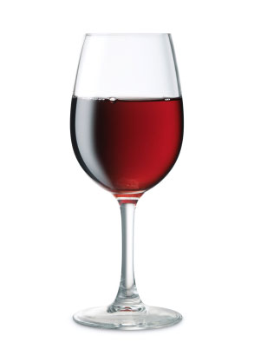
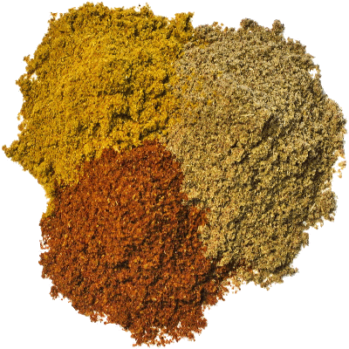
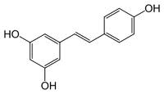
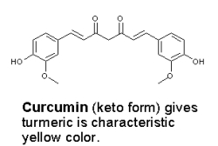
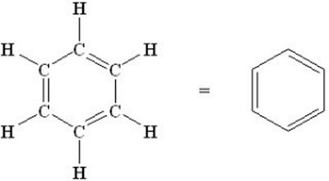
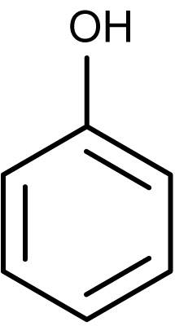
Four Related Molecules
Resveratrol
Curcumin
All of the OH groups can become sulfates
Benzene
Phenol

Slide 27
“High Absorption but Very Low Bioavailability of Oral Resveratrol in Humans”*
Researchers studied absorption of resveratrol
Wanted to understand its role in biology
Found that it was sulfated in the gut, went into the bloodstream and promptly disappeared
I hypothesize that its health benefit has solely to do with its ability to transport sulfate from the gut to the liver
Gut
Liver
*T. Walle et al., Drug Metabolism and Disposition, 32(12), 1377-1382, 2004

Slide 28
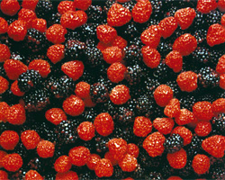
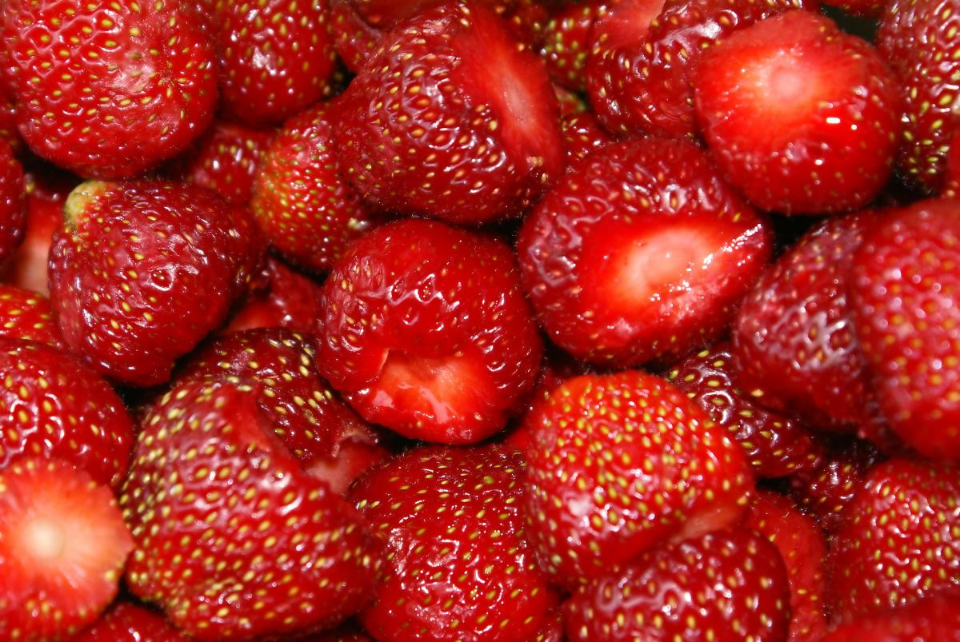
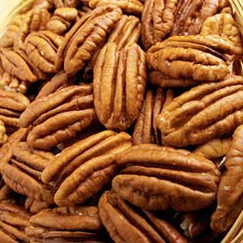
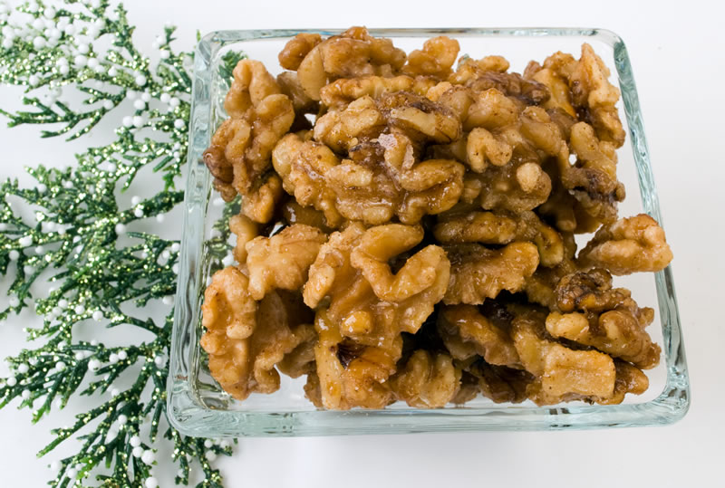
Ellagic Acid

Slide 29
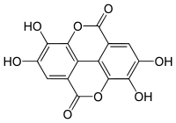
Polyphenols protect from AIDS*
In-vitro experiment on human T-cell lymphotropic virus type-I-carrying MT-4 cells
Extremely susceptible to HIV infection
Sulfated plant polyphenols:
Inhibited HIV infection
Protected from giant cell formation
Protected from cell death
Prevented antigen formation
*T. Mizuno et al., Planta Med 1992; 58(6): 535-539.
Notes:
Aids/polyphenol_sulfates_inhibit_aids_infection.text

Slide 30
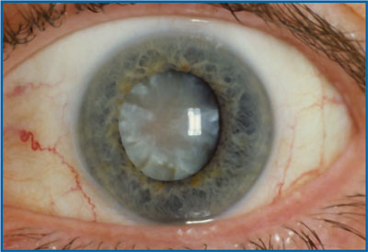
Cataracts and their Treatment*
Premature cataract development is one of the earliest secondary complications of diabetes.
Huge and growing problem in Western world
Due to protein misfolding following oxidation and glycation damage
Natural remedies that have been shown to be beneficial include:
Broccoli, garlic, turmeric, caffeine
Statin drugs increase risk to cataracts**
*K.L. Moreau and J.A. King, Trends Mol Med. 2012 May ; 18(5): 273–282.
** C.M. Machan et al, Optom Vis Sci. 2012 Aug;89(8):1165-71.
Notes:
./Moreau_2012_protein_misfolding_agreggation_cataract_disease_prevention.pdf

Slide 31
Polyphenols Protect the Brain*
*D. Vauzour, Oxidative Medicine and Cellular Longevity Volume 2012, Article ID 914273,
Notes:
./VAuzour_2012_dietary_polyphenols_modulators_brain_function.pdf
Figure 2: Modulation of neuronal dysfunction by dietary polyphenols. In ageing and neurodegenerative diseases, neuronal death can be triggered by specific genetic mutations, neurotoxins, and/or neuroinflammation. Initiating factors promote cellular alterations, including increases in oxidative stress, protein aggregation, DNA damage, and activation of apoptotic cascades. Dietary polyphenols have been observed to protect the brain against such cellular alteration through the modulation of neuronal function against endogenous neurotoxins and inhi- bition of glial-induced neuroinflammation. Aβ, amyloid beta; CysDA, 5-S-cysteinyldopamine; DHBT1, dihydrobenzothiazine 1; TNF-α, tumor necrosis factor alpha; IL-1β, interleukine-1 beta; CRP, C reactive protein; NO, nitric oxide.

Slide 32
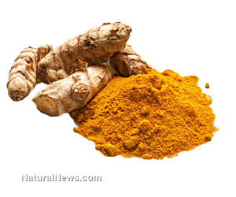
Curcumin!*
Atharvaveda (ca. 6000 yr B.P.) referred to turmeric as medicinal aid to "charm away jaundice."
Turmeric is widely valued as a medicinal herb in South Asia, since ancient times
Heals wounds, treats stomach ache, flatulence, poison, etc.
Curcumin oils have broad-spectrum anti-fungal activity (propose as topical skin treatment)
*Fanai Lalsangluaii et al., Sci Vis 13(2), 49-57, April-June 2013
Notes:
./curcumin_review_2013.pdf

Slide 33
Curcumin’s Health Benefit: Sulfation??*
Curcumin has anticancer properties but absorption is thought to be limited
Curcumin suppresses carcinogenesis in skin, stomach, colon, breast, and liver
Curcumin is absorbed after oral dosing in humans and can be detected as glucuronide and sulfate conjugates in plasma.
*S.K. Vareed et al., Cancer Epidemiol Biomarkers Prev June 2008 17; 1411
Notes:
./curcumin_sulfation_transport.pdf

Slide 34
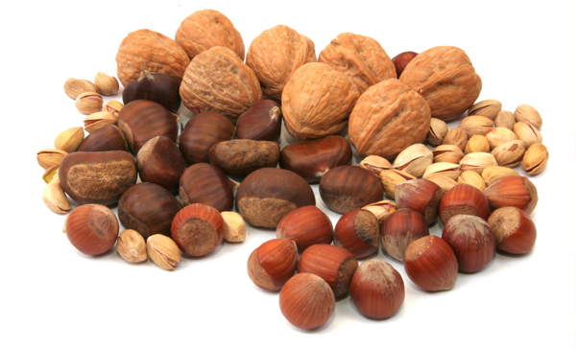
Going Nuts about Nuts!
7,216 men and women 55-80 years old, randomized to 3 interventions*
Mediterranean diet + nuts
Mediterranean diet + olive oil
Control
Nut consumption was associated with significantly reduced all-cause mortality (39% lower mortality risk)
Nuts contain carotenoids, phytosterols, resveratrol, stilbenes, flavonoids and phenols **
These all transport sulfate!
* S. Rohrmann and D. Faeh, BMC Medicine 2013, 11:165
**CY Chen and JB Blumberg, Asia Pac J Clin Nutr. 2008;17 Suppl 1:329-32.
Notes:
./nuts_are_good.text

Slide 35
Recapitulation
A variety of “healthy” compounds in foods have the interesting property that they can be sulfated
These include polyphenols in coffee and tea, resveratrol (wine and nuts), flavonoids in berries and other fruits, and curcumin in curries
I maintain that the health benefits of these foods are mainly due to their ability to transport sulfate in the blood stream

Slide 36
Animal-based Fats

Slide 37
The Saturated Fatty Acid (SFA) and Carbohydrate Debate
“Fifteen years ago, this debate would have been considered impossible because it was believed that SFA intake was the primary determinant of the high rates of CVD in Western countries. However, in recent years, that question has been reexamined, or, more accurately, seriously examined for the first time. In truth, there was not very good epidemiological evidence for this relationship from the beginning.”
-- Walter C. Willett, MD, PhD (2012)
Harvard School of Public Health, Boston, MA, USA
Notes:
For_vic/fatty_acids_in_health_and_disease_2012.pdf

Slide 38
Saturated Fats and Heart Disease: Europe, 1998 *
* Hoenselaar, R. British Journal of Nutrition (2012), 108, 939-942.
Notes:
High School student! Letter to the Editor in rebuttal of an article on saturated fats & cardiovascular disease.
See: ./SFA_heart_disease_highschool.text, .pdf
R. H. is a student at the High School of Arnhem and Nijmegen (The
Netherlands). There is no conflict of interest. The research received
no specific grant from any funding agency in the public, commercial or
not-for-profit sectors.
At least one fairly recent report is available though, which allows
ecological data to be directly correlated. In 2008, the European
Cardiovascular Disease Statistics were published. The report provided
data about per-capita SFA intake in 1998 and annual CHD death rates
from 1972 to 2005 for adults aged 0–64years(8).Based on these data,
SFA intake in 1998 was inversely correlated to CHD mortality in 1998
among males for all countries with available data for this year (n 41)
using SPSS statistical software package version 17.0 (IBM
corporation). Results are shown in Fig. 1 (Pearson correlation 2 0·58;
P, 0·01). Findings were similar for women and for both CHD and stroke
end- points (P for all ,0·01).

Slide 39
Milk Fat Protects from Asthma*
Nearly 3000 3-year-old children studied
Those who ate butter daily had less than 1/3 the incidence of asthma compared to those who didn’t
No associations were observed with the consumption of fruits, vegetables, margarine, and fish.
*A Wijga et al., Thorax. 2003 July; 58(7): 567–572.
Notes:
./milk_fat_reduces_asthma.pdf

Slide 40
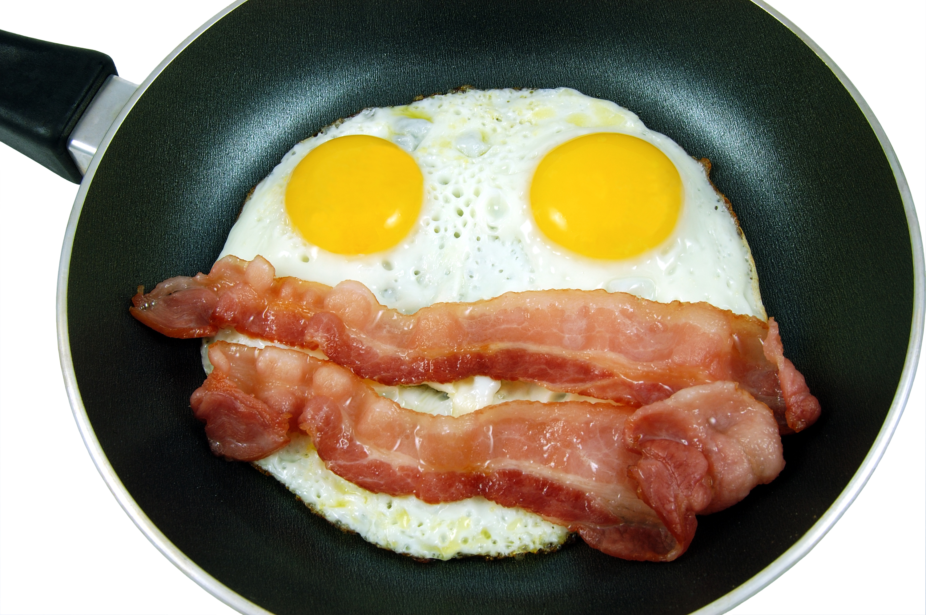
The Benefits Of Eggs, Even For Those At Cardiovascular Risk*
Experimental Biology conference, 2013
Research at Yale showed whole eggs are a healthy part of your diet, even if you have heart disease
U. Conn research showed eggs benefit HDL cholesterol in adults with metabolic syndrome
U. Missouri research showed eggs & pork breakfast is beneficial for overweight adolescents
*Medical News Today, Apr. 25, 2013
www.medilexicon.com/medicalnews.php?newsid=259565
Notes:
./eggs_are_good.text

Slide 41
Effects of Dietary Choice on Lipids*
Nuts
CO
Virgin CO
CO = Coconut Oil
VIRGIN Coconut Oil has special benefits
*Figure 1 in K.G. Nevin and T. Rajamohan, Clinical Biochemistry 2004, 37, 830–835.

Slide 42
Benefits of Ketogenic Diet*
(OVARIAN CYSTS)
*Figure 1, A. Paoli et al., European Journal of Clinical Nutrition (2013) 789 – 796
Notes:
PCOS (Polycystic Ovary Syndrome).
./ketogenic_diet_dynamite_2013.pdf

Slide 43
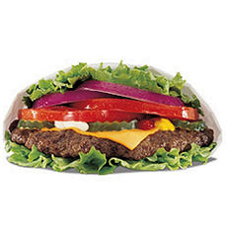
Results of Low-Carb Diet from 17 Trials*
Significantly decreased body weight, BMI, and abdominal circumference
Lower blood pressure
Lower plasma triglycerides
Lower fasting plasma glucose
Reduced glycated hemoglobin
Reduced plasma C-reactive protein (an inflammatory marker)
Increased HDL-C (the “good” lipoprotein)
* F.L. Santos et al., Obesity Reviews, July 2012

Slide 44
Recapitulation
Contrary to popular belief, saturated fat is protective against heart disease
Milk fat is protective against asthma
Eggs and bacon are a good breakfast choice
Virgin coconut oil raises HDL and lowers LDL
Ketogenic diet has many benefits
17 trials show that low-carb diet is beneficial for many metrics

Slide 45
Shore-based Foods

Slide 46
The “Eatwell” Plate
* http://www.nhs.uk/Livewell/Goodfood/Pages/eatwell-plate.aspx

Slide 47
The “Eatwell” Plate
Where are the Shore-based Foods?
* http://www.nhs.uk/Livewell/Goodfood/Pages/eatwell-plate.aspx

Slide 48
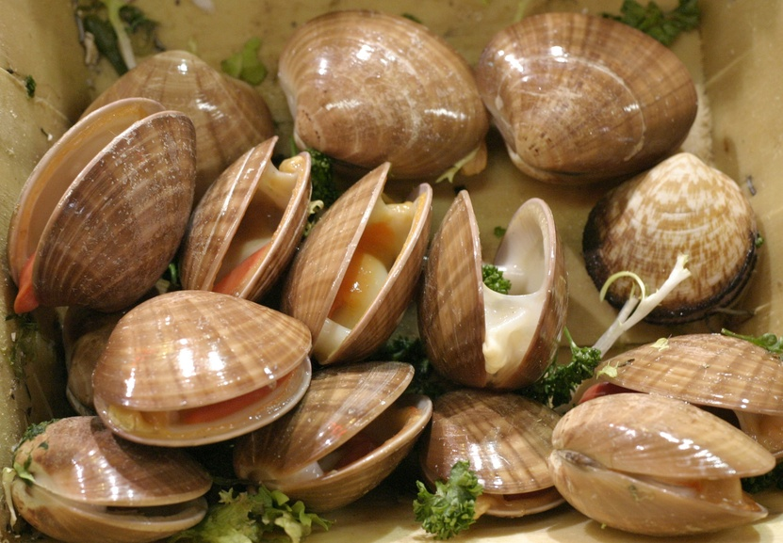
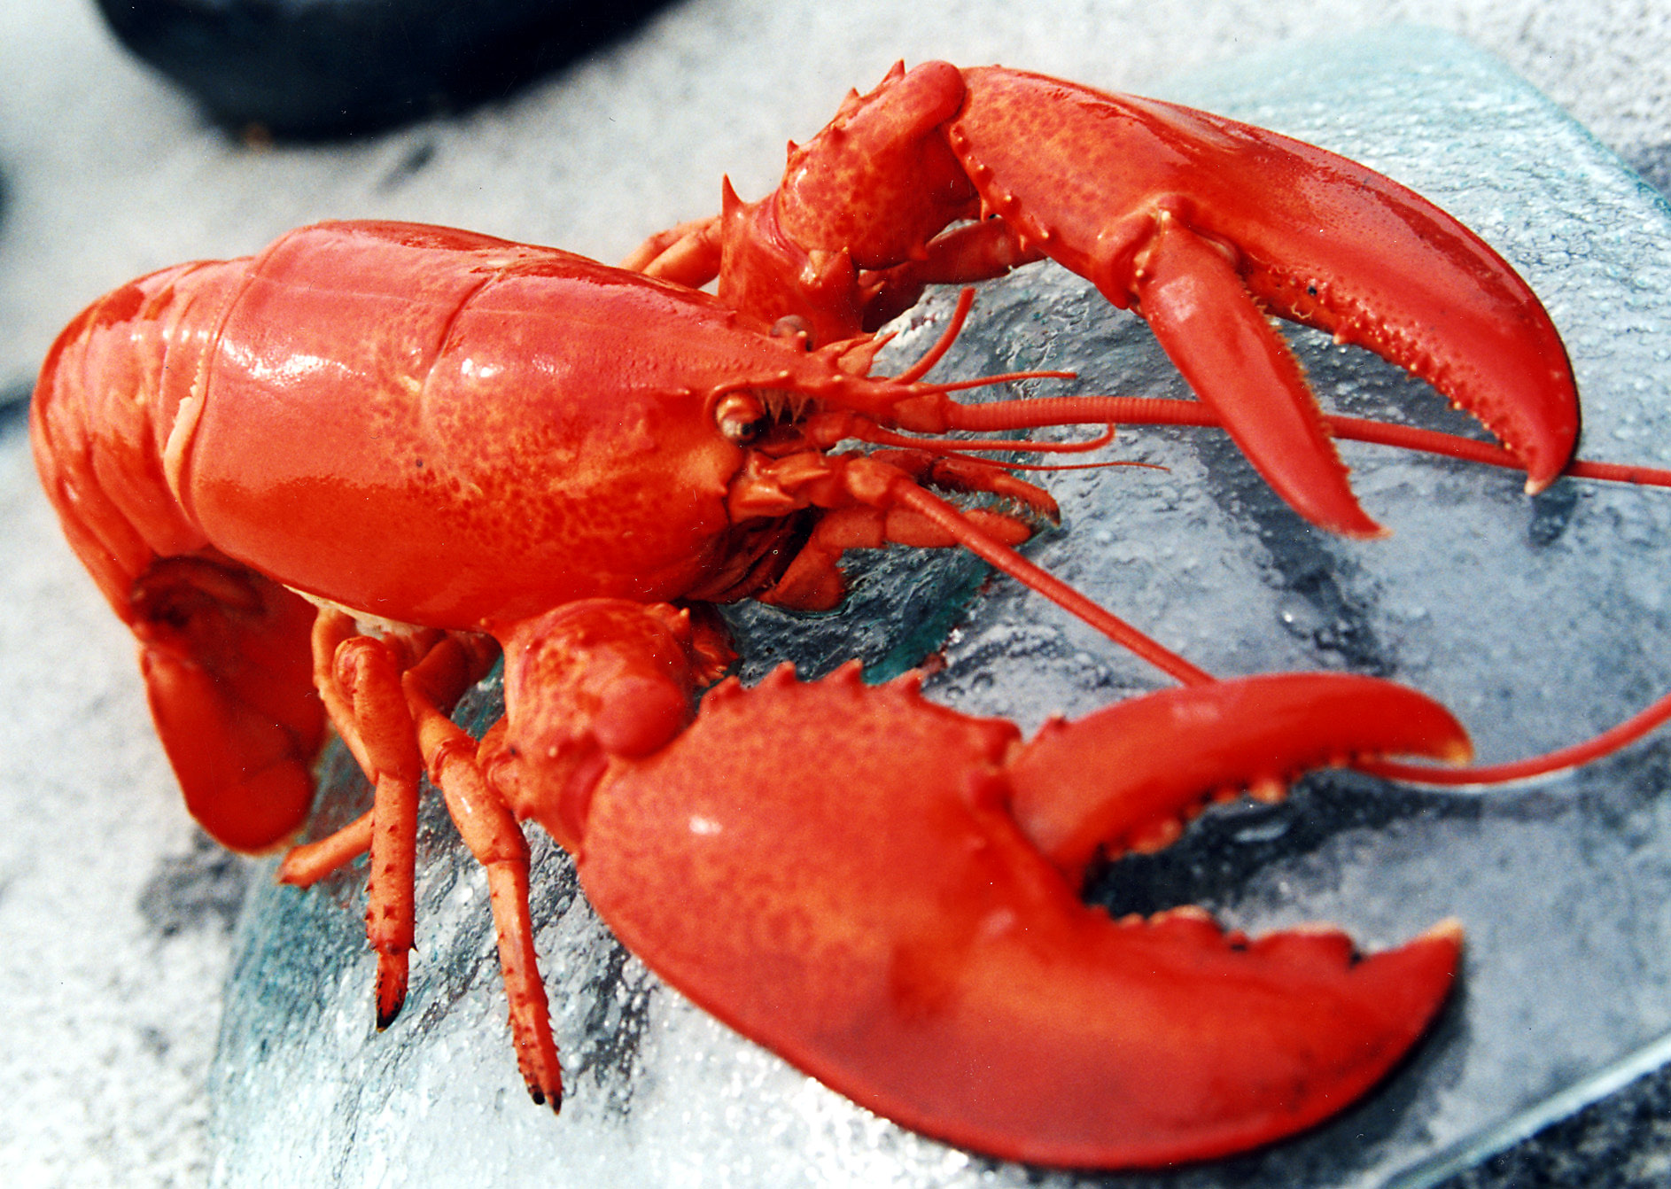
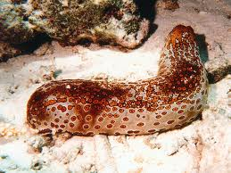
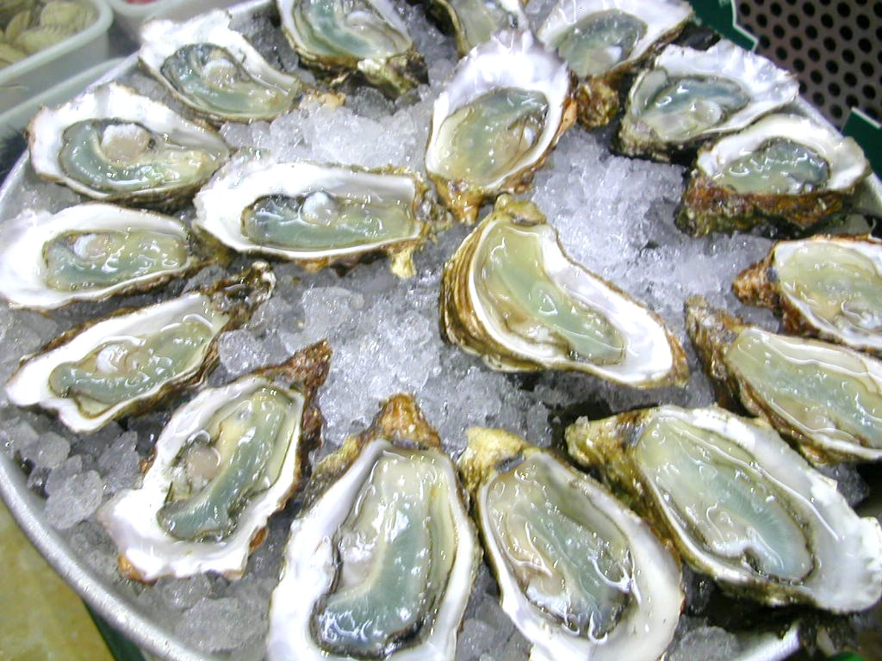
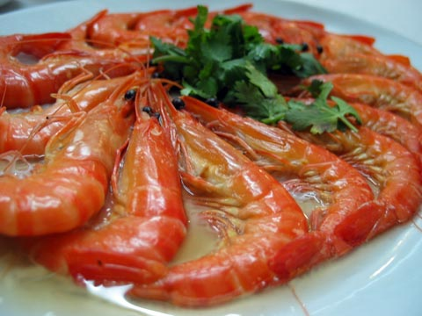
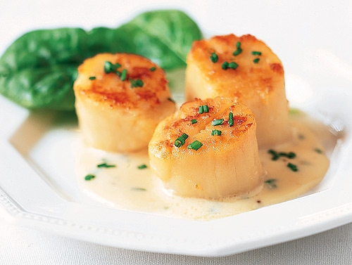
zinc
selenium
SULFUR
Copper
iron
iodine

Slide 49
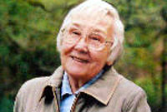
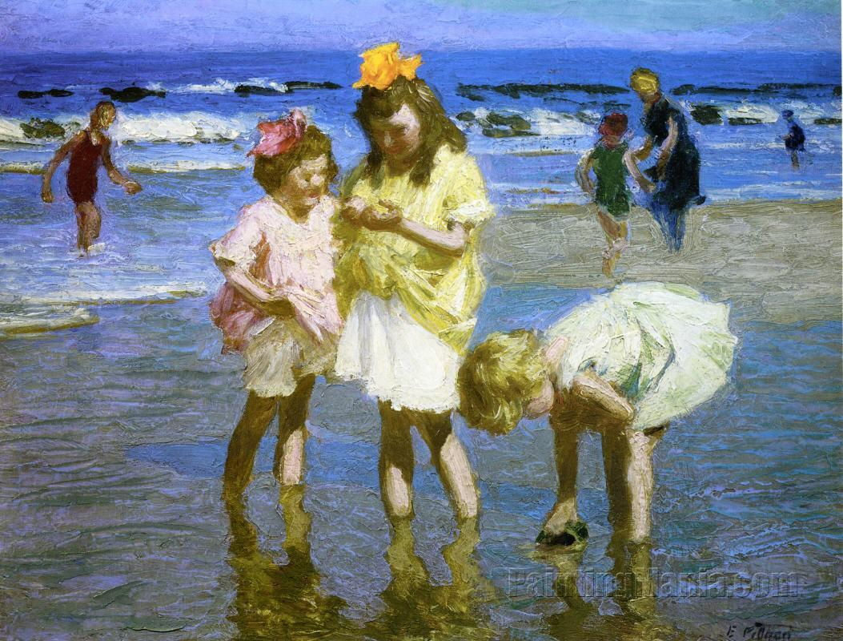
Elaine Morgan and the Aquatic Theory
Proposed that we evolved to be human on ancient seashores, surviving the drought by eating seafood
The Descent of Woman
The Aquatic Ape
The Scars of Evolution
Descent of the Child
Aquatic Ape Hypothesis
Notes:
Alistair Hardy’s aquatic ape hypothesis

Slide 50
Survival of the Fattest*
“The prediction is that a functional deficit in brain development will occur if human infants consume inadequate amounts of shore-based foods”
* S.C. Cunnane, Survival of the Fattest, World Scientific Publishing Company, June 2005

Slide 51
Survival of the Fattest: The Key to Human Brain Evolution*
Iron, iodine, selenium, zinc, copper, and the long-chain polyunsaturated fatty acid, docosahexaenoic acid, are needed to support our large and complex brain
Maritime foods are among the best sources of these nutrients
The shore-based diet hypothesis proposes that human “encephalization” was triggered by adaptation to life at the shoreline.
* S.C. Cunnane, Survival of the Fattest, World Scientific Publishing Company, June 2005
Notes:
SURVIVAL OF THE FATTEST: THE KEY TO HUMAN BRAIN EVOLUTION. By Stephen C. Cunnane.
But see:
./critical_review_of_Cunnane_shore_based_diets.pdf

Slide 52
Selenium and Selenoproteins
"Of all volcanic rocks selenium is highest in volcanogenic rocks especially the basalts.”*
Selenoproteins protect pancreas and thyroid from oxidative damage
*EP Malisa, Environmental Geochemistry and Health 05/2001; 23(2):137-158.
Notes:
Selenium_in_basalt.text

Slide 53
Zinc Deficiency*
It has recently been estimated that 1 out of 5 people in the world might not be consuming or absorbing enough zinc from their diet
Impaired immunity:
Not only are total lymphocyte numbers reduced, but their ability to respond to antigens is also compromised
Zinc supplementation reduces the rates of diarrhea, pneumonia, malaria and mortality in children
*H.J. Blewett and C.G. Taylor, Nutrients 2012, 4, 449-466.
Notes:
./zinc_deficiency_reviiew_2012.pdf
READ THIS!!! – it’s good!!
THIS IS NEW!!!

Slide 54
Iodine and Hypothyroidism*
In the U.S. population, there was a 50% reduction in urinary iodine excretion between 1970 and 1990.
Bromine exposure
Declining consumption of iodized salt, eggs, fish, and seaweed
Soil depletion (Glyphosate)
http://articles.mercola.com/sites/articles/archive/2009/09/05/another-poison-hiding-in-your-environment.aspx

Slide 55
Iodine Deficiency*
Iodine is essential for proper thyroid function
Thyroid hormones control metabolism
Development of fetal skeleton and nervous system
In animal studies, iodine normalized stress-related elevation in cortisol
Iodine deficiency is the most preventable cause of mental retardation
Most of the earth’s available iodine is in the sea
Seaweed is the best natural source
Shrimp, fish, eggs, other seafood
* L. Patrick, Alternative Medicine Review 13(2), 116-127, 2008
Notes:
vitaminK/iodine_deficiency.pdf

Slide 56
Iodine and Breast Cancer*
Breast cancer rates in Japan are 6.6 per 10,000, v.s. 22 in U.S. and 27 in U.K.
25-fold higher intake of iodine in Japan
Iodine supplements shrink breast tumors in animal models
Perchlorate is a toxicant that inhibits iodine uptake
Perchlorate contamination of food and water is growing problem in U.S.
Present in nitrate fertilizers and in pharmaceuticals
* L. Patrick, Alternative Medicine Review 13(2), 116-127, 2008

Slide 57
Sea Salt!
Notes:
>97.5% vs 84% NaCl

Slide 58
Soup: The Forgotten Food
Bone marrow is a rich source of electrolytes, minerals, and fat-soluble vitamins
Bone-based soups are extremely nutritious!

Slide 59
Recapitulation
Aquatic theory of human origins proposes that we became human on the seashore
Shore-based foods provide zinc, iron, sulfur, selenium, iodine, copper, and long-chain essential fatty acids
Deficiencies in these key minerals are widespread
This explains many modern diseases and conditions
Shore-based foods are sorely lacking in the modern American diet
Sea salt is far superior to table salt
Bone marrow-derived soup contains many vital minerals
Anticipate deficit in brain function in infants deprived of shore-based foods

Slide 60
Fermented Foods

Slide 61
Lactate: The Perfect Food
Doesn’t generate AGEs like sugar and starch
Doesn’t generate oxidative damage like unsaturated fats
Carries a negative charge: helps fight acidosis
Heart, liver, and brain get first dibs
These foods also contain vitamin K

Slide 62
Lactate in the Brain*
lactate
glucose
galactose
Neuron
Astrocyte
lactate
Neuron requires lactate to be able to form long-term memories
Astrocyte can supply it (by conversion from glucose) or it can come directly from the medium (diet)
* Suzuki et al., Cell 144, 810–823, 2011
Notes:
Cancer/Lactate_neuron_memory.pdf

Slide 63
“Probiotic lactobacilli: An innovative tool to correct the malabsorption syndrome of vegetarians?”*
Lactobacilli produce phytase which breaks down phytates
Phytates chelate important minerals
Glyphosate is an antibiotic that preferentially kills lactobacillus
*G. Famularo et al. Medical Hypotheses 65(6), 1132-1135, 2005.

Slide 64
Wine Improves Lipid Measures*
“A significant inverse relationship was found between ox-LDL-antibody titre and daily wine intake, which persisted after adjusting for possible confounders”
*M. Di Bari et al., Ann Epidemiol 2003;13:189–195.

Slide 65
Ethyl Sulfate: A biomarker of Ethanol Consumption!*
Ethanol is converted to ethyl sulfate and this allows transport of sulfate from the gut to the liver??
H
Ethyl Sulfate
Ethanol
Remains detectable in urine
for several days after intoxication
*F.M. Wurst et al., Addiction. 2006 Feb;101(2):204-11.
Notes:
treasures/Ethyl_sulfate.text

Slide 66
Recapitulation
Fermentation is a way to turn unhealthy food into healthy food
Lactate is "the perfect fuel" because it is negatively charged and does not glycate blood proteins
Lactobacillus can protect from chelation by phytase
Wine reduces serum levels of oxidized LDL
Ethanol can be converted to ethyl sulfate → it's a sulfate transporter!

Slide 67
What You Can Do!

Slide 68
Eat Foods Containing Sulfur!
Notes:
http://healthyeatingclub.com/info/books-phds/books/foodfacts/html/data/data5g.html
http://www.livestrong.com/article/486021-foods-high-in-sulphur/

Slide 69
Go Organic!

Slide 70
How Much Does it Cost?
Food Organic Conventional
celery 2.99 1.99
cauliflower 4.99 2.99
Bartlett pears 2.69 1.99
orange juice 3.99 2.99
eggs 5.69 3.99
milk 4.69 2.99
cereal 4.56 3.91
TOTAL 29.60 20.85
increase bill by ~40%

Slide 71
Probiotics!

Slide 72
Escape to a sunny place in winter!
Notes:
Summer vacation on Mediterranean Sea resort, Antalya, Turkey

Slide 73
If you Live in Canada, Use a Sunlamp!

Slide 74
Epsom Salts!
Magnesium Sulfate in hot bath water is a cheap and easy way to get sulfate supply to the skin
Infrared heat also beneficial!

Slide 75
Don’ts!

Slide 76
We are Too Comfortable with Aluminum!

Slide 77
Conclusions
We are headed for an enormous crisis in our food supply due to industrialized farming methods
Depletion of nutrients; exposure to toxins
The crisis is made worse by misguided “expert” nutritional advice – low fat/low cholesterol/high carbohydrate diets
We pay for it in major health problems like diabetes, obesity, heart disease, autism, Alzheimer’s, etc.
Healthy choices:
Seafood is loaded with micronutrients
Fermented foods provide lactate and probiotics
Vegetables containing sulfur have many health benefits
Saturated fat is probably the healthiest fat
Think ORGANIC!!

Slide 78
Thank you
For Listening!

